Slide 1
BENG 183 Final Project
Application of Network Based Co-Expression Expression Patterns to Differential Expression of Genes in Tumorigenic Prostate Epithelial Cells
A Comparison of limma and NACEP

Slide 2
Overview of Original Analysis
Differential expression analysis with limma
Linear model for microarray and RNAseq

Slide 3
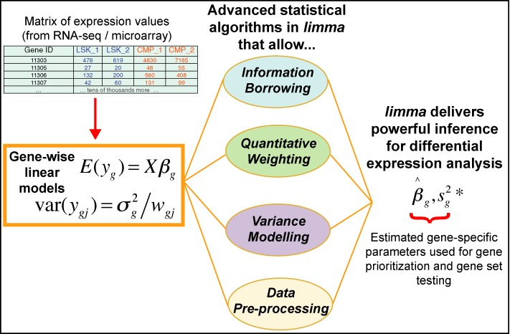
Linear Models for Microarray and RNAseq
Ritchie et al., Nucleic Acids Research (2015)

Slide 4
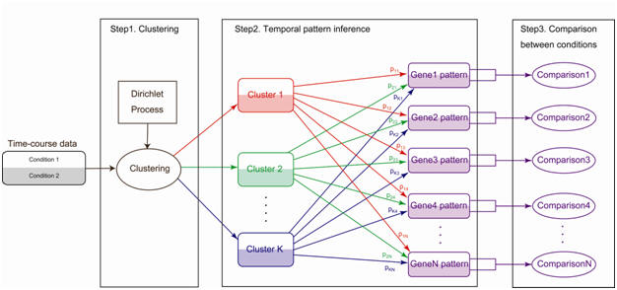
Network Based Co-Expression Patterns (NACEP)
Huang et al., Bioinformatics (2010)

Slide 5
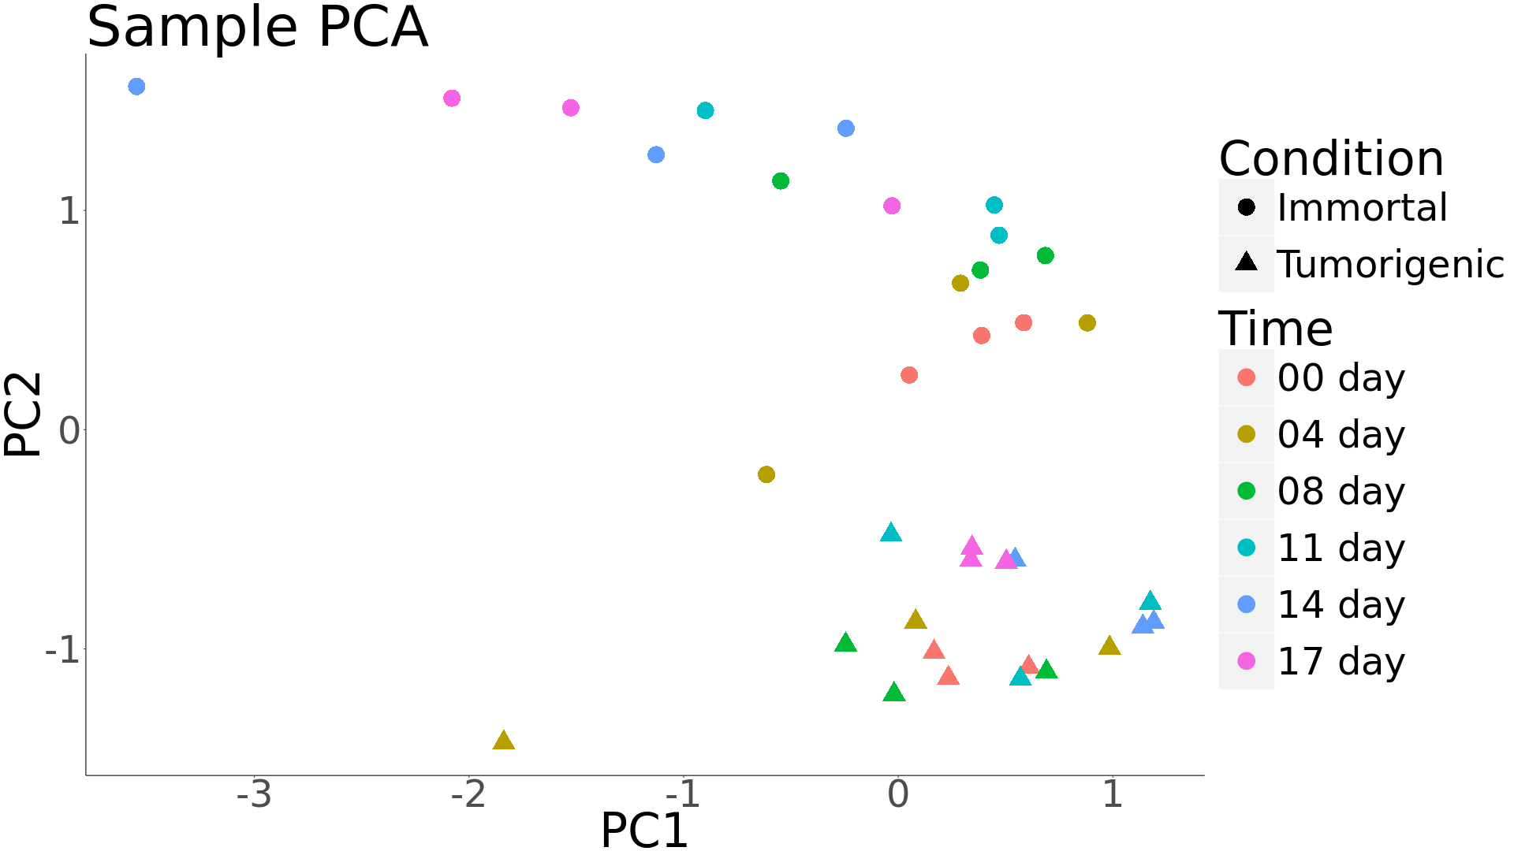
Sample Principal Components Analysis

Slide 6
References

