Slide 1
COVID-19 Tweet Analysis
Group 10

Slide 2
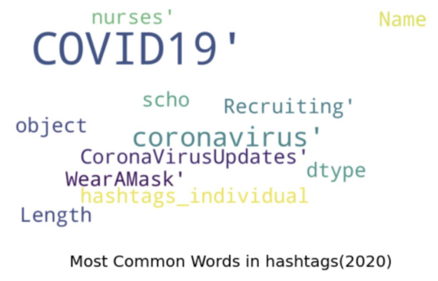
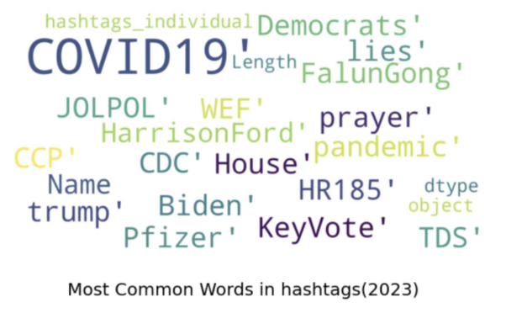
Module #1 Recap
Searched for all tweets with #covid19
2020 Data
July 25th - August 29th
179k rows
2023 Data
January 29th - February 8th (current)
24k rows

Slide 3
What is the Goal of Our Model ?
To understand how people felt about COVID in 2020 and compare it to how people felt about COVID in 2023.
To be more specific than a simple sentiment analysis in which we score sentiment on a -10 to 10 scale (or something comparable)
To be able to capture the full range of emotions that people convey about COVID.

Slide 4
What is the goal of our analysis?
Understand how people feel about COVID / what they talk about.
Capture the full range of topics and emotions (not simple sentiment analysis)
Compare 2020 to 2023 (w.i.p)

Slide 5
Models & Methodologies
Our data issue
Unlabeled data ⇥ Can’t do supervised learning!
Our Novel Solution
Train unsupervised clustering (KMeans) to capture general trends
Use pre-trained transformers (Flan-T5 XXL, ChatGPT) to generate class labels
Run zero-shot text classification on tweets with best keyword

Slide 6
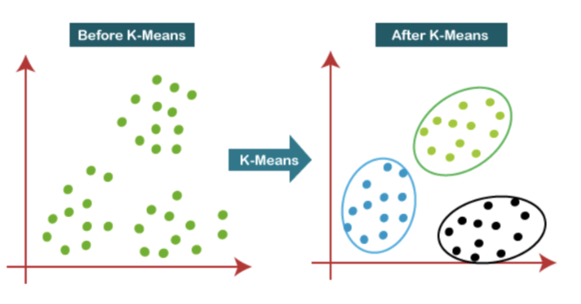
K-Means Clustering
Generate word embeddings for the tweet data
TFIDF / Count-Based
Word2Vec
Turn tweets into 768 feature space
Search over a space of 2-18 clusters to find optimal
Not simple hyperparameter tuning

Slide 7
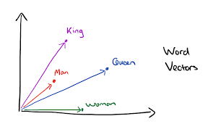
Word Embeddings
Generate word embeddings for the tweet data
TFIDF / Count-Based
Word2Vec
Best: all-mpnet-base-v2
Turn tweets into 768 feature space

Slide 8
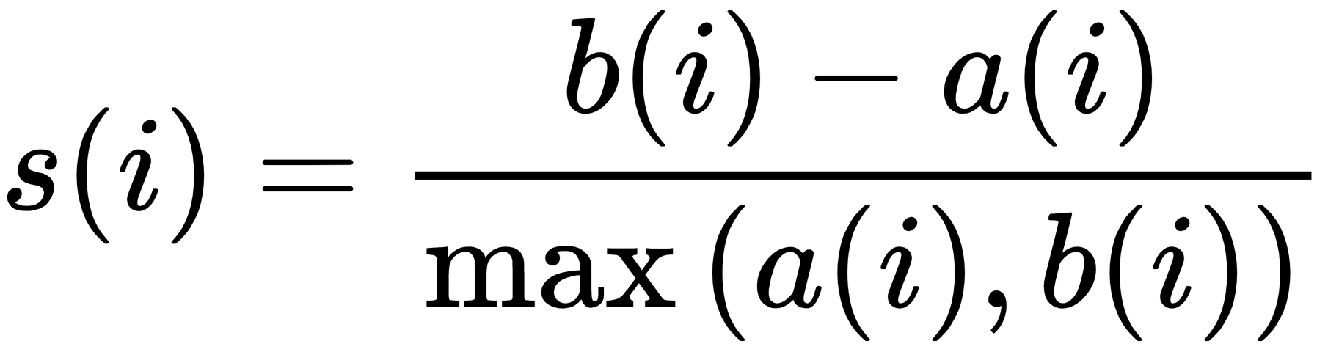
K-Means Metrics
Silhouette score measures how close points in a cluster are to each other
a = average distance from point to all other points in cluster
b = average distance from point to all other points in next closest cluster
0 <= s(i) <= 1

Slide 9
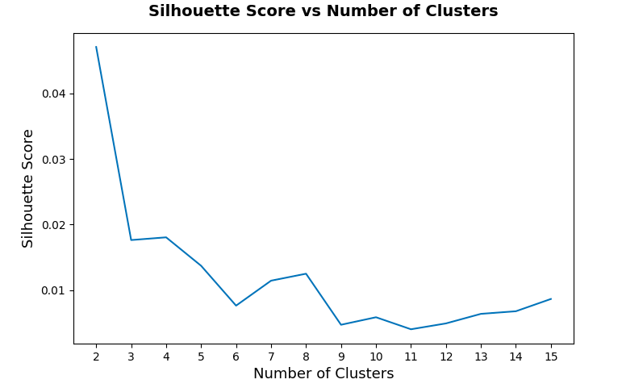
K-Means Results
Search over 2-16 clusters
Elbow method
Not normal tuning

Slide 10
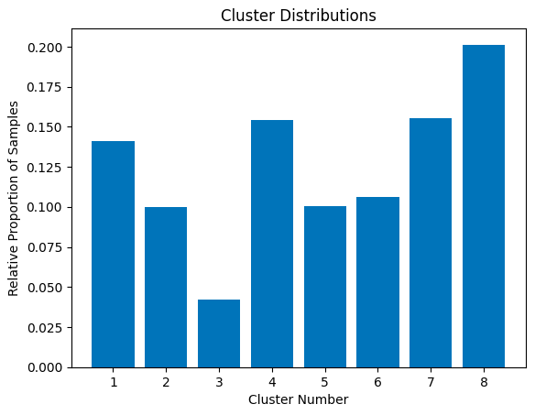
K-Means Results

Slide 11
2. Generate Labels w/ Pretrained Models
Sample 100 tweets from each cluster
Prompt: I am going to give you a list of 100 tweets. Your task is to create 3-5 keyword labels that apply to all of the tweets. You should focus on describing the general trends of the tweets. Many of the tweets contain information about COVID-19. Do not include "covid-19," "covid," "pandemic," or "coronavirus" as keywords
Search and exclude duplicate labels

Slide 12
Generative Labeling Results
Cluster #1:
Social Issues, Personal Development, Business & Economics, Community
Cluster #2:
India, Updates, Testing, Fatalities, Recoveries, Healthcare
Cluster #3:
Face Masks, Safety, Protection, Public Health, Prevention
Cluster #4:
Social Media, Resilience, Community Support, Online Events
*Can’t show counts b/c not count-based labels*
Notes:
Now that we have a well trained KMeans clustering algorithm, we want to understand (or label) these clusters. One common approach is to look manually and determine what each cluster entails, but we are more principled than that. Instead, we'll use a transformer-based summarization tool from Hugging Face in order to summarize what each cluster actually discusses. This will give us possible class names for each cluster . For example, possible class names for cluster 1 are : fake numbers, deaths by region, xxx, xxx.

Slide 13
Generative Labeling Results
Cluster #5:
Global, Cases, Deaths, Statistics
Cluster #6:
Politics, Government Response, Public Health, Conspiracy, Human Rights
Cluster #7:
Health, Information, Vaccine, Public Awareness
Cluster #8:
Layoffs, Misinformation, Mental Health, Lockdown, Access
*Can’t show counts b/c not count-based labels*
Notes:
Now that we have a well trained KMeans clustering algorithm, we want to understand (or label) these clusters. One common approach is to look manually and determine what each cluster entails, but we are more principled than that. Instead, we'll use a transformer-based summarization tool from Hugging Face in order to summarize what each cluster actually discusses. This will give us possible class names for each cluster . For example, possible class names for cluster 1 are : fake numbers, deaths by region, xxx, xxx.

Slide 14

3. Zero-Shot Classification with Hugging Face
Hugging Face Inc. : Develop tools, many open-source, pre-trained models for sentiment analysis and text classification, for building applications using machine learning.
Zero-Shot Classification: Allow a model to classify objects from previously unseen classes, without receiving any specific training for those classes.

Slide 15
3. Zero-Shot Classification with Hugging Face
Selected inference model: facebook/bart-large-mnli
Use transformers library with native PyTorch
2.4 million downloads last month from Hugging Face Hub (it’s legit!)
Remember, we don’t have a choice here!
Must use few-shot with manual labeling or zero-shot
Too lazy to label + transformers very good at zero-shot!

Slide 16
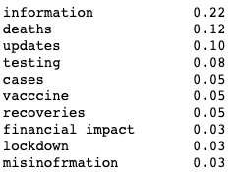
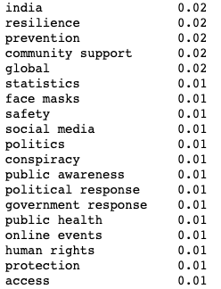
3. Zero-Shot Classification with Hugging Face

Slide 17
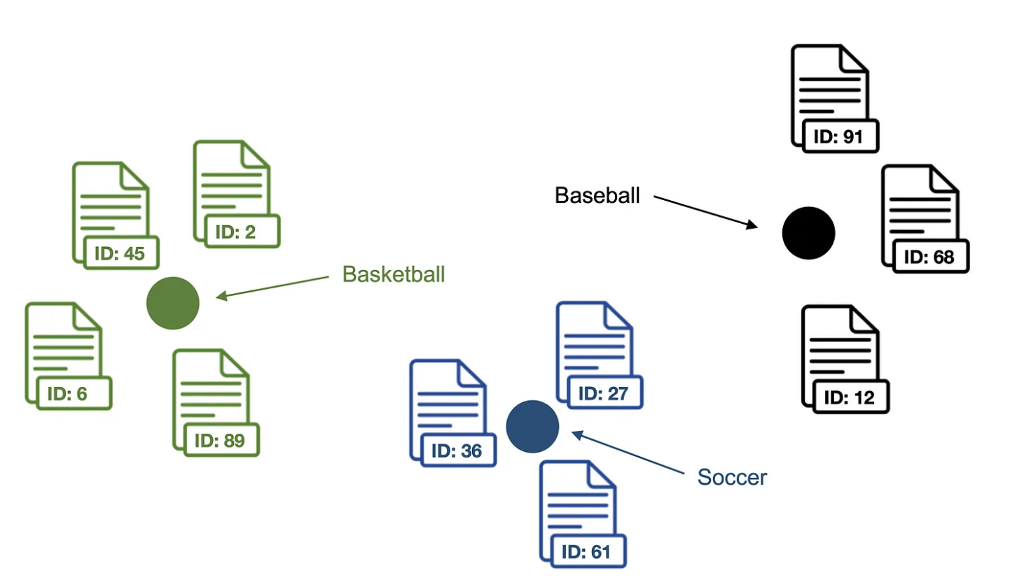
What’s Next?
Lbl2Vec: New algorithm published in 2021.
It automatically generates jointly embedded labels, documents, and word vectors and returns documents of categories modeled by manually predefined keywords.
Key idea: Many semantically similar keywords
can represent a category.
Notes:
We'll compare this to the zero-shot learning from Hugging Face, along with our K-Means clustering to see how it performs.

Slide 18
What’s Next?
Models take a long time to run so have to sample small amounts (1-2k rows).
Run inference for zero-shot classification on GPUs via Colab or AWS Sagemaker to do entire dataset
Compare 2023 to 2020!
Notes:
We'll compare this to the zero-shot learning from Hugging Face, along with our K-Means clustering to see how it performs.

Slide 19
Thanks!
Any questions?

