Slide 1
CAR EMULATOR GUI & VEHICLE MOTION SIMULATOR

Slide 2
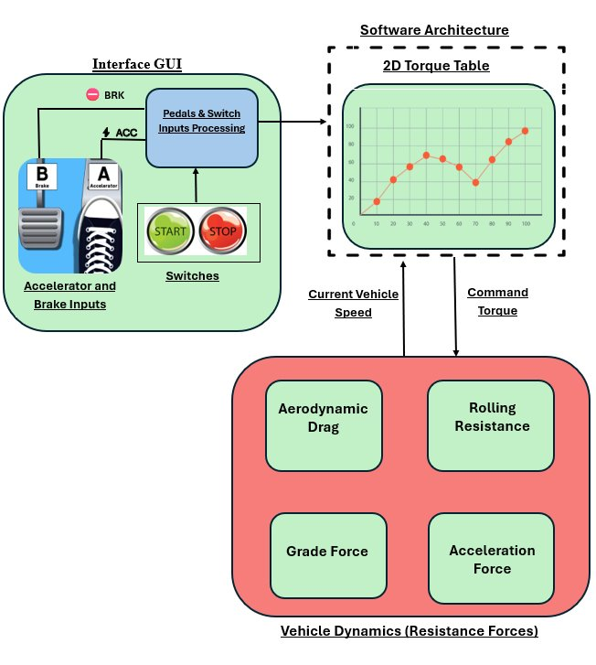
PROJECT OVERVIEW
A desktop engineering tool that converts driver inputs into longitudinal vehicle motion, shows the response live, and records each simulation session for analysis​
Project Objective:​
Provide a deterministic and understandable test environment for ​
accelerator, braking, coasting, stop and restart scenarios.
Delivered Capabilities:​
5 ms fixed-step physics update​
Accelerator and brake input handling​
Velocity, acceleration and operating-state telemetry​
Start, stop, restart and natural coast-to-rest

Slide 3
Dataset
LONGITUDINAL FORCE BALANCE​
Fnet = Fdrive − Fbrake − Fdrag − Frolling
Assumption: level road, constant air density and no driveline inertia. Brake and drive forces arebounded by configured maxima.
CONFIGURED VEHICLE PARAMETERS
Mass
1,350 kg
Drag coefficient
0.30
Frontal area
2.20 m²
Rolling-resistance coefficient
0.012
DRIVE MAP & UPDATE RATES​
Maximum drive force
4,200 N
Maximum brake force
7,000 N
SPEED
ACCELERATOR
DRIVE MAP
DRIVE DEMAND
DRIVE FORCE
km/h
%
interpolate
0…1
N
Maximum speed
160 km/h
5 ms
Physics
50 ms
Telemetry
100 ms
Graph

Slide 4
TECH STACK AND Python concepts
RUNTIME DATA PATH:
GUI / CONTROLS
PHYSICS ENGINE
VISUALIZATION
DATA LOGGER
gui.py
vehicle_dynamics.py
graph_manager.py
data_logger.py
Captures press, release and lifecycle events
Computes forces, acceleration and velocity
Refreshes velocity history independently
Buffers samples and exports workbooks
TECHNOLOGY CHOICES:
Python
Readable modular implementation
CustomTkinter
Styled desktop controls
NumPy
Interpolation and numerical operations
Matplotlib
Embedded live velocity plot
Pandas
Structured session and time-step data
OpenPyXL
Native .xlsx workbook output

Slide 5
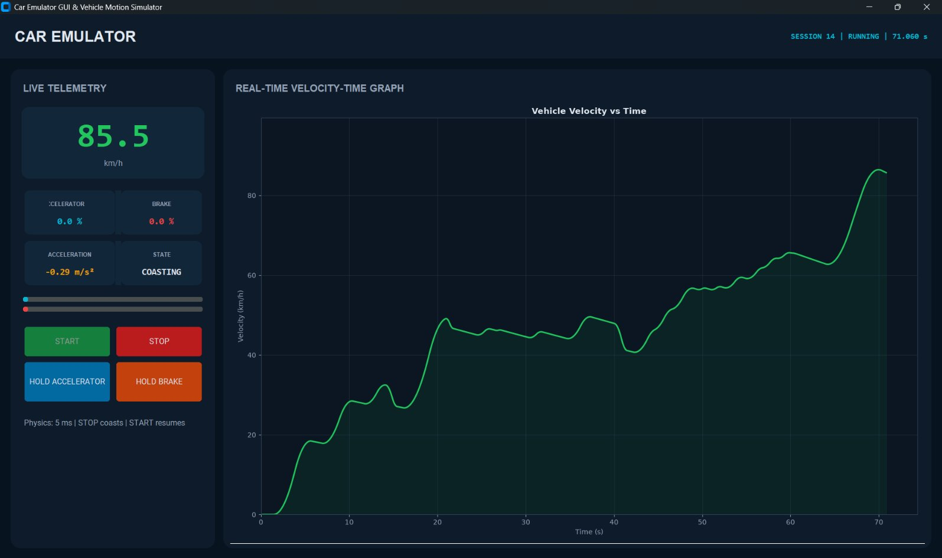
OUTPUT dashboard
Dashboard Features:
Real-Time GUI Contains
Vehicle Speed
Accelerator %
Brake %
Vehicle State
Velocity-Time Graph
Session Summary:
Session ID
Start Timestamp
Stop Timestamp
Duration
Maximum Velocity
Average Velocity
Completion Status
​
​

Slide 6
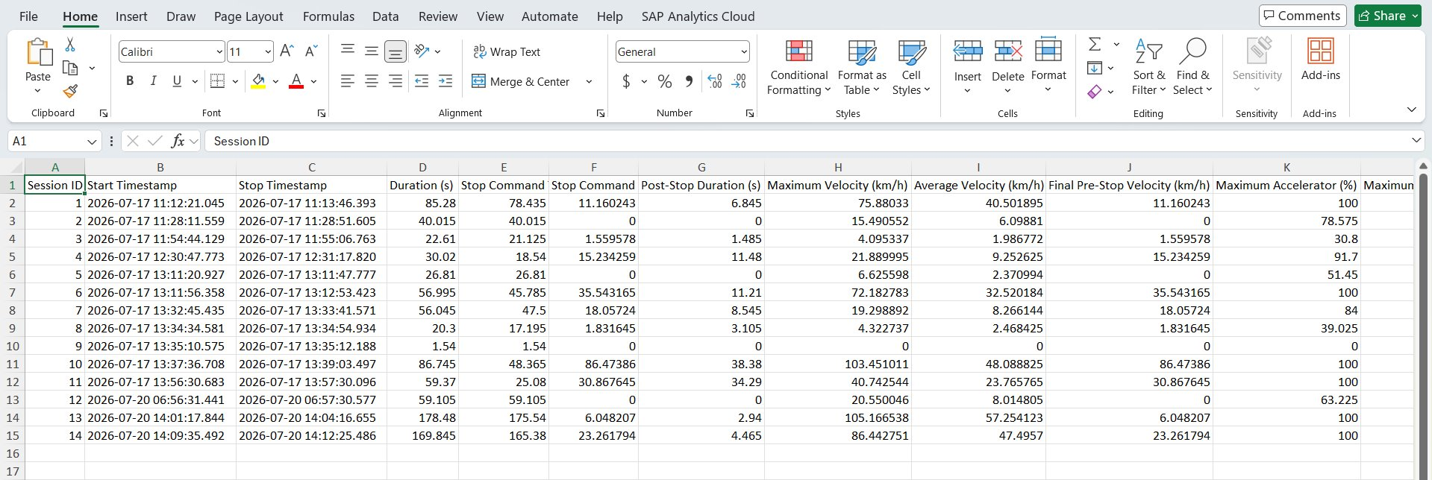
Output dashboard

Slide 7
Summary
Project Achievements:​
Real-Time Vehicle Dynamics Simulator​
GUI-Based Interactive Controls​
Start, Stop & Restart Logic​
Vehicle Force Modelling​
Live Velocity-Time Graph​
Excel-Based Logging​
Modular Architecture​
Future Enhancements:​
Gearbox & Transmission Model​
Road Grade Simulation​
Wind Load Effects​
Fuel Consumption Estimation​
Dashboard Analytics​
CAN Communication Support​
AUTOSAR Integration​
​
Learning Outcomes:​
Vehicle Dynamics Fundamentals​
Automotive Force Calculations​
Event-Driven Programming​
Real-Time Simulation Design​
Spreadsheet Reporting​
​
Final Conclusion:​
The project successfully demonstrates a modular, real-time automotive vehicle motion simulator capable of physics-based vehicle behaviour , telemetry visualization, and automated performance reporting.

Slide 8
THANK YOU

