Slide 1
Driver monitoring system Data analysis tool

Slide 2
Python megaproject
Driver monitoring system data analysis tool
1.Project Overview
2.Dataset
3.Tech stack and python
concepts used
4.Output report/Dashbaord
5.Summary/Future scope

Slide 3
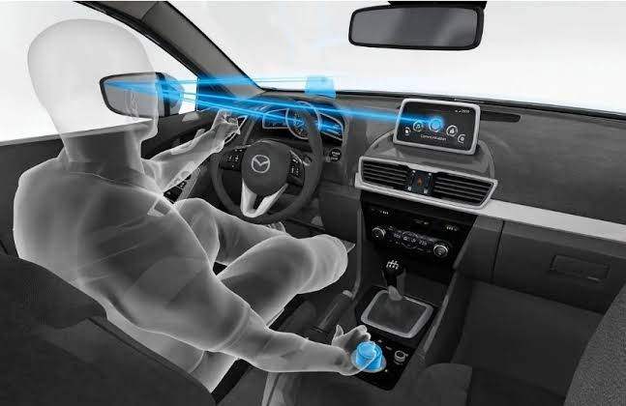
Driver Monitoring System (DMS) data analysis tool
Project Overview
Python-based driver attention & fatigue analysis tool
Quick Facts
5 Python modules
5 drivers, 300 sensor records
Auto-generates Word + PDF report
Fully automated — zero manual review
What it does
Reads eye closure, blink rate, head pitch and yawning readings
for 5 drivers from an Excel file
Calculates a weighted Attention Score (0–100) for every driver, every shift
Ranks all drivers automatically from safest to riskiest
Generates a fully formatted Word report, exported to PDF
Purpose
Replaces manual fatigue-data checking with an automatic, consistent, easy-to-share safety report — so a fleet manager can instantly see which driver or shift needs attention
EDAG Electrics/Electronics Author: Prajwal/Vanshita/Afreen Version:1.0 Scope: EDAG Group internal

Slide 4
Dataset
"Driver Monitoring Data" sheet
300
Parameters in the dataset:
Driver_ID,
Driver_Name,
Shift
Time_Minutes,
Travel_Distance_km
Eye_Closure_%,
Blink_Rate
Head_Pitch_Angle,
Yawning_Count
Sensor Records
5
Drivers Tracked
9
Data Columns
Dataset Link : Click_For_Dataset
Git Link: Common_Git_Repo
3
Shifts per Driver

Slide 5
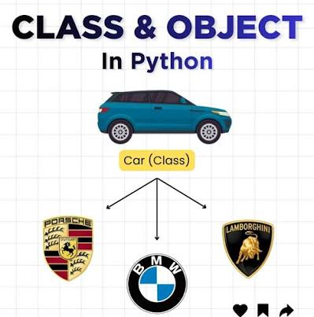
Technology Stack & Python Concepts
Libraries and core Python concepts used in the DMS pipeline
Libraries / Tech Stack
pandas — data loading, cleaning, groupby & aggregation
numpy — numeric rounding & dtype detection
openpyxl — reads the Excel workbook & sheet names
matplotlib — draws all 19 charts
python-docx — builds the Word report (tables, charts, styling)
pywin32 (win32com) — exports the Word report to PDF
Python Concepts Used:
Object-oriented design — DataLoader, DriverEvaluator, WordReport classes
Exception handling — try / except / finally in every module
List comprehensions — required-column validation
Functional mapping — .apply() with scoring functions
Multi-branch conditional logic — if/elif scoring rules
Pandas groupby + agg — per-driver, per-shift aggregation
Ordered categorical dtypes — Morning/Afternoon/Night sorting

Slide 6
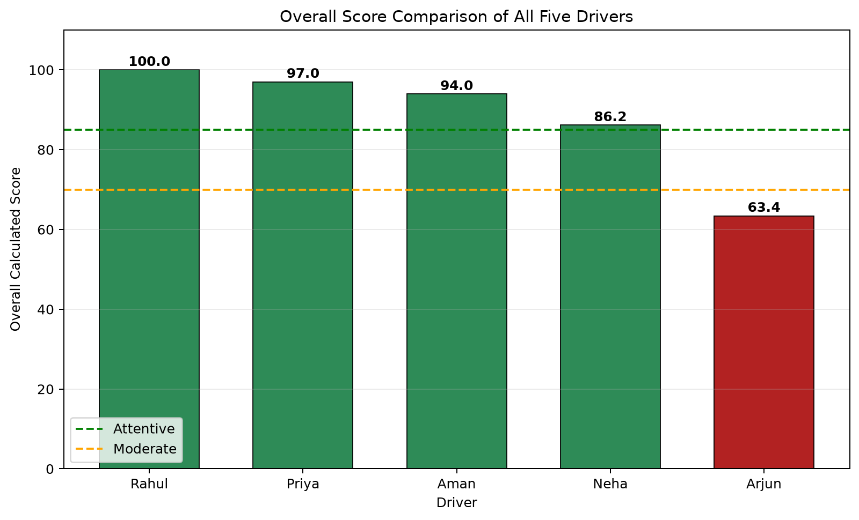
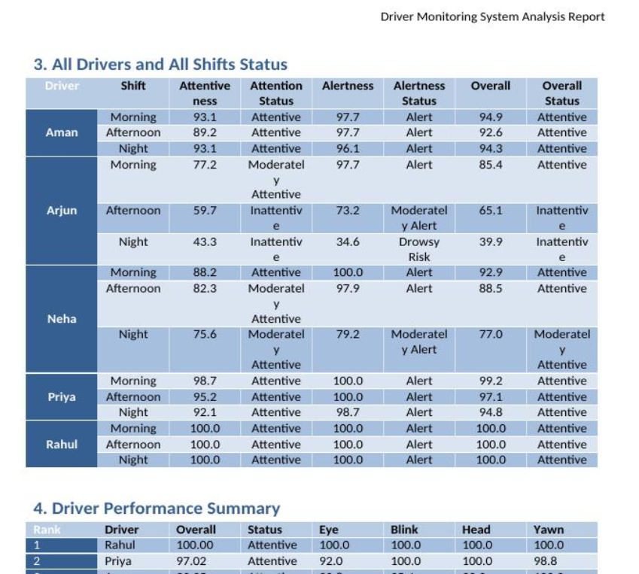
Output Report & Dashboard
Sample output generated by report.py — 9 tables, 19 charts
Dashboard Summary:
Total Records: 300 Drivers: 5
Avg Eye Closure: 8.08% Avg Blink Rate: 12.93
Average Calculated Score: 88.11
Best & Weakest
Best: Rahul — 100.00/100
Weakest: Arjun — 63.43/100

Slide 7
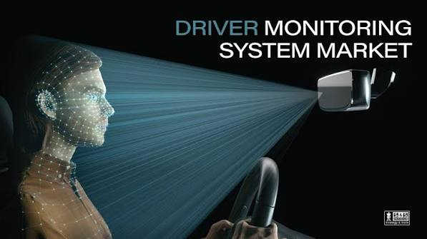
Summary & Future Scope
From raw sensor data to a decision-ready safety report
Project Summary:
The Driver Monitoring System (DMS) analyzes eye closure, blink rate, head movement, and yawning data to calculate driver attention scores. It ranks drivers by safety level and automatically generates Word and PDF reports with tables and charts.
Future Scope
Real-time monitoring using cameras and sensors
Instant fatigue and drowsiness alerts
AI/ML-based fatigue prediction
Web or mobile fleet-management dashboard
GPS, cloud database, and vehicle-data integration
Automatic alerts through SMS, email, or Microsoft Teams

Slide 8
Thank you !

