Slide 1

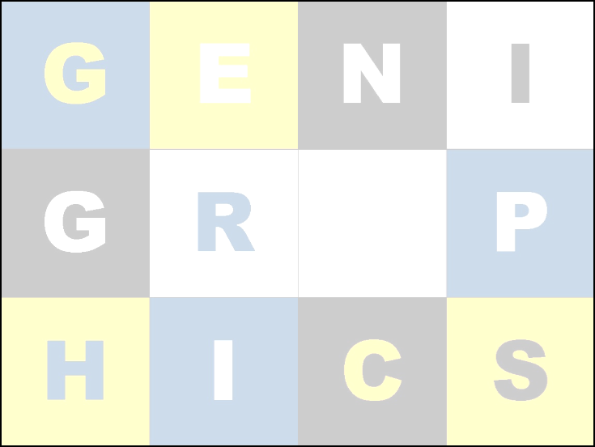
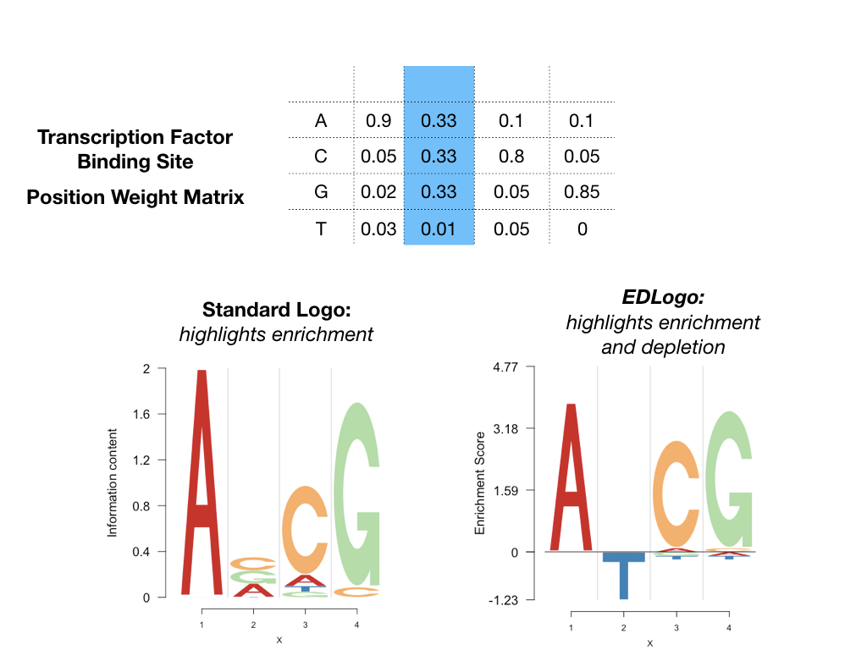
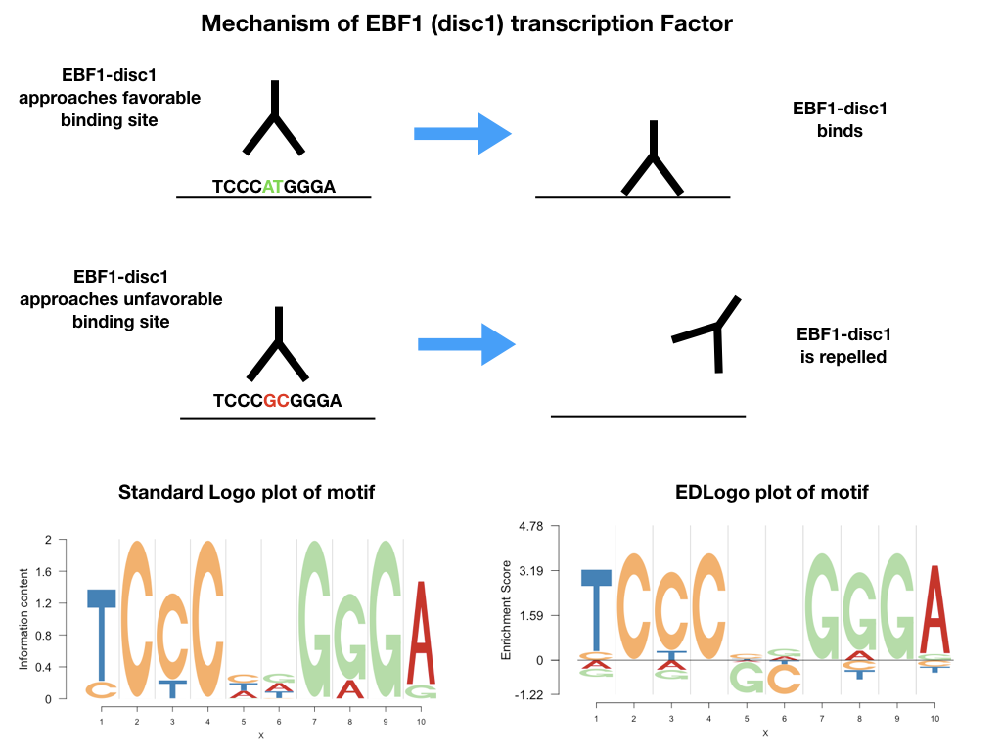
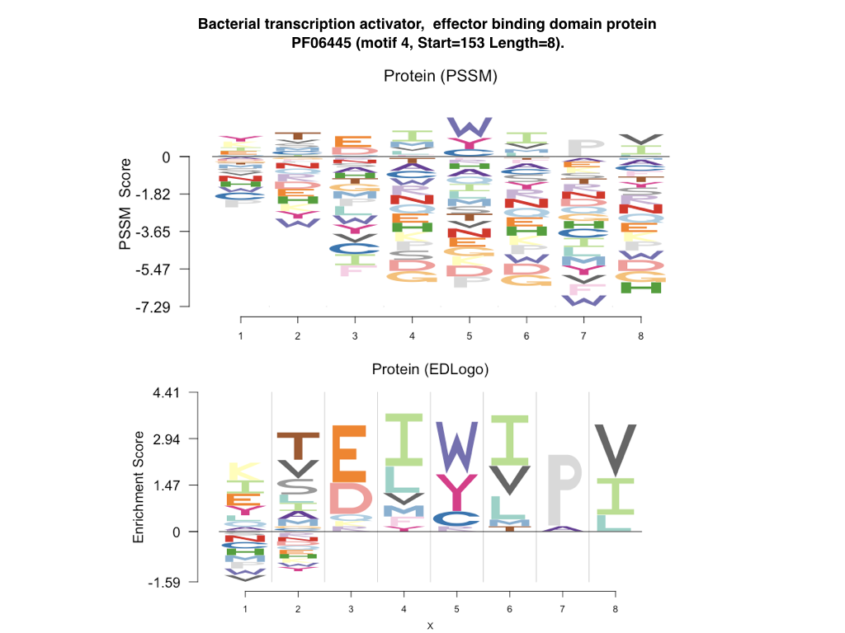
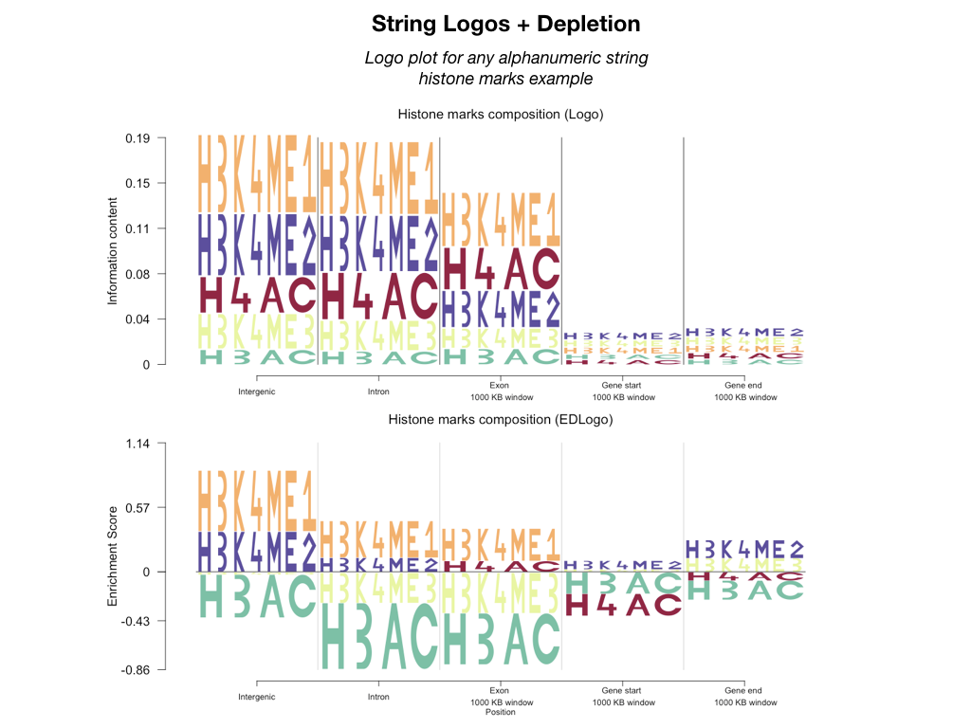
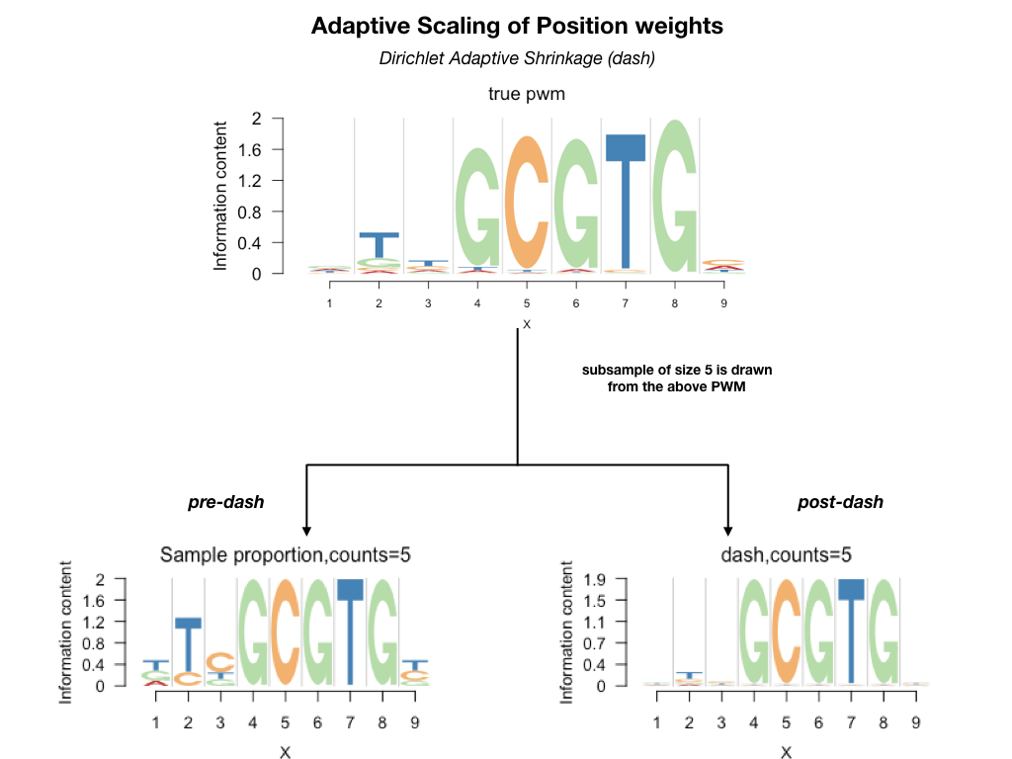
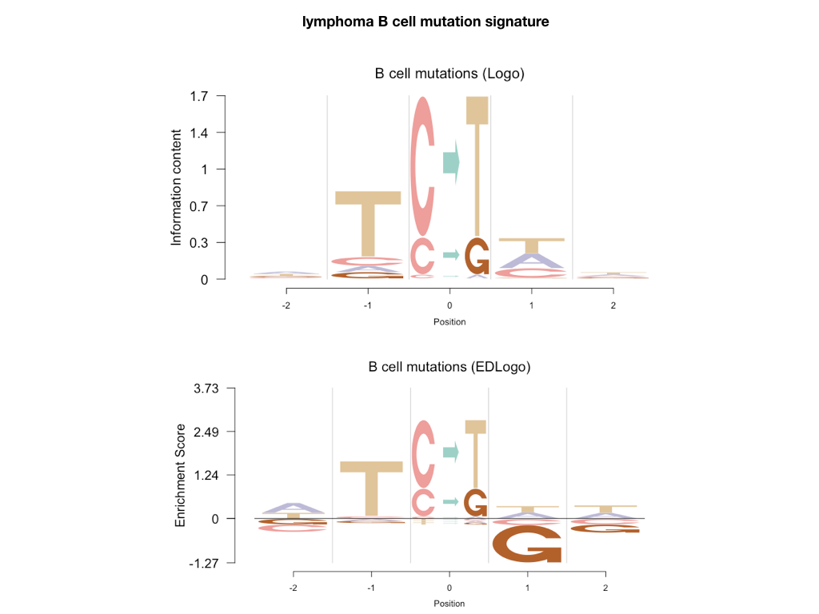
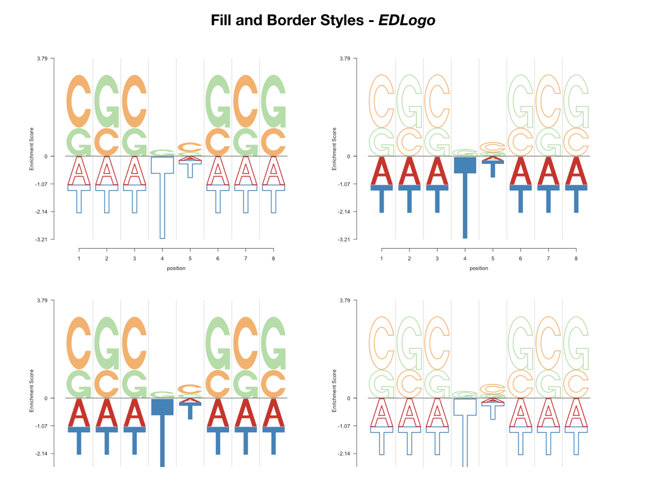
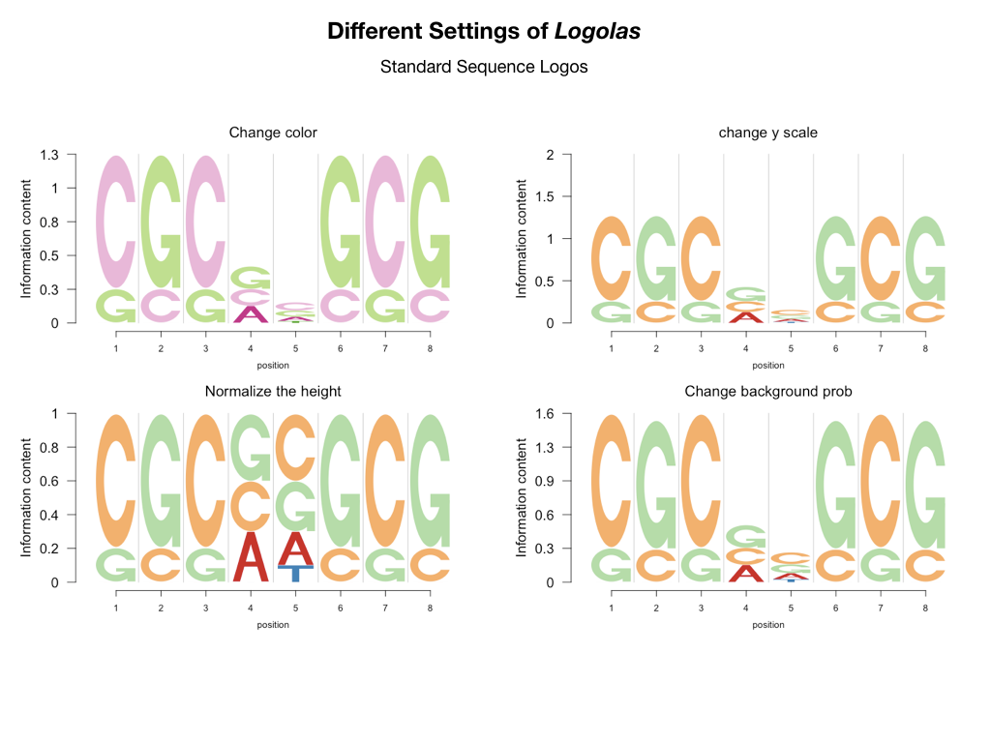
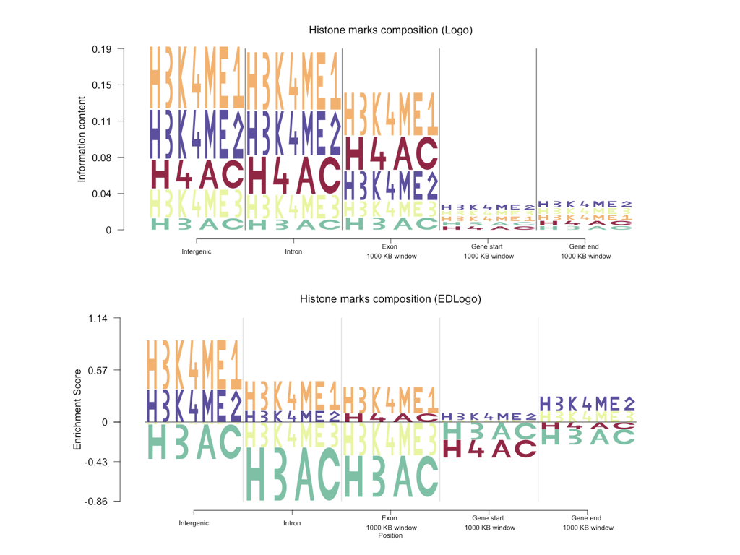
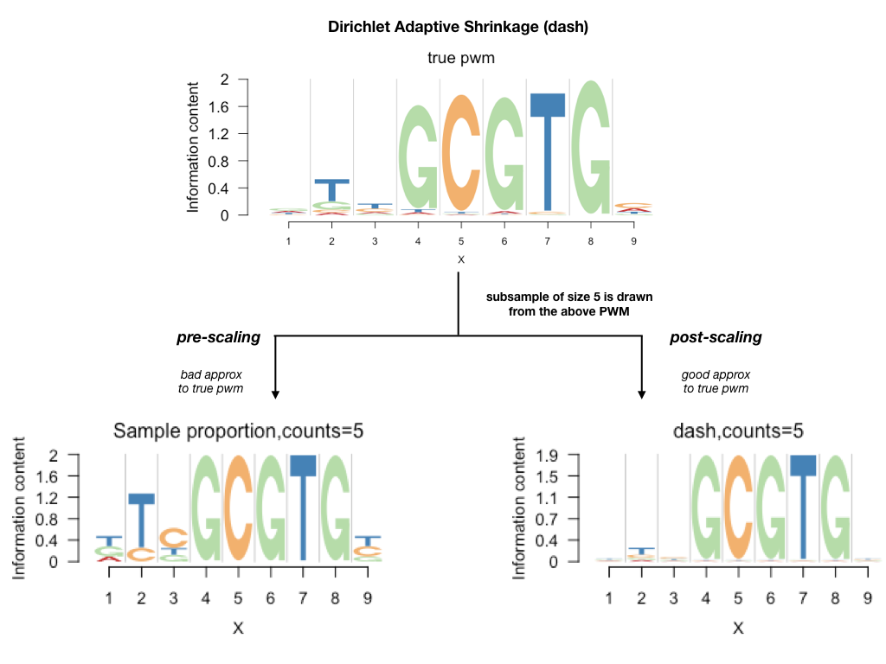
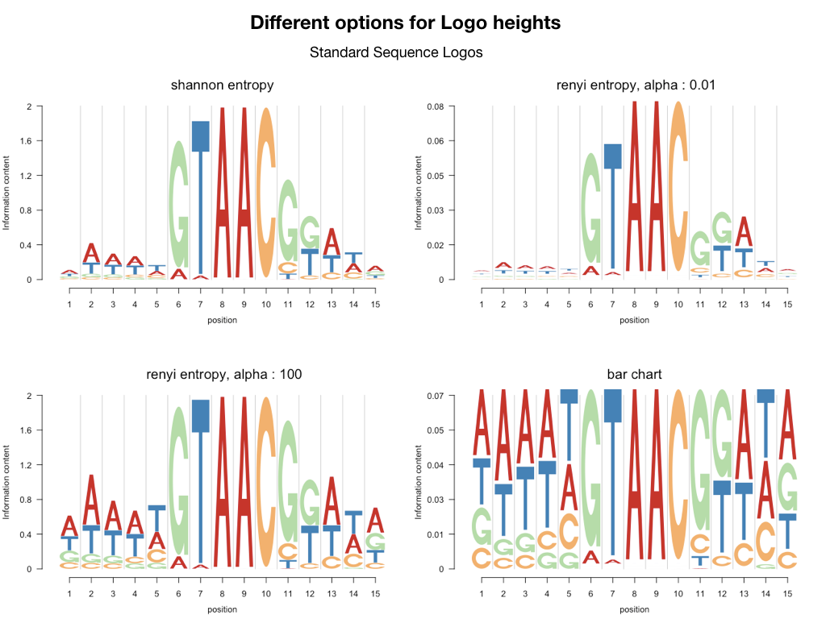
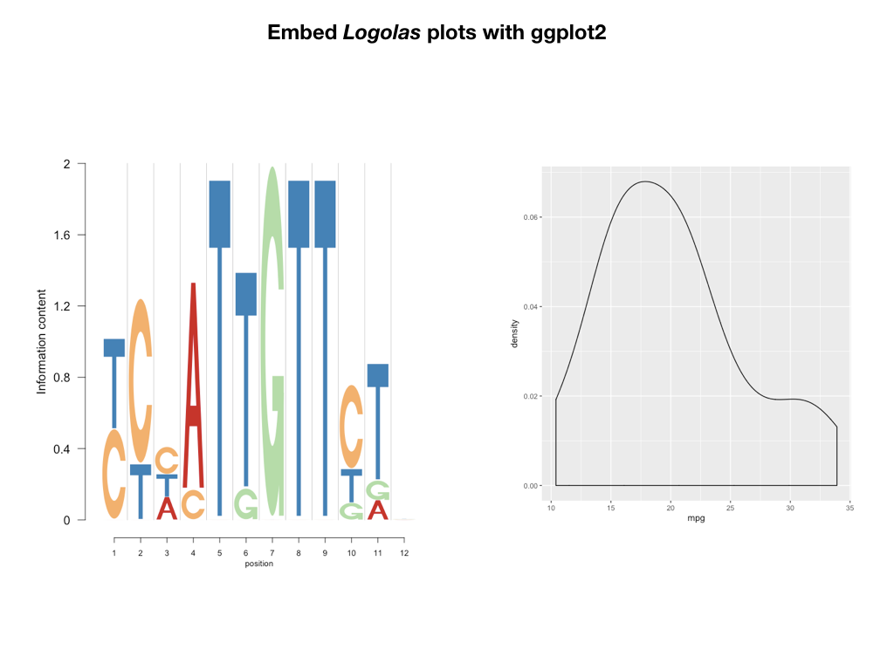
Logolas : New Frontiers in Logo Visualization
REPLACE THIS BOX WITH YOUR ORGANIZATION’S
HIGH RESOLUTION LOGO
Enrichment Depletion Logos (EDLogo) | String Logos | Adaptive Scaling of Logos
Kushal K Dey* Dongyue Xie Matthew Stephens*
Department of Statistics, University of Chicago
*Department of Human Genetics, University of Chicago
Project Page
Standard sequence logos tend to highlight enrichment primarily.
We propose EDLogo plots that highlight both enrichment and depletion at a position.
Depletion is a biological phenomenon. Several transcription factors of EBF-1 family show base depletion in the middle of the motif. An example provided below for EBF1-disc1 transcription factor.
https://kkdey.github.io/Logolas-pages
Gallery
https://kkdey.github.io/Logolas-pages/Gallery.html
R package
Github Version
kkdey/Logolas
Bioconductor
Logolas
PSSM logo plots are often used to visualize protein sequence logos, but EDLogo representation is more parsimonious and interpretable than the PSSM logo plot.
Logolas allows the user to plot string logos. An example application of such string logos is in visualizing mutational signature profiles.
EDLogo representation can detect depletion of G to the right of C mutation dominant signatures, possibly reflecting CpG site bias. We illustrate using an example from Alexandrov et al (2013).
CONTACT
Kushal K Dey
Email: kkdey@uchicago.edu
Github: kkdey
Twitter: kanishkadey
Website: kkdey.github.io
ACKNOWLEDGEMENTS
John D. Blischak,
Hussein Al-Asadi,
Alex E. White,
Trevor Price
REFERENCES
Other Features of Logolas
Logolas provides an adaptive scaling of the Position Weight Matrix based on number of aligned sequences.
This method is called Dirichlet adaptive shrinkage or dash.
Stephens, M.: False discovery rates: a new deal. Biostatistics 18 (2), 275–294 (2016)
Koch, C.M., et al.: The landscape of histone modifications across 1in five human cell lines. Genome Research 17(6), 691–707 (2007)
Alexandrov, L., Nik-Zainal, G., Wedge, D., Campbell, P., Stratton, M.: Deciphering signatures of mutational processes operative in human cancer. Cell Reports 3(1), 246–259 (2013)
Kheradpour, P., Kellis, M.: Systematic discovery and characterization of regulatory motifs in encode tf binding experiments. Nucleic Acids Research, 1–12 (2013)
Joseph, A.P., Shingate, P., Upadhyay, A.K., Sowdhamini, R.: 3pfdb+: improved search protocol and update for the identification of representatives of protein sequence domain families. Database (Oxford) bau026 (2014)
An application of alphanumeric string
symbols in Logolas is in modeling the composition of histone marks in different regions of the genome (sue to Koch et al 2007).

