Slide 1
Final Project Report - ITC6103A1 - Applied Machine Learning - Winter Term 2024
Konstantinos Kechagias @ ACG
Date: 3 April 2024

Slide 2
Agenda
Clustering: Market Segmentation: Unsupervised learning
Summarize the dataset
Preprocessing
K – Means
Agglomerative Hierarchical Clustering (AHC)
Regression
Summarize the dataset
Data Cleaning
Preprocessing
Correlation Analysis
Linear Regression
Polynomial Regression
Ridge Regression
Lasso Regression
Compare Regression Models
Predicting outcome
Summarize the dataset
Data Cleaning
Preprocessing
Decision Tree
K-Nearest Neighbors
Random Forest
Neural Network
Compare Models
Explainable AI (XAI) for RandomForestClassifier
Explainable AI (XAI) for MLPClassifier

Slide 3
1. Clustering: Market Segmentation: Unsupervised learning

Slide 4
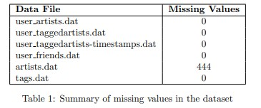
Preprocessing
No Need for Preprocessing

Slide 5
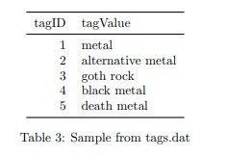
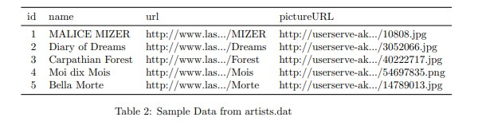
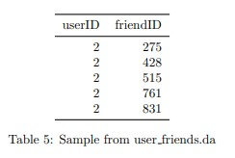
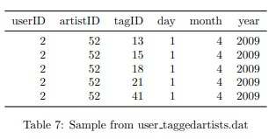
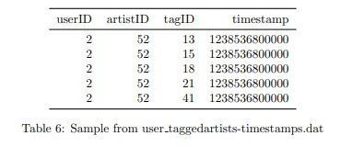
Understanding the data
No User Details

Slide 6
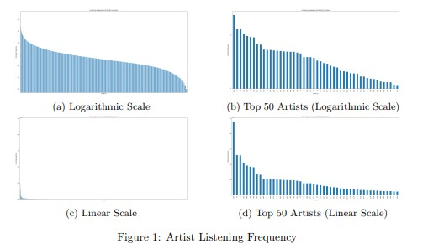
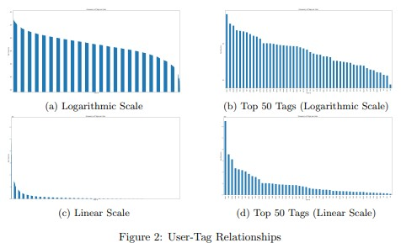
Understanding the data
Power Law distribution for both

Slide 7
Outlier Detection
Methods:
Z-Score -> All know how it works
IQR -> Calculate Quartiles -> IQR=Q3−Q1 -> Q1−1.5×IQR or above Q3+1.5×IQR

Slide 8
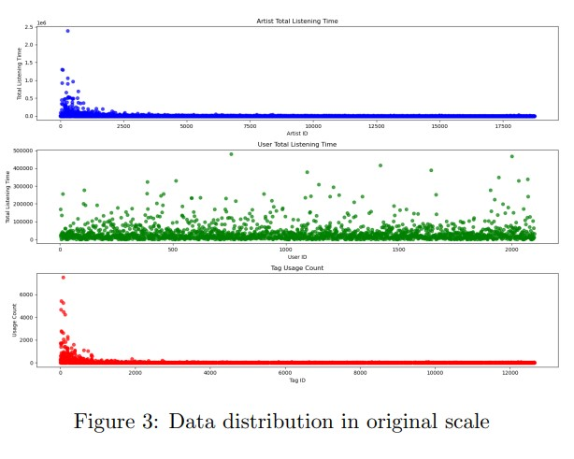
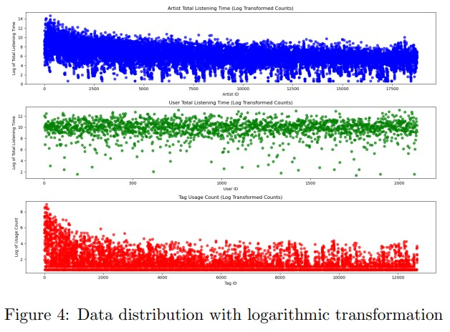
Visualize Data
First & Third > Second (in # Outliers)

Slide 9
Outlier Detection
Results (# outliers):
Z-Score:
85
43
68
IQR:
2493
161
1592

Slide 10
2. Similar User

Slide 11
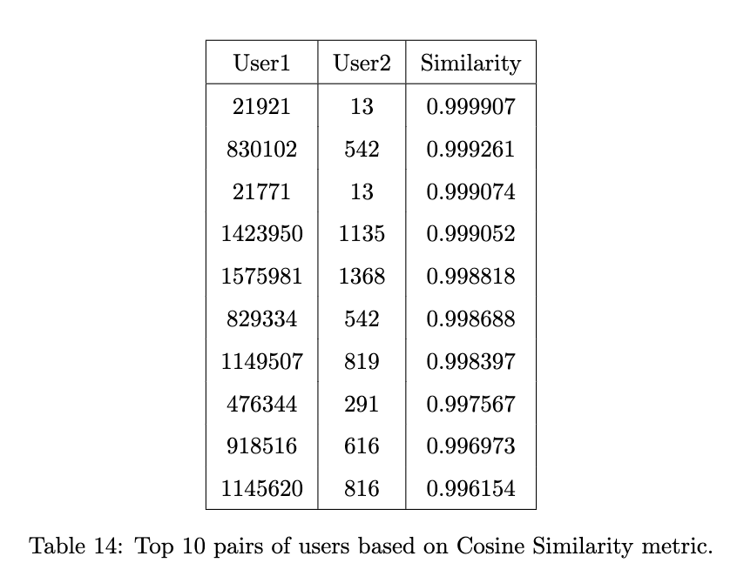
Artist heard similarity
Method:
Cosine Similarity

Slide 12
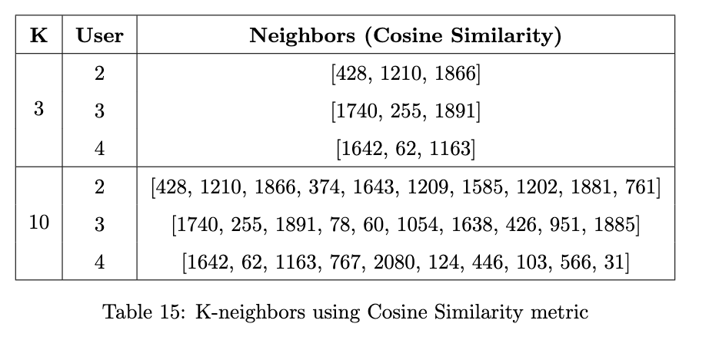
K – Nearest neighbors
Metric:
Cosine Similarity
k = 3, k = 10

Slide 13
3. Dynamics of Listening and Tagging

Slide 14
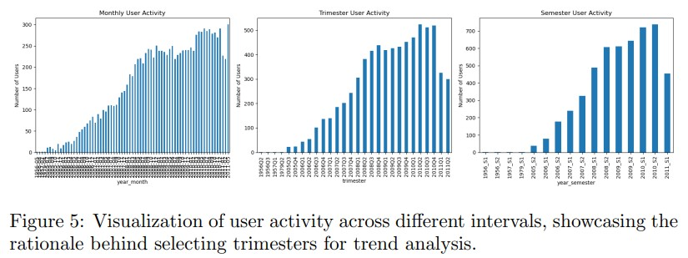
Data Interval Analysis
Trimester seems the better option

Slide 15
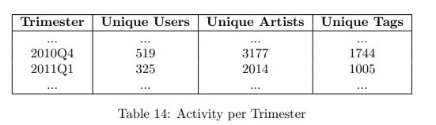
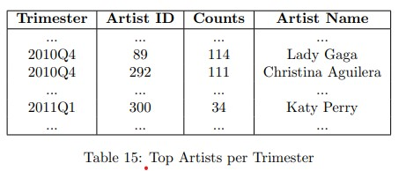
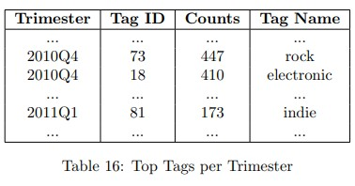
Activity Analysis

Slide 16
4. Comparing Prolific User Detection Methods

Slide 17
Correlation Methods
Methods:
Pearson’s Correlation Coefficient
Spearman’s Rank Correlation Coefficient
Kendall’s Tau Correlation Coefficient

Slide 18
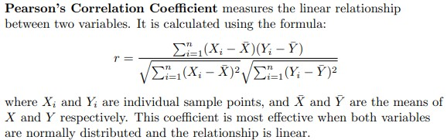
Pearson’s Correlation Coefficient

Slide 19
Pearson’s Correlation Coefficient

Slide 20
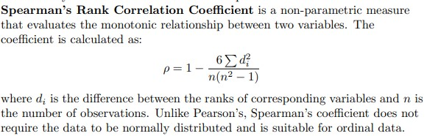
Spearman’s Rank Correlation Coefficient

Slide 21
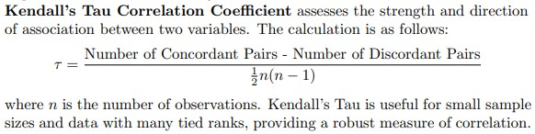
Kendall’s Tau Correlation Coefficient

Slide 22
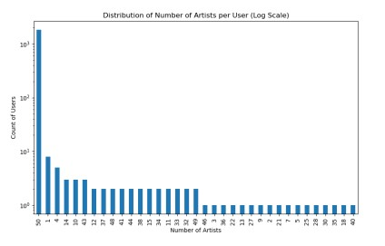
Correlation Analysis
# Artists listened - # Friends:
Pearson’s Correlation Coefficient: 0.0224
Spearman’s Correlation Coefficient: 0.0372
Kendall’s Tau Correlation Coefficient: 0.0309
Zero/Low correlation

Slide 23
Correlation Analysis
User Listening Time- # Friends:
Pearson’s Correlation Coefficient: 0.2307
Spearman’s Correlation Coefficient: 0.2521
Kendall’s Tau Correlation Coefficient: 0.1734
Low/ Moderate correlation

Slide 24
Thank you! : )

