Slide 1
AskDoc - AI Document Reviewer
A Django-based RAG application for document upload, document-specific chat, and local LLM retrieval.
This project uses per-document FAISS indexing and session-aware chat routing.

Slide 2
Overall Implementation
Frontend: Django templates provide a sidebar, file upload flow, recent document sessions, and chat UI.
Backend: Django views ingest documents, manage session-specific FAISS indexes, and serve chat answers using local LLM prompts.
Utility: Document extraction, chunking, embedding generation, and retrieval are handled in RAG/utils.py.

Slide 3
Architecture & Flow
Upload a document → create or reuse session ID → ingest into a per-session FAISS index.
Select a recent document → restore the session and chat history in the sidebar.
Ask a question → backend retrieves document-specific context and returns an answer from the local LLM.

Slide 4
Implementation Details
File ingestion supports PDF, TXT, HTML, and CSV with OCR fallback for scanned documents.
Each document session uses its own FAISS index to isolate retrieval context.
Chat queries include session ID so answers remain tied to the selected document.

Slide 5
Tech Stack & Flow Explanation
Python + Django for web app routing and rendering.
FAISS + SentenceTransformers for embedding search and retrieval.
Transformers + local LLM for answer generation from retrieved document context.
Flow: Upload → Index → Select Document → Query → Retrieve → Answer.

Slide 6
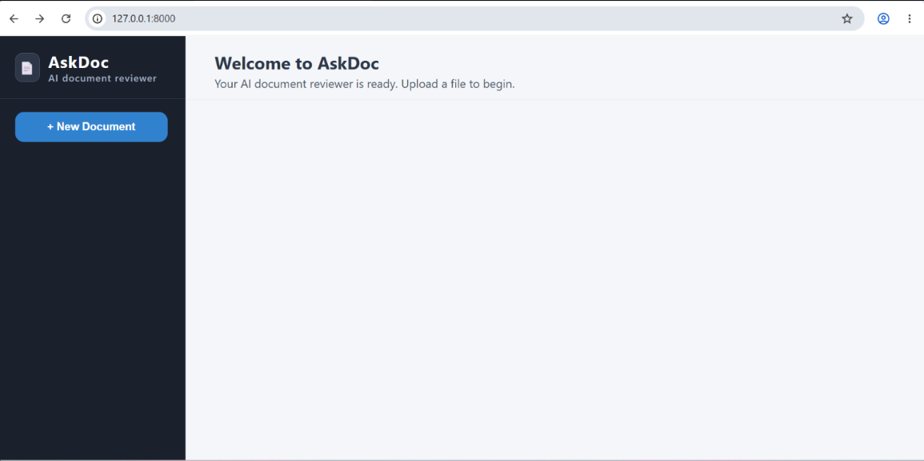
Screenshots

Slide 7
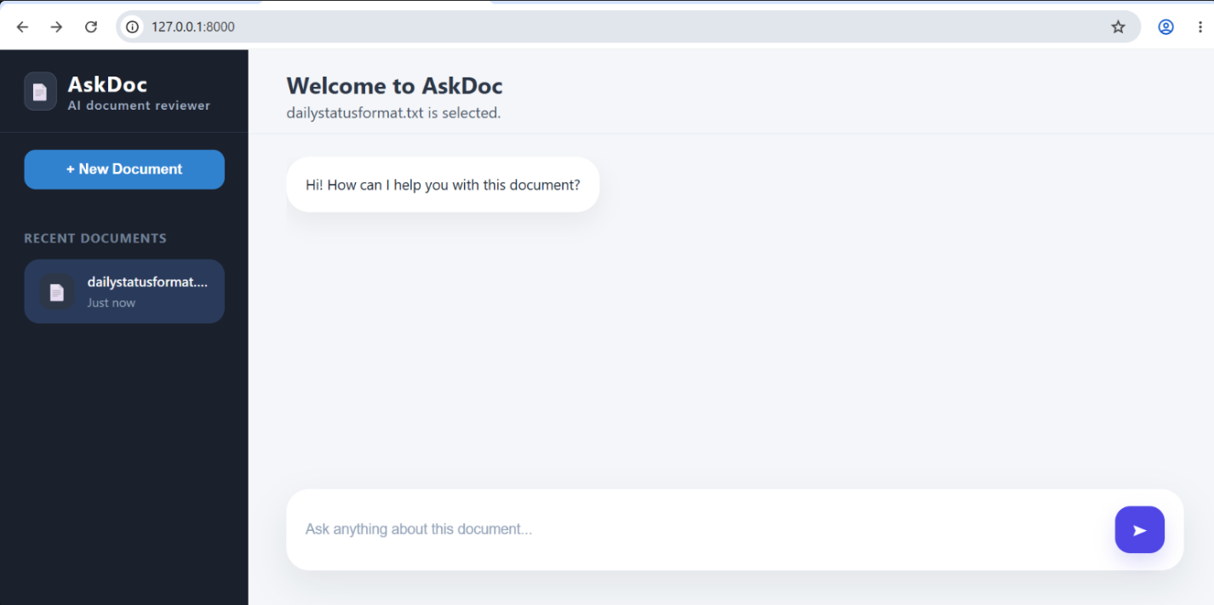

Slide 8
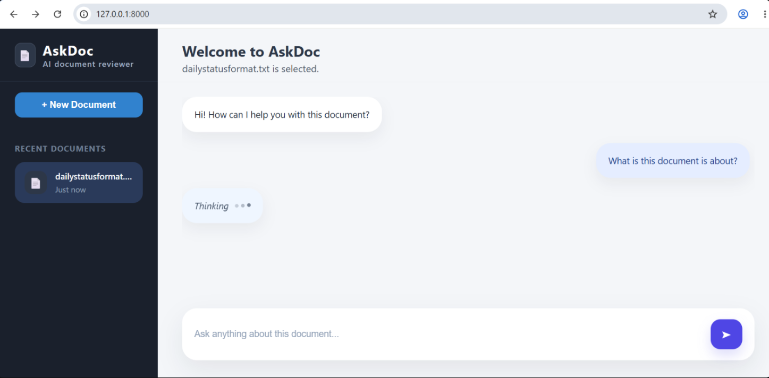

Slide 9
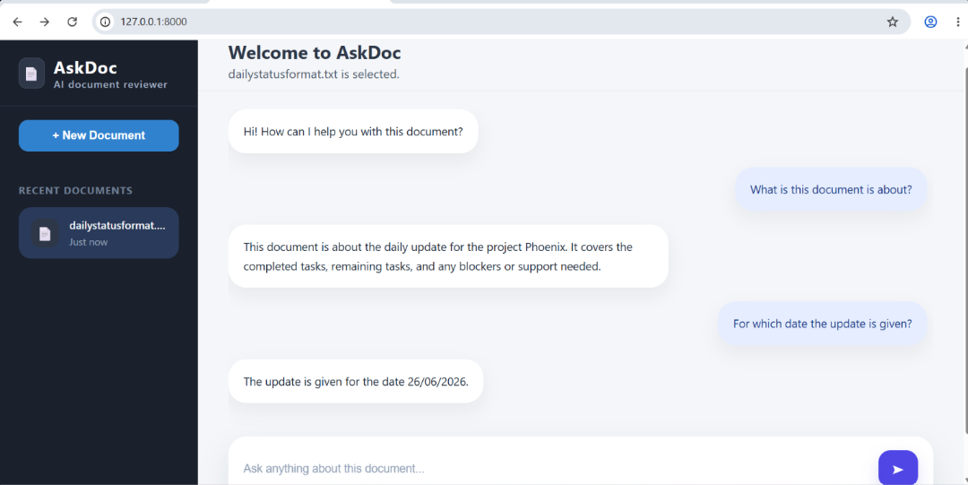

Slide 10
