Slide 1
PROJECT TITLE: Conversational Image Recognition Chatbot
CSE7101- Capstone Project
Review-3
Batch Number: ISE_15
Under the Supervision of,
Mr. Jaikumar B
Associate Professor
School of Computer Science and Engineering
Presidency University
Roll Number | Student Name
20221ISE0046 | K KEERTHI
20221ISE0085 | ADITI N
20221ISE0055 | RAVI RAJ P MATH
Name of the Program: Information Science and Engineering
Name of the HoD: Dr. Zafar Ali Khan N
Name of the Program Project Coordinator: Ms. Suma N G
Name of the School Project Coordinators: Dr. Sampath A K , Dr. Geetha A

Slide 2
Problem Statement Number:
Organization: Bharat Electronics Limited (BEL)
Category (Hardware / Software / Both): Software
Problem Description: Ever since the advent of AI and computer vision, modeling conversations has remained a challenge—especially when combining natural language processing (NLP) and image recognition. While popular chatbots like Apple’s Siri, Google Assistant, and Microsoft’s Cortana excel at language-based interactions, they lack advanced visual understanding. This project focuses on developing a deep learning–based conversational chatbot capable of recognizing objects in images uploaded by users and engaging in relevant, context-aware dialogue about them. The chatbot will not only detect objects but also answer questions regarding the image with grammatically correct and lexically precise responses, enhancing user experience in areas such as automation, accessibility, and interactive learning.

Slide 3
Literature Survey Table
Author(s) | Year | Methodologies Implemented | Accuracy | Limitations & Gaps
Hardik Chordia et al. | 2025 | Vision Transformers (ViT), CLIP, BLIP, LLaVA with GPT-4 | Up to 96% | High compute cost, dataset bias, ethical concerns, lacks multilingual support
Poonam Gupta et al. | 2025 | CNN + GPT with Late Fusion encoder, attention mechanisms | ~92% | Requires large datasets, high computational cost, privacy issues, lack of explainability
D. Prannav et al. | 2025 | CNN + LSTM for image captioning, BLEU score evaluation | BLEU ≈ 0.66 | Poor performance on complex scenes, limited vocabulary, high computational complexity
Li, Lu & Zhu | 2024 | DenseNet121 (images) + ALBert + BiLSTM (text) with cross-attention fusion | 86.5% | Fusion redundancy, low F1 (75%), weak handling of subtle emotions, domain adaptation issues
Kolte et al. | 2024 | CNN + NLP, Visual QA, ResNet, MobileNet, ViLBERT | Not specified | Struggles with complex scenes, limited conversational coherence, weak emotional understanding
Lavanya Kesa et al. | 2021 | CNN with TensorFlow & Keras for face-mask detection | ~90% | Limited to mask detection, not generalizable, lacks multilingual and conversational ability
Nishant Arora, Suhani Talesara, Shashwat Sharma, Dr. Mayank Patel | 2025 | YOLOv8 for object detection (fine-tuned on custom industrial dataset) BERT for natural language question answering Flask backend + Streamlit interface for deployment | mAP@0.5 = 94.7% (object detection) Semantic QA accuracy = 89.2% | Confusion with visually similar objects Struggles with idioms/domain-specific jargon No multilingual support Limited to image input (no video or temporal reasoning yet)

Slide 4
Algorithms
1.CNN extracts image features.
YOLO/DETR detect and classify objects.
2.Transformer-based NLP models understand the user’s question.
LLM generates grammatically correct, context-aware responses.
3.CLIP/BLIP-2 align images with language.
This allows the chatbot to “talk about” the detected objects.
~FLOW CHART
User Input: Upload image + ask a question.
Image Processing:
CNN extracts features.
YOLO/DETR detects objects.
Feature–Language Alignment:
CLIP/BLIP-2 connects visual features with text.
Question Understanding (NLP):
Transformer model understands the query.
Answer Generation:
LLM generates natural, conversational answers.
Output:
Context-aware, grammatically correct response.

Slide 5
Domains & Fields Where You Can Use This Project
1.Automation & Industry
Smart assistants that “see” objects in factories or warehouses.
Robotics vision + conversational control.
2.Accessibility
Helping visually impaired users by describing images or surroundings.
3.Education & Interactive Learning
Students upload diagrams/images → chatbot explains them.
Language learning via describing pictures.
3.Healthcare
Doctors upload X-rays/scans → chatbot assists in interpretation.
Medical image Q&A.
4.E-commerce / Retail
Upload product images → chatbot gives descriptions, prices, comparisons.
5.Security & Surveillance
Conversational analysis of CCTV footage or images.
6.Entertainment & AR/VR
AI companions that can see and discuss user environments.

Slide 6
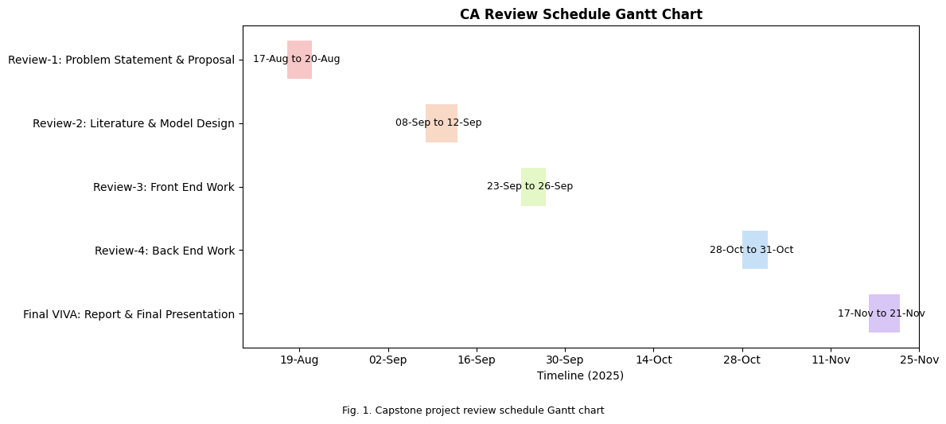
Timeline of the Project (Gantt Chart)

Slide 7
Github Link
The Github link provided should have public access permission.
Github Link
Conversational-Image-Recognition-Chatbot

Slide 8
References (IEEE Paper format)
[1]N. Arora, S. Talesara, S. Sharma, et al., "CONVERSATIONAL IMAGE RECOGNITION CHATBOT," Journal of Emerging Technologies and Innovative Research (JETIR), 2025.
[2]N R. Kolte, H. Wanwe, P. Sathawane, et al., "CONVERSATIONAL IMAGE RECOGNITION CHATBOT," International Research Journal of Modernization in Engineering Technology and Science (IRJMETS), 2024
[3]L. Kesa, S. Takur, K. Pasupuleti, et al., "Chatbot with Facemask Detection Technique," International Journal For Research in Applied Science and Engineering Technology (IJRASET), 2021.
[4]H. Li, Y. Lu, and H. Zhu, "Multi-Modal Sentiment Analysis Based on Image and Text Fusion Based on Cross-Attention Mechanism," Electronics, 2024.
[5]D. Prannav, A. Anwar, S. Sunayana, et al., "Image Caption Generation Using Deep Learning," Journal of Information Systems Engineering and Management, 2025.
[6]H. Chordia, R. Saxena, and G. Lavania, "Conversational Image Recognition Chatbot," Pratibodh - A Journal for Engineering, 2025.

Slide 9


