Slide 1
NYCU 2023 Summer DLP Lab6 – Let’s Play DDPM
TA 林廷翰
Aug 15, 2023
Notes:
‹#›

Slide 2
Outline
Lab Objective
Rule
Lab Description
Scoring Criteria
Notes:
‹#›

Slide 3
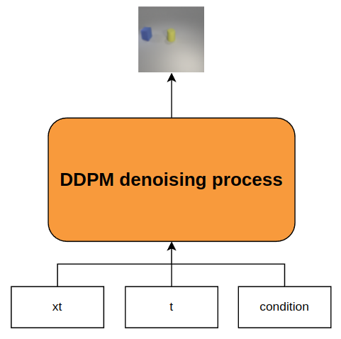

Lab Objective
In this lab, you need to implement a conditional DDPM and generate synthetic images based on multi-labels conditions
Example of labels:
[“cyan cylinder”, “red cube”], [“green sphere”], …

Slide 4
Rule
Report submission deadline: 8/29 (Tue.) 23:55
No need to demo this lab
Zip all files in one file
Report (.pdf)
Source code
Name it like ”DLP_LAB6_yourstudentID_name.zip”
Example: “DLP_LAB6_311605003_林廷翰.zip”
-5% to your score if you do not follow the format

Slide 5
Lab Description
Implementation details
Choose your conditional DDPM setting
Design your noise schedule and UNet architecture
Choose your prediction type

Slide 6
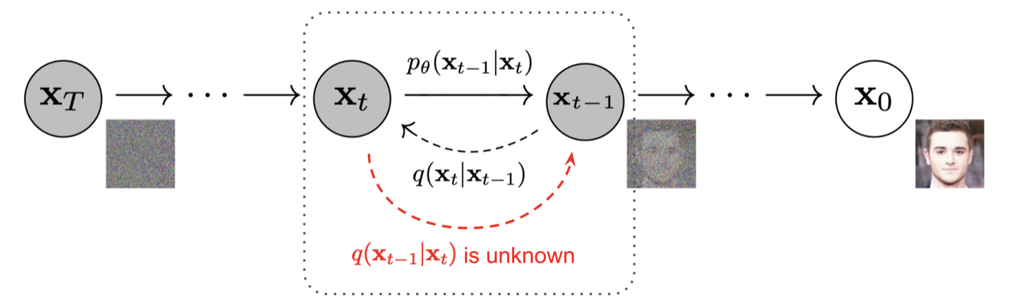
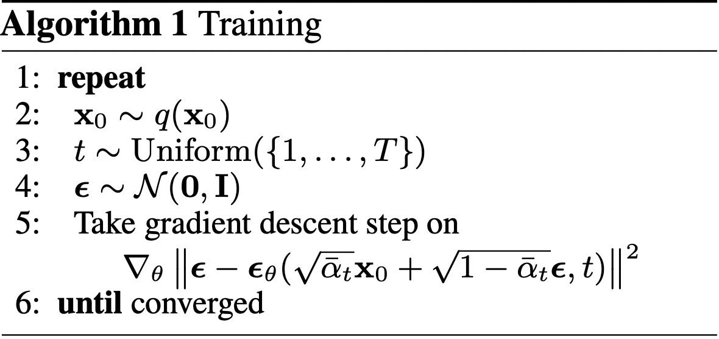
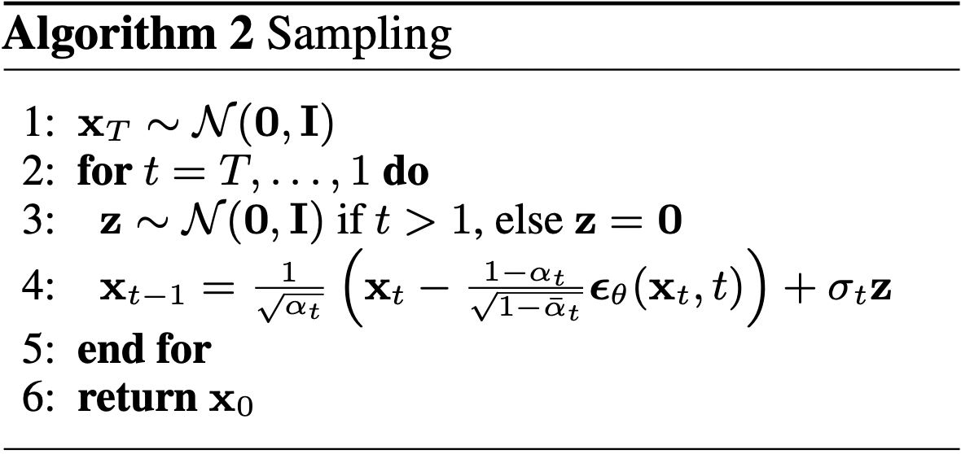
Lab Description – Introduction

Slide 7
Lab Description – Choice of DDPM
Pixel domain diffusion model
Latent diffusion model
encoder/decoder design
Condition embedding
time embedding
label embedding
Noise schedule
linear
cosine
other

Slide 8
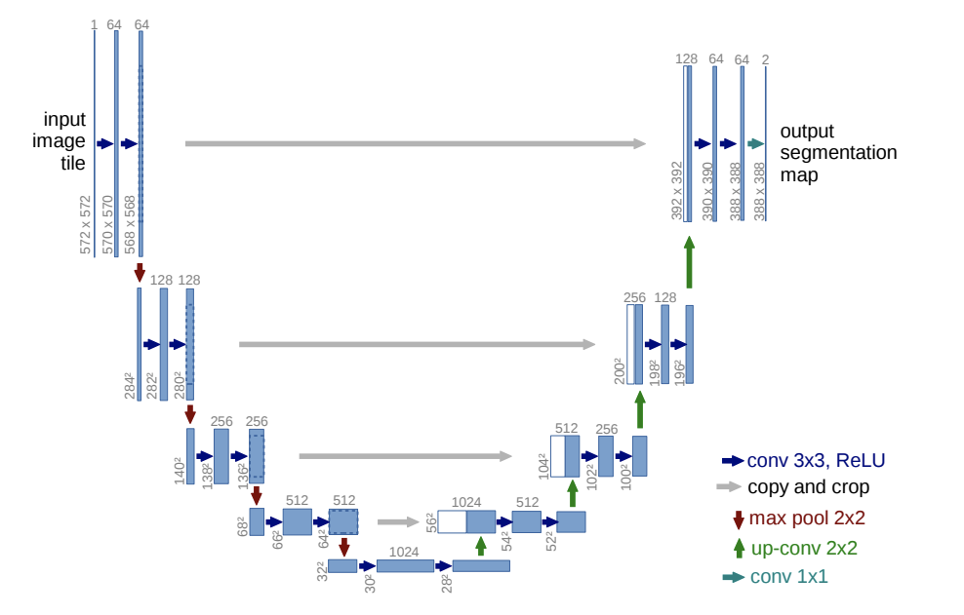
Lab Description – Design of UNet
Number of blocks
Number of layers, channels in each blocks
Down/upsampling blocks design
Architecture for the blocks. e.g. Resnet block
Self/cross attention
Where to add condition
other

Slide 9

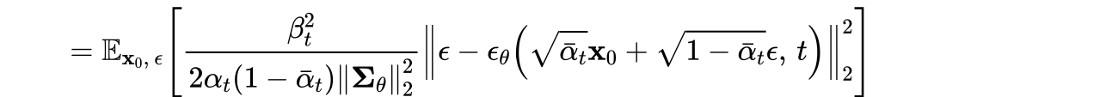
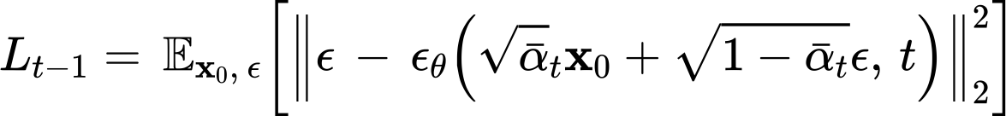
Lab Description – Choice of prediction type
Predicting the noisy sample
Predicting noise
Simplified noise predicting
Perception prioritized noise predicting
Perception Prioritized Training of Diffusion Models

Slide 10
Lab Description – Other details
You can use any DDPM architecture you like
Use the function of a pretrained classifier, eval(images, labels), to compute accuracy of your synthetic images.
Labels should be one-hot vector. E.g. [[1,1,0,0,…],[0,1,0,0,…],…]
Images should be all generated images. E.g. (batch size, 3, 64, 64)
Images should be normalized with transforms.Normalize((0.5, 0.5, 0.5), (0.5, 0.5, 0.5))
Use make_grid(images) and save_image(images, path) (from torchvision.utils import save_image, make_grid) to save your image (8 images a row, 4 rows)
The resolution of input for pretrained classifier is 64x64. You can design your own output resolution and resize it.

Slide 11
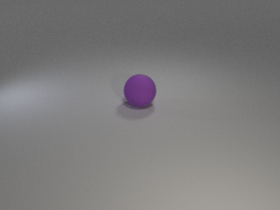
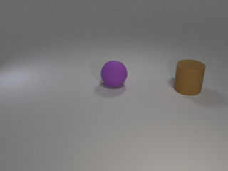
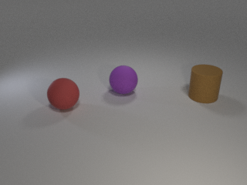
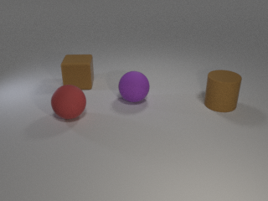
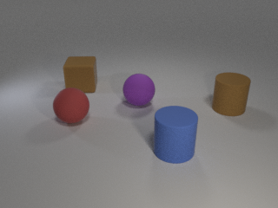
Lab Description - Dataset
Provided files
readme.txt, train.json, test.json, new_test.json, object.json, iclevr.zip, evaluator.py, checkpoint.pth
iclver.zip
On the open source google drive
object.json
Dictionary of objects
24 classes

Slide 12
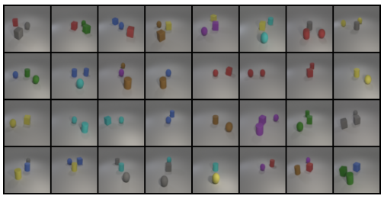
Lab Description – Output examples
Accuracy:0.821 on new_test.json

Slide 13
Lab Description – Requirements
Implement training, testing functions, and dataloader
Choose your DDPM architecture
Design your noise schedule, sampling function
Choose your prediction type and loss functions
Output the results based on test.json and new_test.json
Compute accuracy with provided evaluator on both testing set
Show your synthetic image grids of both testing flies and a progressive generation grid in your report

Slide 14
Scoring Criteria
Report (50%)
Introduction (5%)
Implementation details (20%)
Describe how you implement your model, including your choice of DDPM, UNet architectures, noise schedule, and loss functions. (15%)
Specify the hyperparameters (learning rate, epochs, etc.) (5%)
Results and discussion (25%)
Show your accuracy screenshot based on the testing data. (5%)
Show your synthetic image grids and a progressive generation image. (10%)
Discuss the results of different models architectures or methods. (10%) For example, what is the effect with or without some specific embedding methods, or what kind of prediction type is more effective in this case.

Slide 15
Scoring Criteria
Result (50%)
Classification accuracy on test.json and new_test.json. (25% + 25%)
Score >= 0.8 ---- 100%
0.8 > score >= 0.7 ---- 90%
0.7 > score >= 0.6 ---- 80%
0.6 > score >= 0.5 ---- 70 %
0.5 > score >= 0.4 ---- 60 %
score < 0.4 ---- 0%

Slide 16
Useful tech
https://huggingface.co/docs/diffusers/index
https://github.com/huggingface/diffusion-models-class

