Slide 1
Recent Surges in Ocean Transportation Rates and Their Effects on Selected Ag Markets
Michael K. Adjemian
The University of Georgia
William W. Wilson,
David W. Bullock, and Prithviraj Lakkakula
North Dakota State University

Slide 2
Supply Chain Developments in 2021
Aggregate demand increased sharply following COVID downturn, as pandemic-related labor issues (lockdowns/shortages) prevented supply buildup and smooth transportation of goods
Inventories in many industries drew down substantially
Effects in agriculture:
Increased demand for agricultural commodities and food
Sharply higher ocean shipping costs
Increased inland shipping costs
Rises in energy prices
Increased waiting times at ports and surcharges
Reports of difficulty securing outgoing containers (heterogeneity in effects on different export markets)

Slide 3
Rising real ocean shipping rates

Slide 4
We study the determinants and effects of ocean transport rates
How are ocean rates set?
In turn, how do ocean shipping rates affect:
U.S. maritime export levels of agricultural products
Prices received by agricultural commodity producers
Global export market share (for corn and soybeans, only)
We show that shipping backups affect ocean transport rates… it’s possible that they may also affect ag firm outcomes directly
We review the performance of ag sector stock indices in the face of supply chain pressure

Slide 5
Our main findings
Ocean freight rates rise with the demand for shipping, fuel prices, and destination port congestion; they fall with increases in fleet capacity
We cannot identify statistically significant effects of higher rates on U.S. maritime ag exports or prices received by producers, although short-run median effects are in a direction you might expect
Our models predict that the observed positive shock to ocean rates results in U.S. gains in the export market share for both soybeans and corn
Stock prices for indices representing the (publicly-traded) U.S. agricultural sector are up between 20-60% since January 2020, even as global supply chain pressure is the highest observed since at least the 1990s

Slide 6
Approaches
Measuring (1) ocean rates determinants, and (2) the effects they have on maritime export levels and producer prices <- Time Series Methods
Identify the set of time series models that are consistent with both the data and economic theory (e.g., increased demand raises prices), and measure how they predict variables will affect one another over time
Presented as “impulse response” charts, which show how, e.g., export levels have historically responded over time to a positive shock to ocean rates
Corn and soybean global market share <- Monte Carlo simulation model that optimizes theoretical trade patterns from export locations to importers under a cost-minimization framework
Incorporates a range of costs faced along the supply chain
Explains how exporters’ global market share changed given the observed ocean rate rises compared to what would have been observed without those rises

Slide 7
Data
Everything is collected at a monthly frequency
Bloomberg terminal: ocean rates (bulk: BDI; container: CCFI), energy prices, vessel capacity, export levels
BLS: producer prices (bulk: barley, corn, rice, sorghum, soy, wheat; container: almonds, beef, butter, cheese, chicken, eggs, milk, meat, oats, peanuts, pistachios, walnuts)
USATrade: maritime export levels (in weight)
Clarksons shipping intelligence: ocean rates, congestion
Thomson Reuters / Refinitiv: stock price indices for various components of the U.S. agricultural sector
Federal Reserve Bank of NY: supply chain pressure index

Slide 8
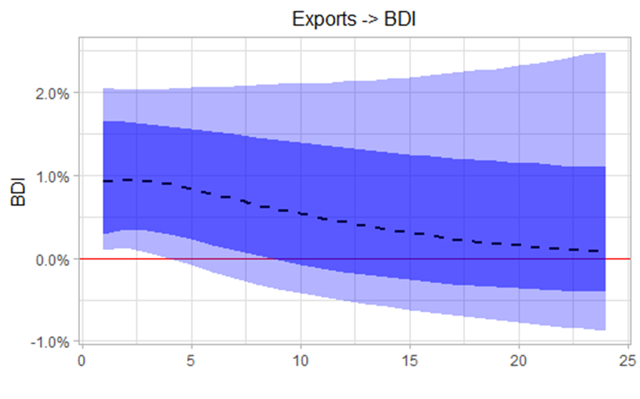
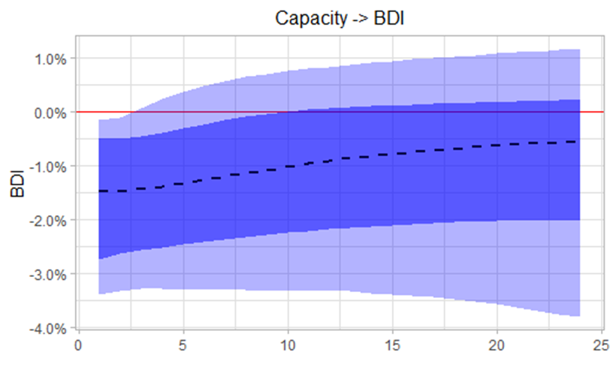
What explains ocean freight / bulk rises?
Short answer: the supply and demand for ocean freight services
Sources: Bloomberg, Clarksons shipping intelligence network, Trade Data Monitor and authors’ calculations.
Notes: The impulse response functions in this figure are estimated via a sign-identified BSVAR. The dashed line represents the modal model, the dark blue region is the range of the 68% credible set, and the light blue region is the 90% credible set.

Slide 9
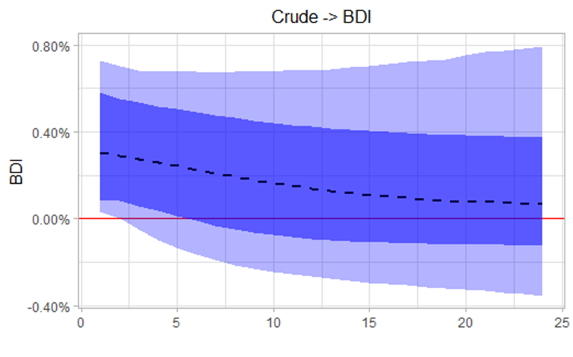
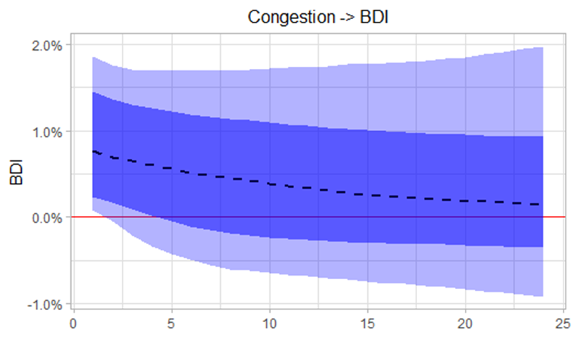
What explains ocean freight / bulk rises?
Congestion ties up capacity (reducing supply), and higher energy prices raise costs
Sources: Bloomberg, Clarksons shipping intelligence network, Trade Data Monitor and authors’ calculations.
Notes: The impulse response functions in this figure are estimated via a sign-identified BSVAR. The dashed line represents the modal model, the dark blue region is the range of the 68% credible set, and the light blue region is the 90% credible set.

Slide 10
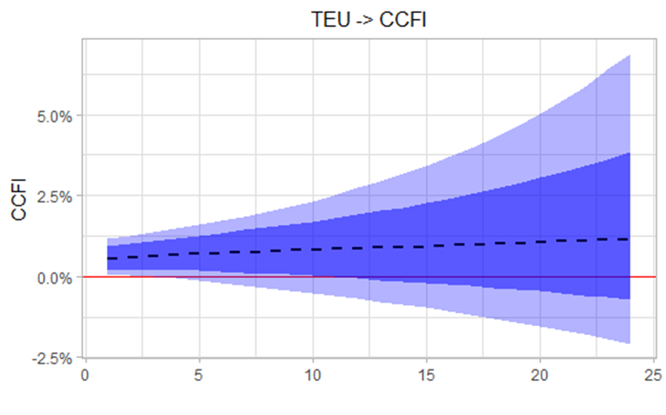
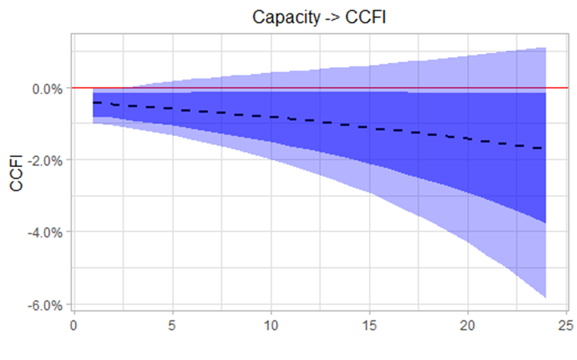
What explains ocean freight / container rises?
Likewise: the supply and demand for ocean freight services
Sources: Bloomberg, Clarksons shipping intelligence network, Trade Data Monitor and authors’ calculations.
Notes: The impulse response functions in this figure are estimated via a sign-identified BSVAR. The dashed line represents the modal model, the dark blue region is the range of the 68% credible set, and the light blue region is the 90% credible set.

Slide 11
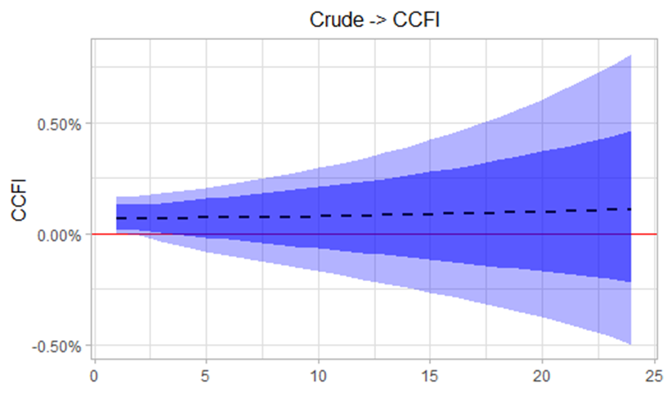
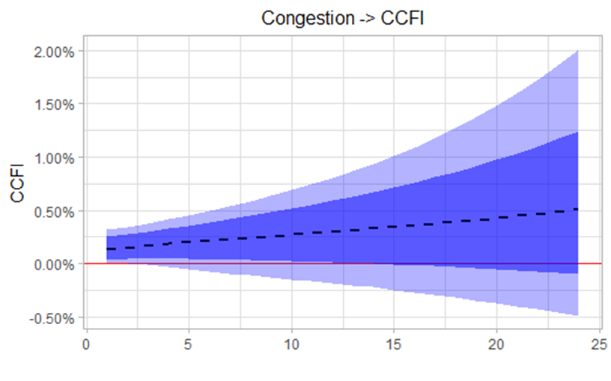
What explains ocean freight / container rises?
Similar results as in the bulk case
Sources: Bloomberg, Clarksons shipping intelligence network, Trade Data Monitor and authors’ calculations.
Notes: The impulse response functions in this figure are estimated via a sign-identified BSVAR. The dashed line represents the modal model, the dark blue region is the range of the 68% credible set, and the light blue region is the 90% credible set.

Slide 12
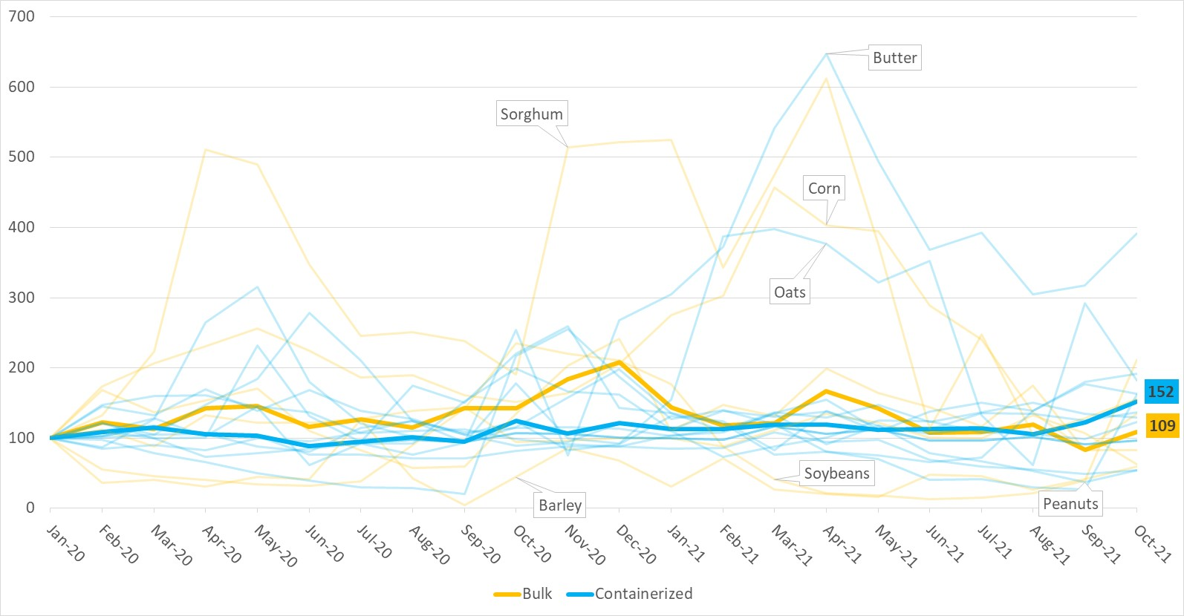
How did maritime ag export levels change during the pandemic (Jan 2020 = 100)?
Sources: USATrade, BLS, and authors’ calculations.

Slide 13
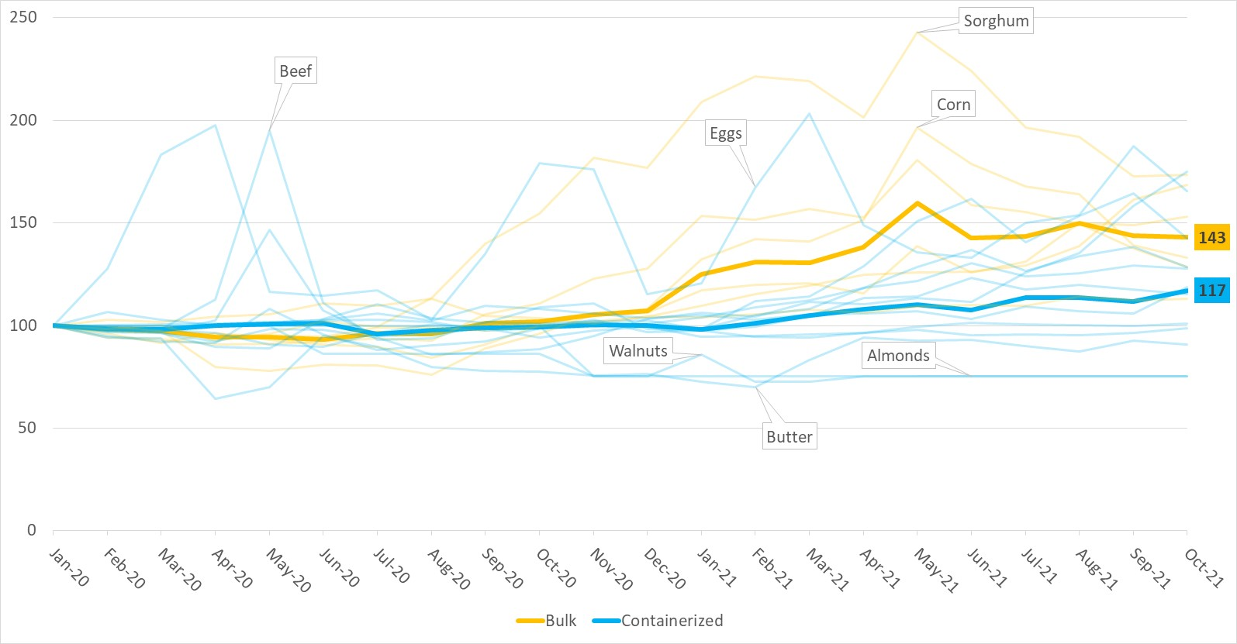
How did producer prices change during the pandemic (Jan 2020 = 100)?
Sources: USATrade, BLS, and authors’ calculations.

Slide 14
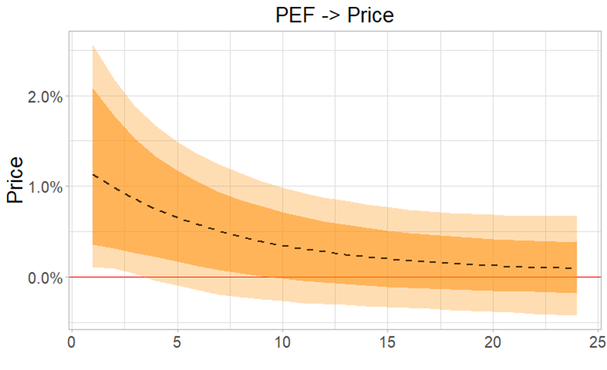
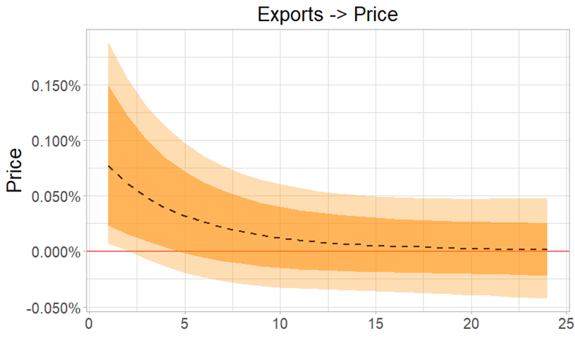
Effects of higher freight rates on U.S. Agriculture?
Representative example: peanuts
Sources: Bloomberg, BLS, USATrade, and authors’ calculations.
Notes: The impulse response functions in this figure are estimated via a sign-identified BSVAR. The dashed line represents the modal model, the dark orange region is the range of the 68% credible set, and the light orange region is the 90% credible set.

Slide 15
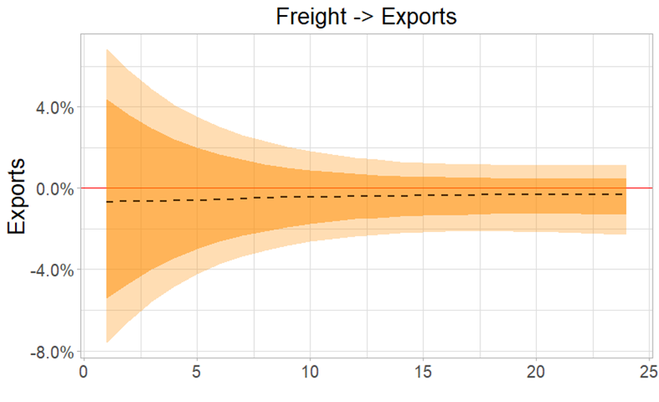
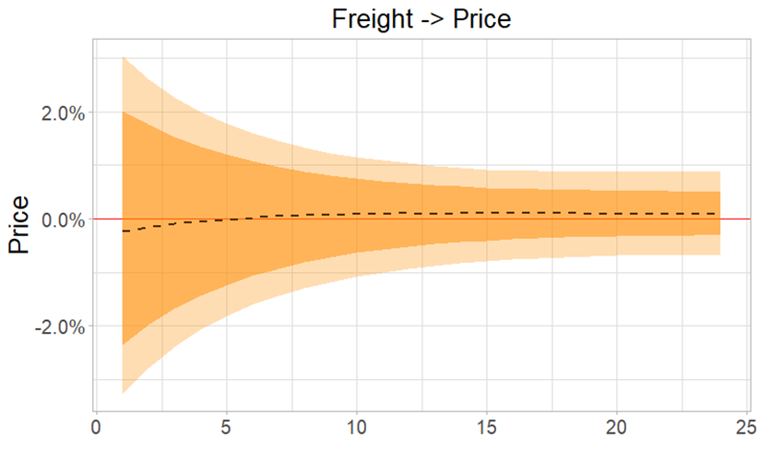
Effects of higher freight rates on U.S. Agriculture?
Can’t identify effects at any level of statistical significance, but short-run median effects are consistent with lower exports and prices
Sources: Bloomberg, BLS, USATrade, and authors’ calculations.
Notes: The impulse response functions in this figure are estimated via a sign-identified BSVAR. The dashed line represents the modal model, the dark orange region is the range of the 68% credible set, and the light orange region is the 90% credible set.

Slide 16
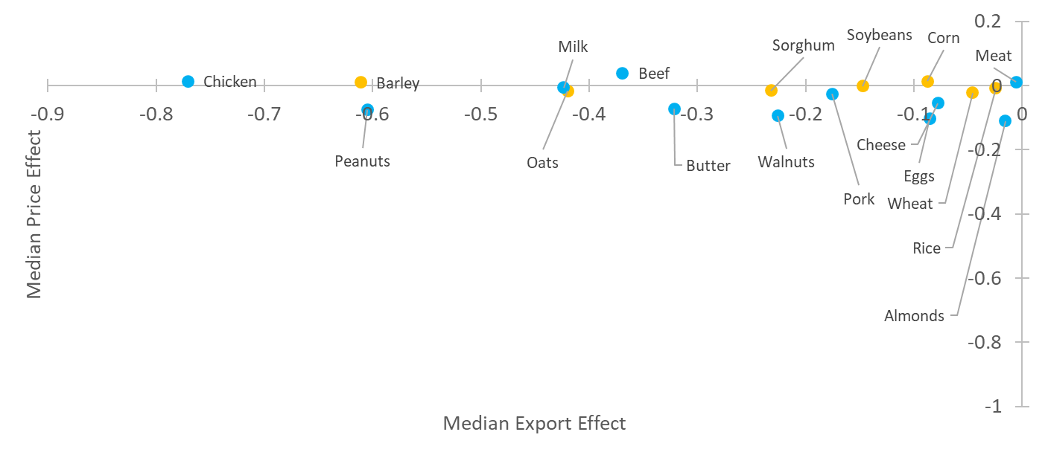
Median predicted short-run effects of higher freight rates on commodity markets
These are NOT statistically significant, but may be indicative
Sources: Bloomberg, BLS, USATrade, and authors’ calculations.

Slide 17
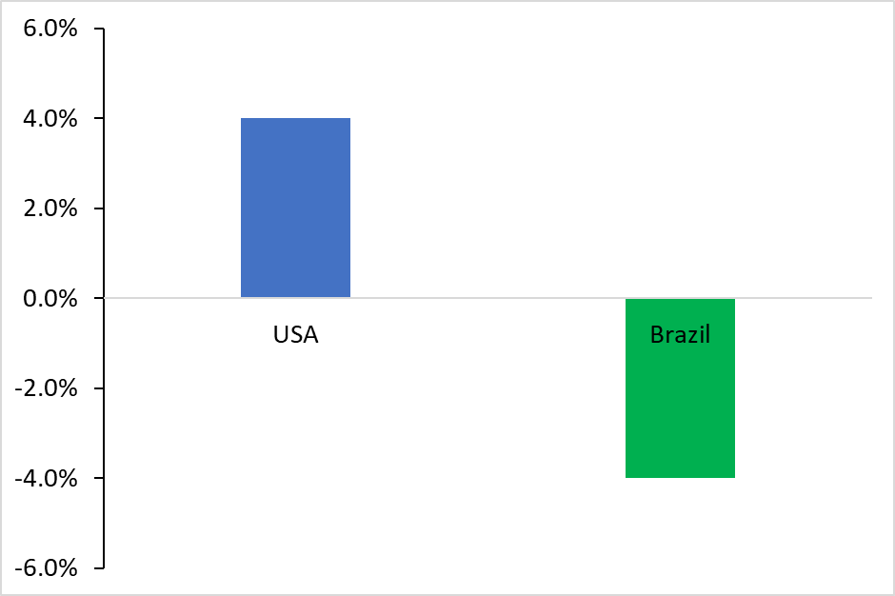
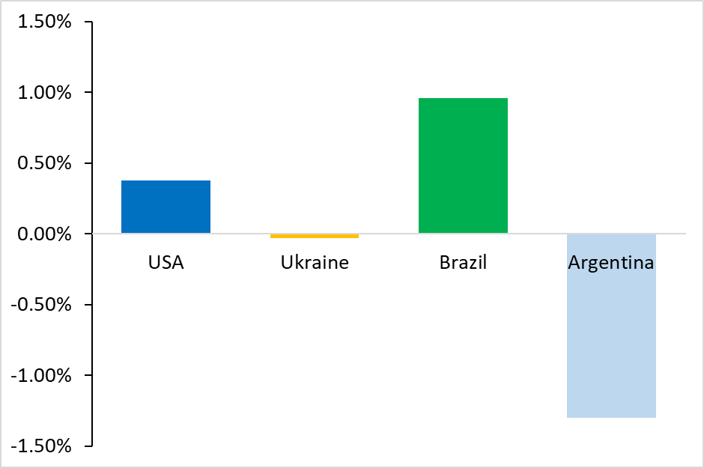
Effects of higher freight rates on U.S. Export Market Share?
We estimate USA gains market share in the corn and soybean cases
Soybeans
Corn
Sources: Bloomberg, USATrade, and authors’ calculations.

Slide 18
U.S. Ag Stock Price Indices are Up
Sources: Thomson Reuters / Refinitiv and authors’ calculations.

Slide 19
Findings and Implications
Broadly, maritime exports and producer prices haven’t measurably fallen in the face of recent ocean rate rises and supply chain problems
Our models produce predictions consistent with those observations
Increased supply chain pressure—so far—has not harmed equity indices for (publicly-traded) components of the U.S. ag sector
Indeed, equity prices for ag chemicals and fishing & farming are up over 60%, while those for food processing and food retail & distribution are up over 20% since January 2020

Slide 20
Findings and Implications
Maritime data (rates, throughput, congestion, vessel capacity, etc.) is not generally transparent or well-organized, complicating real-time analysis… Better publicly-available data will improve decision making across the supply chain
Congestion challenges and inventory risk will likely act to shorten supply chains
Congestion raises ocean rates and poses logistical challenges to U.S. agricultural exporters; infrastructure investments and policies that permit more throughput can ease that pressure
For example: the new Port of Oakland/USDA partnership pop-up site to help ag companies secure and fill empty shipping containers for export

