Slide 1
Overcoming the barriers to supply chain integration
Chapter 16

Slide 2
A Changing Business Landscape
The 21st century has brought:
Increased pace of business change
More volatile markets
Mergers, acquisitions, and new global competition
Customers now demand:
Higher quality
Faster service
Greater flexibility

Slide 3
The Responsive Organisation
Modern businesses must:
Put the customer at the center
Streamline systems for speed and reliability
Legacy structures: hierarchical, bureaucratic, and slow
De-layering is not enough without network and process reform

Slide 4
Building a Logistics Vision
A logistics vision defines:
How logistics creates value
A roadmap for supply chain transformation
Must reflect:
Competitive capabilities
Core differentiators
Customer value priorities

Slide 5
Defining Customer Value
Four key components of logistics value:
Better – superior quality/service
Faster – reduced lead times
Cheaper – cost-effective delivery
Closer – responsiveness to customer needs

Slide 6
Why Organizational Structure is the Main Barrier?
Functional silos dominate conventional organisations
Structures are rigid and resist change
Need for a paradigm shift in business thinking

Slide 7
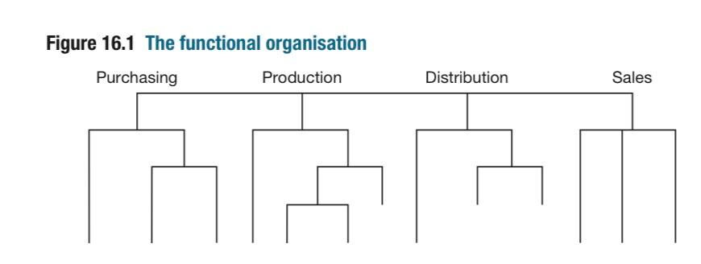

Slide 8
The Problem with Vertical Structures
Organised by function: purchasing, production, sales, etc.
Managers protect their domains (“barons”)
Functional budget control hinders cross-functional efficiency

Slide 9
Sub-Optimisation at Functional Boundaries
Functions try to optimise individually, causing:
Inventory build-up
Longer cycle times
Poor coordination
Example: bulk purchasing = cost saving, but = excess inventory

Slide 10
Inventory Conceals Demand Signals
Inventory across functions distorts visibility of true demand
Upstream teams respond to reorder points, not market signals
Leads to misalignment in production and procurement

Slide 11
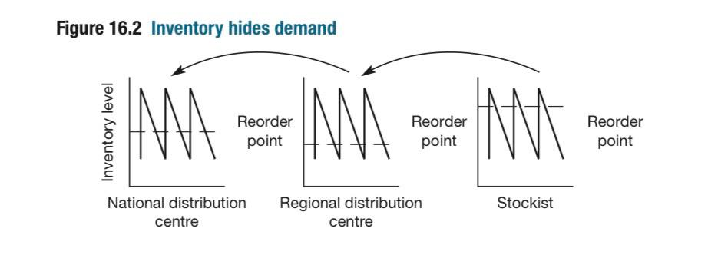

Slide 12
Lack of Cost Transparency
traditional accounting tracks inputs, not outcomes
Functional cost centres obscure full supply chain cost
Need for tools like:
Activity-Based Costing (ABC)
Throughput Accounting

Slide 13
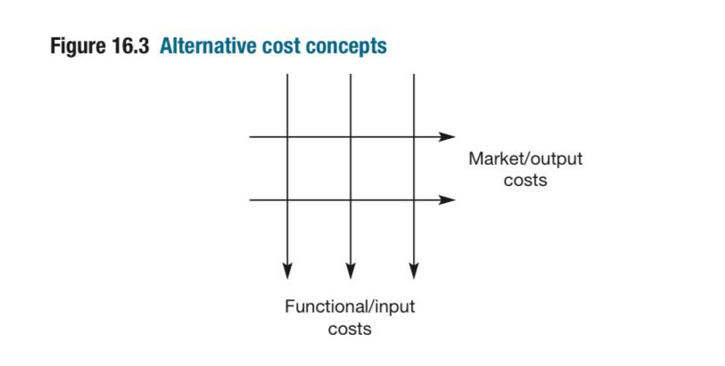

Slide 14
Example – Delivery Cost Variance
Same transport cost looks equal on paper
In reality:
Large DC delivery = low cost per unit
Remote, low-volume delivery = higher cost
These differences are often hidden in aggregate reports

Slide 15
Functional Barriers Damage Customer Service
Order-to-delivery = fragmented process
Sequential, not integrated
Causes:
Delays
Errors
Inefficiencies

Slide 16
The Relay Race Problem
Order flows sequentially:
Sales
Credit check
Planning
Production
Shipping
Invoicing
Each handoff = delay & disconnect

Slide 17
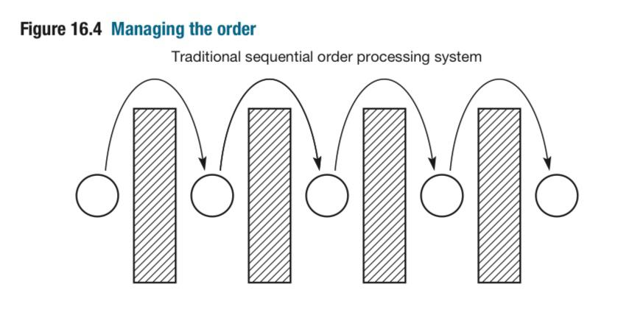

Slide 18
No Single Face to the Customer
Customers deal with multiple departments
No one owns the full customer experience
Leads to:
Frustration
Inconsistent service

Slide 19
Structural Reform – From Vertical to Horizontal
Add logistics “on top” ≠ true integration
True solution: horizontal, process-driven organisation

Slide 20
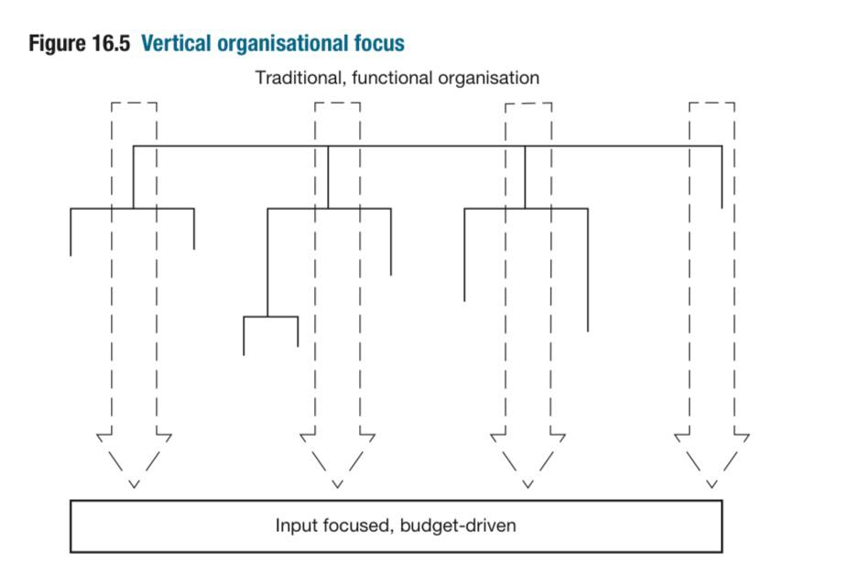
16.5

Slide 21
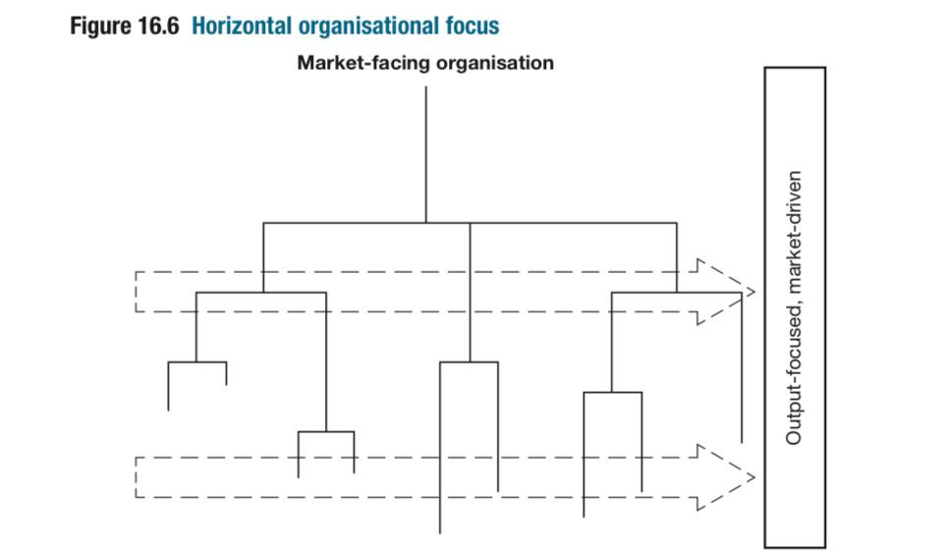

Slide 22
Features of Horizontal Organisations
Organised around end-to-end processes
Flat hierarchy, cross-functional teams
Driven by market-based metrics, not departmental inputs

Slide 23
Core Business Processes (Examples)
Innovation
Consumer development
Customer management
Supplier development
Supply chain management

Slide 24
From Functions to Teams
Traditional functions become centres of excellence
Cross-functional teams = process owners
Led by integrators focused on customer outcomes

Slide 25
Aligning Planning with Execution
Logistics = planning discipline
Links:
Production plans
Materials requirements
Distribution plans
Goal: production must align with real market demand

Slide 26
Order at the Heart of the Business
All activity must facilitate order fulfilment
Organisational structure must reflect the order flow
Planning, control, and IT systems aligned to fulfilment

Slide 27
The Customer Order Management System (COMS)
Integrates:
Order entry
Forecasting
Inventory management
Production
Procurement
Delivery
Input: market signals, promotions, price changes

Slide 28
Order Fulfillment Teams
Cross-functional “cells” own order cycle
Typically include:
Sales, credit, planning, logistics, finance
Placed together physically for fast coordination

Slide 29
Real-World Examples of Success
Ahlstrom:
Lead-time reduced: 1 week → 1 day
Variability reduced: 6 weeks → 1 week
Nashua Corporation:
Order entry: 8 days → 1 hour
40% space reduction
70% fewer customer claims

Slide 30
Manufacturing Cell Model
Model borrowed from lean manufacturing
Key traits:
Parallel execution
Fast handoffs
Collaboration across functions

Slide 31
From Relay Race to Rugby Team
Relay race:
sequential & dependent
Rugby team:
integrated & parallel
Collaboration boosts speed, quality, & service

Slide 32
Logistics as the Engine of Transformation
Traditional orgs = slow, siloed
Global complexity demands agility
Logistics = core driver of change

Slide 33
Hewlett-Packard Case Study
Global order management architecture
Shared visibility from order to shipment
Focus on customer-facing processes

Slide 34
IT Enables Organisational Change
Information systems shape structure
Market data drives internal activity
Real-time signals = better demand fulfilment

Slide 35
Focus on Core Competencies
Perform only what you do better than others
Outsource the rest
Logistics ensures alignment across all partners

Slide 36
Leadership Must Drive Change
Only top-down commitment can:
Break down silos
Reshape structures
Ensure logistics-led transformation

Slide 37
Schneider Electric Transformation (Overview)
€25B revenue, 183 factories, 14,000 suppliers
Delivered >150,000 order lines/day
20-year journey from siloed to customer-driven

Slide 38
STRIVE Framework
S = Sustainable
T = Trusted
R = Resilient
I = Intelligent
V = Velocity
E = Efficiency

Slide 39
Segmented Supply Chains
Based on:
Demand predictability
Customer intimacy
Tailored services & logistics for each customer type

Slide 40
Driving Engagement through Change Management
Key tools used:
Workshops
Presentations
Digital communications
Training

Slide 41
Measurable Results from Transformation
Improved “perfect order” rate
Cost savings
Gartner (2021):
#1 in Europe
#4 worldwide
Net-zero factory targets by 2025

Slide 42
Schneider’s Vision for the Future
Stuart Whiting (SVP):
“Sustainability is a journey of collaboration with our ecosystem.”
Core values:
Resilience
Responsible growth
Stakeholder partnership

Slide 43
Benchmarking as a Performance Tool
Performance = not just internal metrics
Must compare against:
Competitors
Industry leaders (best in class)
Customer expectations

Slide 44
Benchmarking – A Strategic Priority
Increasing competition has shifted performance focus:
From internal productivity
To comparative and best-practice performance
Benchmarking evaluates not just what we achieve, but how we achieve it, compared to others

Slide 45
Evolution of Performance Measurement
Traditional focus: internal measures (e.g. cost per unit, utilisation)
Problem: these lack context unless compared against:
Competitor performance
Industry best practices
Customer expectations

Slide 46
Competitive Benchmarking – Key Principles
Definition: Ongoing comparison of practices, processes, and results with best-in-class organisations
Aims to:
Achieve competitive advantage
Drive continuous improvement
Must be linked to customer-perceived value

Slide 47
Xerox – A Benchmarking Pioneer
Early adopter in manufacturing, later expanded to all functions
Key lesson: Processes (not just outputs) are benchmark able
Realized: Top performance requires looking beyond competitors

Slide 48
Broader Benchmarking Scope
Xerox expanded benchmarking beyond competitors to:
Non-competing firms
Industry leaders in other sectors
Result: Major improvements in productivity, creativity, and quality

Slide 49
Benefits of Benchmarking (Camp’s Framework)
Introduces breakthrough practices from other industries
Encourages open-mindedness and innovation
Reduces resistance to change by external validation
Reveals new technologies or approaches not yet adopted in the industry

Slide 50
SCOR Model A Standardised Framework
Developed by Supply Chain Council (now ASCM)
Built around 6 core processes:
Plan – Forecasting, scheduling, resource alignment
Source – Procurement and inbound logistics
Make – Manufacturing, production, value creation
Deliver – Order management, shipping, distribution
Return – Reverse logistics, warranty, recall handling
Enable – IT systems, compliance, KPIs

Slide 51
SCOR – Scope and Application
✅ Provides a common language for benchmarking logistics operations
✅ Useful for comparing across industries and functions
❌ Focuses on internal efficiency, less on inter-firm relationships

Slide 52
GSCF Framework Strategic Benchmarking
Developed by Douglas Lambert & Global Supply Chain Forum
Focuses on:
Supply chain relationship management
Cross-functional and cross-organisational partnerships
Complements SCOR by capturing relational and collaborative capabilities

Slide 53
Towards a Logistics Scorecard
Benchmarking helps define key performance indicators (KPIs)
Too many metrics = confusion; focus on mission-critical drivers
Use KPIs to track:
Strategic progress
Process efficiency
Customer experience

Slide 54
4-Step Scorecard Construction Framework
Define logistics/supply chain strategy – How does it support business objectives?
Identify measurable outcomes – Better, Faster, Cheaper, Closer
Map enabling processes – Which processes impact these outcomes?
Identify performance drivers – What activities drive success?

Slide 55
Logistics Scorecard Linking Metrics to Value
Strategic Goal | Example KPI
Better | % of Perfect Order Fulfilment
Faster | End-to-End Pipeline Time
Cheaper | Cost-to-Serve per Order
Closer | Customer Retention Rate
Balance internal & external KPIs
Align with both market needs and operational realities

Slide 56
The Role of Measurement in Driving Behavior
“What gets measured, gets managed.”
Old metrics often promote internal efficiency only
New metrics must promote:
Market orientation
Collaboration
Flexibility
The logistics scorecard becomes the engine of change

Slide 57
