Slide 1

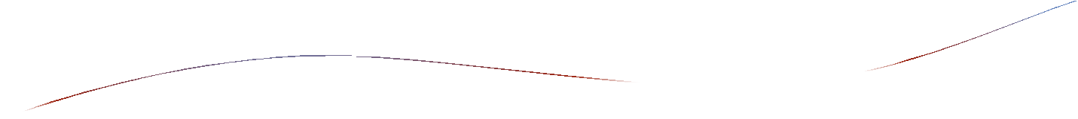




Slide 2

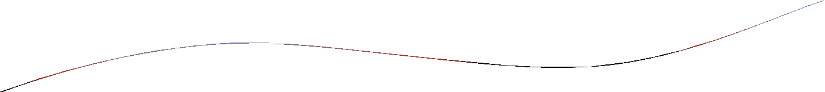
What is supply chain management ?
First one is that practically every product that reaches an end user represents a cumulative effort of multiple organizations. These organizations refers collectively as a supply chain.
The second idea is that while supply chain have existed for a long time , most organizations have only paid attention to what was happening within their “four walls ”. Very few organizations realized about delivering goods to final consumer .
SCM is the active management supply chain activities to maximize customer value and achieve a sustainable competitive advantage.

Slide 3

Meaning:
Supply chain:
Network of organizations and business process for procuring materials, transforming raw materials into the finished products and distributing the finished products to the customers.
Supply chain management :
Integration of suppliers , distributors and customer logistics
into one cohesive process.
Supply chain management process:
information system that automate the flow information between a firm and its suppliers in order to optimize the planning , sourcing , manufacturing and delivering of products and services.

Slide 4



SCM objectives:
SCM outcomes:
Objectives. Supply policies(service levels).
What?
Establish policies , objectives and
operating footprints.
Strategic
Network design.
How much?
Deploy resources to match supply with demand .
When ? Where?
Schedule , monitor , control and adjust production.
Demand forecast
Production ,procurement &logistic plan
Inventory target.
Tactical
Work center scheduling
Order/inventory tracking
Operational
Do:
Build and transport.
Order cycle Material movement.
Execution

Slide 5

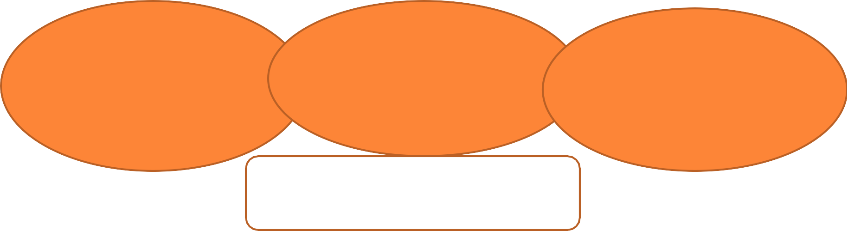
Customer value goals: Give customer what they want , when and how they want it , at low cost.
Business value goals: Rapid demand fulfillment.
Collaborative supply chain planning and execution.
Enterprise coordination of manufacturing and business process.
Effective distribution system
Responsiveness and accountability to customers.
Objectives of SCM

Slide 6

upstream
supplier
supplier
supplier
manufacturer
distributer
retailer
customer
supplier
supplier
supplier
downstream
fig: an example of supply chain.

Slide 7

Information system and SCM
Supply chain activities cover every thing from product development , sourcing , production and logistics as well as information system.
The organizations that make up supply chains are “linked” through physical flow and information flow. Physical flow involves transformation , movement and storage of goods & materials . Information flow allows various supply chain partners to co-ordinate their long term plans and control day to day flow of goods and materials forward and backward. One of the strategy to effective mgmt of supply chain is “just-in-time ” strategy.

Slide 8

Some uncertainties in supply chain are uncertain product demand , late shipment from suppliers , defective parts or raw materials , production process break down.
One of the recurring problem in SCM is “bullwhip” effect.
The bullwhip effect :
Inaccurate information can cause minor fluctuations in demand for the product to be amplified as one moves further back to supply chain. Minor fluctuation in retail sales for a product can create excess inventory for distributors , manufacturers and suppliers.

Slide 9

How information system facilitate SCM
 Information from supply chain management system helps firms
Decide when and what to produce , store and move
Rapidly communicate others
Track the status of orders
Check inventory availability and monitor inventory levels.
Reduce inventory , transportation and warehouse cost
Track shipments
Plan production based on actual customer demand
Rapidly communicate changes in product design.

Slide 10

Supply chain management software
Supply chain planning system: it enables the firms to model its existing supply chain , generate demand forecast for product and develop optical sourcing and manufacturing plans.
Supply chain execution system: it manage the flow of products through distribution centers and warehouse to ensure that products are delivered to right location in most efficient manner.
Supply chain management software vendors are SAP , Oracle PeopleSoft , Manugistics , i2 technologies etc.

Slide 11

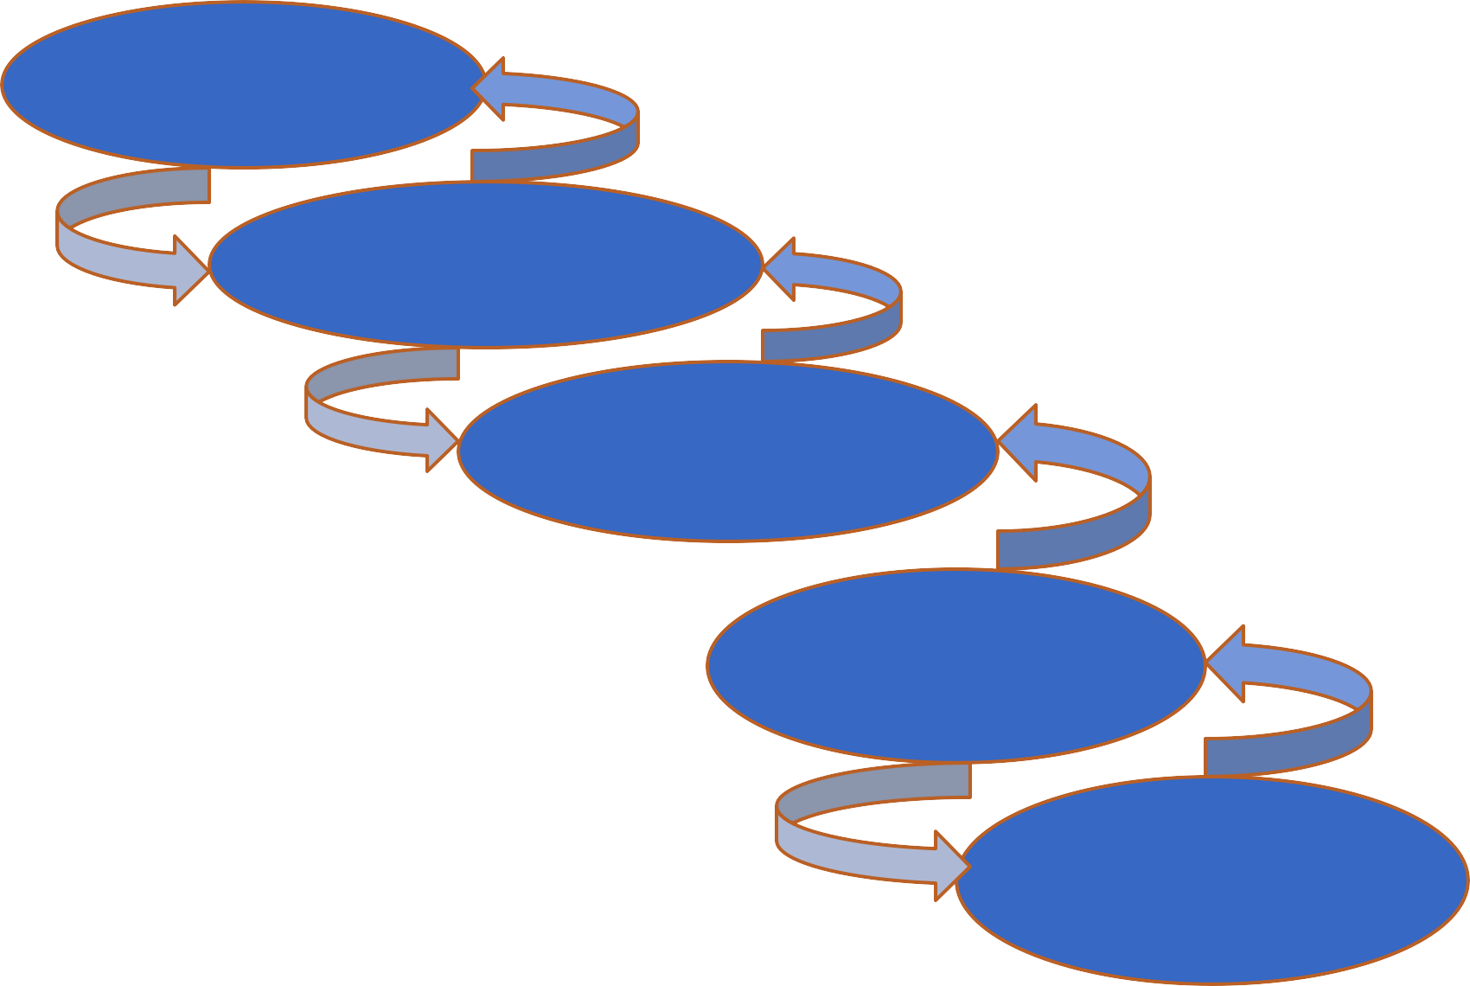
Each interface in the supply chain represents:
Movement of goods Information flow Transfer of title Purchase and sale
Raw material
Component
Manufacturer
Strategic SCM consists of developing smarter ways to: Choose
Buy from and
Sell to your business partners
Retailer
Consumer

Slide 12

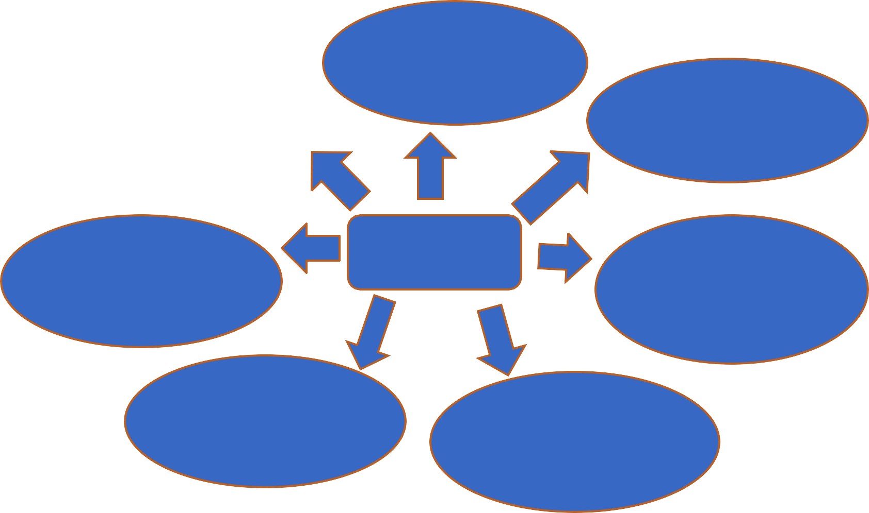
SCM addresses challenges through several areas.
Supply chain
strategy
Logistics
Supply chain planning
Product life cycle management
SCM
Supply chain enterprise application
Procurement
Assets
management

Slide 13

GLOBAL SUPPLY CHAIN AND INTERNET
 Intranet is used by firms to improve coordination among their internal supply chain process and they use extranet to coordinate among business partners and customers .

Slide 14


USE OF INTERNET IN SCM
Planning and scheduling
Order processing
Suppliers
Procurement
Customers
Logistics service
Shipping
Production
Retailers
Inventory
Distributors

Slide 15

Demand driven supply chains
Push versus pull based supply chain models: Push model:
Supplier
Manufacturer
Distributer
Retailer
Customer
Supply to
production based inventory based stock based
purchase what
Forecast
Pull model:
on forecast
on forecast
on forecast
is available
Supplier
Manufacturer
Distributer
Retailer
Customer
Supply to
Order
produce to order
automatically replenish warehouse
automatically
replenish stock
customer
orders

Slide 16

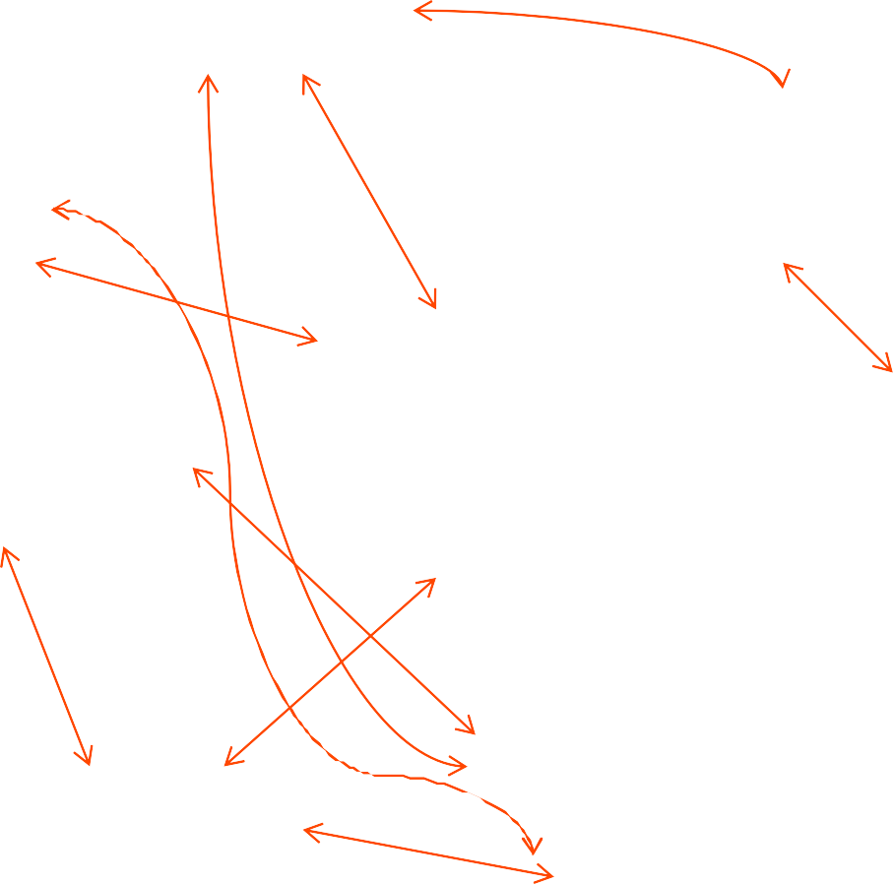
Future internet driven supply chain operates like a digital nervous system.
Distributors
Retailers
Manufacturers
Suppliers
Virtual manufacturers
Logistic providers
Customers
Private industrial networks Net market place
Logistics exchange
Contract manufactures

Slide 17




