Slide 1
Crop disease prediction using CNN
Deep Learning karthikeyan k 2018103549
Sathish kumar 2018103588

Slide 2
IntroductioN
When plants and crops are affected by pests it affects the agricultural production of the country.
Usually farmers or experts observe the plants with naked eye for detection and identification of disease. But this method can be time processing, expensive and inaccurate.
Automatic detection using image processing techniques provide fast and accurate results

Slide 3
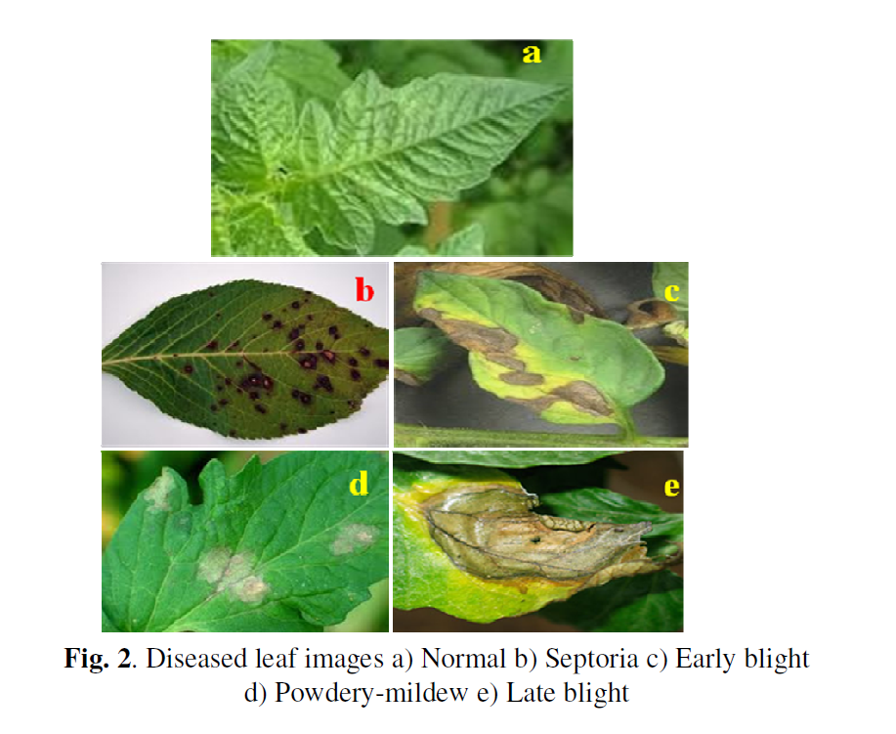
Objectives and dataset
To predict the type of plant disease from the image using CNN
The Dataset was taken from kaggle of PlantVillage dataset.

Slide 4
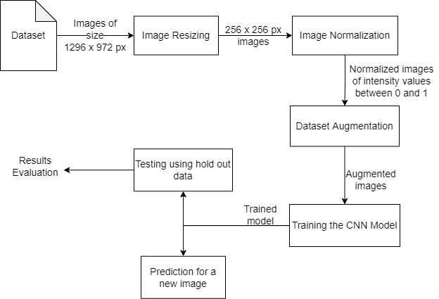
Methodology diagram

Slide 5
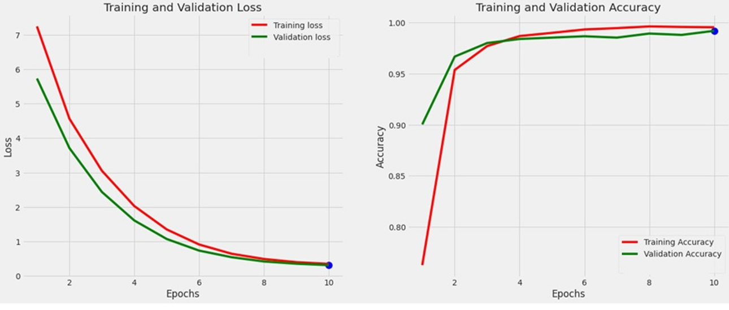
performance

