Slide 1
Final Year Project: Review 1 Public Event Crowd Management
Team Details
1CR20IS084 : Krishna Kant Gupta
1CR20IS094: Mohit Abhishek
1CR20IS082: Kinshuk Kumar
Under the Guidance of
Dr. Ciyamala Kushbu S
Assistant Professor
Information Science & Engineering

Slide 2
AGENDA
1. Motivation
2. Literature Survey
3. Methodology
3.1 Module Description
3.2 Metrics
4.Work Progress
5.Timeline

Slide 3
MOTIVATION
The motivation for exploring pushing behavior in crowded settings stems from the increasing urbanization and frequent occurrences of high-density crowds at public events.
Understanding and mitigating pushing dynamics are crucial for ensuring the safety and well-being of attendees. Manual identification of pushing behavior is impractical, prompting the need for an automated approach.
The potential threats posed by pushing incidents underscore the urgency of developing advanced technologies, such as computer vision and deep learning, to analyze crowd behavior in real-time.

Slide 4
LITERATURE SURVEY
Publication | Synopsis/Summary | Year
Crowds in front of bottlenecks from the perspective of physics and social psychology | A guiding system in front of an entrance can reduce pushing of the waiting people and thus the density at the entrance. | 2018
Pushing and non-pushing forward motion in crowds: A systematic psychological observation method for rating individual behavior in pedestrian dynamics. | Pushing behavior impairs people’s sense of well-being in a crowd and represents a significant safety risk | 2022
A fast hybrid deep neural network model for pushing behavior detection in human crowds. | This research introduces a high-speed hybrid deep neural network for swift and accurate detection of pushing behavior in human crowds. Combining the strengths of convolutional and recurrent neural networks, the model prioritizes real-time processing without sacrificing precision. Incorporating attention mechanisms enhances its sensitivity to subtle crowd dynamics, making it a promising solution for applications in public safety and video surveillance. | 2022

Slide 5
LITERATURE SURVEY
Publication | Synopsis/Summary | Year
Anomaly detection in videos using optical flow and convolutional autoencoder. | The widespread use of surveillance systems reduces security concerns while creating an amount of video data that cannot be examined by people in real-time. | 2019
Abid Mehmood. Lightanomalynet: A lightweight framework for efficient abnormal behavior detection. Sensors, | It defines human falls, some kinds of suspicious behavior, and violent acts as abnormal activities, and discriminates them from other (normal) activities in surveillance videos. | 2021
Energy levelbased abnormal crowd behavior detection. | This research introduces an innovative abnormal crowd behavior detection system leveraging energy metrics derived from spatial and temporal crowd dynamics. By modeling normal behavior and employing machine learning, the system identifies anomalies in real-time, offering a proactive approach for public safety and event management. | 2018

Slide 6
PROBLEM STATEMENT
Design and implement an intelligent public event crowd management system that ensures the safety, security, and convenience of event attendees, while also optimizing the use of event space and resources. The system should be capable of real-time crowd monitoring, behavior analysis, and response coordination to prevent overcrowding, mitigate risks, and enhance the overall event experience.

Slide 7
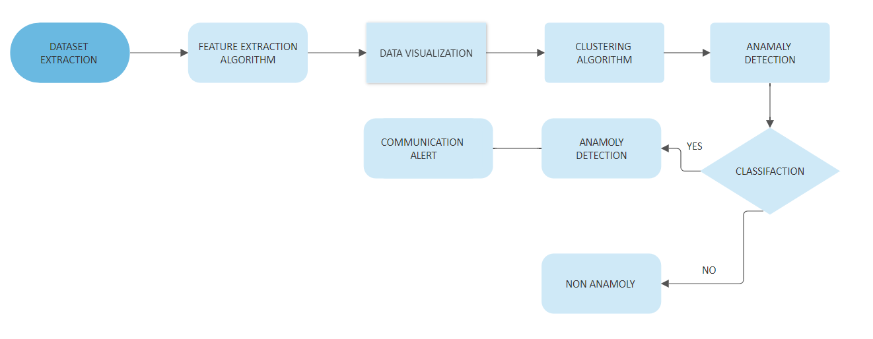
METHODOLOGY

Slide 8
EXPLANATION
Dataset Extraction:
Videos serve as the primary input data. The dataset comprises of multiple videos and the model is designed to analyze and detect anomalies within this video data.
Features Extraction Algorithm:
The second step deals with extracting features from the input videos.Feature extraction algorithms, including deep learning methods like Convolutional Neural Networks (CNNs) for spatial features and optical flow for motion information in video data.
Data Visualization:
Visualization tools like Matplotlib are used, and real-time or interactive visualizations may be included for enhanced comprehension.

Slide 9
EXPLANATION
Clustering Algorithm:
Its role in anomaly detection within video data, and demonstrates outcomes, emphasizing improved anomaly detection performance.
Anomaly Detection:
its distinctive features for identifying anomalies in the project's context. Highlight the broader implications, such as enhancing security or system performance.
Communication Alert:
Specify alert-triggering conditions (anomalies) outline alert channels (email, SMS) to organizers and administrators, and provide a concise response protocol for timely and effective actions upon receiving alerts in the project.

Slide 10
MODULE DESCRIPTION
Computer Vision:
It can process images and videos to identify objects, faces, or even the handwriting of a human.
Installation command
pip install opencv-python
System Libraries:
os,sys,io,time,math
Object Detection Libraries:
YOLO(You Only Look Once)

Slide 11
MODULE DESCRIPTION
Data Visualization:
MatPlotlib: It is used for visualization
Installatiom command
pip install matplotlib
Usage
import matplotlib.pyplot as plt
Video Processing: cv2
Classification Metrics:
sckit-learn
Clustering Algorithms:
DBSCAN
Anomaly Detection:
SVM

Slide 12
METRICS
TYPE | METRIC | USE CASE

Slide 13
WORK PROGRESS
In the preliminary stage we looked upon a major problem with regards to crowds in cities. The population is unevenly spread and is increasing at a rate of 3.15% in metro cities like Bengaluru.
We identified a key area- crowd monitoring where our motto is to work on loopholes that can actually create serious problems-anomaly detection.
We surveyed different papers ranging from bottlenecks to present day pushing instances to identify behavioral patterns and the necessary steps that can be taken.

Slide 14
TIMELINE
OCTOBER
NOVEMBER
DECEMBER
Problem statement selection
Literature survey and plan of action
IMPLEMENTATION
PUBLIC EVENT CROWD MANAGEMENT
Surveying papers, designing a plan of action, selection of apt algorithms
EXPLORATORY DATA ANALYSIS, ANOMALY DETECTION,

Slide 15


