Slide 1
Final Year Project: Review 2 Public Event Crowd Management
Team Details
1CR20IS084 : Krishna Kant Gupta
1CR20IS094: Mohit Abhishek
1CR20IS082: Kinshuk Kumar
Under the Guidance of
Dr. Ciyamala Kushbu S
Assistant Professor
Information Science & Engineering

Slide 2
AGENDA
1. Problem Statement
2. Methodology
3. Implementation Specifications
3.1 Stage-1
3.2 Stage-2
4.Work Progress
5.Timeline

Slide 3
PROBLEM STATEMENT
Design and implement an intelligent public event crowd management system that ensures the safety, security, and convenience of event attendees, while also optimizing the use of event space and resources. The system should be capable of real-time crowd monitoring, behavior analysis, and response coordination to prevent overcrowding, mitigate risks, and enhance the overall event experience.

Slide 4
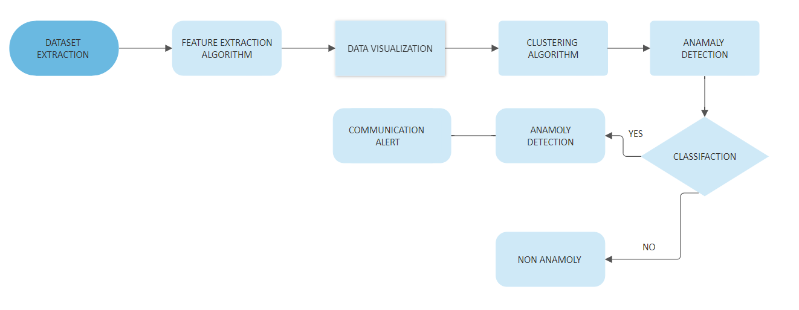
METHODOLOGY

Slide 5
IMPLEMENTATION SPECIFICATIONS
PREFERRED IDE:
GOOGLE COLABORATORY
--RUNTIME ENVIRONMENT- GPU/TPU ENABLED
--MOUNT GOOGLE DRIVE
KAGGLE KERNELS
JUPYTER NOTEBOOK
DATASETS:
AVENUE DATASET
16 training videos and 21 testing videos
https://www.cse.cuhk.edu.hk/leojia/projects/detectabnormal/dataset.html
UCSD DATASET
LIBRARIES AND INSTALLATIONS
numpy, sklearn, Keras, tensorflow-gpu, h5py, scipy, skimage, ffmpeg

Slide 6
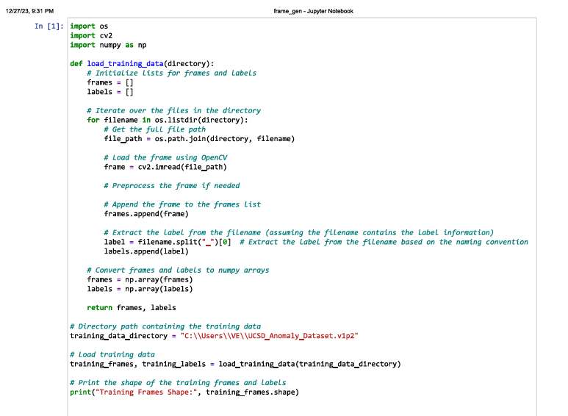
STAGE-1: DATASET INPUT

Slide 7
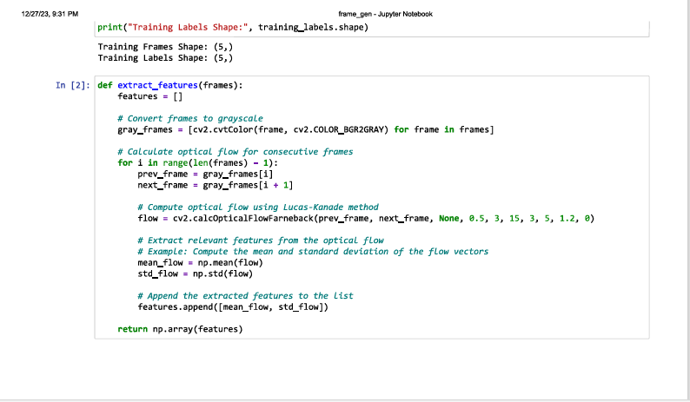
STAGE-1

Slide 8
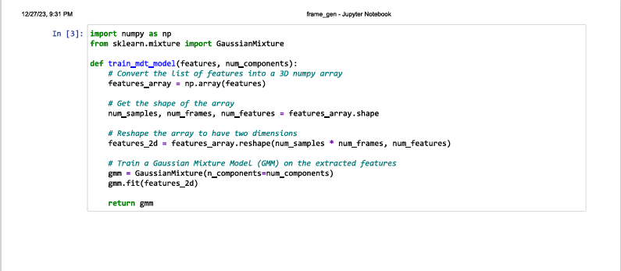
Features to array conversion

Slide 9
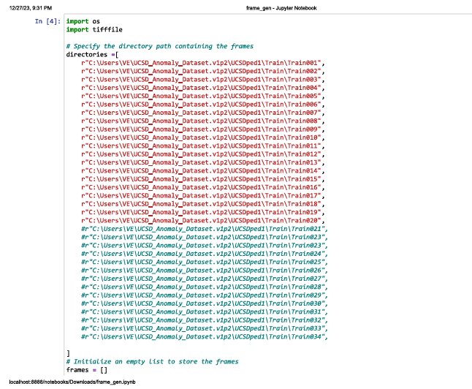
Specifying the directories

Slide 10
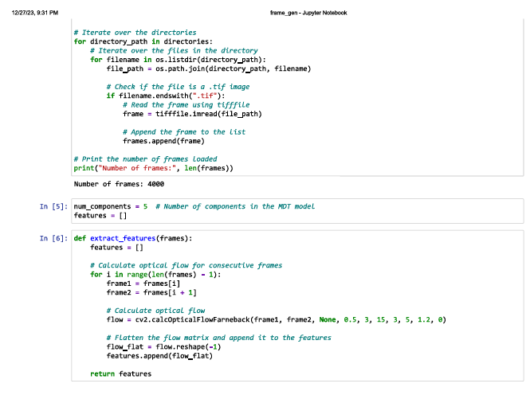
Stage-2 Feature Extraction
Directory specification and feature extraction

Slide 11
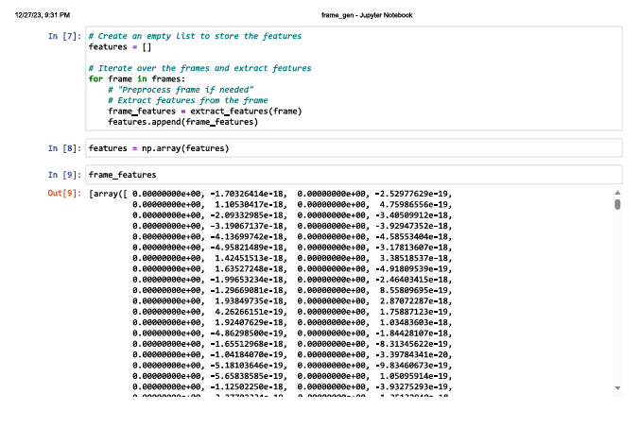
Frame Features

Slide 12
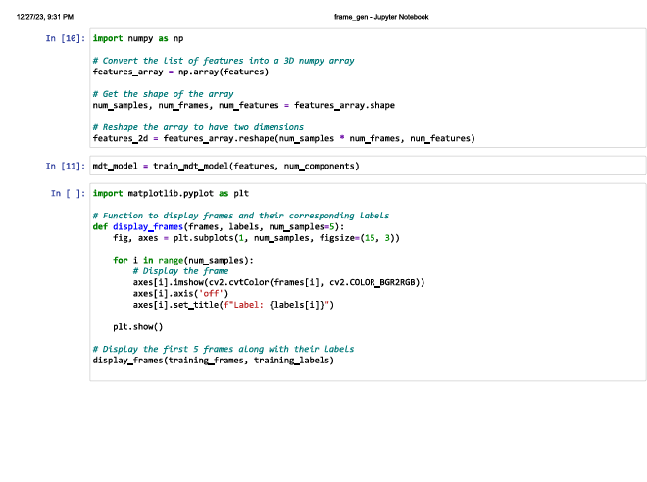
Training the MDT model

Slide 13
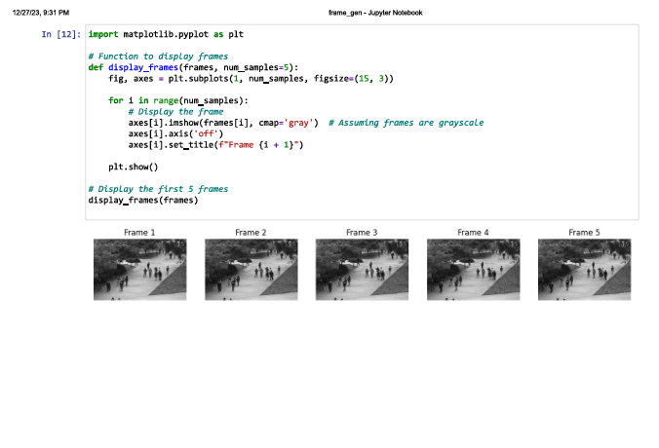
Displaying the frames

Slide 14
WORK PROGRESS
Performing Exploratory Data Analysis(EDA) on a number of datasets to gain insights
Worked out on a few CNN based models to understand the nature of frame extraction
Completed 2 stages of the project- frame generation and feature extraction. Data visualization phase is in progress.

Slide 15
TIMELINE
OCTOBER
NOVEMBER
DECEMBER
Problem statement selection
Literature survey and plan of action
IMPLEMENTATION
PUBLIC EVENT CROWD MANAGEMENT
Surveying papers, designing a plan of action, selection of apt algorithms
EXPLORATORY DATA ANALYSIS, ANOMALY DETECTION,

Slide 16


