Slide 1
5th Semester Mini project: Review 2 Twitter Sentiment Analysis
Team Details
1CR20IS084 : Krishna Kant Gupta
1CR20IS092: Manvanth B V
1CR20IS082: Kinshuk Kumar
Under the Guidance of
Prof. P. Devisivasankari
Assistant Professor
Information Science & Engineering

Slide 2
PROBLEM STATEMENT
To implement Twitter Sentiment Analysis model that helps to overcome the challenges of identifying the sentiments of the tweets.

Slide 3
AGENDA
Abstract
Proposed Methodology
Implementation details
Work Completed
Work yet to complete
Conclusion

Slide 4
ABSTRACT
Sentiment analysis refers to identifying as well as classifying the sentiments that are expressed in the text source. Tweets are often useful in generating a vast amount of sentiment data upon analysis.
Sentiment analysis is an NLP technique that allows to classify if a text or comment is either positive,negative or neutral.

Slide 5
ABSTRACT
Analysing the public sentiment is important for many applications such as firms trying to find out the response of their products in the market, predicting anti-national speech and hate-speeches and political agendas and predicting socio-economic phenomena such as stock exchange
The aim of this project is to develop a functional classifier for accurate and automatic sentiment classification of an unknown tweet stream

Slide 6
LITERATURE SURVEY
The paper [1] (Kaur, 2015) describe regarding geographic area flood information set collected from twitter and realize the opinion of individuals. They used Naive Bayes formula for the classification of information and result they got 67% accuracy. They collected several resolution from the individuals that are useful for each government and non-government organization to handle such scenario in an exceedingly higher manner. These strategy is simpler than lexicon-based formula

Slide 7
LITERATURE SURVEY
The paper [2] (Paul, 2017) describe regarding the ultimate match of Indian premier league sport event 2015. Objective of this paper is to research standardity {the recognition} of IPL match and that player are popular and that team is dominate. They need used Hadoop and Map cut back artificial language. They got result like MS Dhoni is most talked regarding player and metropolis Indians team fairly dominated. This technique gave higher result.

Slide 8
LITERATURE SURVEY
The paper [3] (Mittal, 2016) describe the requirement and impact of the sentiment analysis on online platform. They need additionally bestowed a listing of sentiments of emotions, interjections and comments that are extracted from posts and standing updates. They need results to knowing whether or not {the on-line the web the net} reviews and posts are being useful to client or not and that online websites being most popular by the purchasers.

Slide 9
LITERATURE SURVEY
The paper [4] (Anto, 2016) describe the merchandise rating mistreatment sentiment analysis. In promoting of any product the producer can get the proper result from the client feedback. After got feedback they'll changes to his product in step with the feedback. Some users continually fail to convey their feedbacks. Objective of this paper is to avoid the problem of providing feedbacks and supply the technique which might provide automatic feedback on the premise of information collected from twitter. They used the technique SVM and got result eightieth accuracy. This system offer quick and valuable feedback.

Slide 10
Hardware/Software
Specification
Hardware Specification:
Core I3 10th Generation
64-bit operating system, x64-based processor
Installed RAM: 8 GB
Version:21H1

Slide 11
Software Specification &
Implementation Details
Language- Python
I.D.E.- Jupyter Notebook
Libraries- Numpy,pandas,matplotlib,re,seaborn,nltk

Slide 12
Motivation
We have chosen to work with twitter since it is a better approximation of public sentiment as compared to conventional internet articles and website blogs
The response of twitter is more prompt and also more general
Twitter under the power of some individuals has the ability to change the macro-scale socioeconomic phenomena. Eg: A tweet from Elon Musk can drastically change the stock market rate of a particular firm so his freedom to tweet is monitored by a government organisation in US.

Slide 13
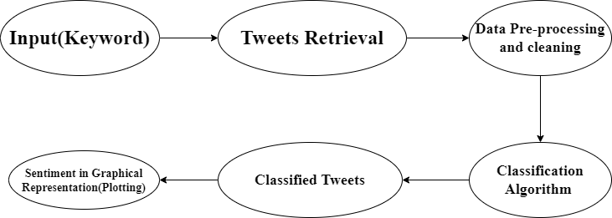
Proposed Methodology

Slide 14
Data Pre-processing
Pre- processing of tweets include:
Removing punctuations, hyperlinks and hashtags
Tokenization
Converting words to lower cases
Removing stop words
Lemmatization/stemming:Transforming a word to its root word

Slide 15
NLTK
Natural Language Toolkit (or NLTK) is a suite of libraries and programs for symbolic and statistical natural language processing (NLP) for English written in the Python Programming language.
NLTK is intended to support research and teaching in NLP or closely related areas, including empirical linguistics, cognitive science, artificial intelligence, information retrieval, and machine learning.

Slide 16
Vader_lexicon
VADER (Valence Aware Dictionary and Sentiment Reasoner) is a lexicon and rule-based sentiment analysis tool that is specifically attuned to sentiments expressed in social media, and works well on texts from other domains.
The VADER lexicon is an empirically validated by multiple independent human judges, VADER incorporates a "gold-standard" sentiment lexicon that is especially attuned to microblog-like contexts.

Slide 17
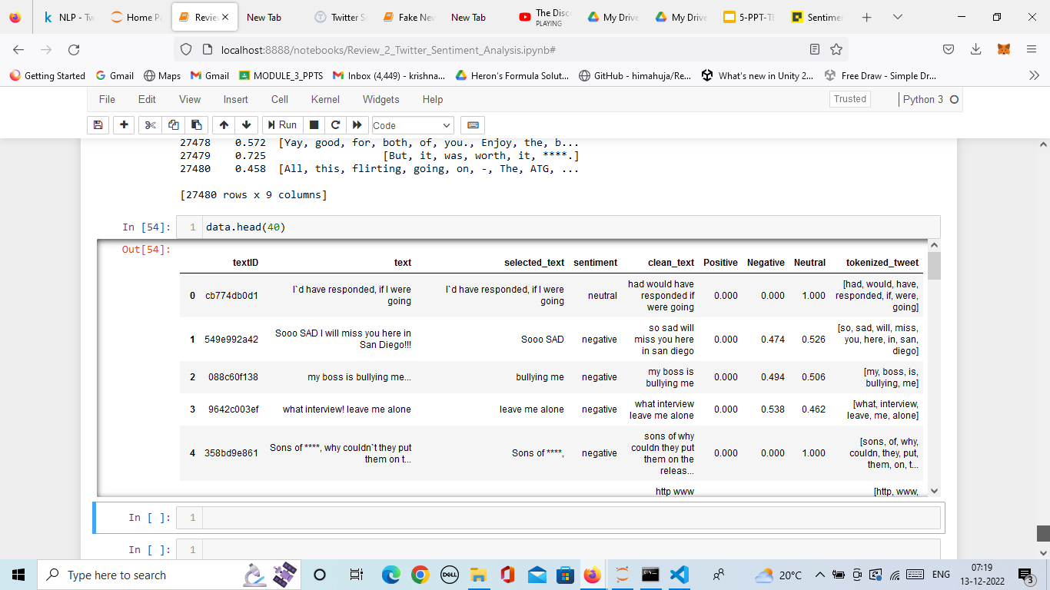
Screenshots

Slide 18
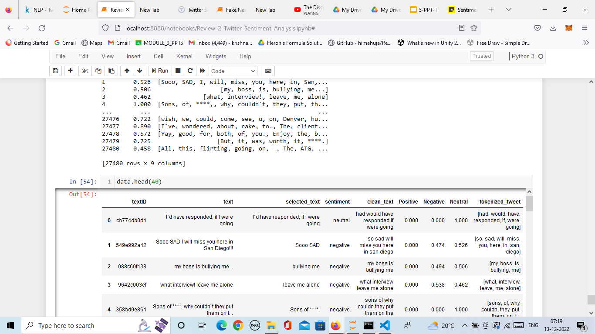
Screenshots

Slide 19
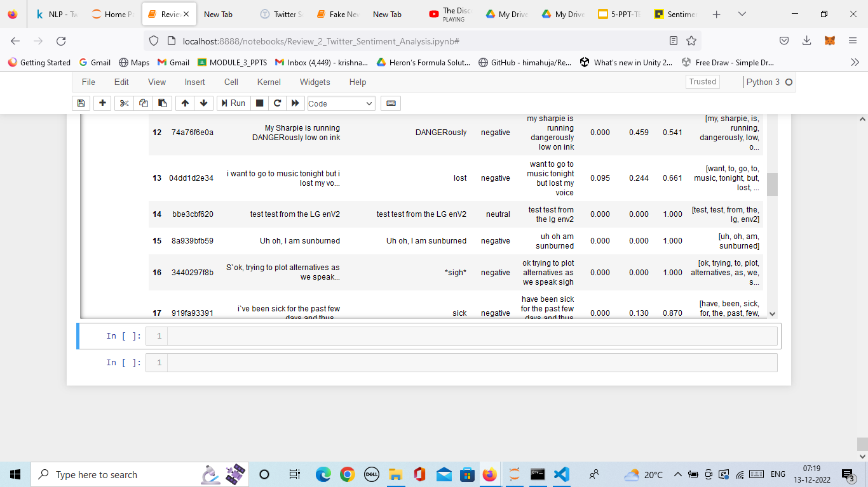
Screenshots

Slide 20
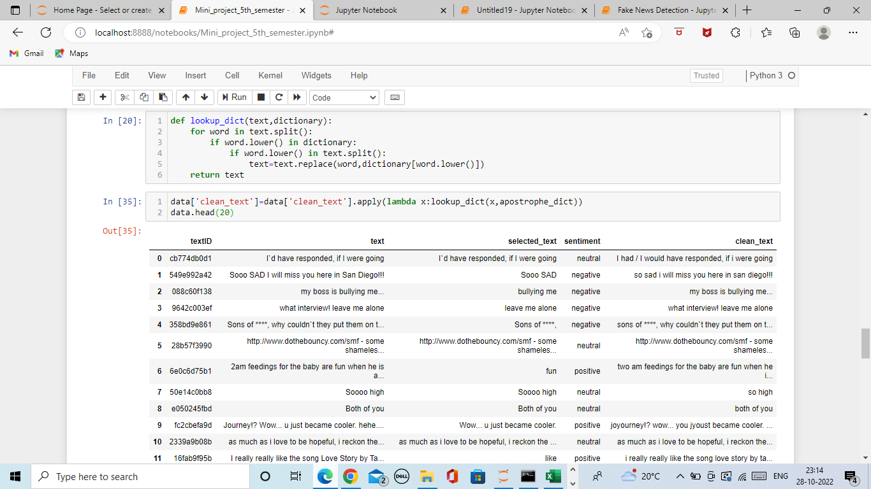
Screenshots

Slide 21
Work to be done/completed
Work completed: Data preprocessing and cleaning and calculated the sentiment scores using NLTK
Work to be done: To use a ML supervised learning algorithm for classification and to represent the sentiment data graphically using matplotlib,seaborn and wordcloud libraries
Note:TextBlob and WordCloud did not work in Jupyter Notebook

Slide 22
Conclusion
We have completed the data-preprocessing and cleaning part of the Twitter Sentiment Analysis dataset

Slide 23


