Slide 1

Improving Predictions of Which NCAA Players Are Most Likely to Be Drafted into NBA
Data Science in Sports
Sucheng Li
Notes:
https://www.espn.com.au/nba/story/_/id/45179882/2025-nba-mock-draft-projecting-all-59-picks-post-combine-cooper-flagg-dallas-mavericks

Slide 2
Introduction
Background:
The NBA (National Basketball Association) Draft is the primary pathway for NCAA (National Collegiate Athletic Association) players to enter professional basketball league.
Hundreds of college players declaring for the draft each year. However, only 60 players are selected in the two-round NBA Draft.
Despite media exposure and scouting reports, draft decisions still rely heavily on subjective evaluations rather than data-driven insights.
This project aims to build a predictive model that uses machine learning to enhance draft forecasting accuracy and scouting efficiency.
Value of this project and Business Model:
This project uses data science to improve NBA draft predictions by analyzing player performance, physical attributes, and historical draft trends. The project reduces selection risks, improves accuracy, and increases efficiency in talent selection.
Similar predictive approaches can also enhance fairness and decision-making in recruitment, education, and other talent-focused fields.

Slide 3
Data Sources and Characteristics
Data Source 1: NBA Daft History from the official NBA stats site (National Basketball Association, n.d.), including draft results, player names, draft year, and pick numbers.
https://www.nba.com/stats/draft/history
Moderate Volume, Low but Necessary Variety, Low Velocity (updated annually), High Veracity
Data Source 2: NCAA Team rosters and player stats, scraped from Sports Reference (Sports Reference, n.d.), including players physical attributes and their performance in NCAA.
https://www.sports-reference.com/cbb/schools/#NCAAM_schools
Moderate Volume, High Variety, Low Velocity (updated annually), High Veracity

Slide 4
Data Analysis Techniques and Statistical Methods
Feature Normalization (Height_cm, Weight_kg, PTS, REB, and AST).
Principal Component Analysis (PCA) was applied to extract the top 2 components.
K-Means clustering was performed on the PCA-reduced data.
Logistic regression models were trained based on 2022 draft.
Logistic regression models were tested based on 2021 draft.

Slide 5
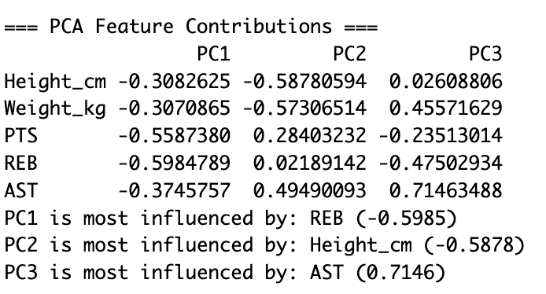
Demonstration - PCA
PC1 is heavily influenced by rebounding and scoring ability (REB and PTS), reflecting a player’s overall statistical impact.
PC2 is dominated by height, weight, and assist, separating players based on physical size and playmaking tendencies.

Slide 6
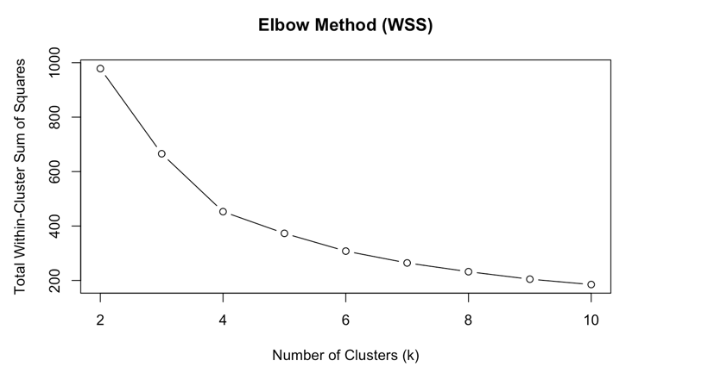
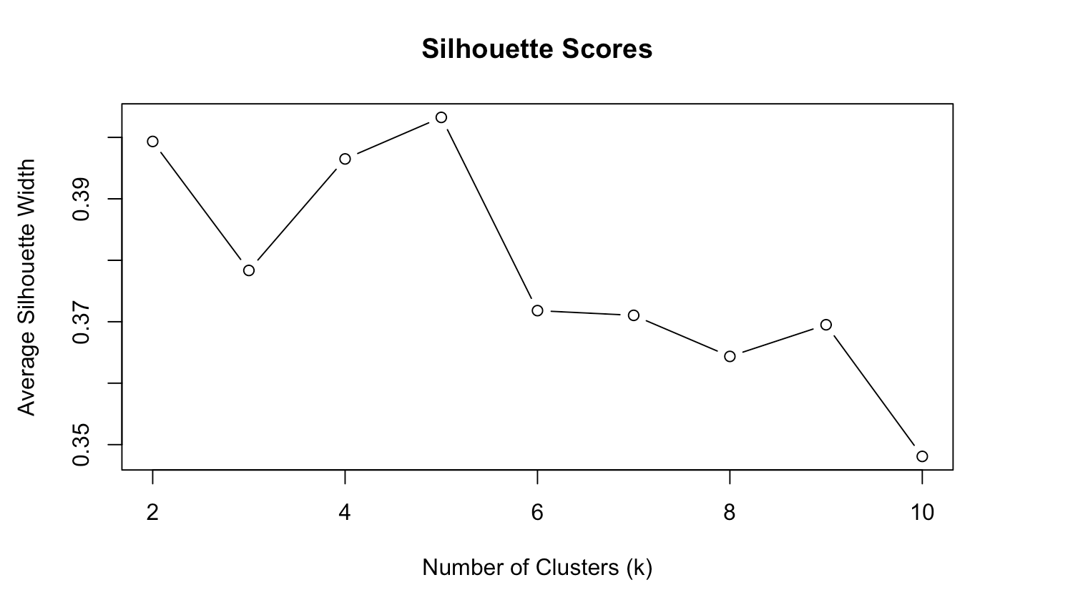
Demonstration – K-Mean Clustering
K-Means clustering was applied to the PCA-transformed data to group players into distinct types based on their underlying statistical profiles.
To determine the optimal number of clusters, both the Elbow Method and Silhouette Scores were evaluated.
The Elbow plot showed a clear inflection at k = 5, indicating a balance between model complexity and within-cluster variance. Similarly, the Silhouette analysis peaked around k = 5, suggesting good separation and cohesion among clusters.

Slide 7
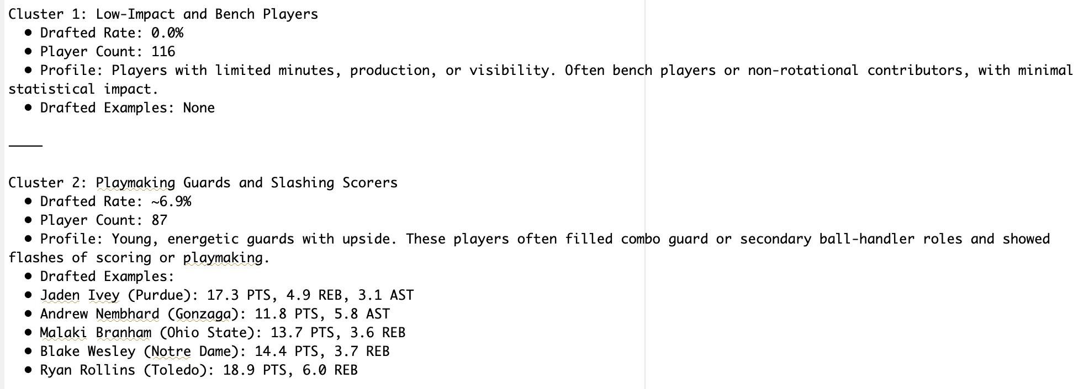
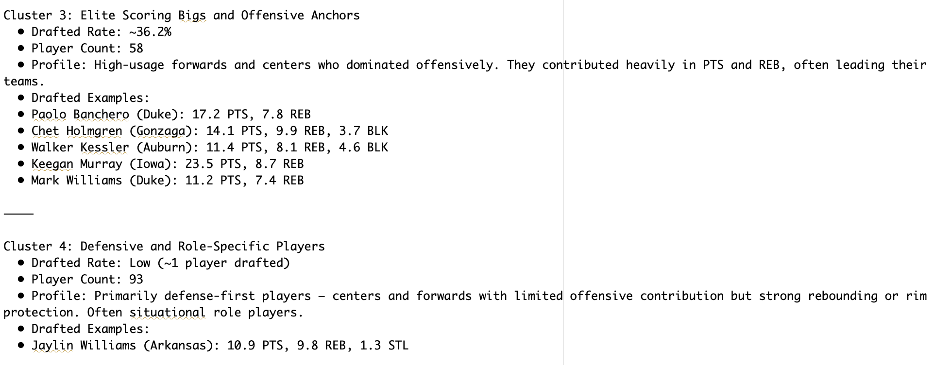
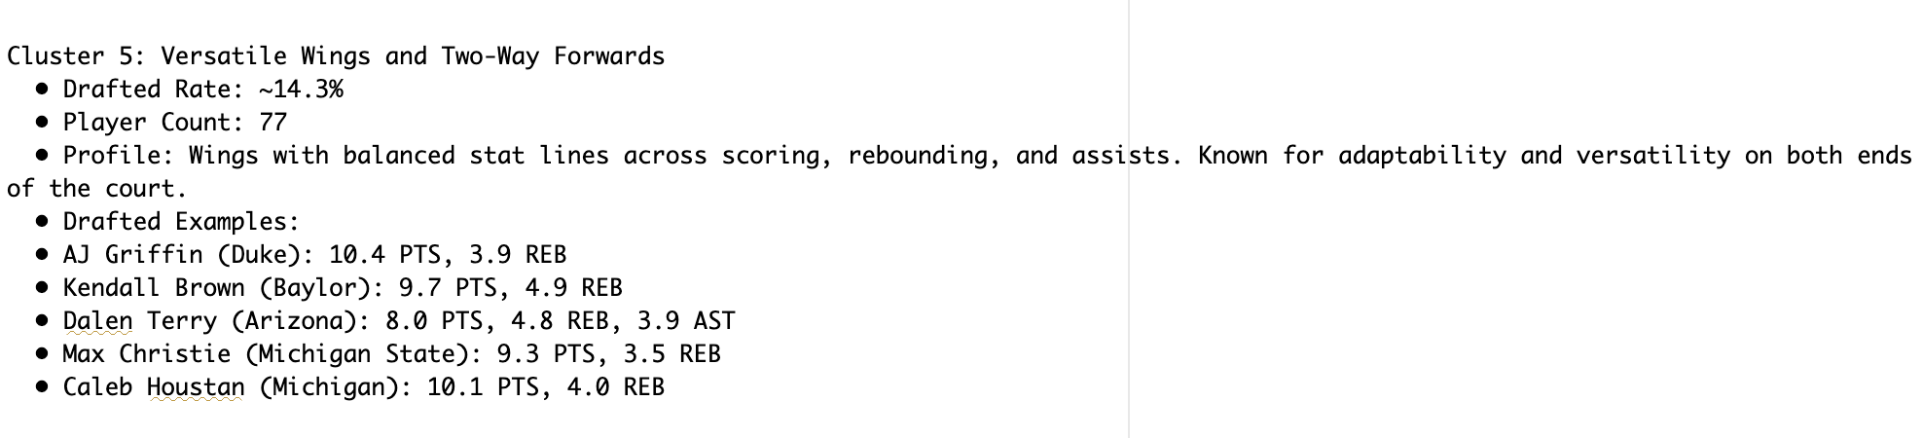
Demonstration - K=5
This classification is based on the players’ actual contribution on basketball court and their physical attributes.
This is a Novel classification method that captures the current trend of positionless basketball.

Slide 8
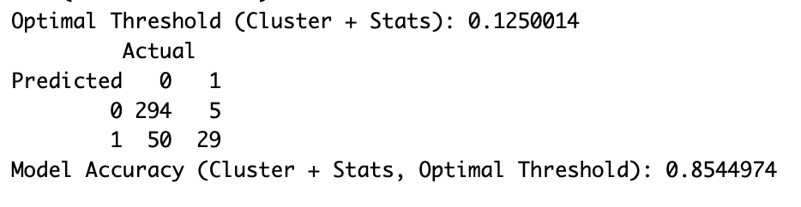
Demonstration – Logistic Regression Model (Training Performance)
The optimal threshold of 0.125 reflects class imbalance since only few players were selected.
The model achieved an accuracy of 85.4%, with high recall (0.853)—correctly identifying 29 out of 34 drafted players—while maintaining an F1 score of 0.513.
Although precision (0.367) was moderate due to some false positives (50), this is acceptable in scouting contexts where missing talent (False Negatives) is riskier than over-selecting (False Positives).

Slide 9
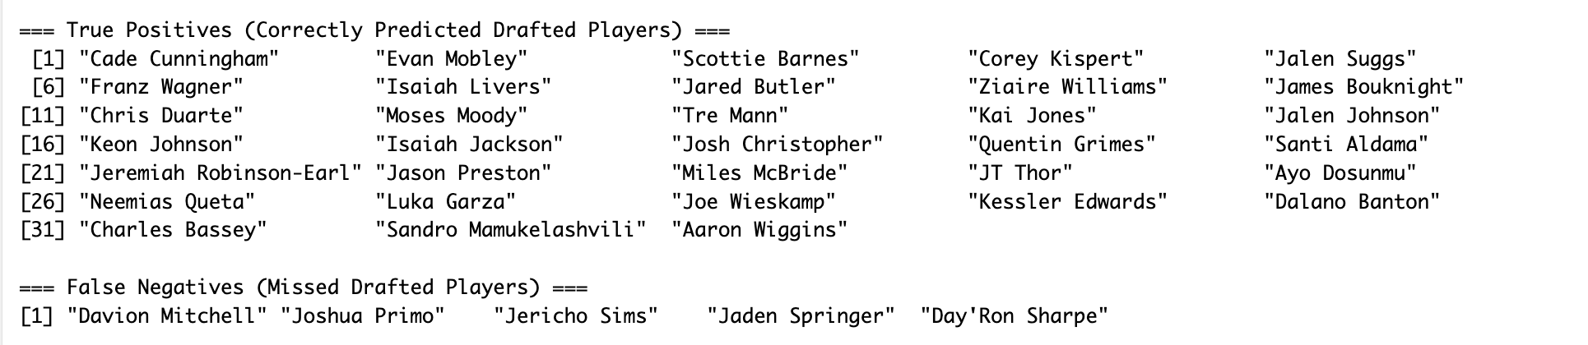
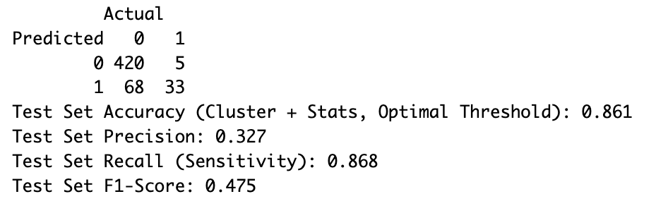
Demonstration – Logistic Regression Model (Test Performance)
The model achieved an accuracy of 86.1%, closely matching its training accuracy, and a high recall (0.868), correctly identifying 33 out of 38 drafted players.
Although precision (0.327) declined slightly from training, this is expected in imbalanced datasets and acceptable in scouting, where missing talent (False Negatives) is riskier than over-selecting (False Positives).
Therefore, the model demonstrated strong out-of-sample reliability, suggesting practical applicability for future draft prediction tasks.
Who’s Most Likely to Be Drafted?
Cluster 3: consistently exhibits the highest draft rates, indicating that PTS + REB-heavy bigs and scoring forwards are valued highly in the NBA draft.
Cluster 2: playmaking guards shows moderate draft rates, suggesting that guards with offensive output and playmaking stats are noticed, but only when combined with efficiency or athletic ceiling.
Cluster 5: a hybrid zone — drafted players here tend to be well-rounded or NBA-ready wings.

Slide 10
Data Governance and Management
Data Source 1: NBA Daft History from the official NBA stats site (National Basketball Association, n.d.), including draft results, player names, draft year, and pick numbers.
Data Source 2: NCAA Team rosters and player stats, scraped from Sports Reference (Sports Reference, n.d.), including players physical attributes and their performance in NCAA.
Cleaned Data Set: Cleaned 2021-2022 draft results, Cleaned 2021-2022 NCAA rosters, uploaded to public GitHub repository (https://github.com/kkgob/FIT5145_assignmnet_3_data.git).
Access Control: Cleaned datasets were stored on a public GitHub repository with version control. Only essential features were stored to minimize exposure.
Lifecycle Management: Data was cleaned, analyzed, and transformed within a documented pipeline, ensuring traceability and integrity across stages.
Ethical Use: No commercial use or redistribution of the data. The analysis remained within the scope of academic purposes.
Anonymity and Security: All player identifiers were retained solely for clustering and were not exposed in any sensitive outputs. No financial data or biometric identifiers were involved.

