Slide 1

UBS Datathon Challenge
Neural Activation

Slide 2
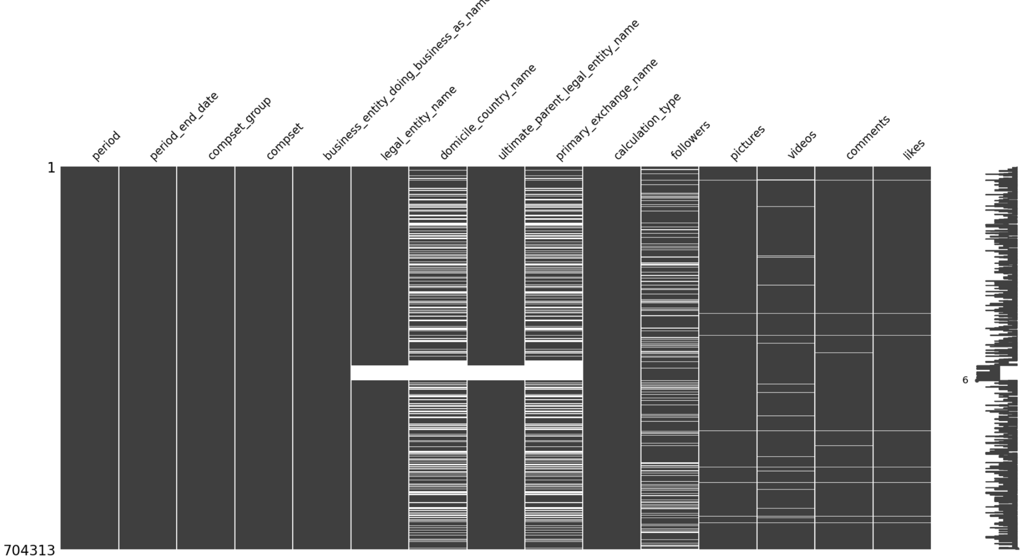
Data Story
Data Insights
Public Sentiment analysis
External Stock Market data

Slide 3
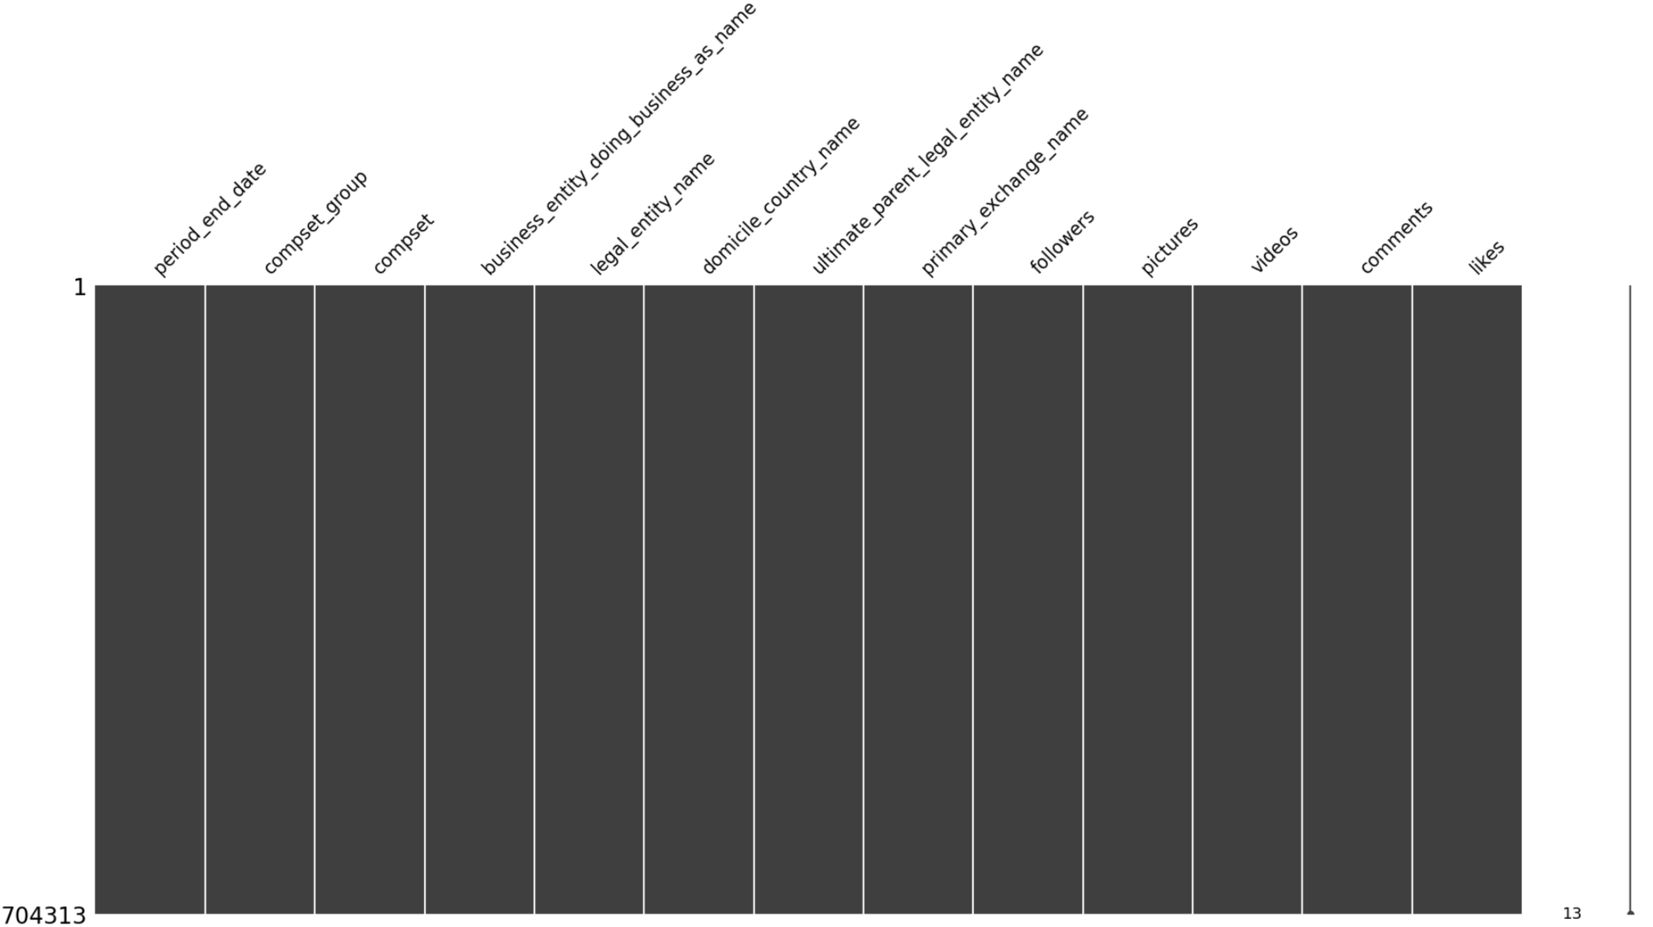
Data Processing
Remove Redundancy & Duplication
Fix contaminated Data
Data Imputation
Outlier preservation

Slide 4
Analysis
Sector Relevance
Company Analysis
SHEIN Case Study
Correlation Dataset & Stock

Slide 5
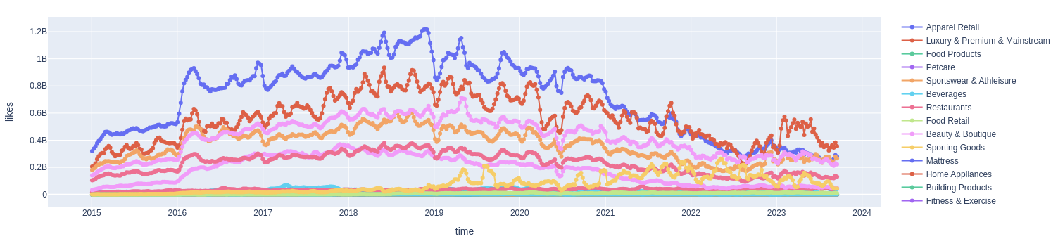
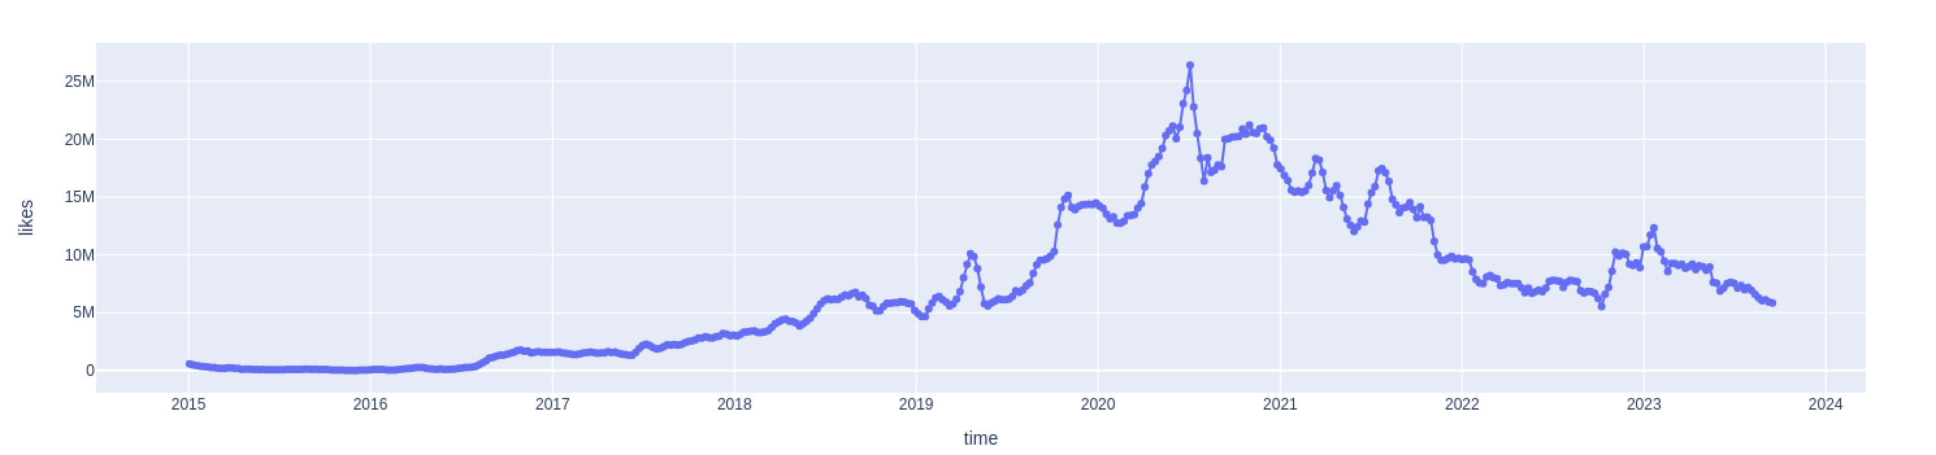

Slide 6
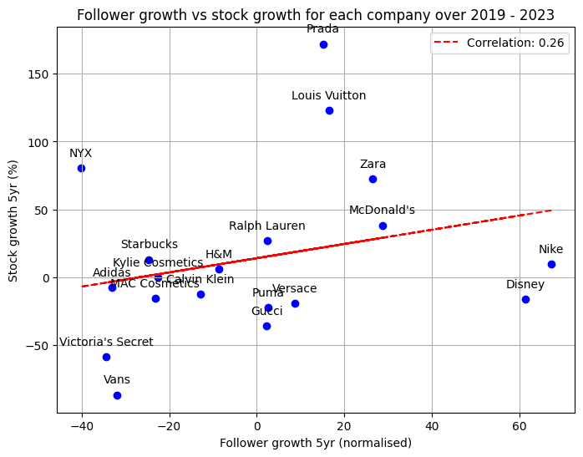

Slide 7
Outlook
Additional financial reports
=> Improved Context Correlation
Use further Approaches
=> Forecasting/Anomaly Detection Models

