Slide 1
Credit Card Defaults in Taiwan Motivation and Analysis
Krunal Khatri

Slide 2
Agenda
Original Data Gatherers
Problem Description
Data Description
Data Cleaning
Summary of Models Applied
Conclusion

Slide 3
Original Data Gatherers
2 researchers from Taiwan and Canada
Sorting Smoothing Method to compute actual probabilities
Original paper empirically compared proposed method to other methods
Their data was donated for open internet in January – 2016
Their paper was published in 2007

Slide 4
Motivation and Problem Description
Motivation:
Defaults among credit card customers in Taiwan, expected to peak around 2006
Problem:
Increase market share by issuing credit cards to unqualified applicants
Customer’s credit overuse irrespective of repayment ability
Solution:
Have a model to predict the probability of default within a short period of monitoring credit use to better allocate resources and reduce risk

Slide 5
Data
30k customer’s credit card behavior for dates: April – September 2005
Original paper says 25k
23 variables tracking demographic information and payment history
Some obvious outliers
More levels than documented (Marriage, Gender, Education)
Currency rate $1 NT = $0.034 US
Data is highly structured with outliers impeding pattern recognition.

Slide 6
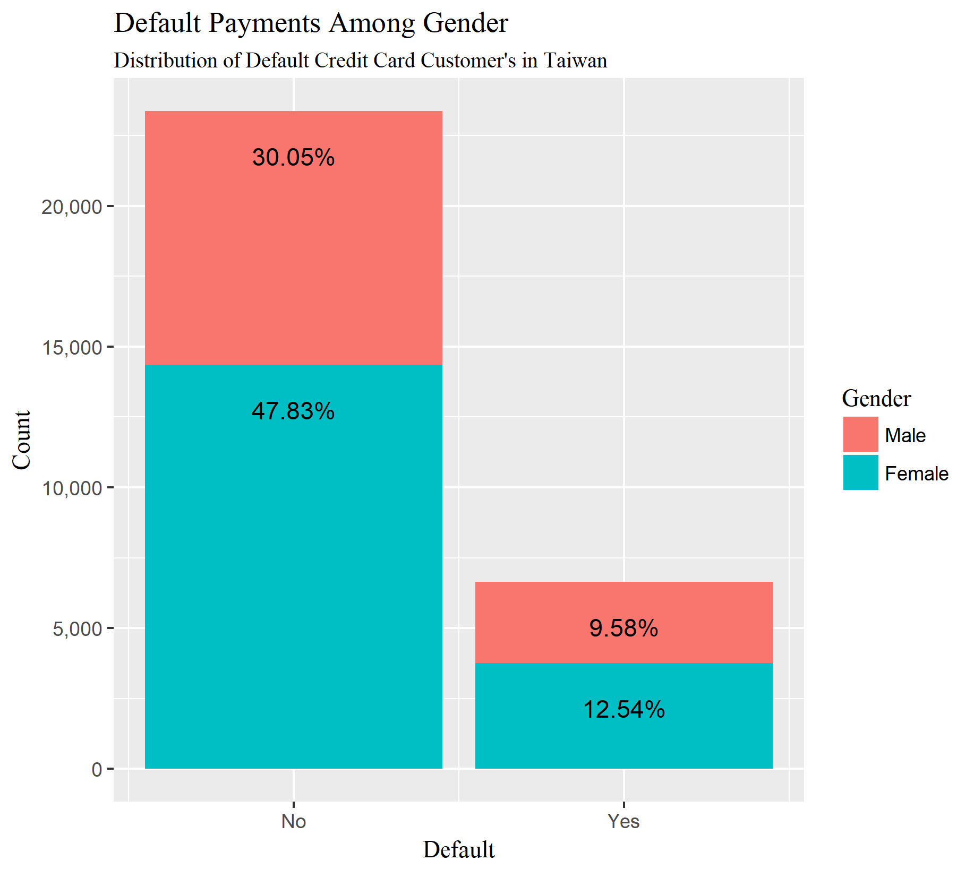
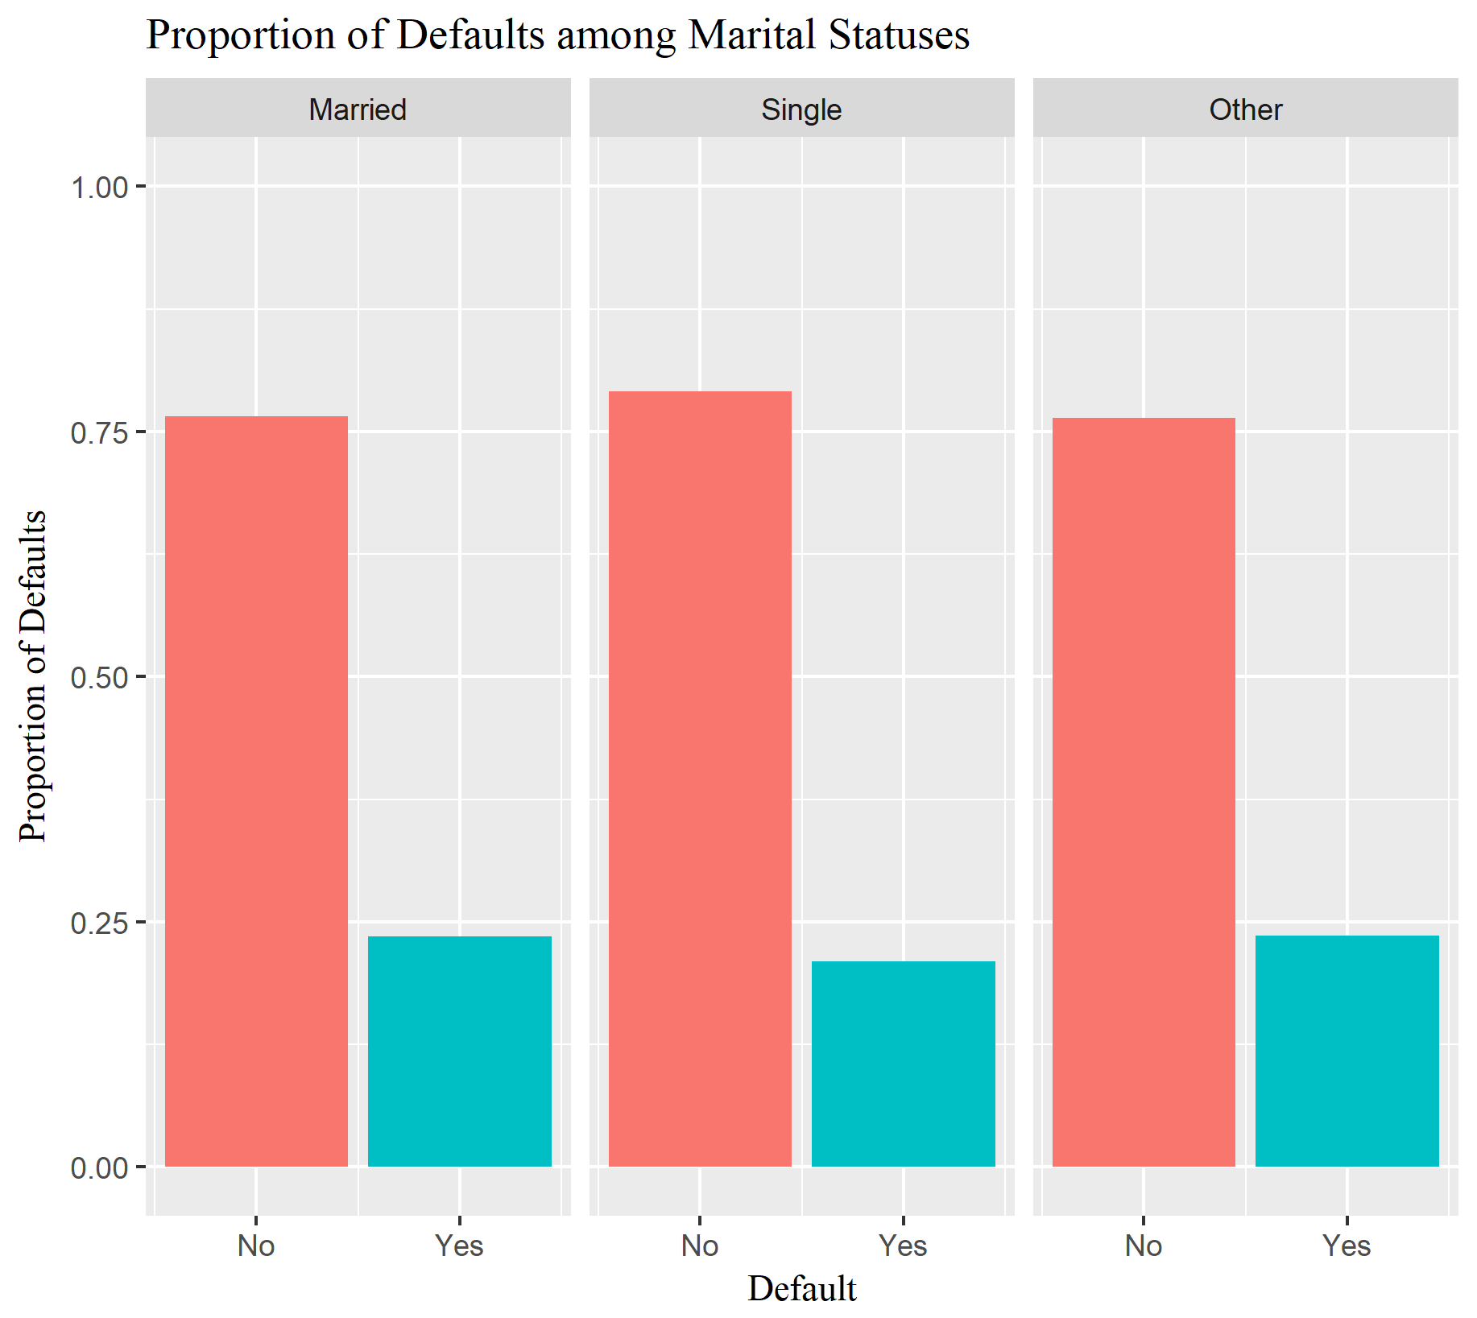

Slide 7
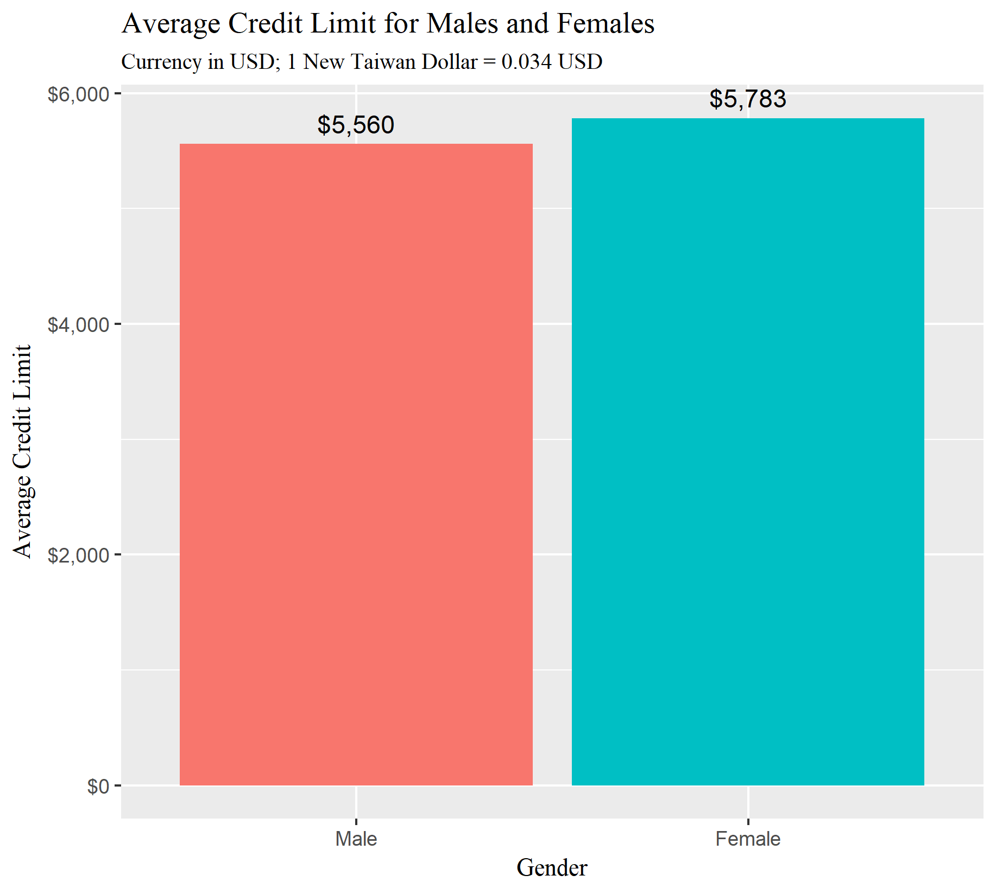
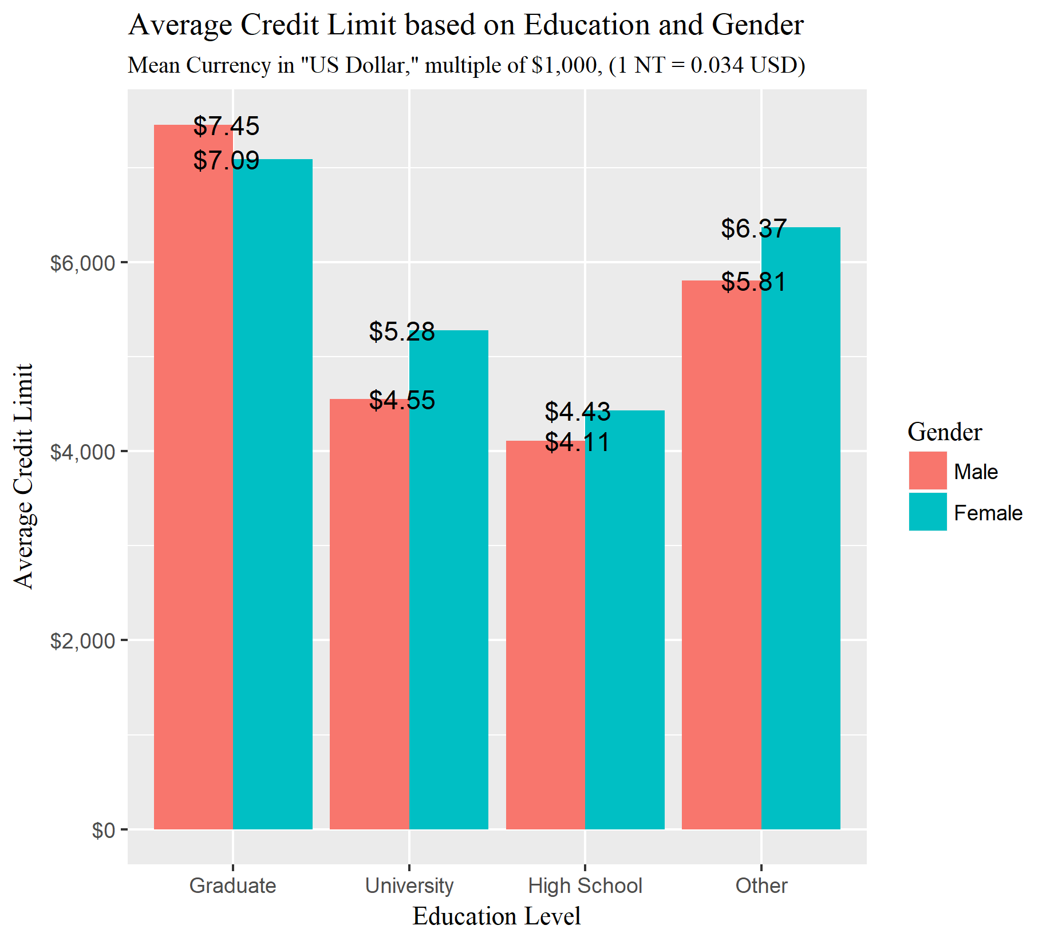

Slide 8
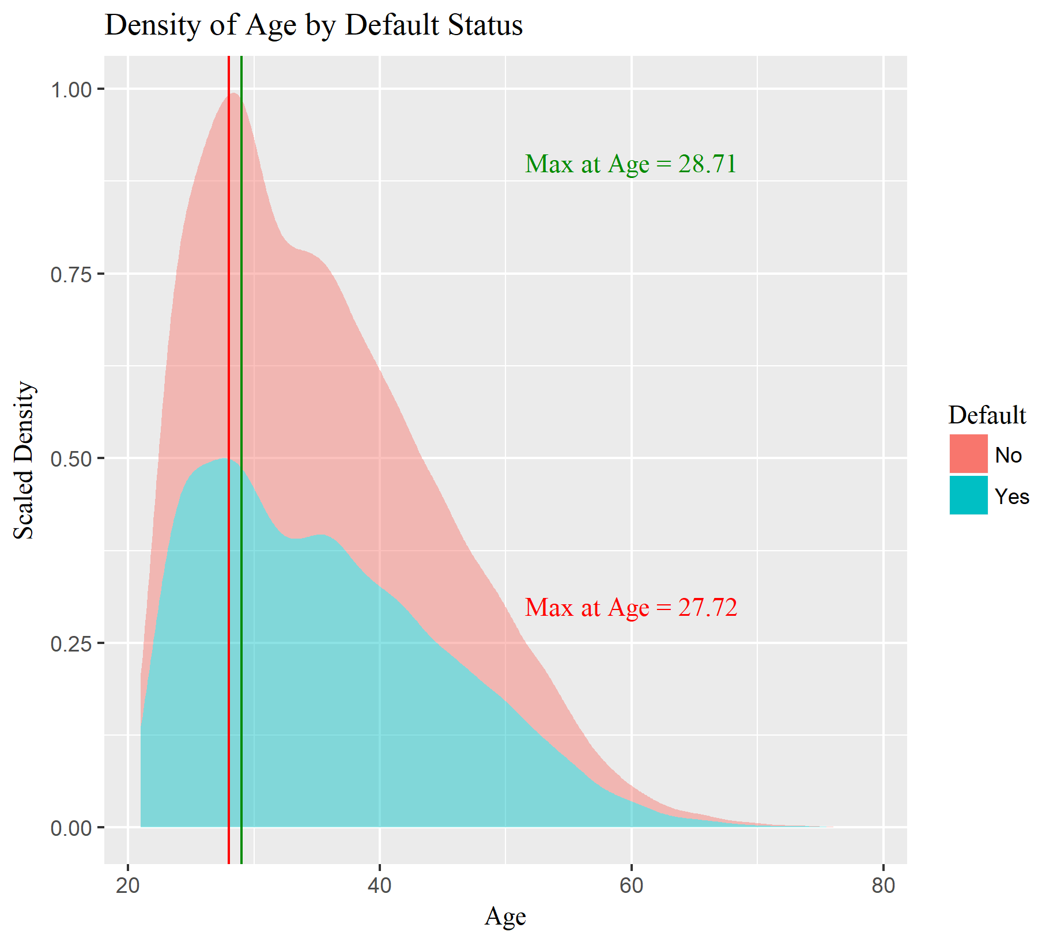

Slide 9
Approach and New Feature
Naïve Approach will have ~23% misclassification error because of unbalanced response so, model metrics to be closely validated
Logistic regression deemed payment history from April – June 2005 insignificant.
Possible multicollinearity issues between Billed Amount and Payment Amount
Billed Amount and Payment Amount from July – September were combined to create a more complex variable: Trailing Amount
Payment history and demographic information was maintained.

Slide 10
Splits & Full and Reduced Models
For better model validation, data was split into 80:20 for training and testing purposes.
Full Model included the past 6 months payment history of delays and on-time payments
Reduced Model included only 3 months of the above

Slide 11
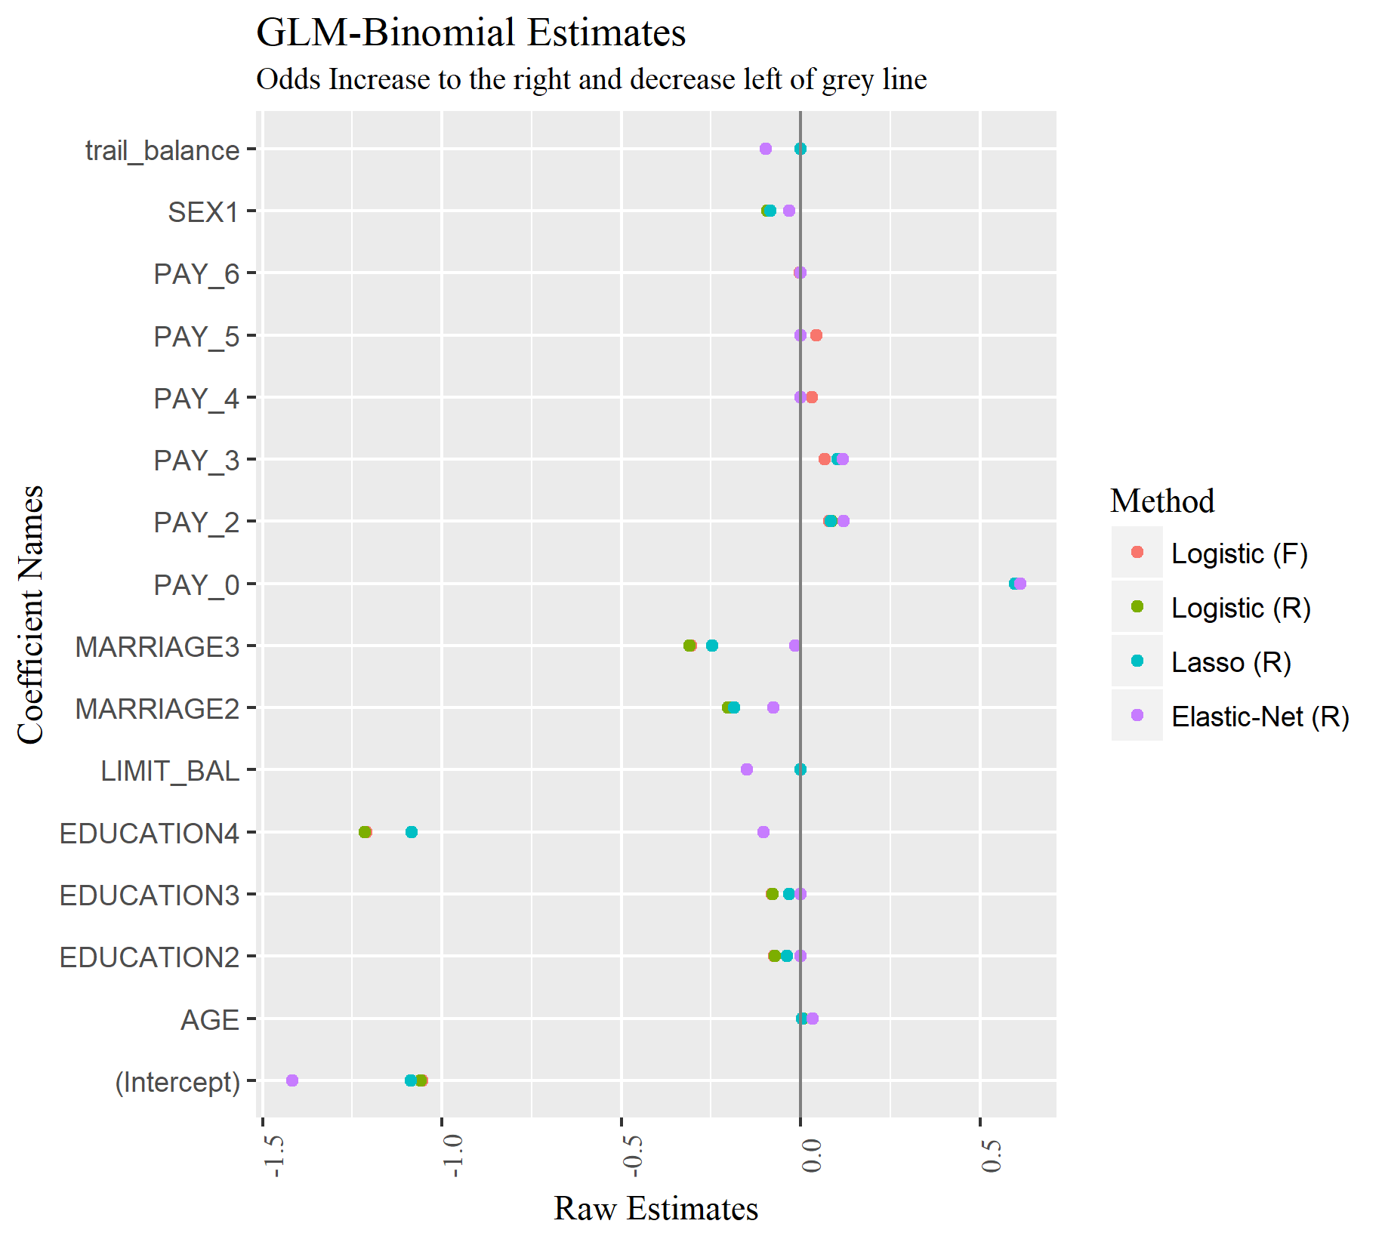
Variables
SEX1 = Female
SEX0 = Male
MARRIAGE1 = Married
MARRIAGE2 = Single
MARRIAGE3 = Other
EDUCATION1 = Graduate
EDUCATION2 = College
EDUCATION3 = HS
EDUCATION4 = Other

Slide 12
Comments on GLM-Binomial Estimates
Exponentiation of Raw Estimates gives us the odds ratio of that estimate, provided all other estimates are held constant.
exp(0) = 1.
So, an estimate = 0 does not have any change in odd of default status, for a particular customer, from the particular model.
Multiple Criteria can be used to select between different models liked: test of deviance, test of ROC curves, predictions based on test data, AIC or, a domain driven approach in which, model estimates that make the most sense

Slide 13
Ensemble Methods
Random Forest:
mtry selected using 10 fold cross-validation on different mtry values with 500 trees.
Neural Network:
Multiple single hidden layer neural networks were bagged to average predictions from each network in the bag
Hyper parameters of decay rate, number of hidden neurons and number of networks to bag were performed using a grid search and 10 fold cross-validation

Slide 14
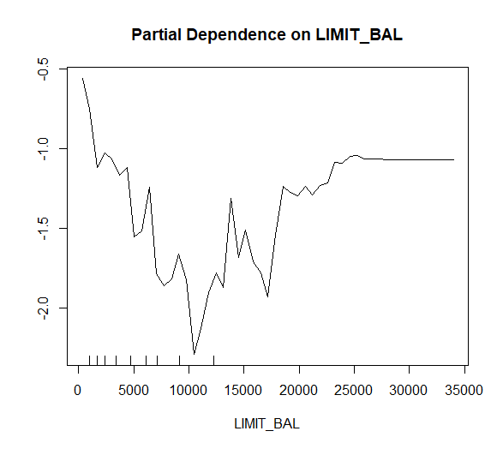
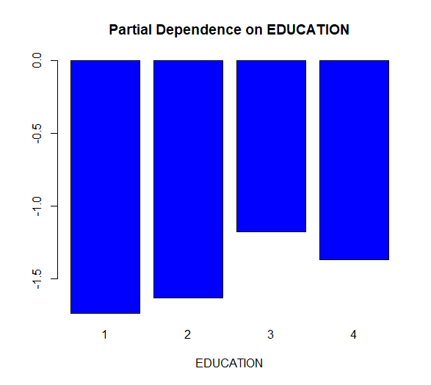
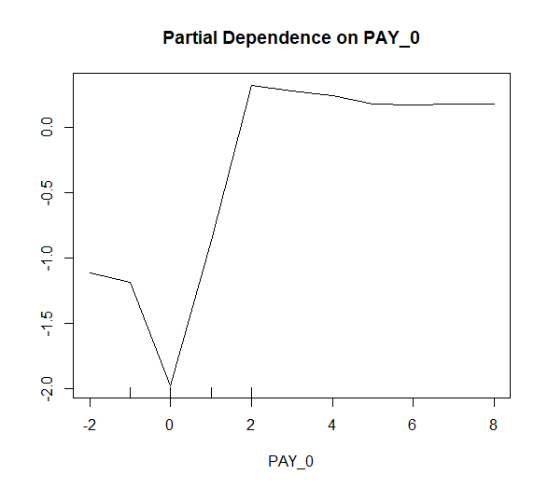
Random Forest Partial Plots

Slide 15
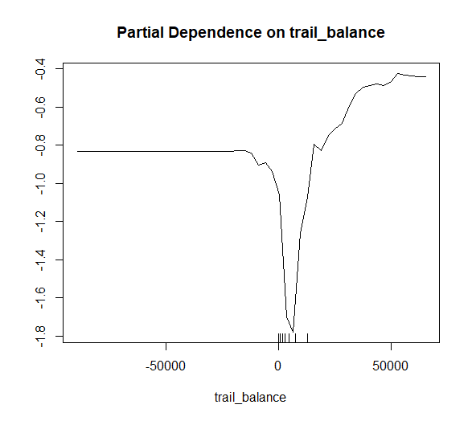
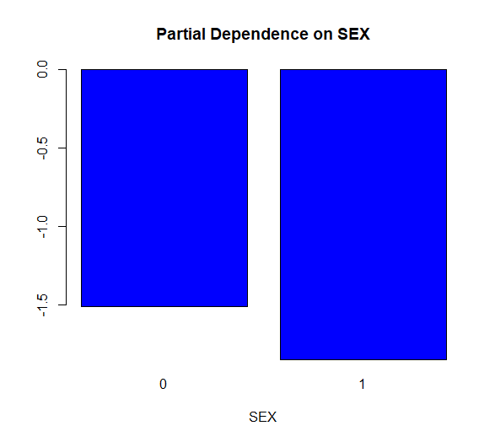
Random Forest Partial Plots

Slide 16
Final Results
Method | Misclassification Error | False Positives | True Positive | ROC (AUC) | Hyper Parameters | HL – GOF
Lasso (R) | 18.95% | 1.07% | 15% | 0.721 | Lambda = 0.014 Alpha = 1 Parameters = 12 | Significant
Elastic-Net (R) | 19.43% | 2.09% | 19.39% | 0.723 | Alpha = 0.2105 Lambda = 0.0193 Parameters = 11 | Significant
Logistic Regression (R) | 19.01% | 2.06% | 23.16% | 0.722 | AIC = 22462 Parameters = 12 | Significant
Logistic Regression (F) | 19.0% | 2.52% | 22.71% | 0.721 | AIC = 22457 Parameters = 16 | Significant
QDA (R) | 23.02% | 17.95% | 59.09% | 0.728 | Parameters = 182 | Significant
Random Forest | 17.75% | 4.46% | 36.15% | 0.657 | mtry = 2 trees = 500 | Significant
Neural Network | 22.10% | 0.021% | 0% | 0.711 | Hidden = 5 Decay Rate = 0.01 Bags = 50 | Significant

Slide 17
Conclusion
Misclassification Rate:
We need this to be as small as possible suggesting a good fit for test data
False Positives:
When a good customer is predicted as possible to default
This should be as low as possible
True Positives:
When a customer who may default is predicted as default customer
This should be as close to 100% as possible.
ROC:
Area Under the ROC which is a unit square should be close to 1
Hyper Parameters:
These are the best regularization parameters that produce a good model using the least number of parameters.
Hosmer – Lemeshow Goodness of Fit Test
Using the Chi-Squared test, this methods quantifies if a model is good or not
H0: Model is adequate fit for the data.
A significant p-value suggests that we do not have good enough data to NOT reject H0

Slide 18
Thank You
References:
Yeh, I. C., & Lien, C. H. (2009). The comparisons of data mining techniques for the predictive accuracy of probability of default of credit card clients. Expert Systems with Applications, 36(2), 2473-2480.
All model fitting and graphics were produced using R.

