Slide 1
BANKING BOT
TEAM MEMBERS
S.DHARSHINI(711714104016)
S.GOWRI GAYATHRI(711714104021)
K.KHAVYA(711714104030)
N.KOWSALYA(711714104031)
FACULTY GUIDE
Ms.PRISCILLA JOY
INDUSTRY GUIDE
Mr.VASANTH
Department of CSE, KGiSL Institute of Technology, Coimbatore

Slide 2
Abstract
Banking bot is an artificial intelligent development for banking operations, who understand people queries and responds accordingly.
The main aim of this project is to develop a banking bot using artificial intelligent algorithms which should be able to analyze and understand user’s queries and react accordingly.
For any banking related queries we have to go to the bank or call to customer care. It takes lot of time and effort and bank people are also very busy to attend our queries. On the other hand we don’t get complete information from the customer care executives.
It will be more suitable if we can directly post our queries online or chat with the bank people and get the response with no time. To overcome the problem we proposed banking bot where people can directly chat with a bot.
Department of CSE, KGiSL Institute of Technology, Coimbatore

Slide 3
Area Introduction-Existing system
Improper and ineffectual.
Time consuming and draggy.
Less flexible
Disadvantages of existing banking applications are:
Message request cant be sent if there is low balance
Joint Users can’t create an account in application
MPIN request and validation is a tedious process
Department of CSE, KGiSL Institute of Technology, Coimbatore

Slide 4
Proposed System
Format less.
Bot understand all banking terminologies and operations.
Department of CSE, KGiSL Institute of Technology, Coimbatore

Slide 5
Literature Review
Literatures | Reviews
http://freeprojectsreport.com/2016/11/ai-banking-bot-project.html | Frame work
http://nevonprojects.com/banking-bot-project/ | Customer care
http://ieeexplore.ieee.org/xpl/RecentIssue.jsp?punumber=4804728 | chating
https://chatbotsmagazine.com/ | Chat bot
Department of CSE, KGiSL Institute of Technology, Coimbatore

Slide 6
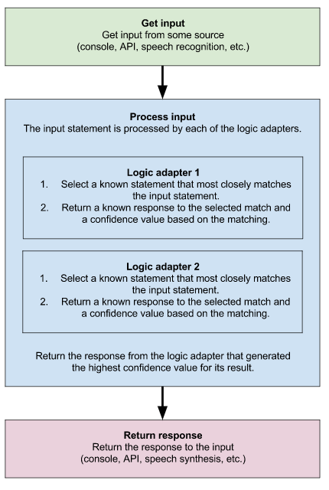
Process flow

Slide 7
Data Flow Diagram Level 0
User
Chat Bot Application
Admin
Ask query
Update
Response
Department of CSE, KGiSL Institute of Technology, Coimbatore

Slide 8
DFD Level 1
User
Ask query
Process Query
Search keywords
Response
Database
Query Output
Update Logs
Store updates

Slide 9
Module Split up
ADDING A BENEFICIERY
FUND TRANSFER
MINI STATEMENT
BALANCE
Department of CSE, KGiSL Institute of Technology, Coimbatore

Slide 10
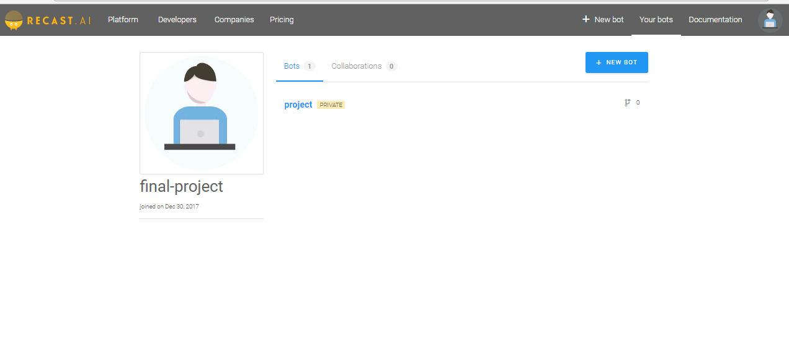
Screen shots of modules under progress.

Slide 11
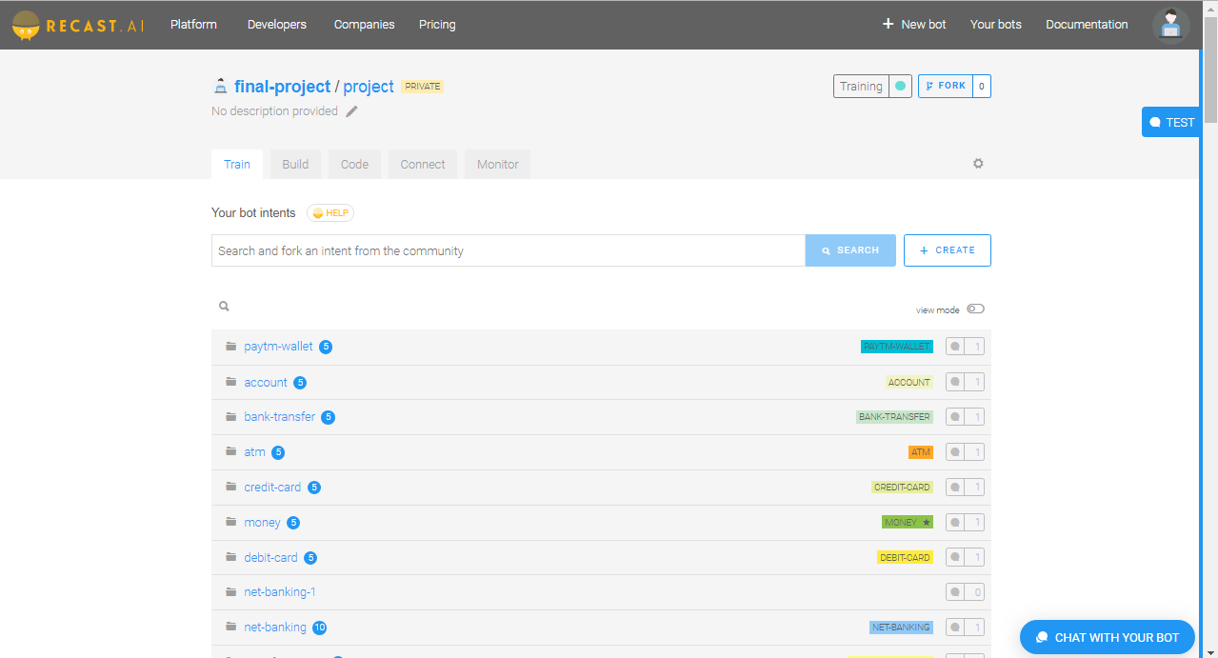
Intent creation-Training the bot

Slide 12
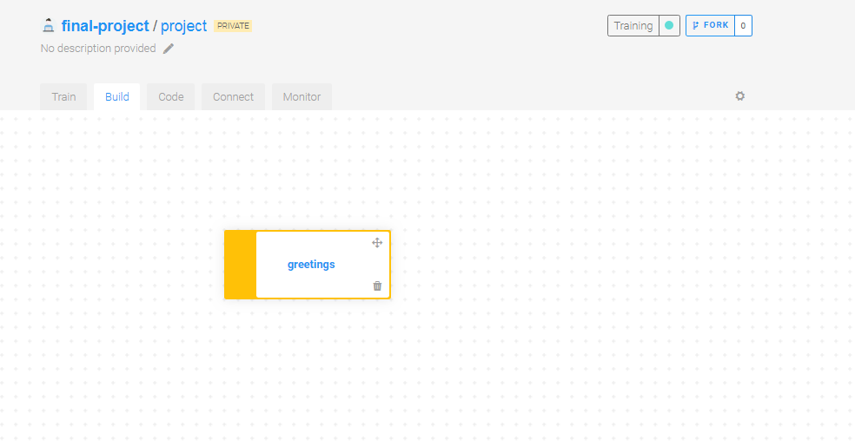
Build section

Slide 13
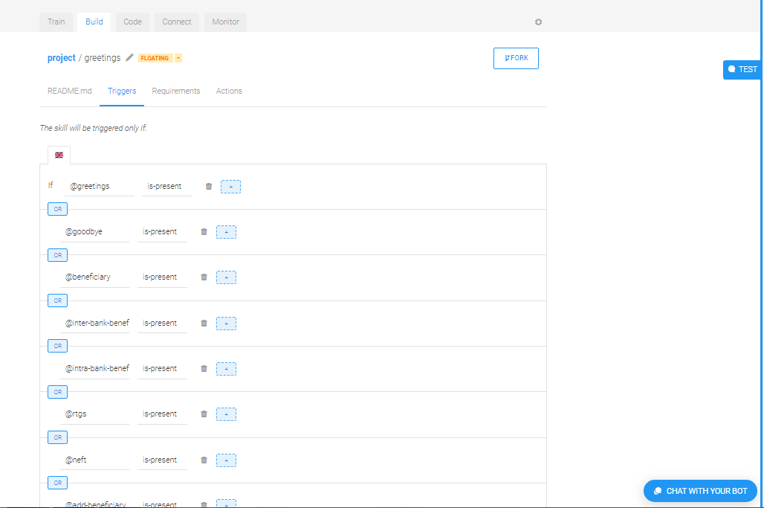
Entities-creation

Slide 14
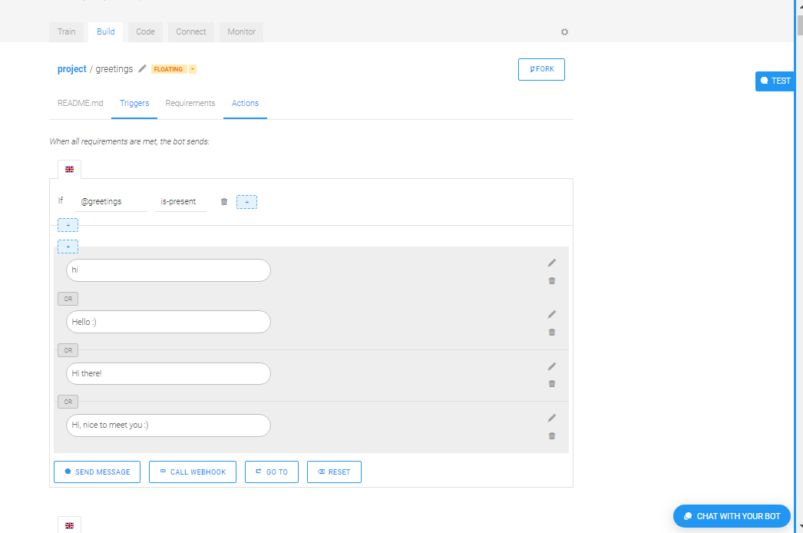
Mapping with the entities

Slide 15
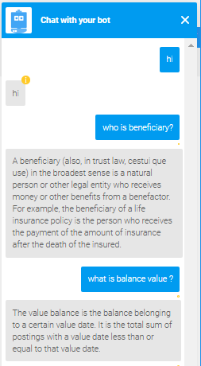
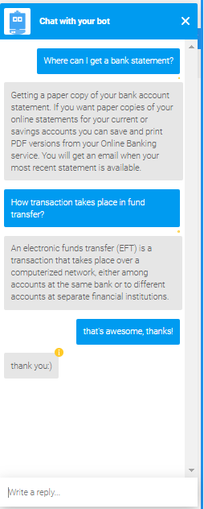
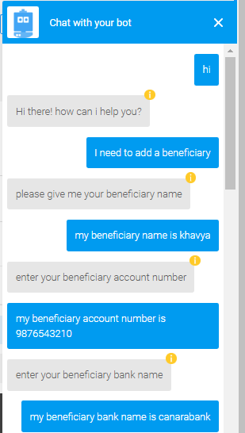
Building the conversation

Slide 16
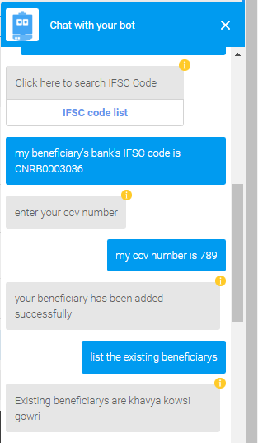
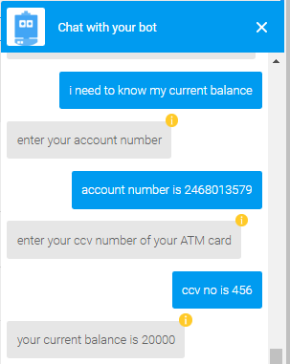

Slide 17
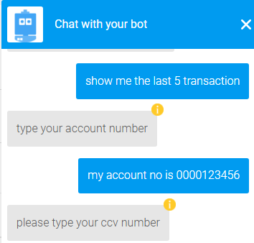
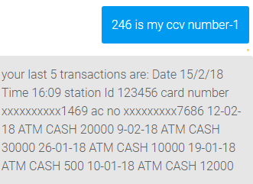

Slide 18
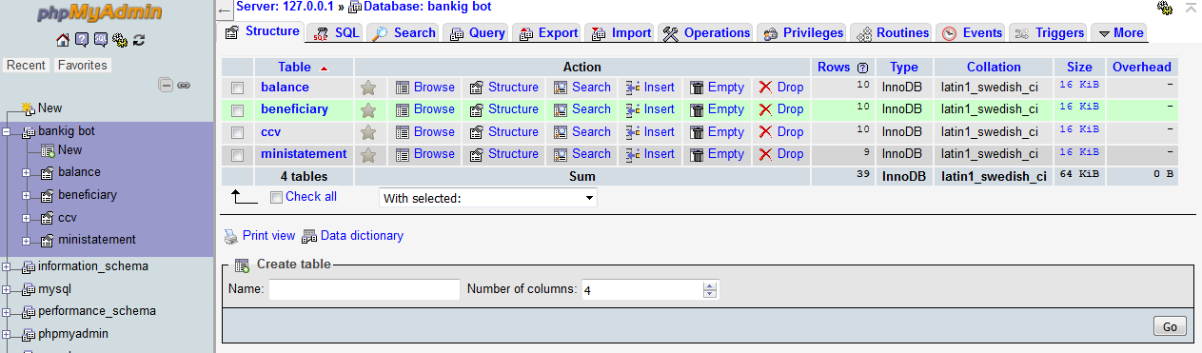
DATABASE API Connectivity

Slide 19
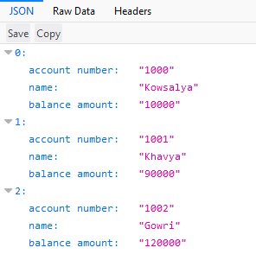
Sample JSON Data

Slide 20
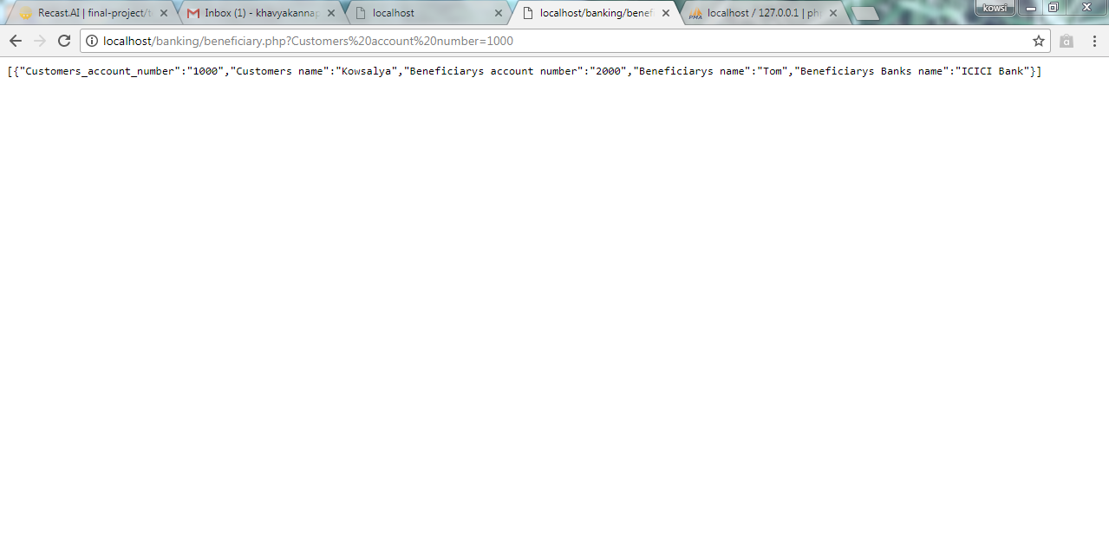
Dynamic API Calls

Slide 21
Thank you…

