Slide 1








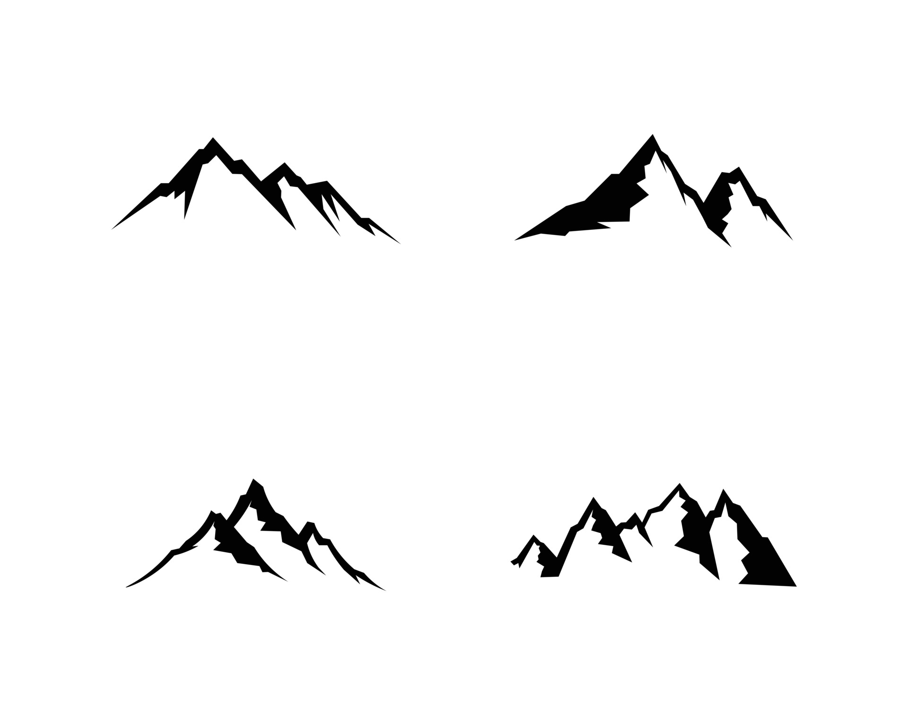









Automatic Analytics Optimization map
Backtest
Digital Twin
Trading System
Markets
RFQs
Automatic Control
Trading Systems
Non-linear command
Performance Ratio
Data Simulation
FTT
Continuous Wavelets T
Kalman filter
PID

