Slide 1
Serverless Architecture using Azure Functions

Slide 2

Intro
Khiem-Kim Ho Xuan
Fullstack .NET Developer

Slide 3
Motivation
Azure Functions
Deploy and Debug (D&D)
Durable Functions
Latest news (What’s new)

Slide 4
Motivation

Slide 5
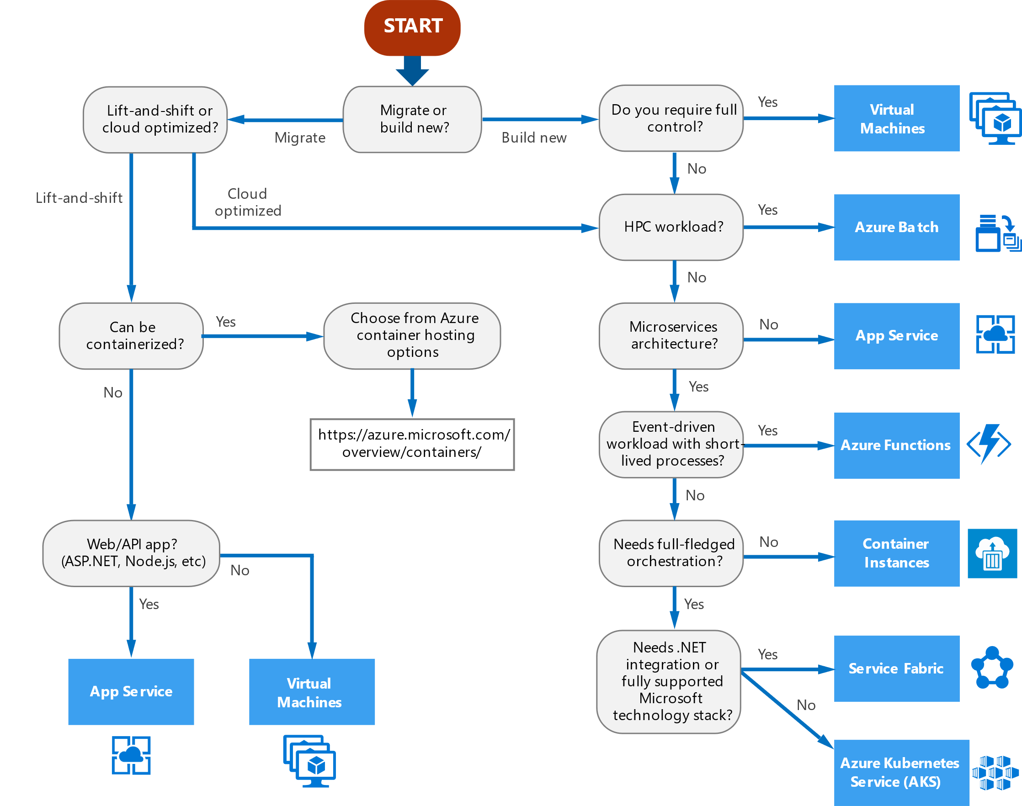
Microsofts choice of platform

Slide 6
Serverless architecture
More code, less infrastructure (really?)
Create separation of logical part in your solution
Functions as a Service (FaaS)
Develop and deploy individual functions
We focus on Azure functions
Azure Functions are based on Azure App Service.
Think of it as Web apps with WebJobs

Slide 7
Serverless challenges
Managing states
Long running processes
Scaling
Monitoring, tracing and logging
Manage failure and providing resiliency

Slide 8
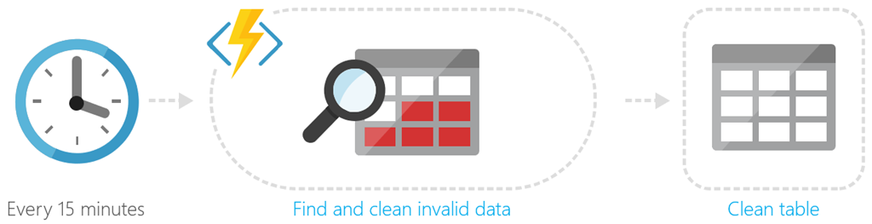
Serverless design examples
Scheduling

Slide 9
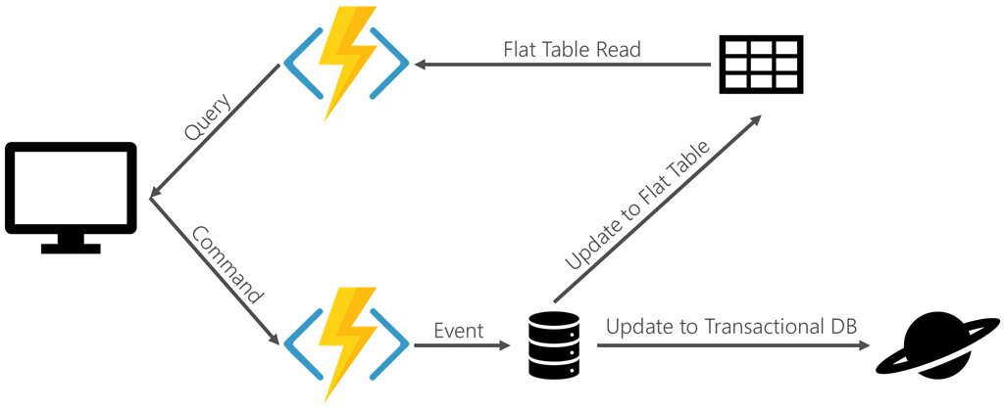
Serverless design examples
Command and Query Responsibility Segregation (CQRS)
Notes:
Command and Query Responsibility Segregation (CQRS) is a pattern that provides different interfaces for reading (or querying) data and operations that modify data. It addresses several common problems. In traditional Create Read Update Delete (CRUD) based systems, conflicts can arise from high volume of both reads and writes to the same data store. Locking may frequently occur and dramatically slow down reads. Often, data is presented as a composite of several domain objects and read operations must combine data from different entities.

Slide 10
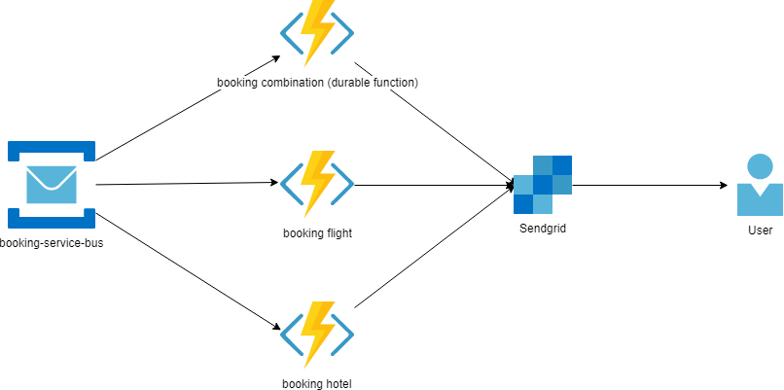
Serverless design examples
Event processing

Slide 11
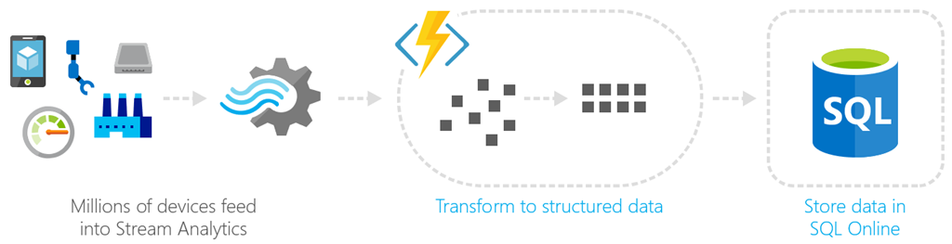
Serverless design examples
Data streaming

Slide 12
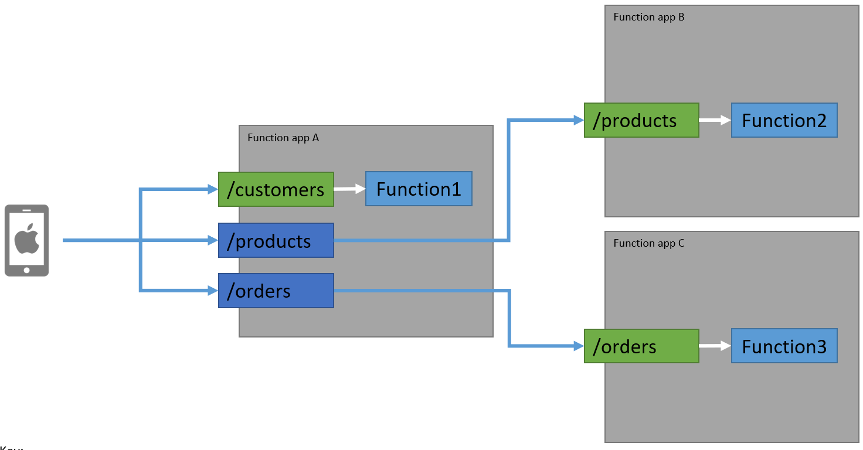
Serverless design examples
API Gateway

Slide 13
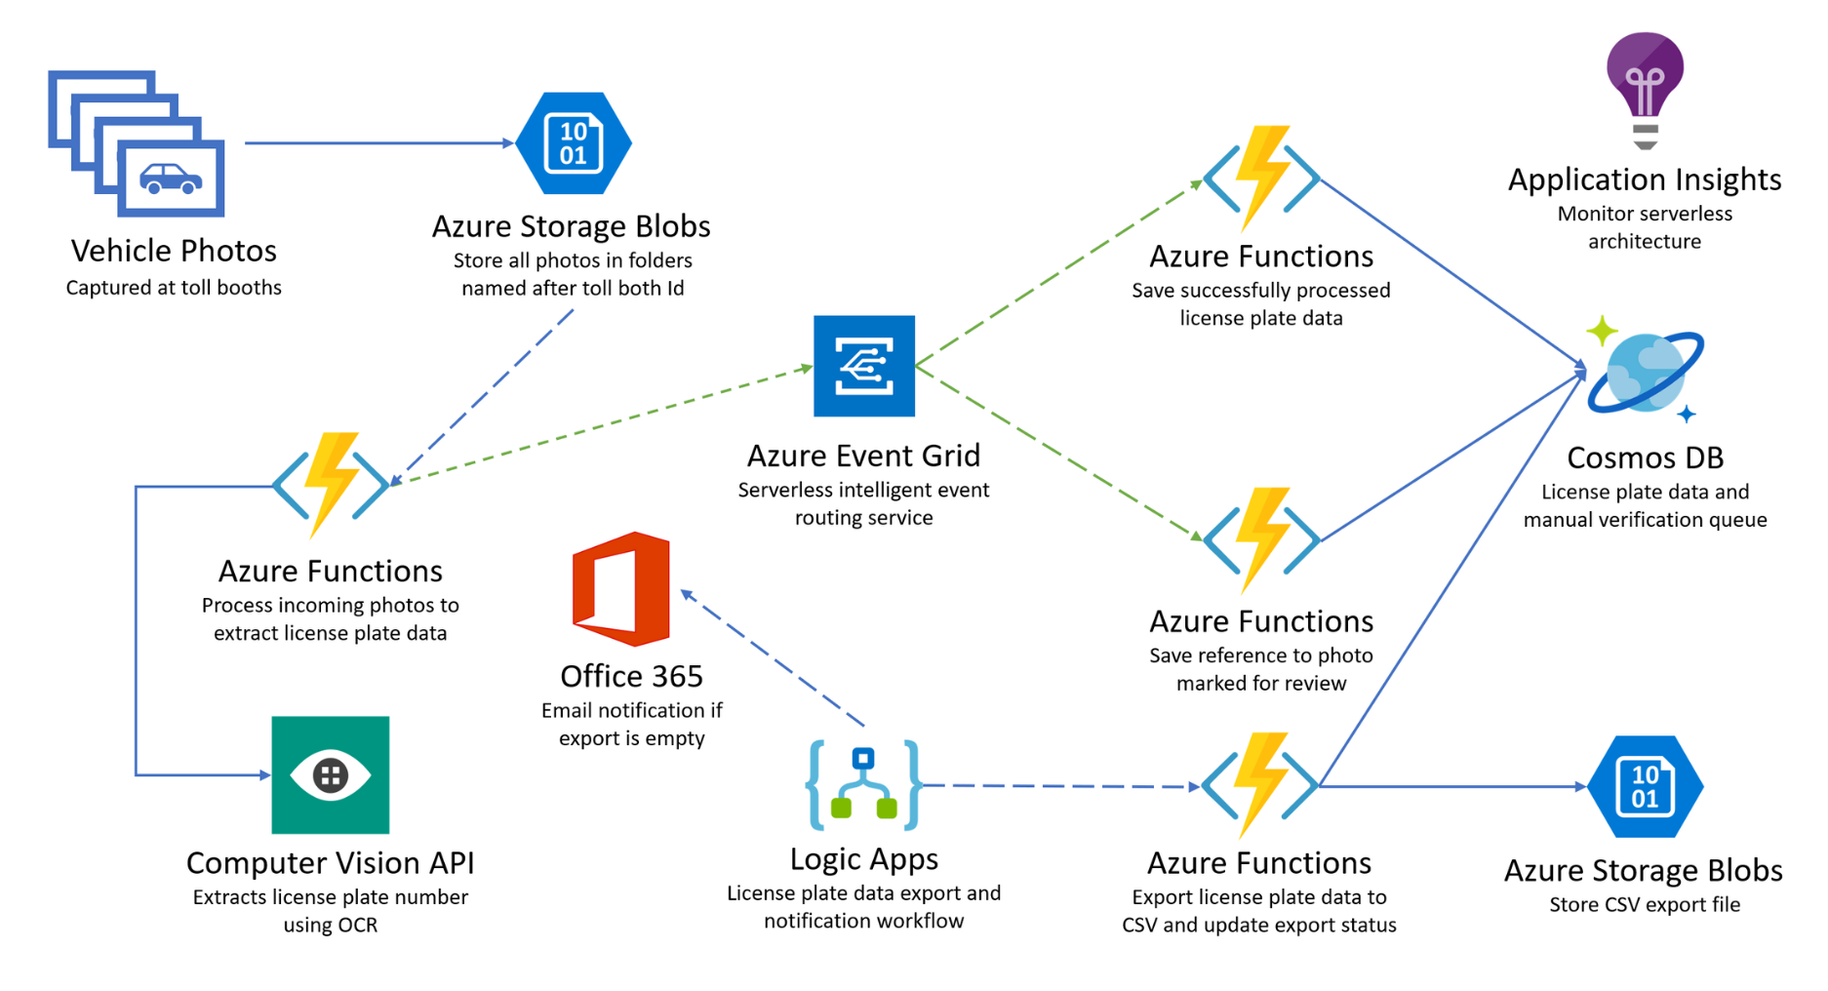
Full use case study

Slide 14
Azure Functions

Slide 15
What?
Microsofts answer to serverless compute service that are event driven
Develop small piece of codes in the cloud
Good for processing, integrating systems and simple APIs
Offerings
HttpTrigger
TimerTrigger
ServicebusTopicTrigger
BlobTrigger
CosmosDbTrigger
Etc.

Slide 16
Integrations
Azure Cosmos DB
Azure Event Hubs
Azure Event Grid
Azure Notification Hubs
Azure Service Bus (queues and topics)
Azure Storage (blob, queues, and tables)
On-premises (using Service Bus)
Twilio (SMS messages)

Slide 17
Costs
Consumption plan: Azure provides the necessary computational resources. Pay for the time your code runs
Allocates compute resource power when your code is running.
Billing based on number of executions, execution times
App Service plan: Run functions like your web apps.
Dedicated VMs on a service plan
Best choice if you need more CPU or memory options and scalability
Can scale with Always on options

Slide 18
Code samples
[FunctionName("BookingFlight")]
public static void Run([ServiceBusTrigger("booking", "booking-flight", Connection = "ServicebusConnectionString")]string mySbMsg, ILogger log)
{
log.LogInformation($"C# ServiceBus topic trigger function processed message: {mySbMsg}");
}
[FunctionName("GetPosts")]
public async Task<IActionResult> Get(
[HttpTrigger(AuthorizationLevel.Function, "get", Route = "posts")] HttpRequest req,
ILogger log)
{
log.LogInformation("C# HTTP trigger function processed a request.");
var res = await _client.GetAsync("https://test.com");
return new OkResult();
}

Slide 19
Missing Dependency Injection?
Microsoft.Azure.Functions.Extensions
Microsoft.NET.Sdk.Functions package version 1.0.28 or later
Create a Startup.cs file
Keyvault integration?
Add system assigned to Azure function and policy to access the keyvault
Add reference in appsettings in Azure portal
Name: <Name of config>
Value: @Microsoft.KeyVault(SecretUri=<Secret Identifier>)

Slide 20
Missing Dependency Injection?
using System;
using System.Collections.Generic;
using System.Text;
using Microsoft.Azure.Functions.Extensions.DependencyInjection;
using Microsoft.Extensions.Configuration;
using Microsoft.Extensions.DependencyInjection;
[assembly: FunctionsStartup(typeof(BookingFlights.Functions.Startup))]
namespace BookingFlights.Functions
{
public class Startup : FunctionsStartup
{
public override void Configure(IFunctionsHostBuilder builder)
{
var config = new ConfigurationBuilder()
.AddJsonFile("local.settings.json", optional: true, reloadOnChange: true)
.AddEnvironmentVariables()
.Build();
builder.Services.AddSingleton(config);
builder.Services.AddHttpClient();
}
}
}

Slide 21
Missing Dependency Injection?
public class BookingFlightFunction
{
private readonly HttpClient _client;
private readonly IConfiguration _configuration;
public BookingFlightFunction(IHttpClientFactory httpClientFactory, IConfiguration configuration)
{
_client = httpClientFactory.CreateClient();
_configuration = configuration;
}
[FunctionName("GetPosts")]
public async Task<IActionResult> Get(
[HttpTrigger(AuthorizationLevel.Function, "get", Route = "posts")] HttpRequest req,
ILogger log)
{
log.LogInformation("C# HTTP trigger function processed a request.");
var res = await _client.GetAsync("https://microsoft.com");
return new OkResult();
}
}

Slide 22
Booking app architecture

Slide 23
Deploy and Debug (D&D)

Slide 24
Deploy through Visual Studio 2019
Deploy locally for now

Slide 25
Deploy Infrastructure and Functions through Azure DevOps
What is needed and how do you deploy?

Slide 26
What is missing?
Good to have stateless
But access states and shared resources?
Headache and missing control of functions involved
We need an orchestrator/workflow

Slide 27
Durable Functions
Notes:
Worflow orchestration. Gives tools to define stateful, long running operations and reliable communications. It acts as a state managementf

Slide 28
What?
Library for workflow orchestration to Azure Functions
Consist of
Orchestrator
Controls flow of several activities
Activities
Logic of applications
Notes:
Tools to define stateful, long running operations and manages reliable communications during its states that are managed behind the scenes

Slide 29
Event Sourcing
Workflow needs to keep track of its progress
Stores progress during a workflow in a table storage.
Orchestrator loads history of execution progress from storage
Durable context uses this concept to continue or restart to previously stored result
Benefits:
Durability
Scalability
Observability
Notes:
Durability — if a host running an orchestration fails, the history is retained in persistent storage and is loaded by the new host where the orchestration restarts;
Scalability — append-only writes are fast and easy to spread over multiple storage servers;
Observability — no history is ever lost, so it’s straightforward to inspect and analyze even after the workflow is complete.

Slide 30
Code sample of orchestrator
[FunctionName("BookingOrchestrationClient_BookingCombinationStart")]
public static async Task BookingCombinationStart(
[ServiceBusTrigger("booking", "booking-combination", Connection = "ServicebusConnectionString")]string mySbMsg,
[OrchestrationClient]DurableOrchestrationClient starter,
ILogger log)
{
// Function input comes from the request content.
string instanceId = await starter.StartNewAsync("BookingOrchestrationClient", null);
log.LogInformation($"Started orchestration with ID = '{instanceId}'.");
}

Slide 31
Code sample of orchestrator
[FunctionName("BookingOrchestrationClient")]
public static async Task<List<string>> RunOrchestrator(
[OrchestrationTrigger] DurableOrchestrationContext context)
{
var outputs = new List<string>();
// Replace "hello" with the name of your Durable Activity Function.
outputs.Add(await context.CallActivityAsync<string>("BookingOrchestrationClient_Hello", "Tokyo"));
outputs.Add(await context.CallActivityAsync<string>("BookingOrchestrationClient_Hello", "Seattle"));
outputs.Add(await context.CallActivityAsync<string>("BookingOrchestrationClient_Hello", "London"));
// returns ["Hello Tokyo!", "Hello Seattle!", "Hello London!"]
return outputs;
}

Slide 32
Code sample of activities
[FunctionName("BookingOrchestrationClient_Hello")]
public static string SayHello([ActivityTrigger] string name, ILogger log)
{
log.LogInformation($"Saying hello to {name}.");
return $"Hello {name}!";
}

Slide 33
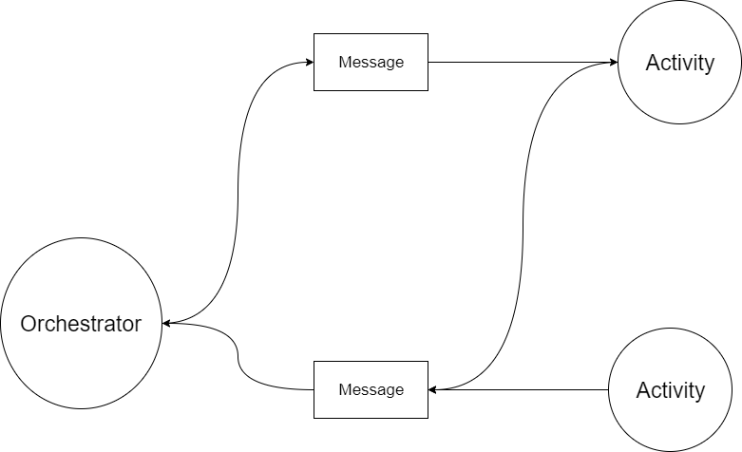
Behind the scenes
Notes:
CallActivityAsync invokes and a message is queued from the orchestrator to the activity function. Activity sends the result as a queue message back to the orchestrator. When orchestrator gets the message, it can then invoke the second activity.

Slide 34
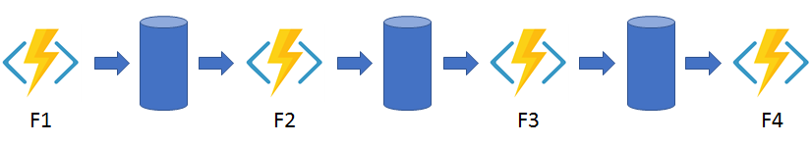
Design pattern
Functional Chaining
Notes:
In the function chaining pattern, a sequence of functions executes in a specific order. In this pattern, the output of one function is applied to the input of another function.

Slide 35
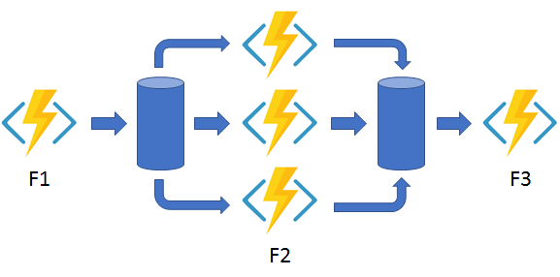
Design pattern
Fan in Fan out
Notes:
In the fan out/fan in pattern, you execute multiple functions in parallel and then wait for all functions to finish. Often, some aggregation work is done on the results that are returned from the functions.

Slide 36
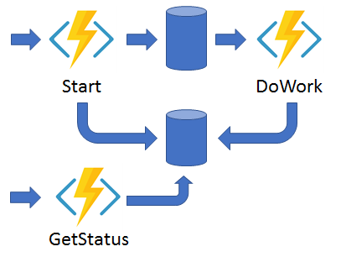
Design pattern
Async HTTP API
Notes:
The async HTTP API pattern addresses the problem of coordinating the state of long-running operations with external clients. A common way to implement this pattern is by having an HTTP endpoint trigger the long-running action. Then, redirect the client to a status endpoint that the client polls to learn when the operation is finished.

Slide 37
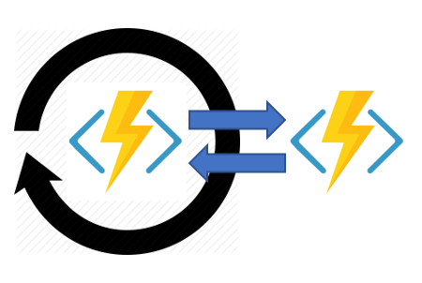
Design pattern
Monitoring
Notes:
The monitor pattern refers to a flexible, recurring process in a workflow. An example is polling until specific conditions are met. You can use a regular timer trigger to address a basic scenario, such as a periodic cleanup job, but its interval is static and managing instance lifetimes becomes complex. You can use Durable Functions to create flexible recurrence intervals, manage task lifetimes, and create multiple monitor processes from a single orchestration.

Slide 38
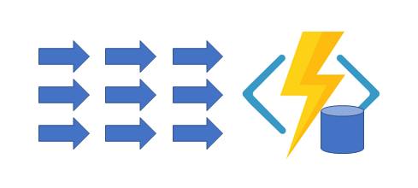
Design pattern
Aggregator
Notes:
The sixth pattern is about aggregating event data over a period of time into a single, addressable entity. In this pattern, the data being aggregated may come from multiple sources, may be delivered in batches, or may be scattered over long-periods of time. The aggregator might need to take action on event data as it arrives, and external clients may need to query the aggregated data.

Slide 39
Durable functions in practice

Slide 40
Latest news (What’s new)

Slide 41
Kubernetes-based Event Driven Autoscaling (KEDA)
Tool to create or run event driven K8S workloads such as Azure Functions in K8S.
Still experimental
https://github.com/kedacore/keda

Slide 42
Keep in touch
Email: khiem.ho@knowit.no
Github: kkho
Source code: https://github.com/kkho/serverless-architecture-poc

