Slide 1
Aim
The aim of this project is to design, simulate and test a network
Cisco Packet Tracer was used to simulate and test the network.

Slide 2
Case problem
Noble Pharma Solutions Ltd is a fictitious pharmaceutical company producing a wide range of drugs. The company is currently relocating to new a headquarters in Doha. The new premises is going to have the three buildings, with different departments located within

Slide 3
Case problem
Distribution of Departments
Building | Department | Staff Number
Building 1 | Manufacturing | 105
 | Research & Development | 30
 | Server Room | 12
Building 2 | Sales & Marketing | 100
 | Human Resources & Logistics | 24
Building 3 | Finance & Accounts | 16
 | Administration & PR | 24

Slide 4
requirements
OSPF routing
Inter-VLAN communication
NAT capabilities
Basic Configurations:
Hostname on switches and routers
MOTD banner
Console & vty passwords
Password encryption
SSH access
Use hierarchical model
Connected to at least 2 ISPs
Use public static IP addresses: 78.142.100.0/30, 78.142.100.4/30, 78.142.100.8/30, and 78.142.100.12/30.
Base IP: 192.168.100.0
Each department on different subnet and VLAN
Dynamic IP allocation using DHCP
Static IP allocation to server nodes

Slide 5
Network topology
The hierarchical model was used:
Access level – each department was served by a different switch
Distribution level – each access-level switch was connected to 2 distribution-level switches
Core level – 2 core routers were used

Slide 6
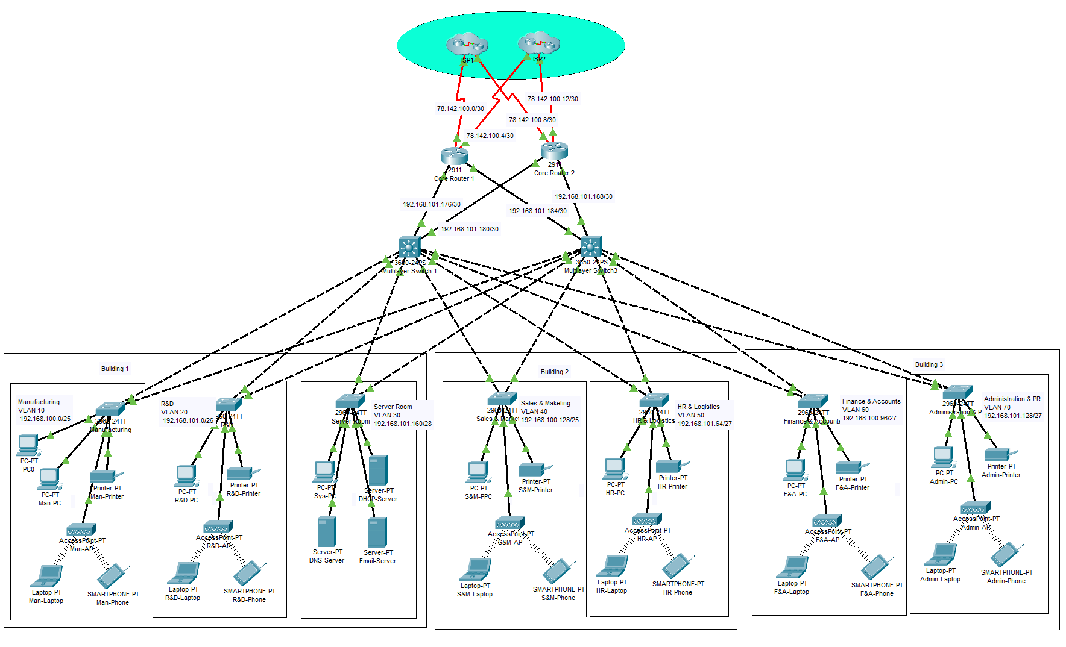
Network topology

Slide 7
Configuring the network

Slide 8
1. Basic Configurations
Message of the day banner (MOTD) – configured to “No Unauthorized Access”
Console password – configured to “cisco”
Vty password – configured to “cisco”
Password encryption – was enabled

Slide 9
2. Vlan setup, access & trunk port configuration
VLANs were assigned as shown
The distribution-switch facing ports of the access-level switches were configured to be trunks.
Ports pf access-level switches serving end nodes were configured to operate in access mode.
Unused ports were allocated to dummy VLAN
Department | VLAN
Manufacturing | VLAN 10
Research & Development | VLAN 20
Server | VLAN 30
Sales & Marketing | VLAN 40
HR & Logistics | VLAN 50
Finance & Accounts | VLAN 60
Administration & PR | VLAN 70

Slide 10
3. IP Addressing & subnetting
Department/ Device Ports | Network Address | Subnet Mask | Host Address Range | Broadcast Address
Building 1
Manufacturing | 192.168.100.0 | 255.255.255.128 | 192.168.100.1 – 192.168.100.126 | 192.168.100.127
R&D | 192.168.101.0 | 255.255.255.192 | 192.168.101.1- 192.168.101.62 | 192.168.101.63
Server room | 192.168.101.160 | 255.255.255.240 | 192.168.101.161 – 192.168.101.174 | 192.168.101.175
Building 2
Sales & Marketing | 192.168.100.128 | 255.255.255.128 | 192.168.100.129 – 192.168.100.254 | 192.168.100.255
Human Resource & logistics | 192.168.101.64 | 255.255.255.224 | 192.168.101.65 – 192.168.101.94 | 192.168.101.95

Slide 11
3. IP Addressing & subnetting
Department/ Device Ports | Network Address | Subnet Mask | Host Address Range | Broadcast Address
Building 3
Finance & Accounts | 192.168.101.96 | 255.255.255.224 | 192.168.101.97 – 192.168.101.126 | 192.168.101.127
Administration & PR | 192.168.101.128 | 255.255.255.224 | 192.168.101.129 – 192.168.101.158 | 192.168.101.159
Interfaces
R1 – MLSW1 | 192.168.101.176 | 255.255.255.252 | 192.168.101.177 – 192.168.101.178 | 192.168.101.179
R1-MLSW2 | 192.168.101.180 | 255.255.255.252 | 192.168.101.181 – 192.168.101.182 | 192.168.101.183
R2-MLSW1 | 192.168.101.184 | 255.255.255.252 | 192.168.101.185 – 192.168.101.186 | 192.168.101.187

Slide 12
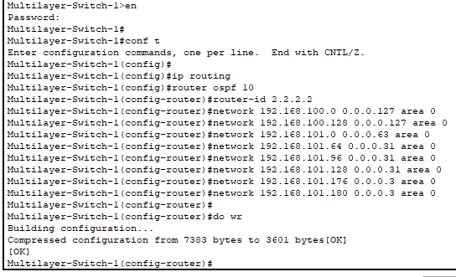
4. OSPF Configuration
OSPF routing protocol was configured for distribution-level switches and core-level routers.
The networks accessible to each routing device were advertised.

Slide 13
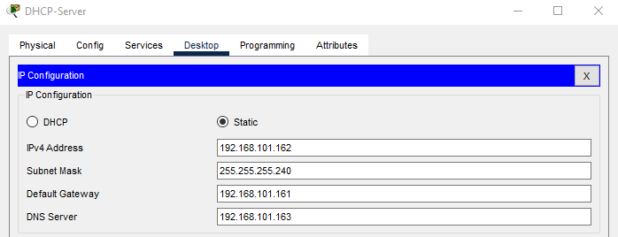
5. Static ip allocation of server nodes
Server nodes were allocated IP addresses as shown:
Device | DHCP Server | DNS Server | PC
IP | 192.168.101.162 | 192.168.101.163 | 192.168.101.164

Slide 14
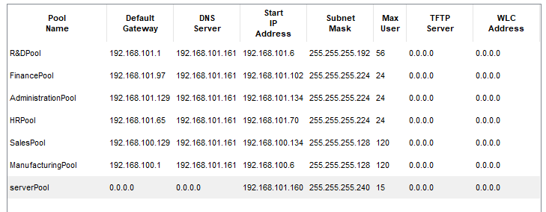
6. Dhcp configuration
DHCP service was enabled. Address pools were assigned as shown:

Slide 15
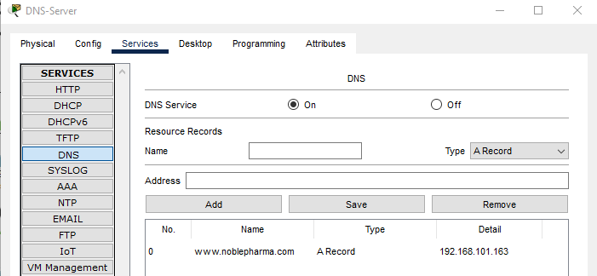
7. DNS Configuration
DNS service was enabled. An A record of www.noblepharma.com was entered

Slide 16
8. Inter-Vlan routing
Inter-VLAN routing was enabled.
The IP address and subnet of each VLAN was specified
The VLANs were instructed not to shutdown

Slide 17
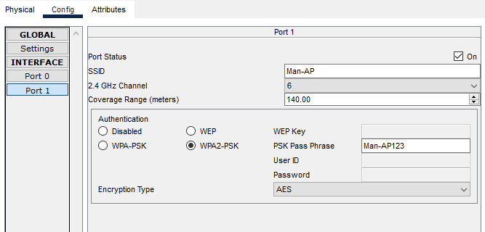
9. Access point configuration
The SSIDs and WPA2-PSK passwords of each AP in departments were setup

Slide 18
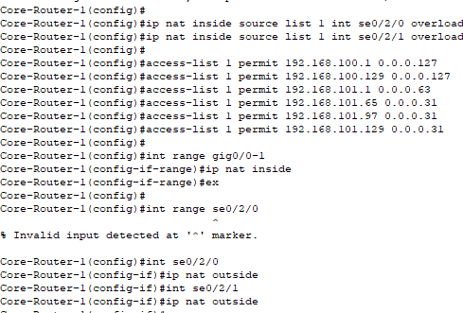
10. Nat configuration
NAT was configured to be used.
An access list was also configured to define from which networks permission was to be granted to communicate with the outside world

Slide 19
Testing and results

Slide 20
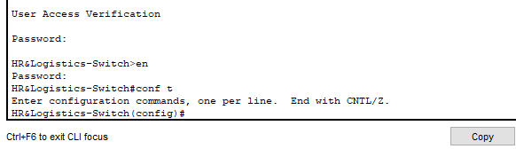
1. Login security
Console and vty passwords were requested to authorize access to switches and routers

Slide 21
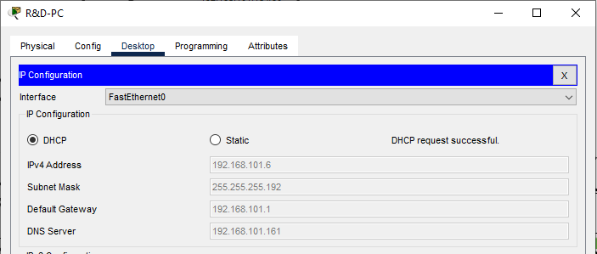
2. Dynamic ip acquisition
Devices were able to acquire IP addresses dynamically using the DHCP server

Slide 22
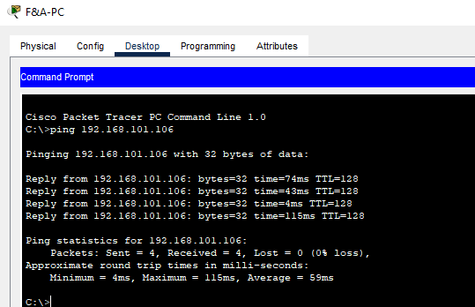
3. intRA-vlan routing
Inra-VLAN routing was a success. .
Pings to devices on the same department was successful

Slide 23
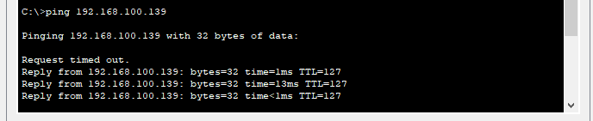
3. inter-vlan routing
Inter-VLAN routing was a success. .
Pings to devices on other departments was successful

Slide 24
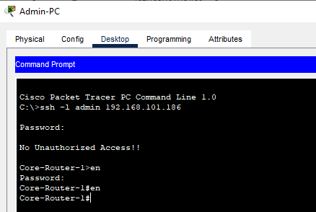
4. ssh
SSH was a success.
One was able to log into switches and routers from local machines

Slide 25
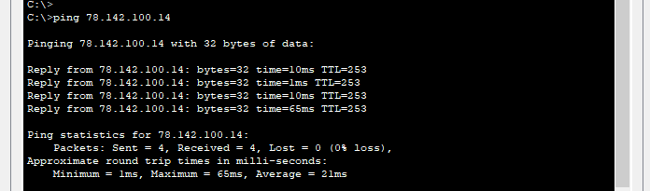
5. nat
NAT was success successful. Inside IP addresses were converted to outside IPs and vice versa.

Slide 26
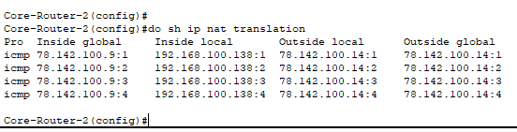
5. nat

Slide 27
conclusion

Slide 28
conclusion
In this project, we were able to accomplish:
Implementation of hierarchical model
VLAN setup
IP addressing and Subnetting
OSPF configuration
DHCP configuration
DNS configuration
AP configuration
NAT configuration
Basic functionality implemented were:
Login security – console and vty
MOTD banner
Password encryption
SSH

