Slide 1
Opentelemetry 데모 실행
Springboot, Django 테스트 어플리케이션 개발
프로메테우스 대시보드 연동

Slide 2
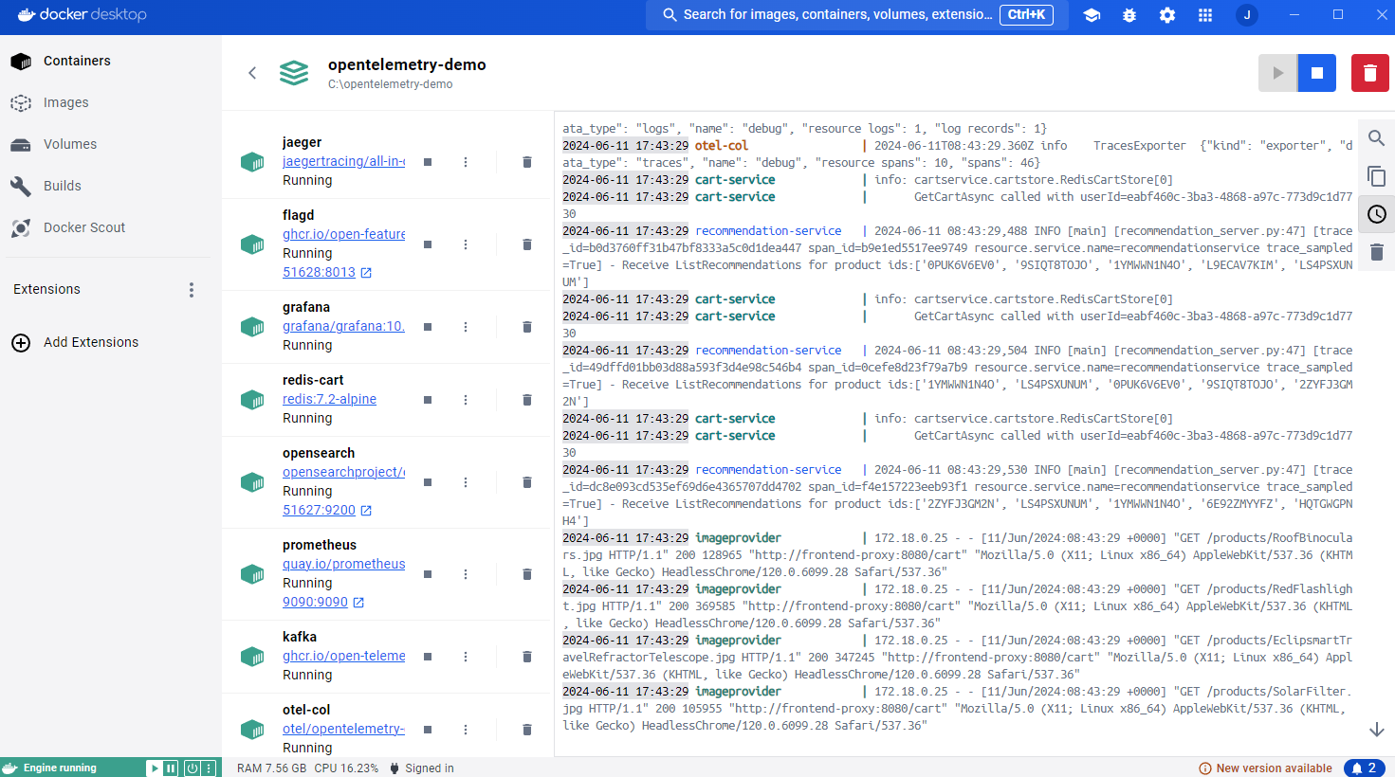

Slide 3
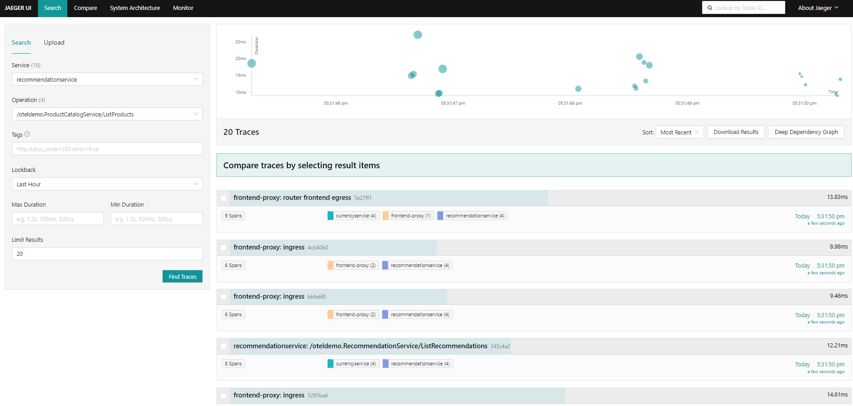

Slide 4
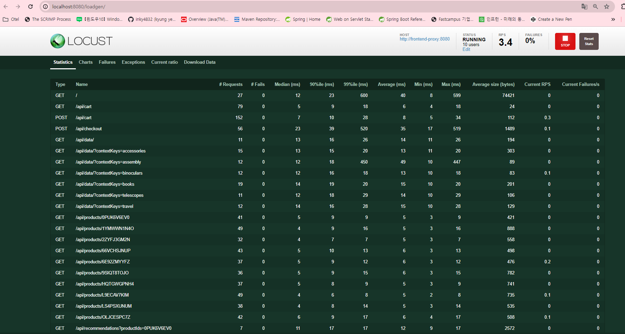

Slide 5
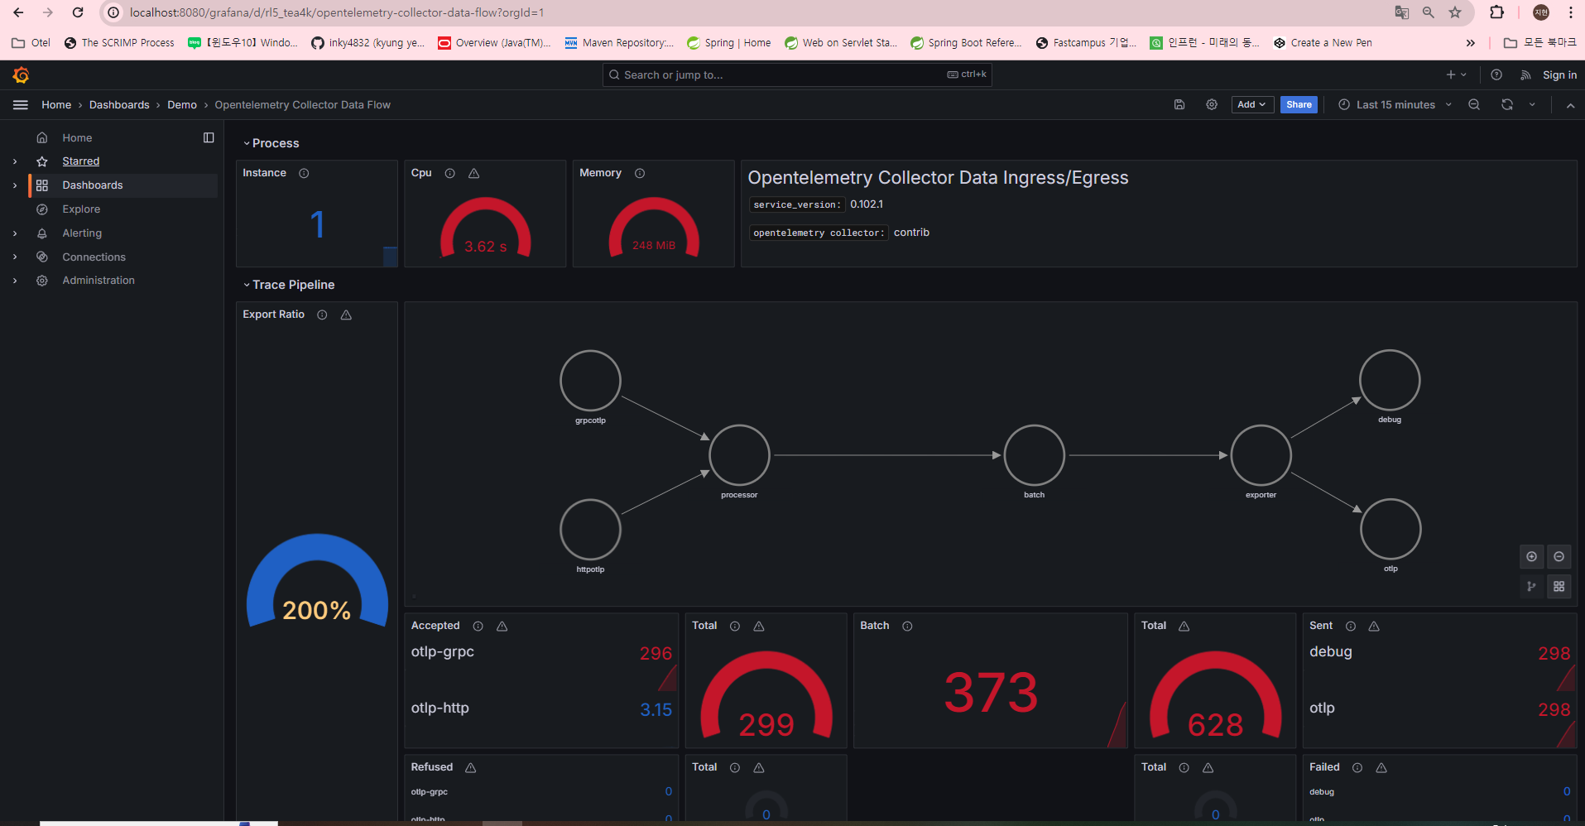

Slide 6
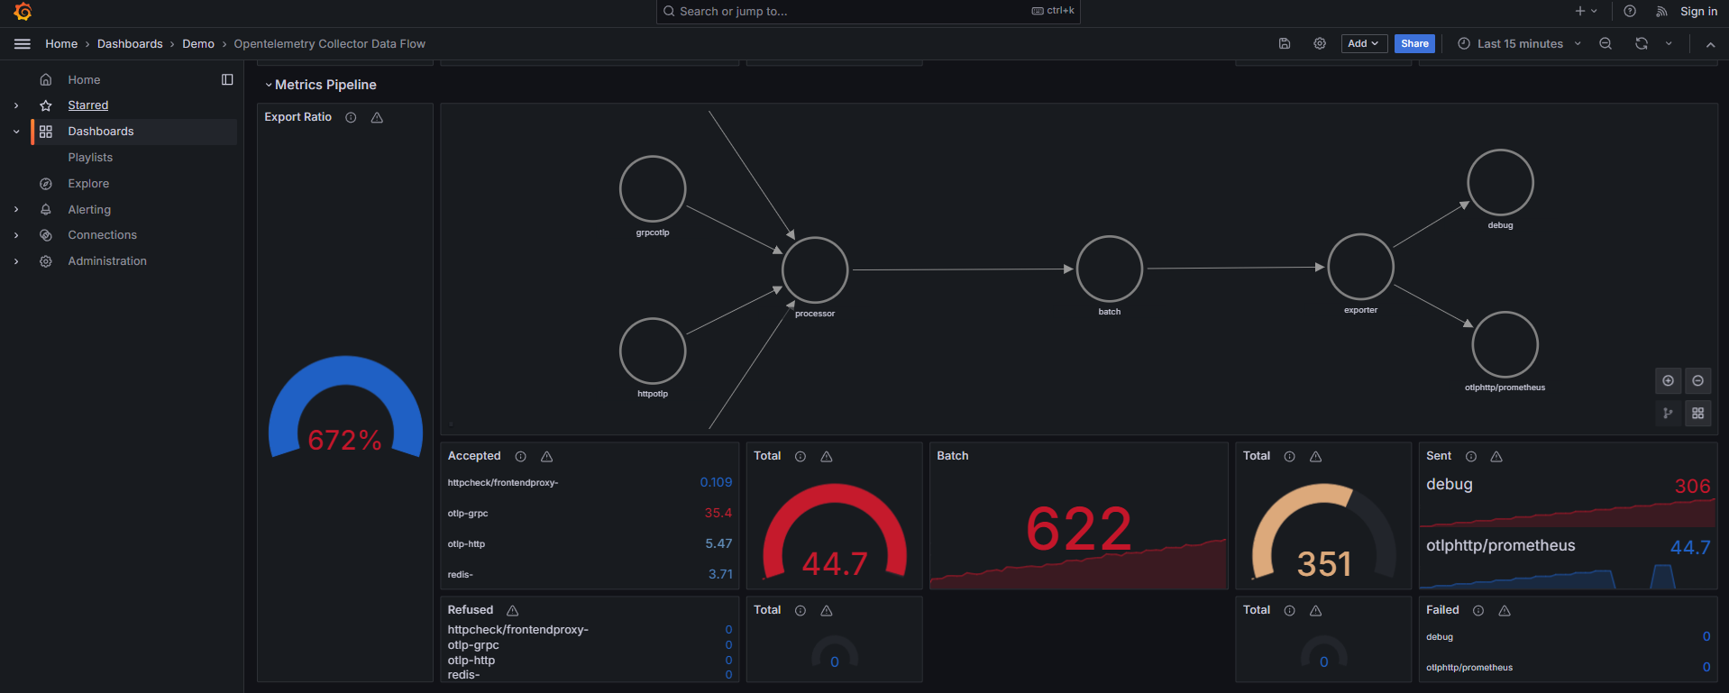

Slide 7
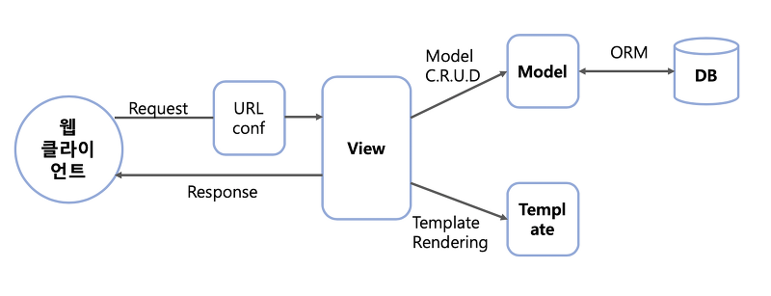

Slide 8
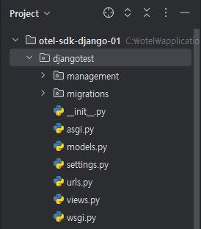
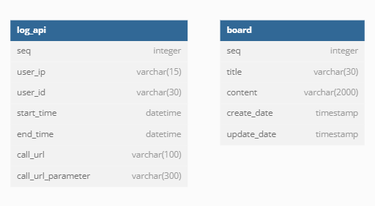
Models.py
from django.db import models # Create your models here. class log_api(models.Model): seq = models.AutoField(primary_key=True) user_ip = models.CharField(max_length=15) user_id = models.CharField(max_length=30) start_time = models.DateTimeField() end_time = models.DateTimeField() call_url = models.CharField(max_length=100) call_url_parameter = models.CharField(max_length=300) class board(models.Model): seq = models.AutoField(primary_key=True) title = models.CharField(max_length=30) content = models.CharField(max_length=2000) create_date = models.DateTimeField() update_date = models.DateTimeField()
Settings.py
from pathlib import Path import os from django.utils.log import DEFAULT_LOGGING # 환경 변수 설정 os.environ['OTEL_EXPORTER_OTLP_ENDPOINT'] = 'localhost:4317' os.environ['OTEL_SERVICE_NAME'] = 'django_app' os.environ['OTEL_EXPORTER_OTLP_INSECURE'] = 'true' os.environ['OTEL_METRIC_EXPORT_INTERVAL'] = '500’
…
…
LANGUAGE_CODE = 'en-us' TIME_ZONE = 'Asia/Seoul' USE_I18N = True USE_TZ = False

Slide 9
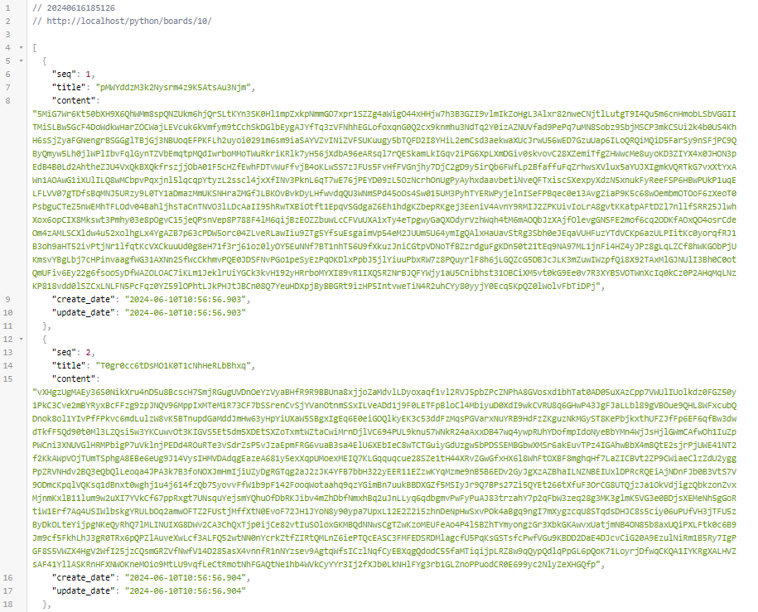
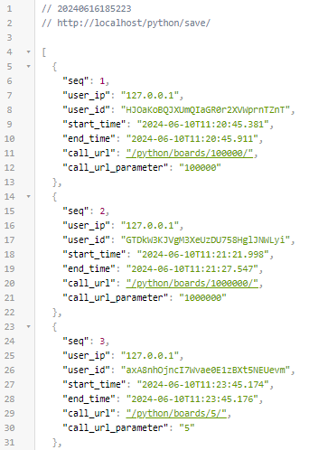
Urls.py
실제 호출 시
from django.contrib import admin from django.urls import path from .views import get_data, log_data, home urlpatterns = [ path('admin/', admin.site.urls), path('boards/<int:num_items>/', get_data, name='get_data'), path('save/', log_data, name='log_data'), path('', home, name='home'), ]
Views.py
tracer = trace.get_tracer("django-app.tracer") meter = metrics.get_meter("django-app.meter") request_duration = meter.create_histogram( "request_duration", description="Request processing time in milliseconds", unit="ms" ) def get_client_ip(request): ip_address = request.META["HTTP_X_REAL_IP"] return ip_address def get_data(request, num_items): start_time = timezone.now() data = board.objects.all()[:num_items].values('seq', 'title', 'content', 'create_date', 'update_date') data_list = list(data) end_time = timezone.now() client_ip = get_client_ip(request) log_api.objects.create( user_ip=client_ip, user_id=get_random_string(30), start_time=start_time, end_time=end_time, call_url=request.path, call_url_parameter=num_items ) duration = (end_time - start_time).total_seconds() * 1000 # 밀리초 단위로 변환 request_duration.record(duration, {"method": request.method, "path": request.path}) return JsonResponse(data_list, safe=False) # 데이터를 JSON 형식으로 반환

Slide 10
from opentelemetry import metrics os.environ.setdefault('DJANGO_SETTINGS_MODULE', 'djangotest.settings') application = get_wsgi_application() # 리소스 설정: 여기에서 'job' 라벨을 지정합니다. resource = Resource.create({ "service.name": "python.sdk.otel-app.co.kr", "service.instance.id": "Django-Testapplication", "job": "django-service" # 이렇게 job 이름을 설정할 수 있습니다. }) logger_provider = LoggerProvider(resource=resource) set_logger_provider(logger_provider) exporter = OTLPLogExporter(insecure=True) logger_provider.add_log_record_processor(BatchLogRecordProcessor(exporter)) handler = LoggingHandler(level=logging.NOTSET, logger_provider=logger_provider) logging.getLogger().addHandler(handler)# OpenTelemetry 설정 span_exporter = OTLPSpanExporter(endpoint=os.getenv('OTLP_GRPC_ENDPOINT', '127.0.0.1:4317')) span_processor = BatchSpanProcessor(span_exporter) trace.set_tracer_provider(TracerProvider()) tracer_provider = trace.get_tracer_provider() tracer_provider.add_span_processor(span_processor) trace.get_tracer_provider().add_span_processor(span_processor) tracer = trace.get_tracer(__name__) # 특정 작업을 나타내는 스팬 시작 및 다양한 속성 추가 with tracer.start_as_current_span("operation", kind=SpanKind.INTERNAL) as span: # 스팬에 속성 추가 span.set_attribute("hostname", "hostName") span.set_attribute("ip-address", "ip") span.set_attribute("region", "korea") span.set_attribute("http.method", "httpMethod") span.set_attribute("http.url", "httpUrl") span.set_attribute("http.uri", "httpUri") span.set_attribute("http.queryString", "queryString") span.set_attribute("http.fullUrl", "fullUrl") logging.getLogger().error("This is a log message") # Metric Exporter 설정 # 메트릭 데이터를 같은 엔드포인트로 전송, PeriodicExportingMetricReader를 사용하여 주기적으로 메트릭 수집 및 전송 metric_exporter = OTLPMetricExporter(endpoint=os.getenv('OTLP_GRPC_ENDPOINT', '127.0.0.1:4317')) metric_reader = PeriodicExportingMetricReader(metric_exporter) meter_provider = MeterProvider(resource=resource, metric_readers=[metric_reader]) metrics.set_meter_provider(meter_provider) meter = metrics.get_meter(__name__, version="0.1")

Slide 11
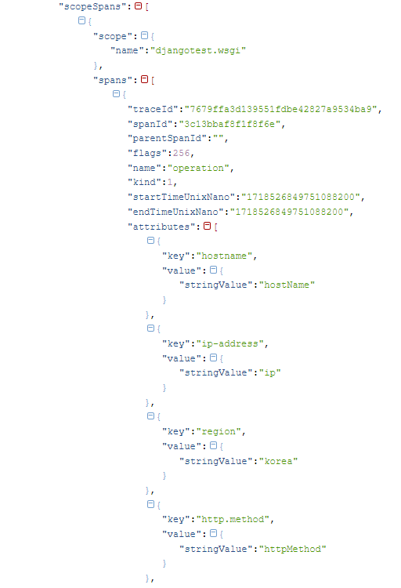
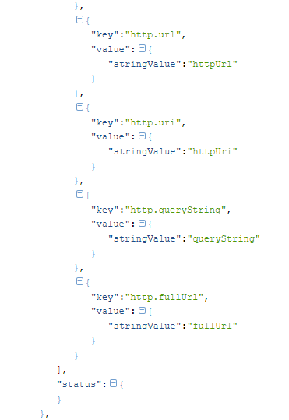
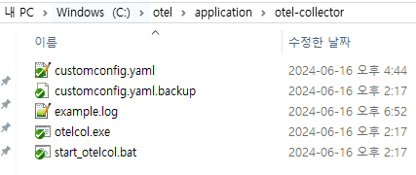
Wsgi.py
# 특정 작업을 나타내는 스팬 시작 및 다양한 속성 추가 with tracer.start_as_current_span("operation", kind=SpanKind.INTERNAL) as span: # 스팬에 속성 추가 span.set_attribute("hostname", "hostName") span.set_attribute("ip-address", "ip") span.set_attribute("region", "korea") span.set_attribute("http.method", "httpMethod") span.set_attribute("http.url", "httpUrl") span.set_attribute("http.uri", "httpUri") span.set_attribute("http.queryString", "queryString") span.set_attribute("http.fullUrl", "fullUrl") logging.getLogger().error("This is a log message")
example.log

Slide 12
def get_cpu_usage_callback(_: CallbackOptions): for (number, percent) in enumerate(psutil.cpu_percent(percpu=True)): attributes = {"cpu_number": str(number)} yield Observation(percent, attributes) # Callback to gather RAM memory usage def get_ram_usage_callback(_: CallbackOptions): ram_percent = psutil.virtual_memory().percent yield Observation(ram_percent) requests_counter = meter.create_counter( name="requests", description="number of requests", unit="1" ) requests_size = meter.create_histogram( name="request_size_bytes", description="size of requests", unit="byte" ) cpu_gauge = meter.create_observable_gauge( callbacks=[get_cpu_usage_callback], name="cpu_percent", description="per-cpu usage", unit="1" ) ram_gauge = meter.create_observable_gauge( callbacks=[get_ram_usage_callback], name="ram_percent", description="RAM memory usage", unit="1", ) # Django에서 발생하는 요청 및 응답을 자동으로 추적하여 관련 스팬 생성 DjangoInstrumentor().instrument() # WSGI 애플리케이션 초기화 application = get_wsgi_application()

Slide 13
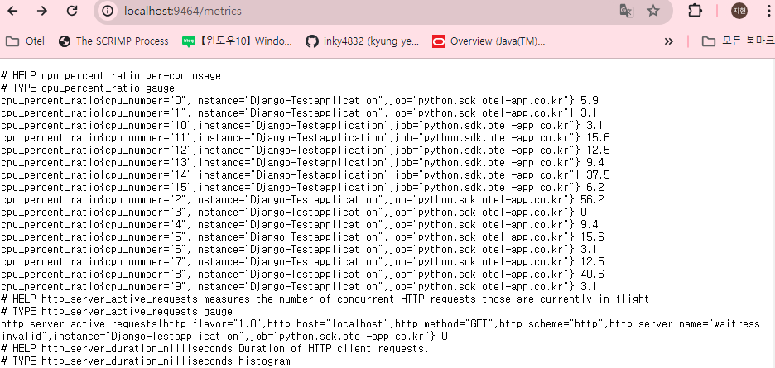
Cpu 코어별로

Slide 14
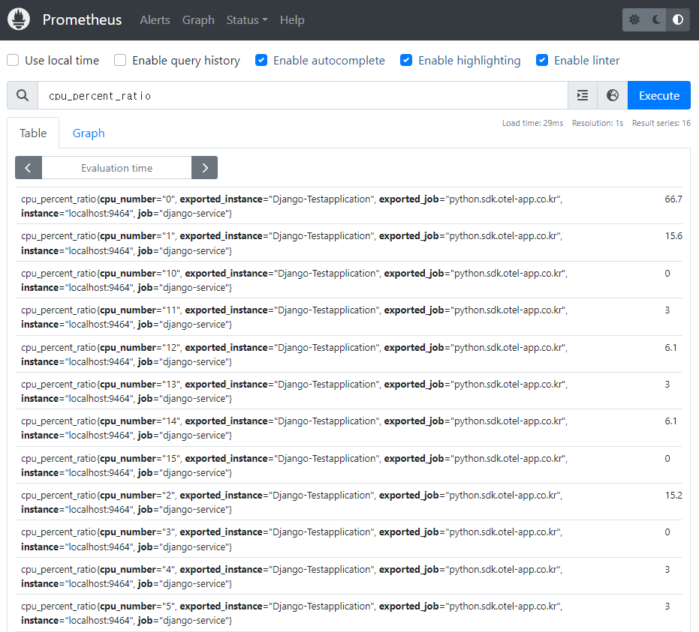
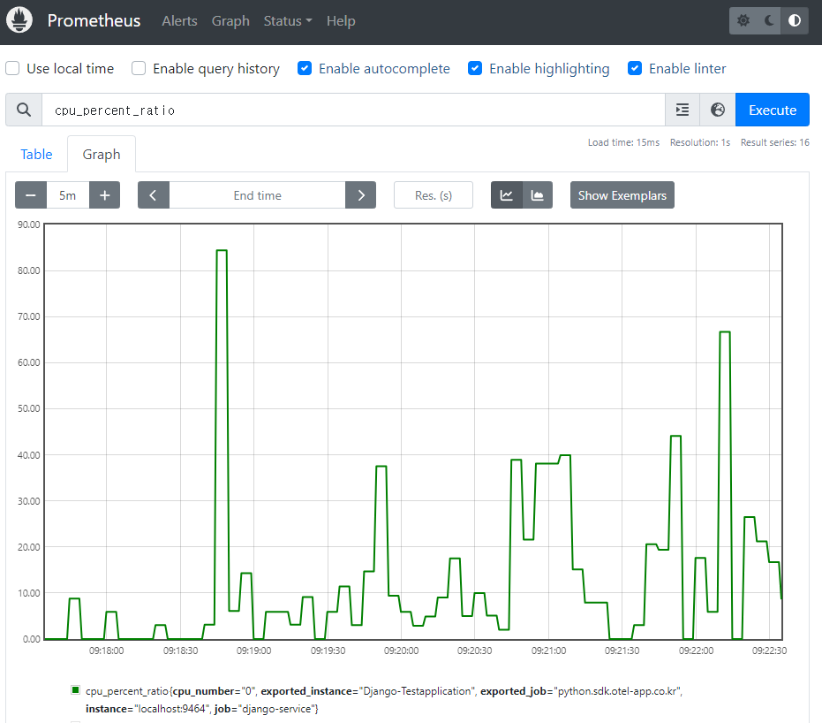

Slide 15
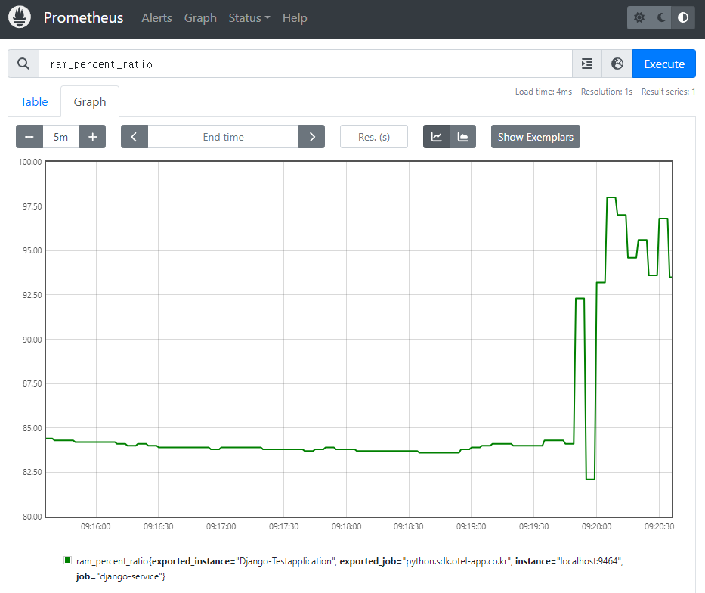

Slide 16
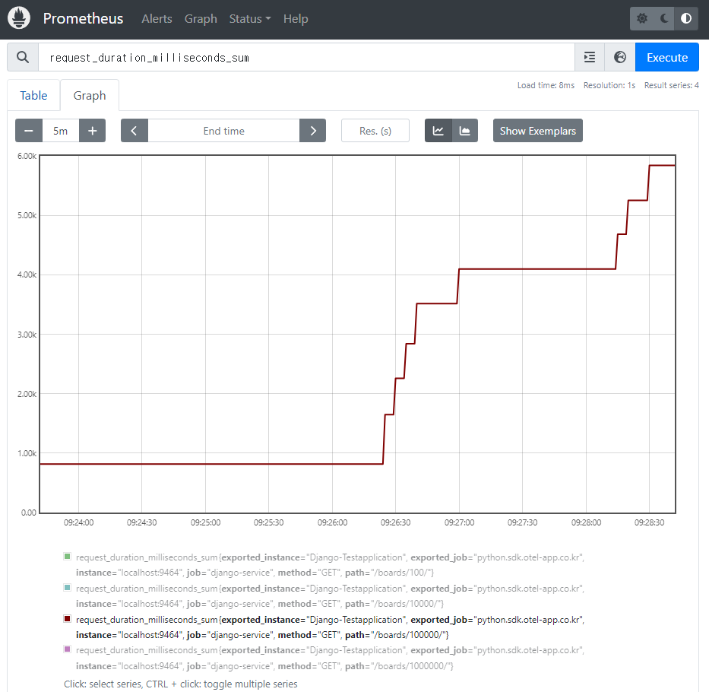
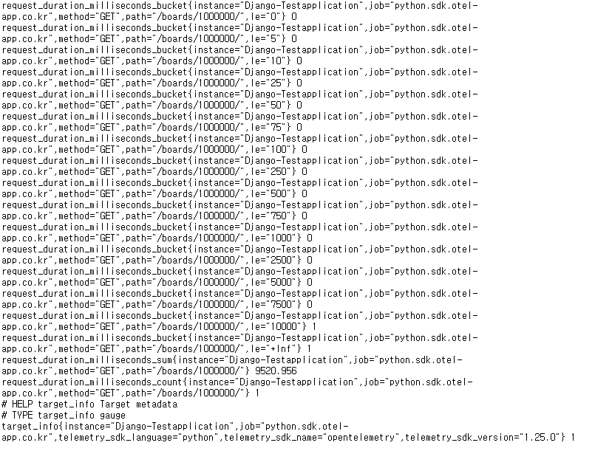

Slide 17
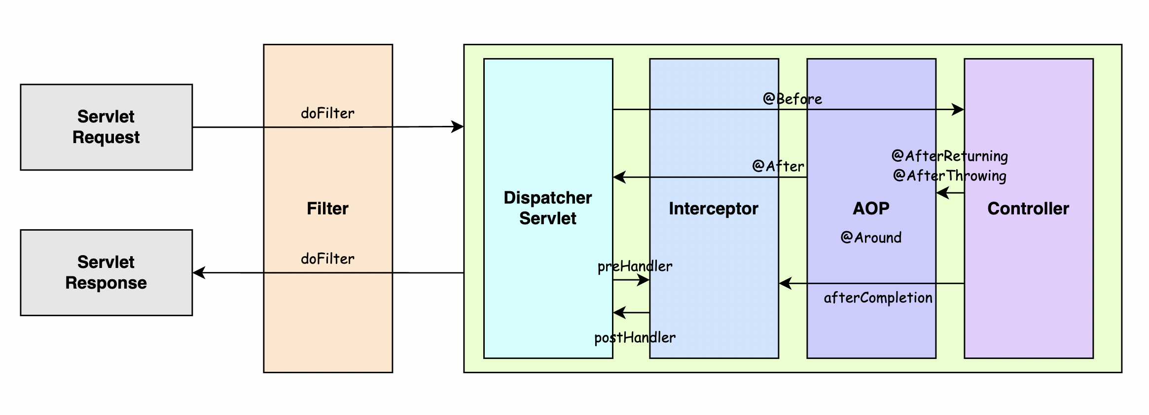
스프링의 AOP 영역

Slide 18

SpringBoot – OpenTelemetry Config
@Configuration public class OpenTelemetryConfig { private static final long METRIC_EXPORT_INTERVAL_MS = 800L; @Bean public OpenTelemetry openTelemetry() { Resource resource = Resource.getDefault() .toBuilder() .put(ResourceAttributes.SERVICE_NAME, "otel-sdk-springboot-01-service") //서비스명 설정 .put(ResourceAttributes.SERVICE_VERSION, "1.0.0") //서비스 버전 설정 .build();
…중략… OpenTelemetry openTelemetry = OpenTelemetrySdk.builder() .setTracerProvider(sdkTracerProvider) .setMeterProvider(sdkMeterProvider) .setLoggerProvider(sdkLoggerProvider) .setPropagators(ContextPropagators.create(TextMapPropagator.composite(W3CTraceContextPropagator.getInstance(), W3CBaggagePropagator.getInstance()))) .buildAndRegisterGlobal(); // OpenTelemetryAppender.install(openTelemetry); return openTelemetry; } //AOP에서 사용하기 위해 Bean 등록 @Bean public Tracer tracer(OpenTelemetry openTelemetry) { return openTelemetry.getTracer("com.kt.otelsdkspringboot01"); } @Bean public Meter meter(OpenTelemetry openTelemetry) { return openTelemetry.getMeter("com.kt.otelsdkspringboot01"); } }

Slide 19
@Aspect @Configuration public class OpenTelemetryAspect { private static final Logger logger = LogManager.getLogger(OpenTelemetryAspect.class.getName()); … 중략 … @Before("@annotation(org.springframework.web.bind.annotation.RequestMapping) || " + "@annotation(org.springframework.web.bind.annotation.GetMapping) || " + "@annotation(org.springframework.web.bind.annotation.PostMapping) || " + "@annotation(org.springframework.web.bind.annotation.PutMapping) || " + "@annotation(org.springframework.web.bind.annotation.DeleteMapping)") public void startSpan(JoinPoint joinPoint) { AttributesBuilder attrsBuilder = Attributes.builder() .put("hostname", hostName) .put("ip-address", ip) .put("region", "korea") .put("http.method", httpMethod) .put("http.url", httpUrl) .put("http.uri", httpUri) .put("http.queryString", queryString) .put("http.fullUrl", fullUrl); Attributes attributes = attrsBuilder.build(); Span span = tracer.spanBuilder(joinPoint.getSignature().getName()) .setSpanKind(SpanKind.SERVER) // Use SERVER to indicate an incoming request .startSpan(); span.setAllAttributes(attributes); requestCounter.add(1, attributes); LongHistogram histogram = meter.histogramBuilder("SpringBoot-app-histogram") .ofLongs() // Required to get a LongHistogram, default is DoubleHistogram .setDescription("SpringBoot-app-URL-histogram") .setUnit("call count") .build(); histogram.record(1,attributes);
… 중략… currentSpan.set(span); } }
SpringBoot – AOP (Before)

Slide 20
SpringBoot – AOP (After)
@Aspect @Configuration public class OpenTelemetryAspect { private static final Logger logger = LogManager.getLogger(OpenTelemetryAspect.class.getName()); --- 중략--- @After("@annotation(org.springframework.web.bind.annotation.RequestMapping) || " + "@annotation(org.springframework.web.bind.annotation.GetMapping) || " + "@annotation(org.springframework.web.bind.annotation.PostMapping) || " + "@annotation(org.springframework.web.bind.annotation.PutMapping) || " + "@annotation(org.springframework.web.bind.annotation.DeleteMapping)") public void endSpan(JoinPoint joinPoint) { Span span = currentSpan.get(); if (span != null) { try { span.end(); } finally { currentSpan.remove(); } } logger.info("### end span ###"); } }

Slide 21
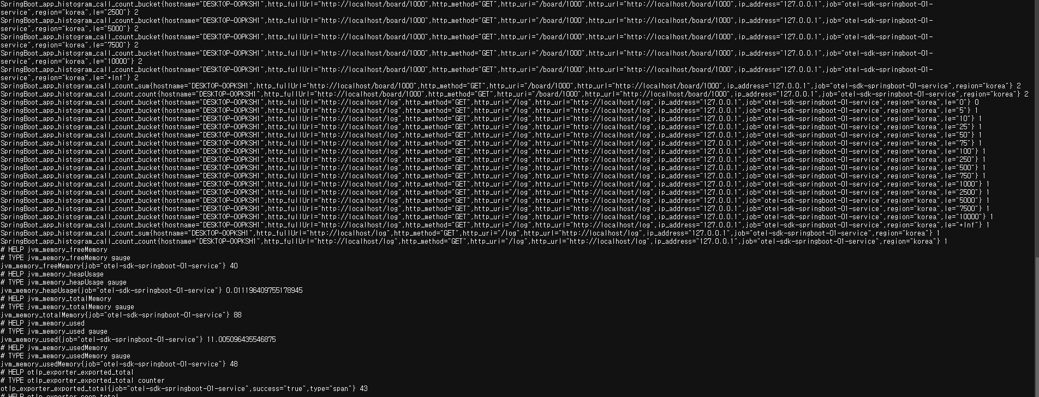
OpenTelemetry – 수집된 metrice

Slide 22
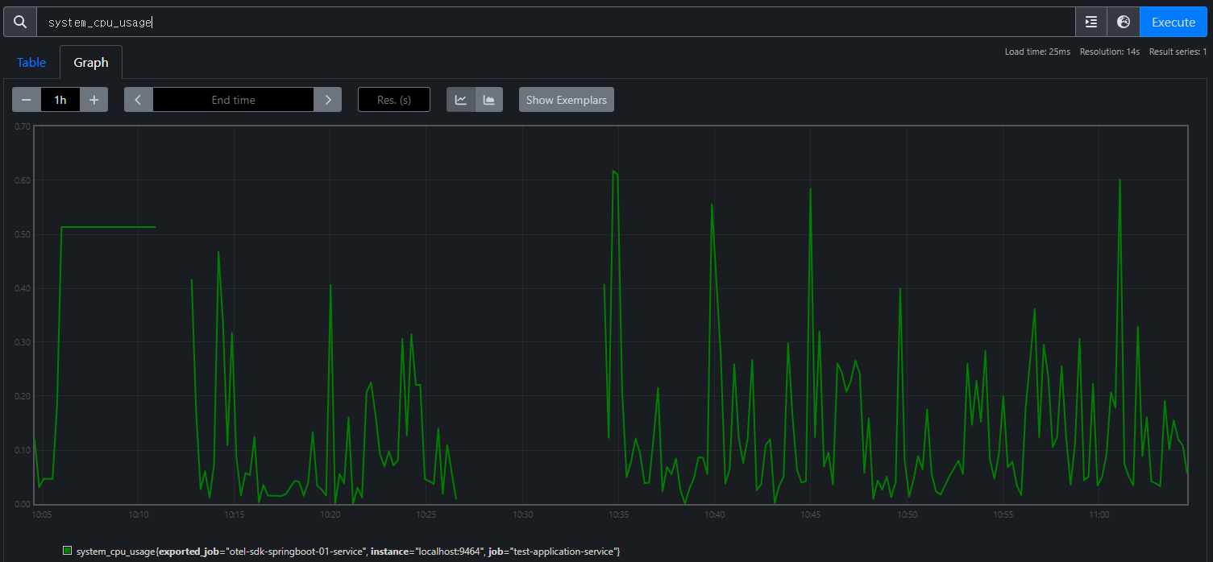
Prometheus 에서 확인한 CPU 사용량

Slide 23
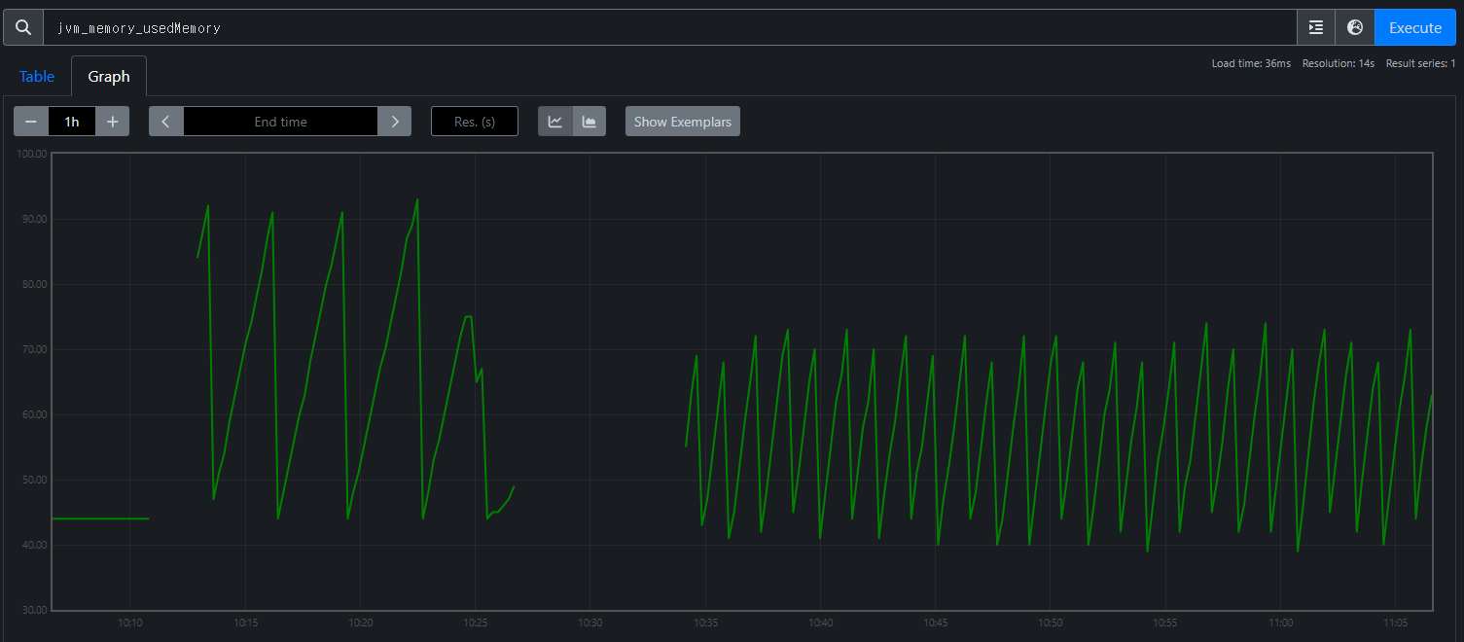
Prometheus 에서 확인한 Memory 사용량

Slide 24
2024-06-23 업데이트

Slide 25





Data Flow Overview
Metric
Span(trace)
Log
Test Application
Opentelemetry Collector
Monitoring Tool
SDK-SpringBoot
Prometheus
OTLP Receiver
Metric
OTLP Exporter
Metric
SDK-DJango
Jaeger
Grafana
OTLP Receiver
Span(trace)
OTLP Exporter
Span(trace)
Agent-SpringBoot
Auto-SpringBoot
OTLP Receiver
Log
OTLP Exporter
Log
Loki
Auto-DJango
Log.json

