Slide 1
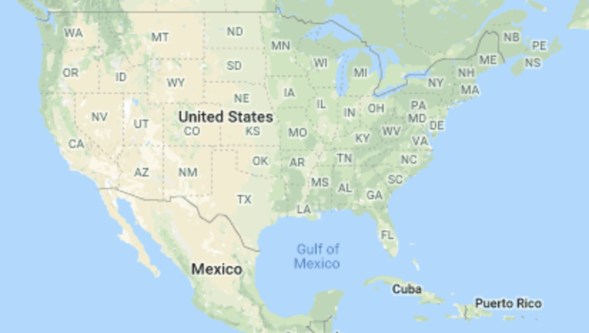
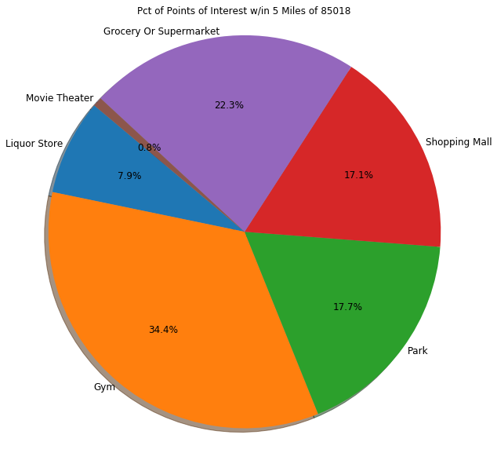
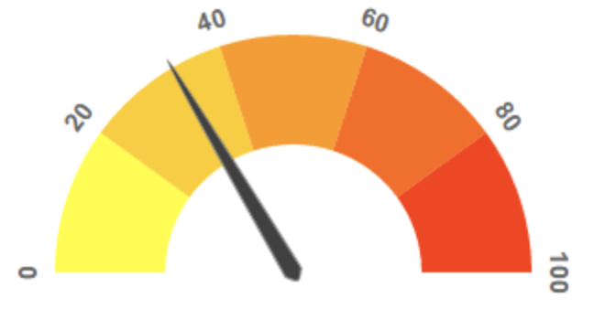
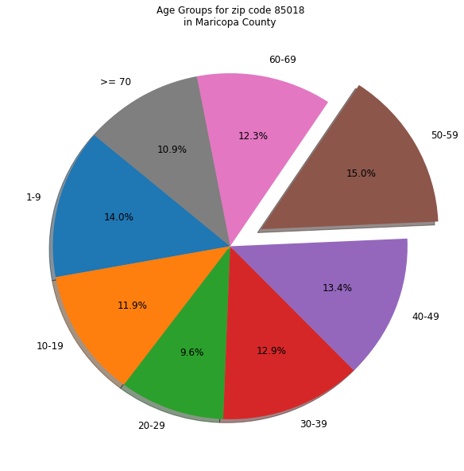
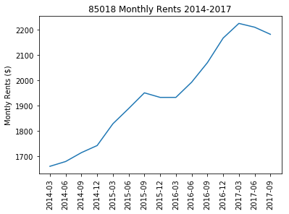
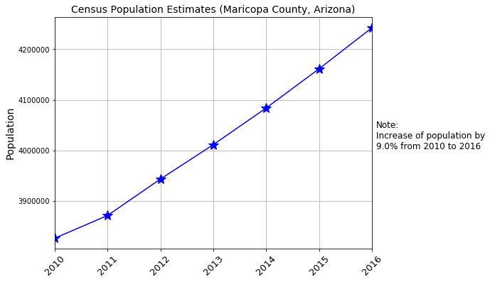
CitySlip 2.0
Search
CitySlip Score:
Average Home Value: 1.0/5
Average Rent: 3.0/5
Real Estate Market Health: 1.43/5 Average Winter Temp (F): 5.0/5 Average Summer Temp (F): 1.0/5 Total Schools: 3.47/10
Total Points of Interest: 20.0/30 Population Growth: 5.0/10
Sales Tax Rate: 1.0/5
Walkability: 1.8/5
Crime Risk: 5.0/15
DRAFT
Housing Market

