Slide 1
Electron-Initiated Photochemistry
Karl K. Irikura
Chemical Sciences Division, National Institute of Standards and Technology, Gaithersburg, Maryland, USA
www.nist.gov
ACS Boston, 8/22/2018
COMP 478
Notes:
Since this is the COMP division, I’ll emphasize computational modeling.

Slide 2
Overview
Importance of photochemistry
“Photochemistry” generalized
Examples
Gamma radiolysis
Proton beam therapy
Electron impact
Gas-phase catalysis

Slide 3
Photochemistry is important
Cosmochemistry (t = 380,000 yr)
Supports life on Earth (photosynthesis)
Basis of vision (rhodopsin)
Spectroscopy and analytical chemistry
Photography and photolithography
Photodegradation (weathering; skin cancer)
Cleaner source of energy for civilization (photovoltaics; plants)
Fluorescence, phosphorescence, chemiluminescence
Synthetic chemistry
Notes:
The energy in fossil fuels also originated in photchemistry.

Slide 4
“Photochemistry” generalized
Goal: inject lots of energy non-thermally (without incineration)
Non-adiabatic dynamics
“Photochemistry” usually means visible/UV light
Sunlight is abundant and free
Enough energy for electronic excitation
Shorter wavelengths of light
Gamma radiolysis
Charged particles (alpha, beta “rays”)
Proton-beam cancer therapy
Electron-ionization mass spectrometry
Lightning bolts, plasmas (both particles and radiation)

Slide 5
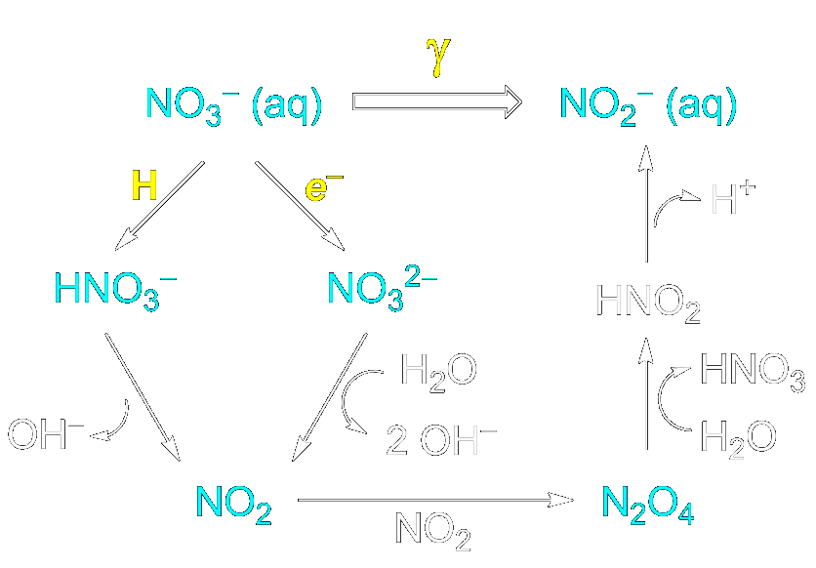
Gamma radiolysis
High-energy photon
Everything is a “chromophore”
“Pulse radiolysis” uses high-energy electrons (several MeV)
Mostly ionize solvent, not solute
Oxidative DNA damage
Radiation damage of materials
Example: reduction of aqueous nitrate (nuclear reactors)
Compare with municipal wastewater treatment by photocatalytic reduction
Tugaoen, H. O.; Garcia-Segura, S.; Hristovski, K.; Westerhoff, P. Challenges in photocatalytic reduction of nitrate as a water treatment technology. Sci. Total Environ. 2017, 599, 1524.
Horne, G. P.; Donoclift, T. A.; Sims, H. E.; Orr, R. M.; Pimblott, S. M. Multi-Scale Modeling of the Gamma Radiolysis of Nitrate Solutions. J. Phys. Chem. B 2016, 120, 11781.
Notes:
Ionizing radiation all similar.
Co-60: beta ~ 0.3 MeV plus 2 gammas ~ 1 MeV
The H atoms, electrons, and other high-energy species result from a cascade of fast events following ionization of a molecule by the gamma photon.

Slide 6
Gamma radiolysis
High-energy photon
Everything is a “chromophore”
“Pulse radiolysis” uses high-energy electrons (several MeV)
Mostly ionize solvent, not solute
Oxidative DNA damage
Radiation damage of materials
Example: reduction of aqueous nitrate (nuclear reactors)
Compare with municipal wastewater treatment by photocatalytic reduction
Tugaoen, H. O.; Garcia-Segura, S.; Hristovski, K.; Westerhoff, P. Challenges in photocatalytic reduction of nitrate as a water treatment technology. Sci. Total Environ. 2017, 599, 1524.
Horne, G. P.; Donoclift, T. A.; Sims, H. E.; Orr, R. M.; Pimblott, S. M. Multi-Scale Modeling of the Gamma Radiolysis of Nitrate Solutions. J. Phys. Chem. B 2016, 120, 11781.
Notes:
Ionizing radiation all similar.
Co-60: beta ~ 0.3 MeV plus 2 gammas ~ 1 MeV
The H atoms, electrons, and other high-energy species result from a cascade of fast events following ionization of a molecule by the gamma photon.

Slide 7
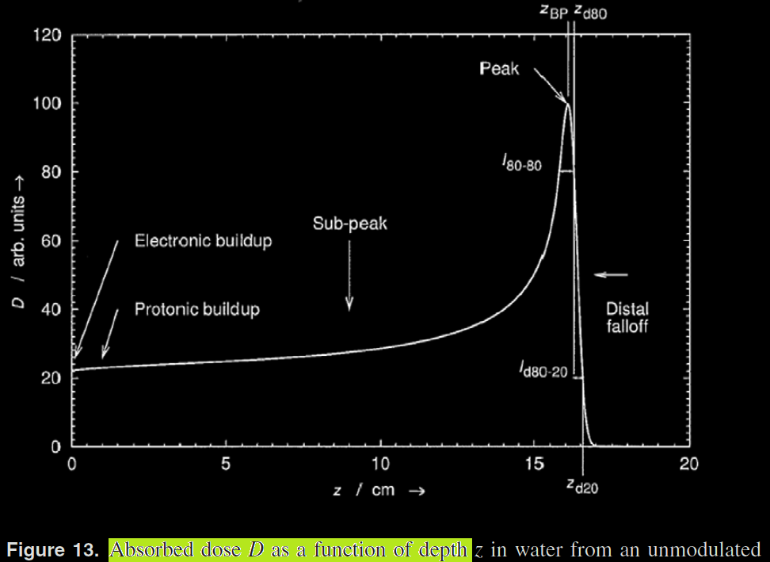
Proton beam therapy
For treating cancer
Dosage is better targeted than radiation therapy
No exit dose
Less damage to healthy tissue
High-energy H⁺ slows down
By scattering electrons
Slow H⁺ has big cross section
Radiolysis chemistry (DNA damage)
Newhauser, W., D.; Zhang, R. The physics of proton therapy. Phys. Med. Biol. 2015, 60, R155.
Notes:
Clinically, it’s still unclear that PB is better than x-ray. But it should be better, theoretically (as shown).
Figure is for 154 MeV. Typical is 70-250 MeV.
“Dose” means the energy deposited.
The analogous curve for x-rays is very different; it decays with depth, so the highest dose is near the skin.

Slide 8
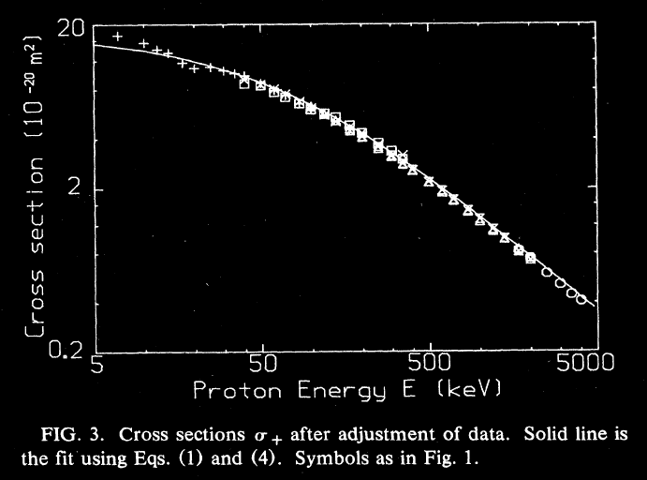
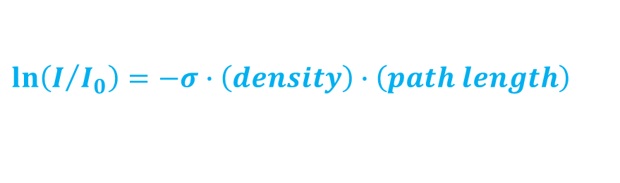
Proton ionization cross sections
Cross section (σ) is the extinction coefficient per particle (units of area)
$$ln\left(I/{I_{0}}\right)=−σ∙\left(density\right)∙\left(path length\right)$$
The slower the H⁺ gets, the more it slows down
Rudd, M. E.; Goffe, T. V.; Dubois, R. D.; Toburen, L. H. Cross sections for ionization of water vapor by 7-4000-keV protons. Phys. Rev. A 1985, 31, 492.
Notes:
The figures are for gas-phase H₂O.
When a proton ionizes something, it loses some energy and slows down.
Cross section for ejecting electrons peaks near 50 keV.
Cross section for creating positive ions is larger and declines with energy. As a proton slows down, it becomes more likely to slow down further.

Slide 9
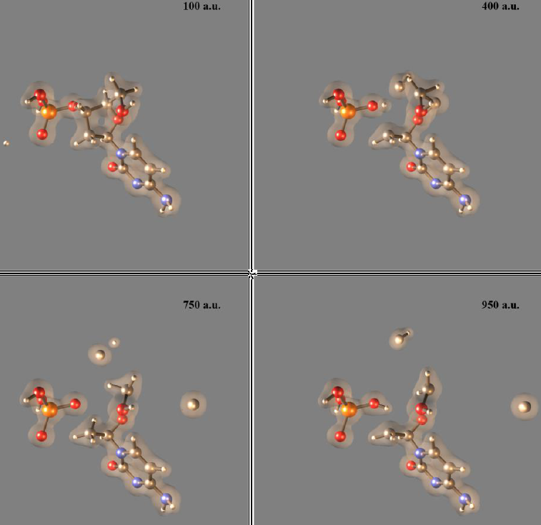
Proton beams: non-adiabatic dynamics
High-energy (10s of keV) radiolysis of water
Free radicals (H, OH)
Secondary ions (H⁺, OH⁻, e⁻)
Excited states
Reactive molecules (HOOH)
Some direct H⁺ collisions with DNA
Snapshots at right
Time shown ≈ 23 fs
Teixeira, E. S.; Uppulury, K.; Privett, A. J.; Stopera, C.; McLaurin, P. M.; Morales, J. A. Electron Nuclear Dynamics Simulations of Proton Cancer Therapy Reactions: Water Radiolysis and Proton- and Electron-Induced DNA Damage in Computational Prototypes. Cancers 2018, 10, 136.
Notes:
100 a.u. of time ~= 2.4 fs
Work by the group of Jorge Morales (Texas Tech. U).
“Figure 6. SLEND simulation of a proton-induced DNA SSB in H+ + excised cytosine nucleotide at 1 keV (frame times shown in atomic units (a.u.)). Colored spheres represent atoms (white = H, gray = C, red = O, blue = N, and orange = P) and the transparent clouds represent an electron density isosurface. The H+ projectile approaches the nucleotide from the left aiming at the C atom of the 3′ phospho-ester bond (first panel), hits that atom, breaks that bond and scatters away (second panel); meanwhile, the nucleotide breaks into CH2OH, H3PO4, CH, and C moieties and the rest of its structure. During the collision, one H atom migrates from the CH3 group hanging from the damaged sugar to the detached H2PO4 group to form a H3PO4 molecule (third and the fourth panels).”

Slide 10
Electron beams on molecules
Electronic excitation (M*)
Like photo-excitation, but can change spin by ±1
Ionization (M⁺)
Produces many different fragment ions
Basis of electron-ionization mass spectrometry (EIMS)
Attachment (M⁻)
Low-energy electrons
Processes that are chemically boring but relevant in plasmas
Vibrational/rotational excitation
Elastic scattering
Notes:
Excitation, ionization, and attachment may be followed by fragmentation or other chemistry.
I’ll focus on ionization.

Slide 11
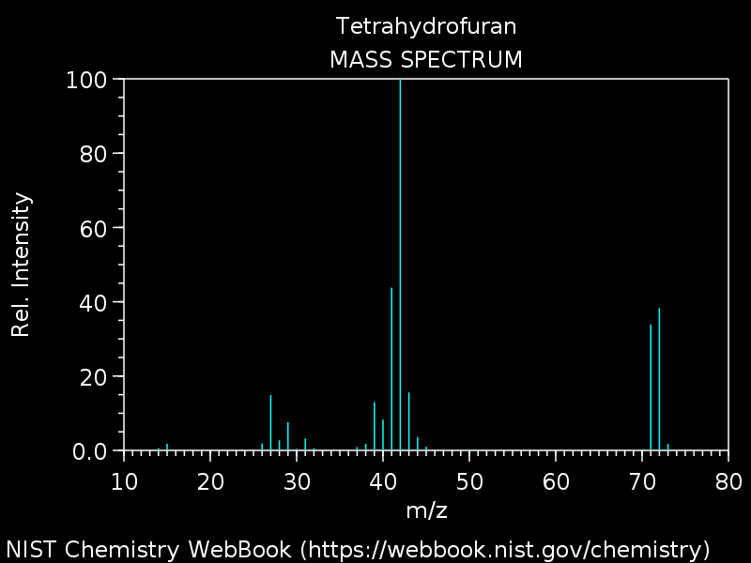
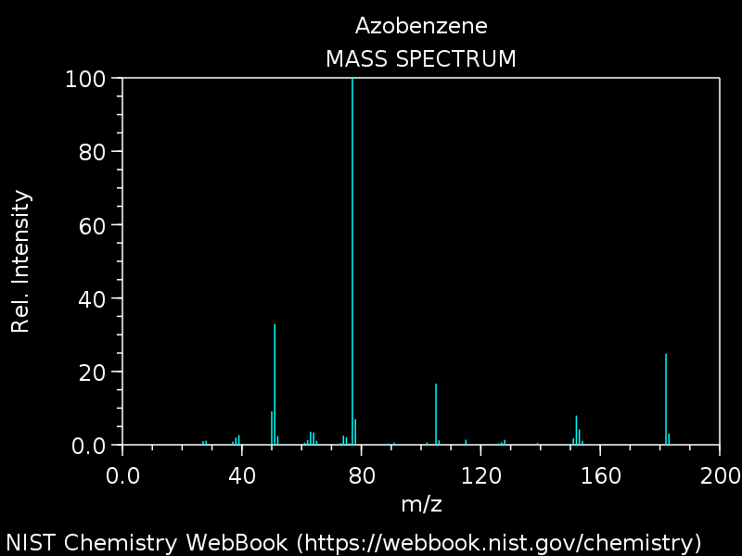
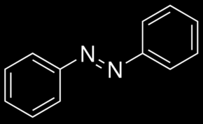
EIMS examples
No reliable, predictive theory!

Slide 12
First-Principles modeling of EIMS?
Distribution of internal energies
Can be computed ab initio 😊
Chemical fate (branching fractions of reaction products)
Adiabatic (on ground state potential-energy surface) 😐
Diabatic (on excited-state surface) 😒
Non-adiabatic (with electronic transitions) 😱
Smaller effects that partly cancel
Thermal energy of neutral target gas
Instrumental detection bias
Grimme, S. Towards First Principles Calculation of Electron Impact Mass Spectra of Molecules. Angew. Chem. Int. Ed. 2013, 52, 6306.
Notes:
I’ll return to this slide a few times.
See pioneering attempt by Stefan Grimme, in Germany (Bonn).

Slide 13
First-Principles modeling of EIMS?
Distribution of internal energies
Can be computed ab initio 😊
Chemical fate (branching fractions of reaction products)
Adiabatic (on ground state potential-energy surface) 😐
Diabatic (on excited-state surface) 😒
Non-adiabatic (with electronic transitions) 😱
Smaller effects that partly cancel
Thermal energy of neutral target gas
Instrumental detection bias
Grimme, S. Towards First Principles Calculation of Electron Impact Mass Spectra of Molecules. Angew. Chem. Int. Ed. 2013, 52, 6306.

Slide 14
Ions are created by removing electrons
e⁻
Just delete 1 electron
Creates a hole-state cation
Often an excited state
Excited-state chemistry
Energy may be high
High density of electronic states
Probably non-adiabatic
vacuum
M
M⁺
Notes:
To a first approximation, the incident electron knocks a bound electron out of the molecule, often creating a molecular ion in an excited state.

Slide 15
Internal energy distribution
From Kim’s BEB (Binary-encounter Bethe) theory
Yields ionization cross section for each molecular orbital (MO)
https://github.com/kkinist/BEB
Agrees with all experimental measurements!
But there are only two
😊
Irikura, K. K. Ab Initio Computation of Energy Deposition During Electron Ionization of Molecules. J. Phys. Chem. A 2017, 121, 7751.
Ren, X.; Pflüger, T.; Weyland, M.; Baek, W. Y.; Rabus, H.; Ullrich, J.; Dorn, A. An (e, 2e+ion) study of low-energy electron-impact ionization and fragmentation of tetrahydrofuran with high mass and energy resolutions. J. Chem. Phys. 2014, 141, 134314.
Notes:
BEB theory is described on a supplemental slide.
This part of the problem appears to be under control.
Experimental team in Germany (Braunschweig and Heidelberg).

Slide 16
First-Principles modeling of EIMS?
Distribution of internal energies
Can be computed ab initio 😊
Chemical fate (branching fractions of reaction products)
Adiabatic (on ground state potential-energy surface) 😐
Diabatic (on excited-state surface) 😒
Non-adiabatic (with electronic transitions) 😱
Smaller effects that partly cancel
Thermal energy of neutral target gas
Instrumental detection bias
Grimme, S. Towards First Principles Calculation of Electron Impact Mass Spectra of Molecules. Angew. Chem. Int. Ed. 2013, 52, 6306.
Notes:
Finding the important reactions on the ground state is done often, but is computationally intensive and usually labor-intensive.

Slide 17
Some reactions are in ground state
Some ions are born in the ground state
Low internal energy
Many ions are born in hole states
Relaxation to ground state transfers energy to vibrations
Hot ions can dissociate
Molecular dynamics and/or RRKM theory for kinetics
vacuum
[M⁺]*
M⁺ → products
Notes:
When the excited state relaxes to the ground state, the excess energy is transferred to vibrations (red-hot molecular ion on right).

Slide 18
Predicting ground-state reactivity
Useful across chemistry!
Feasible but laborious
Automation is a current research topic
Some software is becoming available publicly
http://forge.cesga.es/wiki/g/tsscds
Often we can predict accurately
😐
Irikura, K. K.; Todua, N. G. Facile Smiles-type rearrangement in radical cations of N-acyl arylsulfonamides and analogs. Rapid Commun. Mass Spectrom. 2014, 28, 829.
Notes:
We can make these predictions, but they’re a lot of tedious work.
Example software is from Emilio Martínez-Núñez, in Spain (Santiago de Compostela).

Slide 19
First-Principles modeling of EIMS?
Distribution of internal energies
Can be computed ab initio 😊
Chemical fate (branching fractions of reaction products)
Adiabatic (on ground state potential-energy surface) 😐
Diabatic (on excited-state surface) 😒
Non-adiabatic (with electronic transitions) 😱
Smaller effects that partly cancel
Thermal energy of neutral target gas
Instrumental detection bias
Grimme, S. Towards First Principles Calculation of Electron Impact Mass Spectra of Molecules. Angew. Chem. Int. Ed. 2013, 52, 6306.
Notes:
The existence of photochemistry proves that excited states do not always relax to the ground state before reacting.

Slide 20
Predicting excited-state reactivity
Dissociative (broken-bond) states are easy
Follow the forces to products
But many excited states are bound
Must explore the excited-state surface
How to stay on the “same” excited state across intersections?
Sometimes we can predict accurately
vacuum
😒
[M⁺]* → products
Notes:
We can probably predict accurately sometimes, but not all the time.

Slide 21
First-Principles modeling of EIMS?
Distribution of internal energies
Can be computed ab initio 😊
Chemical fate (branching fractions of reaction products)
Adiabatic (on ground state potential-energy surface) 😐
Diabatic (on excited-state surface) 😒
Non-adiabatic (with electronic transitions) 😱
Smaller effects that partly cancel
Thermal energy of neutral target gas
Instrumental detection bias
Grimme, S. Towards First Principles Calculation of Electron Impact Mass Spectra of Molecules. Angew. Chem. Int. Ed. 2013, 52, 6306.

Slide 22
Predicting non-adiabatic reactivity
Electron dynamics coupled to nuclear dynamics
A challenging research topic
Many theoretical strategies
None validated?
Can anyone predict accurately??
vacuum
😱
[M⁺]* → isom → [X⁺]* → products
Notes:
Someone might be able to predict accurately sometimes.

Slide 23
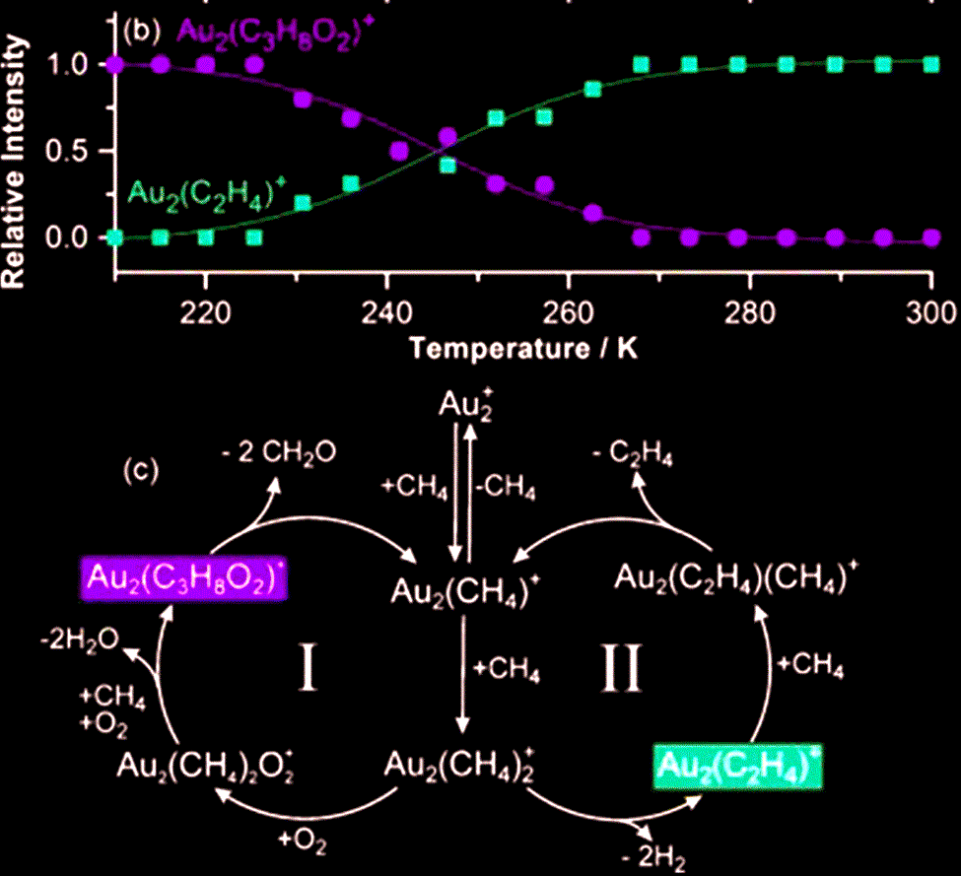
Catalysis by gas-phase ions
CH₄ conversion by Au₂⁺ (shown)
In presence of O₂, selectivity is controlled by temperature
C₂H₄ for T > 260 K
CH₂O for T < 230 K
Olefin dehydroaromatization (not shown)
Catalyzed by Fe₄⁺ and by some atomic ions
Schwarz, H. Ménage-à-trois: single-atom catalysis, mass spectrometry, and computational chemistry. Catal. Sci. Tech. 2017, 7, 4302.
Notes:
This is to show you that gas-phase ion chemistry is not only about molecular physics.
There are gas-phase analogues of both homogeneous and heterogeneous catalysts.

Slide 24
Questions or comments?

Slide 25
Electron ionization mass spectrometry (EIMS)
Molecular ions (M⁺) are created with a wide range of internal energies
Many break into fragments
Characteristic spectrum of fragment masses
Important for analytical chemistry
70 eV is typical in analytical work
Strong signal
Stable fragmentation pattern
M + e⁻
2e⁻ + [M⁺]*
[M⁺⁺]* + 3e⁻
M⁺
M⁺⁺
Z + A⁺
B⁺ + C⁺ + Y
secondary ions

Slide 26
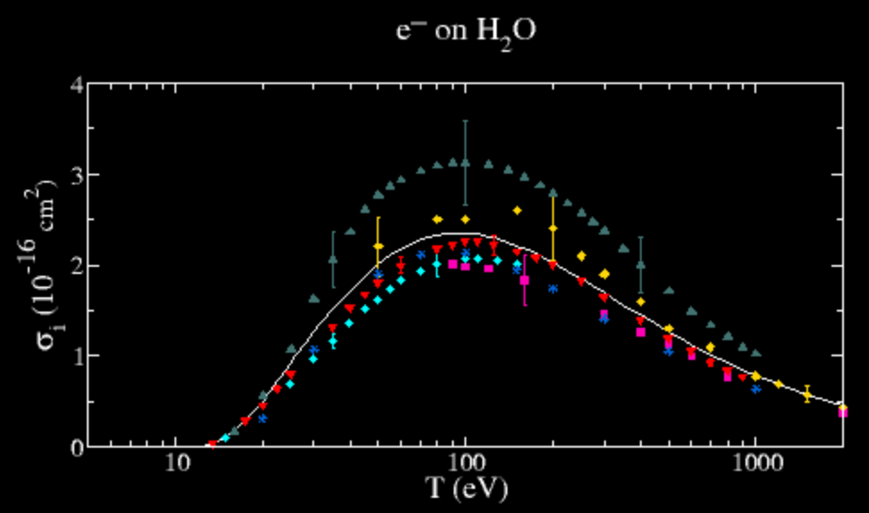
Total ionization cross sections (TICS) from BEB
Sum over all MO’s = molecular cross section
TICS typically within 15% of experiments
BEB is the most popular theory for computing TICS
https://github.com/kkinist/BEB
http://physics.nist.gov/ionxsec
Kim, Y.-K.; Rudd, M. E. Binary-Encounter-Dipole Model for Electron-Impact Ionization. Phys. Rev. A 1994, 50, 3954.
Notes:
There are data plotted from several sources, but all for the same quantity (positive ions). The solid line is BEB theory and the symbols are experimental measurements.
The good performance of BEB for TICS adds confidence in using it for individual MO cross sections.

Slide 27
Binary-encounter Bethe (BEB) theory
Yields total ionization cross section for one molecular orbital (MO)
Sum over occupied MOs
Input quantities are obtained from routine ab initio calculations
T = kinetic energy of incident electron
U = MO kinetic energy
B = MO binding energy
t = T/B; u = U/B; n is a parameter usually = 1
Kim, Y.-K.; Rudd, M. E. Binary-Encounter-Dipole Model for Electron-Impact Ionization. Phys. Rev. A 1994, 50, 3954.
Notes:
BEB is the most popular theory for computing TICS.
It says nothing about subsequent chemistry, such as ion fragmentation in EIMS.

Slide 28
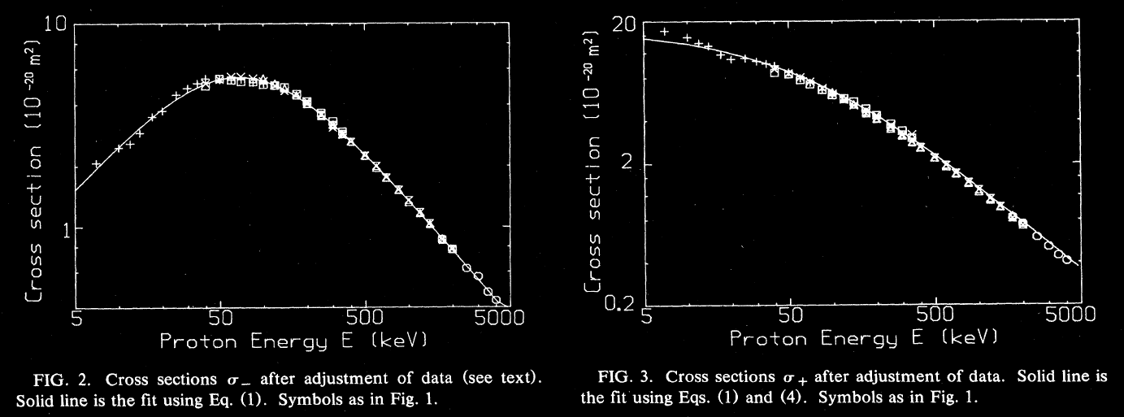
Proton ionization cross sections
Cross section (σ) is the extinction coefficient per particle (units: area)
$$ln\left(I/{I_{0}}\right)=−σ∙\left(density\right)∙\left(path length\right)$$
Rudd, M. E.; Goffe, T. V.; Dubois, R. D.; Toburen, L. H. Cross sections for ionization of water vapor by 7-4000-keV protons. Phys. Rev. A 1985, 31, 492.
Notes:
The figures are for gas-phase H₂O.
When a proton ionizes something, it loses some energy and slows down.
Cross section for ejecting electrons peaks near 50 keV.
Cross section for creating positive ions is larger and declines with energy. As a proton slows down, it becomes more likely to slow down further.

