Slide 1
Improving SSVEP Spellers with Data Augmentation and Language Models
Joseph Zhang
Ruiming Zhang
David Hill
Kipngeno Koech
Mentor: Kate Shapovalenko
Notes:
Hi everyone, today we are going to introduce our group project, Improving SSVEP Spellers with Data Augmentation and Language Models

Slide 2
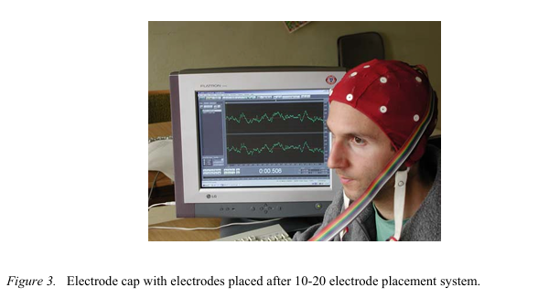
Electroencephalography (EEG)
Notes:
First, let me introduce the background. EEG is a non-invasive technique used to record the electrical activity of the brain. It captures brain signals through electrodes placed on the scalp.

Slide 3
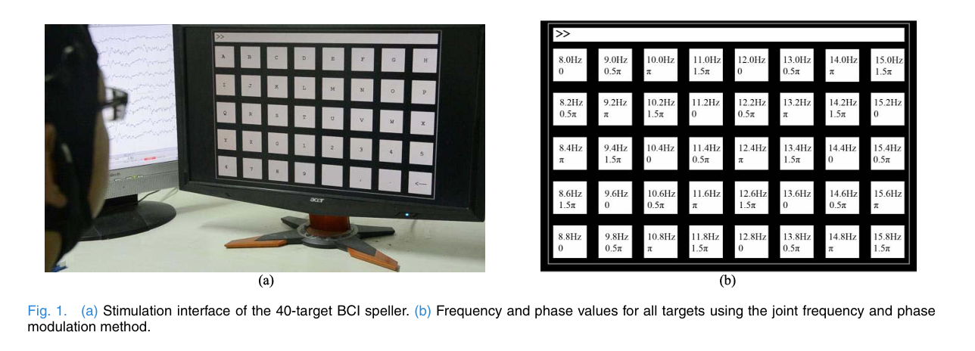
Steady-State Visual Evoked Potential (SSVEP) Speller
Notes:
One typical type of brain signal measured with EEG is the SSVEP which is elicited by visual stimuli with stable frequencies.
The SSVEP Speller is a Brain-Computer Interface application using SSVEP. As shown in the figure, the system collects these brain signals through EEG when subjects focusing on one target letter. Then the computer tries to decode which letter the subject is looking at. In this way SSVEP speller can help people with disabilities communicate.

Slide 4
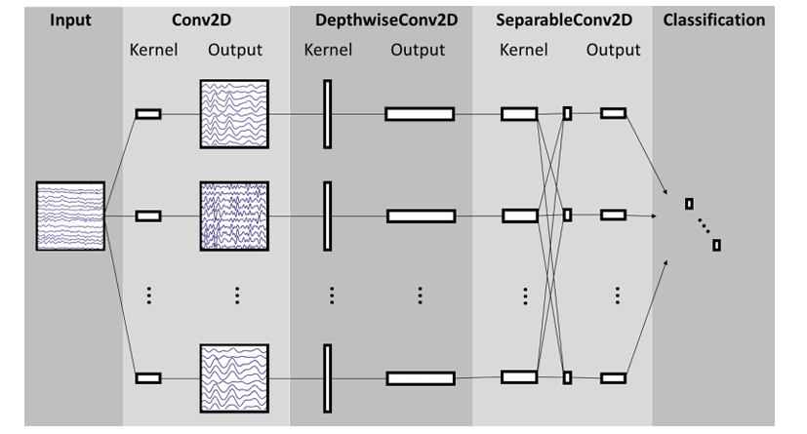
EEGNet
Notes:
In recent years, deep learning has shown great potential in SSVEP classification. EEGNet is a widely-used CNN for EEG signal classification. But the performance is not good enough for real-time high accuracy application.

Slide 5
The Problem
Current deep learning models for EEG suffer from low accuracy and poor generalization to unseen subjects due to high data variance.
People’s brains work very differently!
Notes:
The problem is Current deep learning models for EEG suffer from low accuracy and poor generalization to unseen subjects due to high data variance.
People’s brains work very differently!

Slide 6
Our Solution:
Data Augmentation
Language Modeling
Notes:
Using EEGNet as our baseline model, we have proposed two methods: Data augmentation and Language modeling.

Slide 7
The Dataset and Preprocessing
We use the Benchmark dataset (Tsinghua University) commonly used in SSVEP speller research:
35 subjects, mean age 22
6 trials of 40 characters
5 second recordings sampled at 1000Hz, downsampled to 250Hz
Our preprocessing:
Cut out first 0.5s and last 0.5s to get 4s recordings (FIX THIS IN REPORT)
Downsample to 62.5Hz
Apply bandpass filter 6Hz - 90Hz
Dataset split:
Two subjects removed for one “hidden” dataset
The other 33 subjects’ data is divided into train, validation and test datasets: 80-10-10
Notes:
The dataset we use is a publicly available SSVEP dataset that we refer to as the benchmark dataset. We preprocess the whole dataset then divide it into four sets: training, validation, and two test datasets. One of the test datasets is taken from two subjects who are “hidden” during training, meaning they are not used in the training process. The other 33 subjects’ data is split into training, validation, and test datasets in an 80-10-10 fashion.

Slide 8
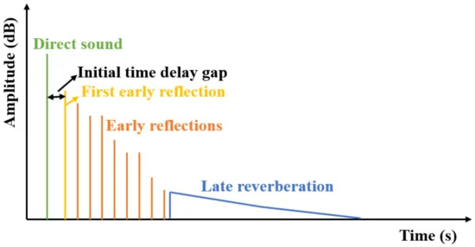
Method 1: Data Augmentation
In the DL-EEG space, augmentations are not common and we were curious why. We tried the following augmentations on the benchmark dataset:
Frequency masking
Time masking
Phase noise
Magnitude noise
Salt and pepper noise
Random impulse addition
Notes:
We try six different augmentations on the training dataset in an attempt to improve the model’s accuracy. Frequency masking, time masking, and salt and pepper noise are done as would be expected. Phase and magnitude noise are done by adding noise to the corresponding component in the discrete frequency domain. Random impulse addition is illustrated in the image. It takes the green, vanilla impulse response and adds various random reflection impulses. Then it convolves this new impulse response with the original data in an attempt to add an echo effect for better generalization.

Slide 9
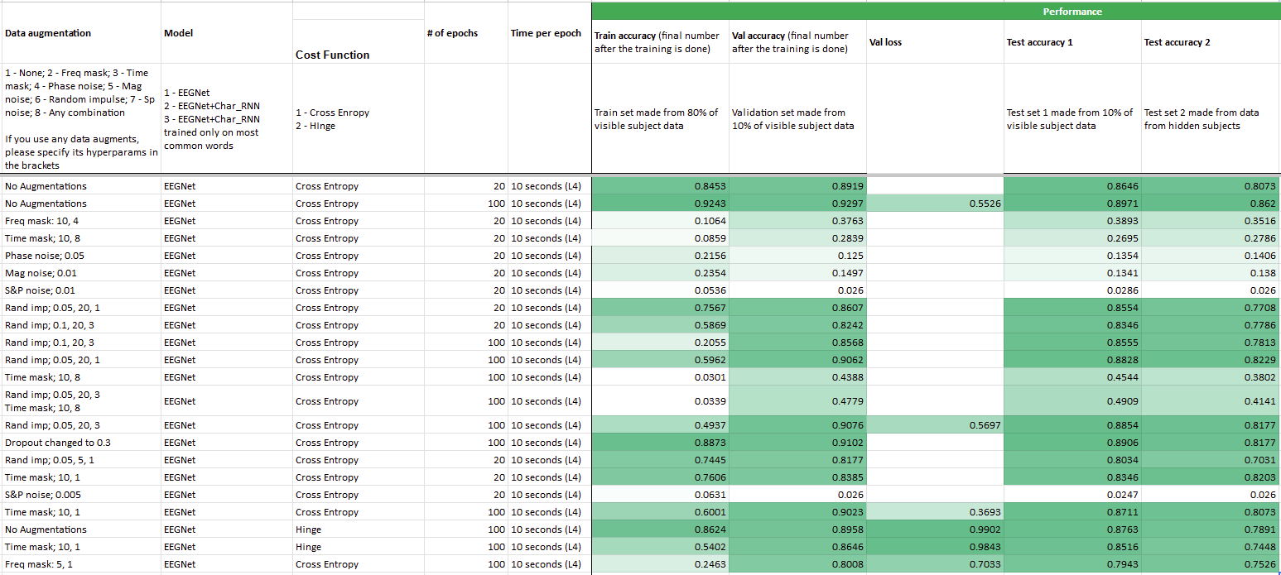
Data Augmentation Results
Notes:
Here are the results of some of our ablations. The second row shows our best validation accuracy, which was with no augmentations for 100 epochs. We found that while none of the augmentations improved the validation accuracy, the time-masking did improve the validation loss. This is promising for future work because it means that it is improving the model’s confidence in its answers while not improving its overall correctness. Frequency masking, salt and pepper noise, phase noise, and magnitude noise all performed very poorly. Random impulse addition did not significantly improve or diminish performance on the validation and test 1 datasets. However, it made the testset 2 accuracy worse, indicating that it actually affected the generalizability of the model, but not in the way that we had hoped.

Slide 10
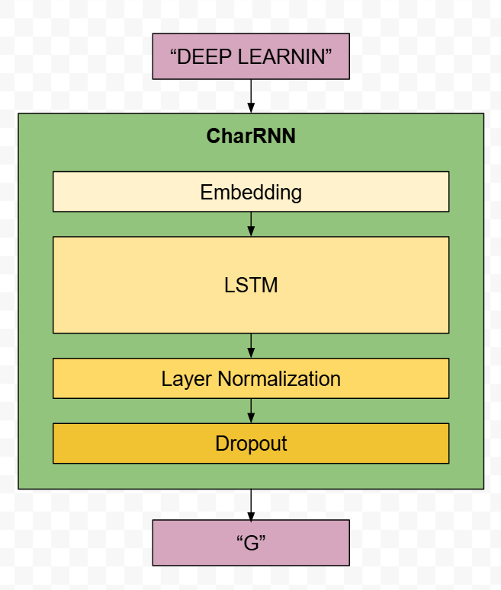
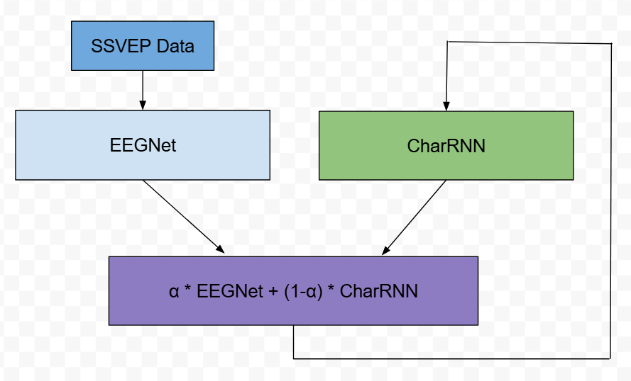
Method 2: Hybrid EEGNet-CharRNN Model
Notes:
Our second method involves incorporating a language model into EEGNet’s inference pipeline. The idea is that a speller task shouldn’t only be evaluated on individual targets, but on its accuracy in meaningful outputs like words and sentences. So instead of solely relying on EEGNet for predicting every letter a subject looks at, we can leverage the high confidence of language models. We trained a simple character-based RNN for this purpose.
We then combined EEGNet and the RNN into this hybrid model. EEGNet will process SSVEP data while the RNN will process the sequence of previously-predicted letters, and then the two predictions are combined according to the equation here. Alpha is the ratio of weighting placed on the predictions of each model, with values closer to 1 meaning more weight is put on the predictions of EEGNet.

Slide 11
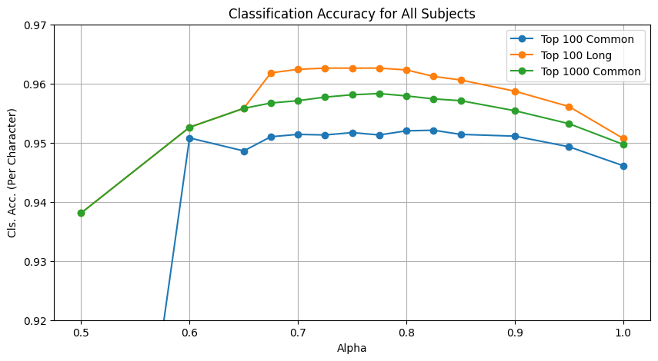
EEGNet-CharRNN: Results
Best accuracy improvements over baseline: 0.6% to 1.19%
Notes:
And now the results. The evaluation metric is letter classification accuracy on various datasets containing English words. These are the results for all subjects, so the starting baseline accuracy of EEGNet alone, which is on the right with an alpha of 1, is already quite high at around 95%. However, as we reduce alpha, which means incorporating more predictive power from the RNN, we can see that the hybrid model can perform about 1% better than the baseline, which is very significant for an already high accuracy. These results make sense, as if we are a few letters into a word and EEGNet gives a prediction with poor confidence, the RNN can still provide the correct prediction as it could be expected based off letter frequency alone.

Slide 12
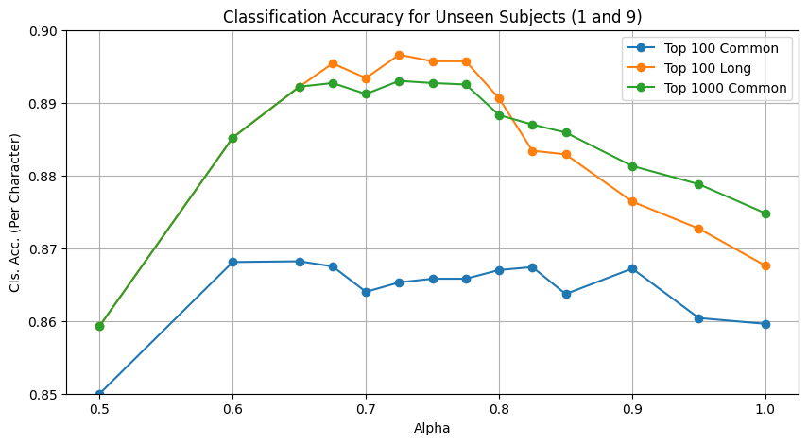
EEGNet-CharRNN: Results
Best accuracy improvements over baseline: 0.86% to 2.9%
Improves EEGNet’s generalizability!
Notes:
This chart shows the classification accuracy for the two unseen subjects, so the baseline is expectedly lower. This is where our hybrid model gets to shine the most, with up to a 3% accuracy increase over baseline. This makes sense because the less confident EEGNet is, the more useful the RNN becomes at fixing EEGNet’s poor predictions. Therefore, our hybrid model helps improve the generalizability of EEGNet for speller tasks.

Slide 13
Conclusion
Time-masking is promising!
Language models improve generalizability of word-level decoding!
Using larger language models like GPTs will extend this into paragraph-level decoding.
By utilizing data augmentation and language models, we are paving the way for more accurate SSVEP speller systems that can help people with disabilities communicate.
Notes:
To conclude, we found that time masking is a promising augmentation for EEG classification tasks. We also demonstrated that our hybrid model can decode words at high accuracy. To scale this system for more complex tasks like paragraph-level decoding, advanced language models such as GPT will be essential. By utilizing data augmentation and language models, we are paving the way for more accurate SSVEP speller systems that can help people with disabilities communicate.

Slide 14


