Slide 1
Python
Files, Loops and Printing
Monday, March 13, 2017

Slide 2
Anatomy of a single file python script

Slide 3
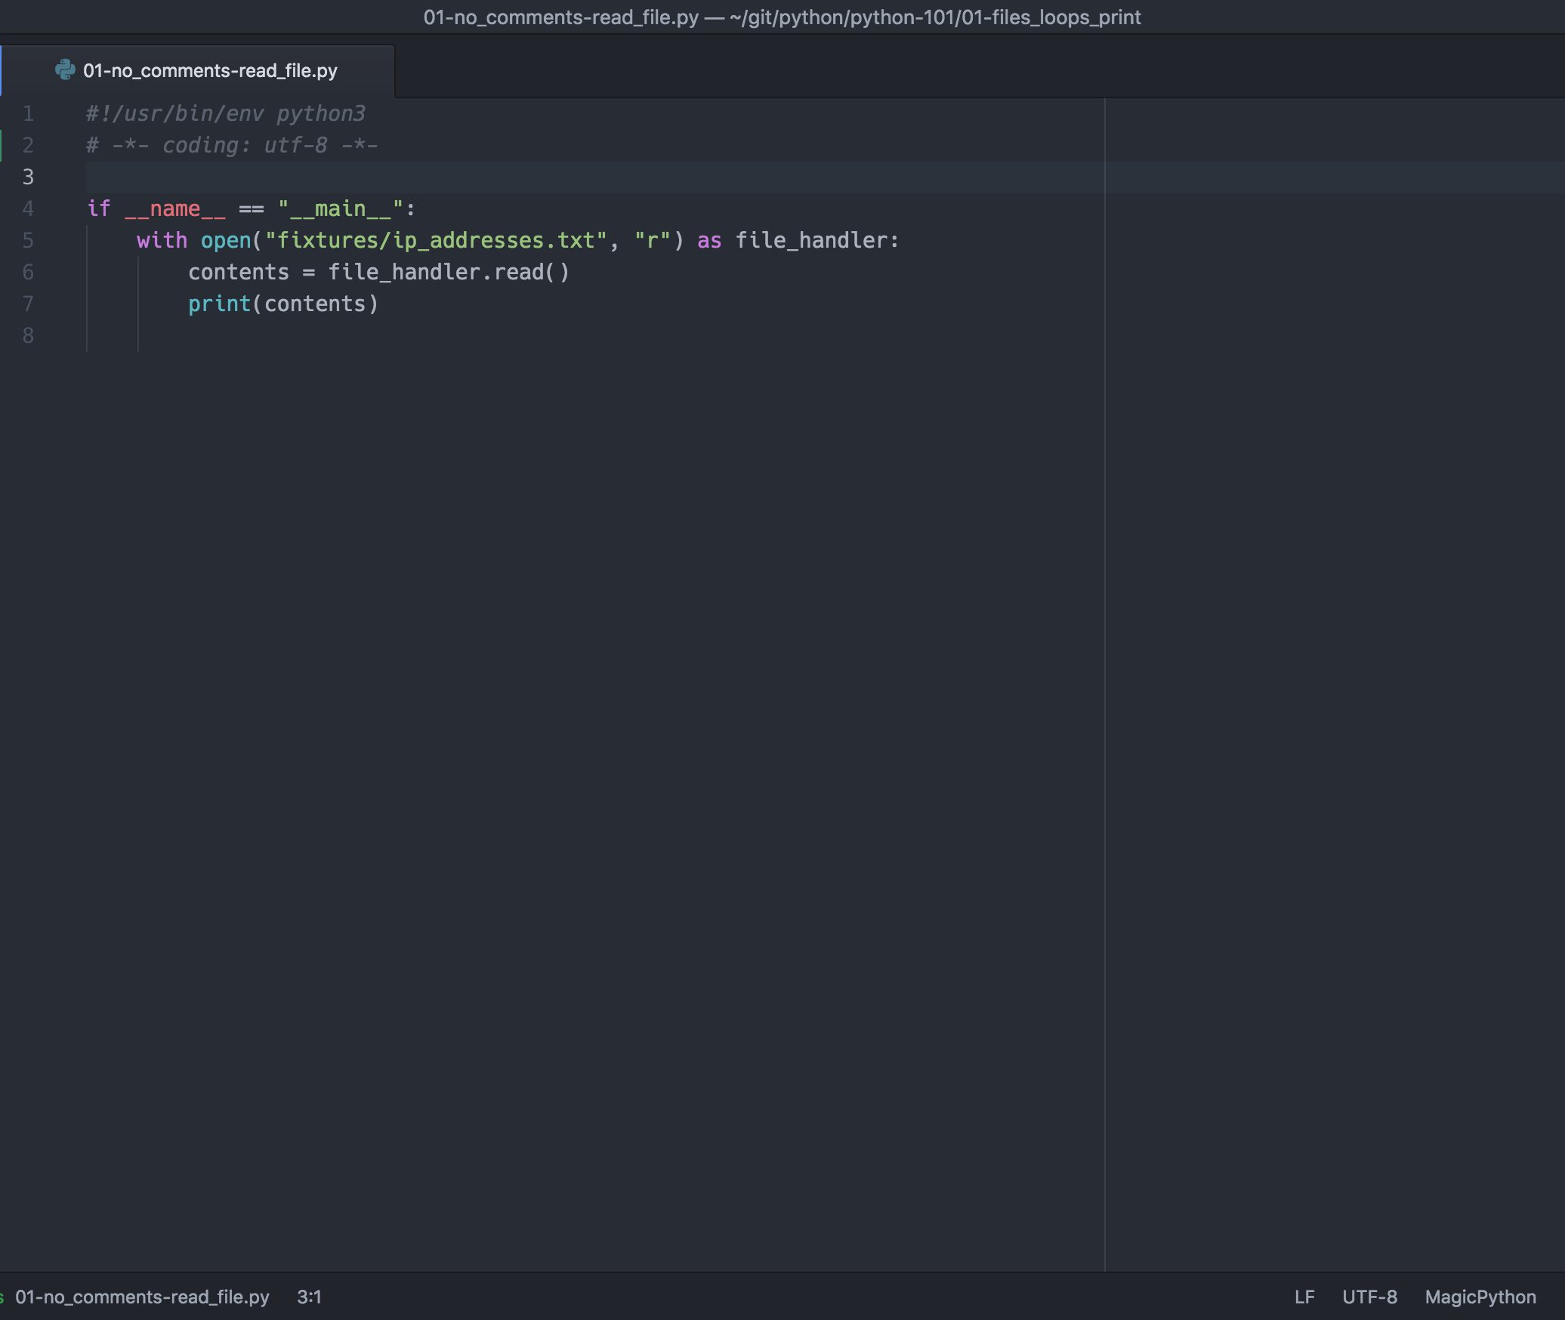
Shebang
Encoding (Python 2 Only)
Execution Protection
Action(s)

Slide 4
Reading A File

Slide 5
with open vs open
Using with open (file) rather than open (file) alone you do not need to close the file at the end because with will automatically do this for you
While it is common to see with statements when working with files due to Python Enhancement Proposal 0343 (PEP), with is able to be used in any situation you need or want to ensure specific actions are taken either before or after beginning something. Due to this, with makes it possible to remove try/finally error handling statements and use with instead.

Slide 6
File Modes
When opening a file, you must tell the system how you intend to use it so that it may ensure you have permission to do so.
There are 4 different text file modes that may be used when opening a file:
[default] "r" — File will only be read
"w" — For only writing to a file. Note: an existing file with the same name will be erased
"a" — Opens a file for appending data. Any data written is automatically added to the end.
"r+" — Opens the file for reading and writing.
At times though, a text mode will not be appropriate, such as when working with an unknown file encoding in these cases, binary modes are used by using the "b" mode.

Slide 7
Reading a file’s contents
The easiest though riskiest way to read a file is with .read(). For safer file handling, consider using an iterator such as for line in file or buffered file reading
When reading a file there are a number of options for python developers for how to read a file, each with their own pros and cons.
The easiest way to read a file’s contents is to call the read function. By default, read will return the entire contents of the file. In this instance, it is the developer’s responsibility to ensure that the file is not twice as large as the machine’s available memory. In the event that the file is too large, the program may crash or the machine may become unresponsive.
When working with a large file, or when executing a use case such as processing a file line by line, consider other methods of working with a file such as an iterator (shown) or buffered I/O (not shown).

Slide 8
Iterators

Slide 9
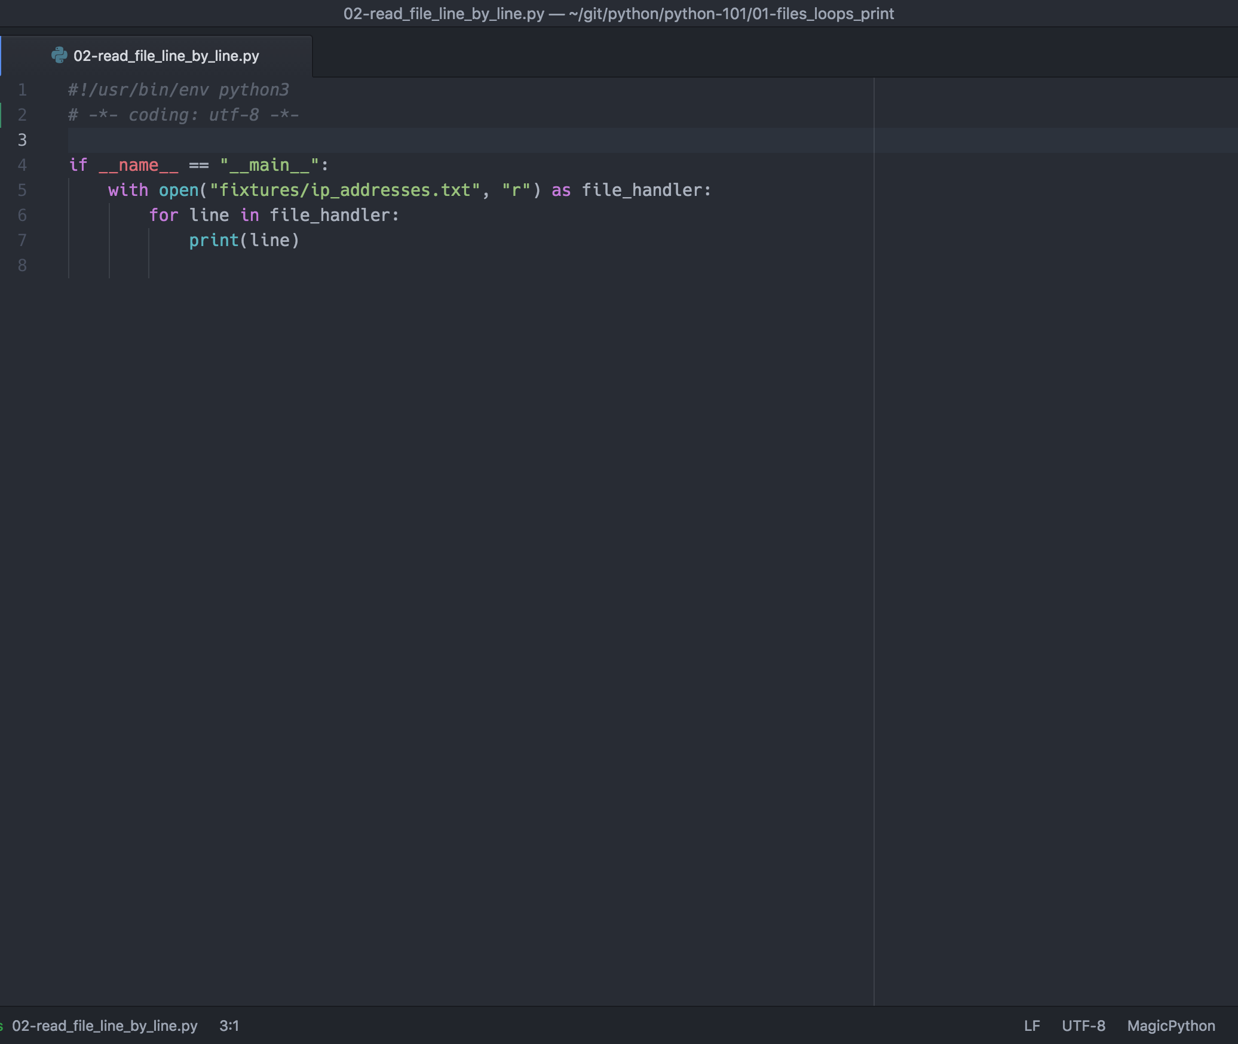
Iterators offer advanced concepts for free.
Using an iterator such as for line in file treats the file as if it is an iterable. When Python detects this use, it will automatically use buffered IO and memory management so that that you do not have to worry about a large file

Slide 10
Line endings

Slide 11
Handling line endings with printing
Files that are read maintain their default file endings, often a newline or carriage return character. When printing, this can lead to unexpected behavior as the implementation of print will put a newline character (exceptions apply)
For this reason, it is common for individuals use use one of three strip methods. By default, if no definition of which characters should be removed is given, whitespace characters such as space, tab, linefeed, carriage returns, etc. will be removed.
lstrip — Returns a copy of the string with leading characters removed;
rstrip — Returns a copy of the string with training characters removed;
strip — Returns a copy of the string with leading and trailing characters removed.

Slide 12
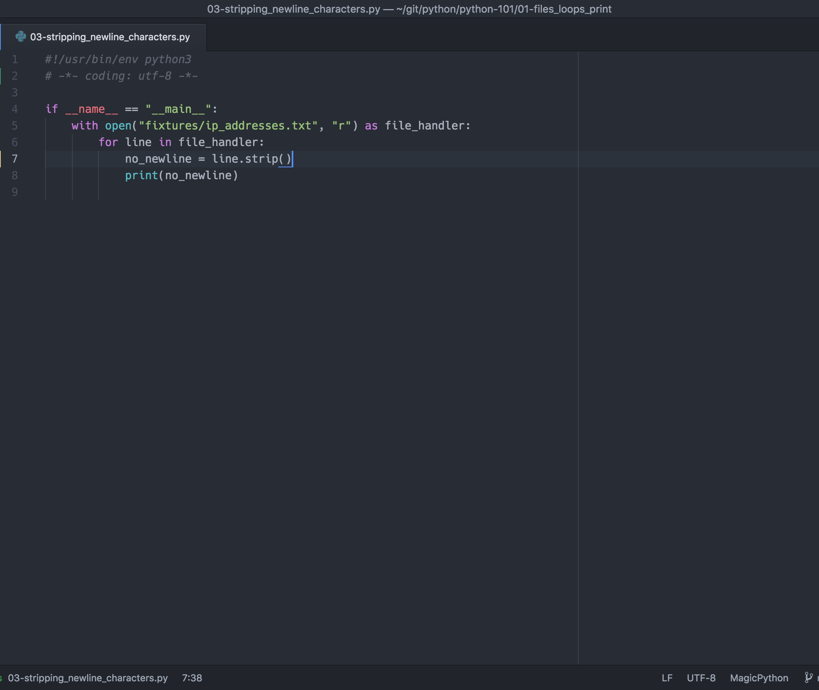
When planning to manage the output yourself, consider stripping the string
Strip allows you to take control over when newlines are present

Slide 13
Template Strings

Slide 14
Templates allow you to reuse strings easily
When you want to use standard formats, such as when outputting the configuration for a device, it is recommended to use templates. Templates allow you to reuse text and ensure that the correct type conversions occur to avoid errors.
When using the + operator to concatenate strings and variables, there are situations where the type of an object (e.g. class, string, integer, etc.) will not be compatible with a string. In these cases, errors can occur when concatenating the object with a string. For this reason, it is recommended to use a template string to ensure that Python attempts to convert the object to the correct desired format.

Slide 15
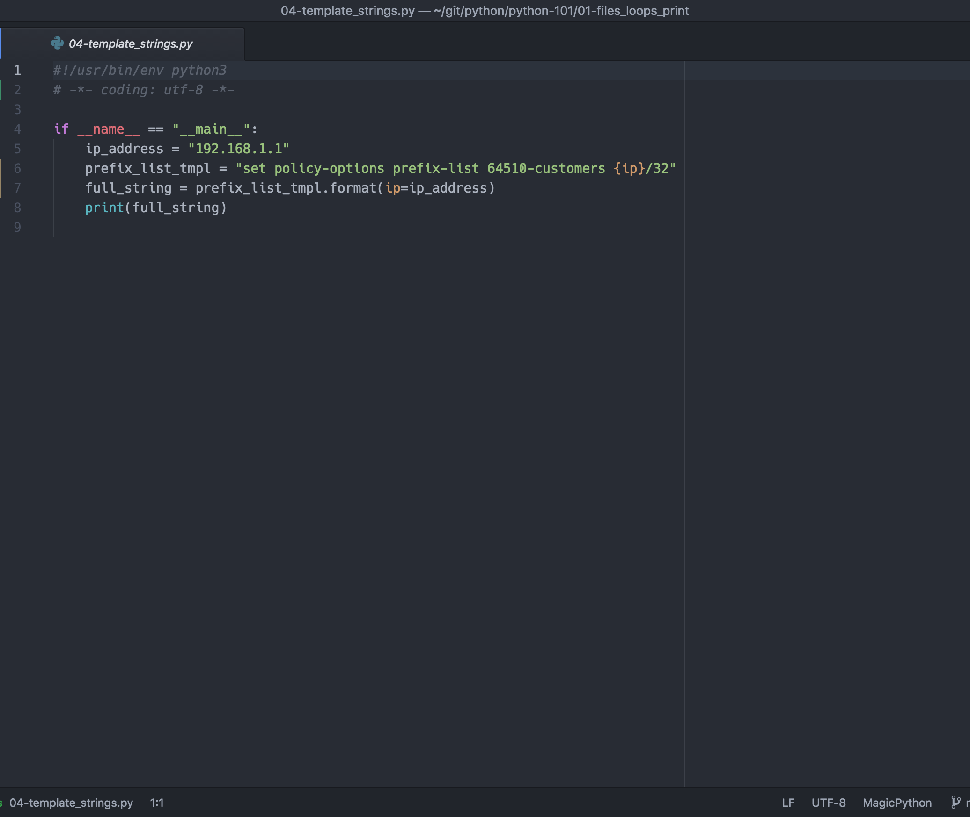
Templates allow for easier reasoning and greater flexibility
Templates can feature either named or unnamed parameters. Here, we see a named parameter. Templates may also dictate the type of an object so that python converts the object in a specific manner.

Slide 16
Putting it together

Slide 17
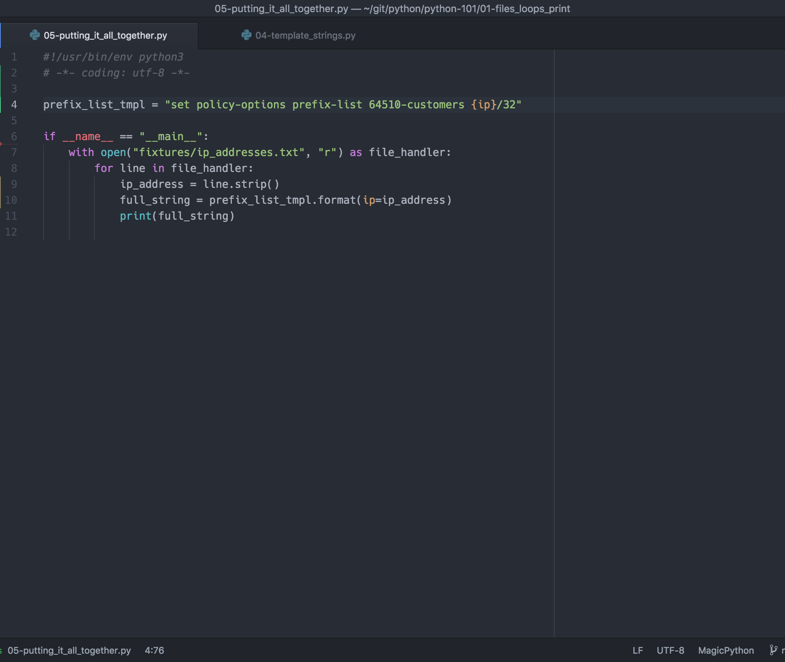
Leveraging these features
When we put it all together, we end up with a relatively safe and concise program

