Slide 1
Automation on Agile
Nov 2014

Slide 2
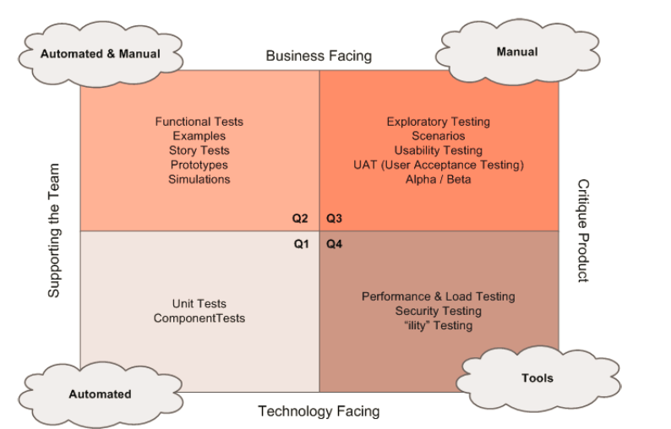
4 Quadrants of Agile Testing
User Test
Test
Non function Test
Dev Test

Slide 3
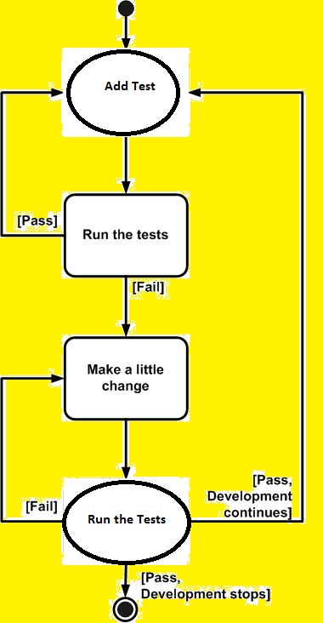
About BDD
BDD is a software development
process based on test-driven develop
-ment.
Behavior Driven Development mainly
concentrates on specification.
Therefore the focus is totally changed.
we don't focus anymore on the
structure of the source code,
the entire focus lies on the behavior
of the source code.
It should be created in such a way
that the behavior is precise,
unambiguous and in an executable form.

Slide 4
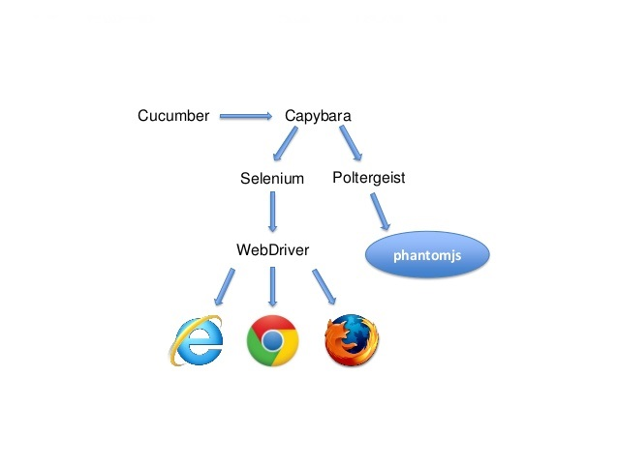
Cucumber workflow
capybara with selenium
Will stimulate with all
Head browsers for interaction.
capybara with polytergeist will
stimulate with headless browser that
is phantomjs.
Phantomjs is a great tool for end-
to-end tests of your application.
It provides a headless browser
based on webkit that allows your
tests to navigate through the
web application.

Slide 5
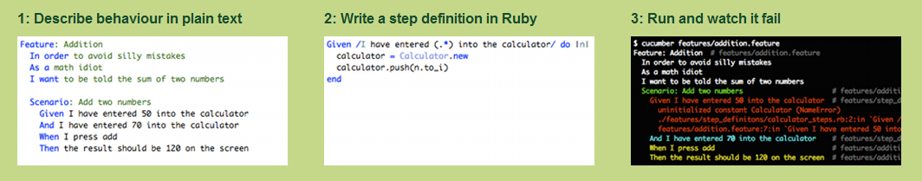
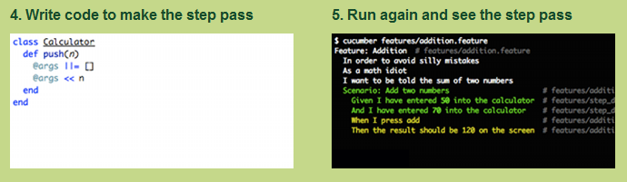
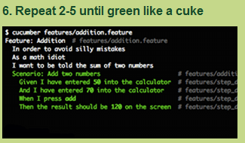

Approach to Automate BDD

Slide 6
Components in the our Framework
Gherkin
is a Business Readable, Domain Specific Language created specifically for behavior descriptions. It gives you the ability to remove logic details from behavior tests. It originally came from Cucumber.
Gherkin serves as your project’s documentation and automated tests.
Gherkin is as a communication tool. It is close enough to natural language that both technical and non-technical people can collaborate.
Capybara
Capybara is a library written in the Ruby programming language which makes it easy to simulate how a user interacts with your application.
Capybara can talk with many different drivers which execute your tests through the same clean and simple interface.
We can choose between Selenium, Webkit or pure Ruby drivers.
Poltergeist
Poltergeist is a driver for Capybara that allows you to run your tests on a headless WebKit browser, provided by PhantomJS.

Slide 7
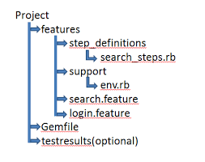
Framework structure

Slide 8
Capgemini Approach

Slide 9
Thank You.

