Slide 1
Royal Mail Group

Slide 2
What is BDD?
In software engineering, behavior-driven development (BDD) is a software development process that emerged from test-driven development (TDD).
BDD is a development process where tests for code are written before the writing of implementation code.
If some one have zero knowledge in technical. still if they want to explain to technical people they will explain through simple plain English that is exactly what bdd is.
while u r developing the application that application development should based on the behavior.
Automated acceptance tests are a by-product of BDD.

Slide 3
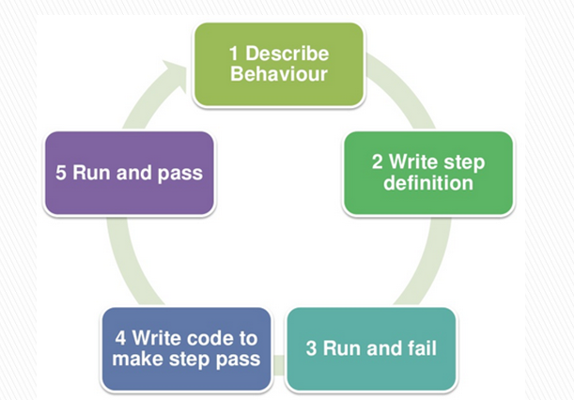
BDD-behavior driven development
Through gherkin language

Slide 4
Why BDD ?
selenium as a tool which help you but why ruby? because we will be working with agile.
so the agile methodology requires you to collaborate with different set of peoples.
you would be working with stake holders, business analyst, developers.
you will be writing the scripts in plain English statement.
In water fall methodology testing phase will come after the development phase. for example: we will test this form once it is created.
But in bdd we are going to drive the creation of the software.
we will be first in line to interact with owners of the application.

Slide 5
they are going to write the user stories in plain English language.
we are going to convert that English statement into gherkin language then we are feeding gherkin into a ruby automated test.
then we will give these automated tests to devs to develop the software. Once they developed the software again it will come to normal testing.

Slide 6
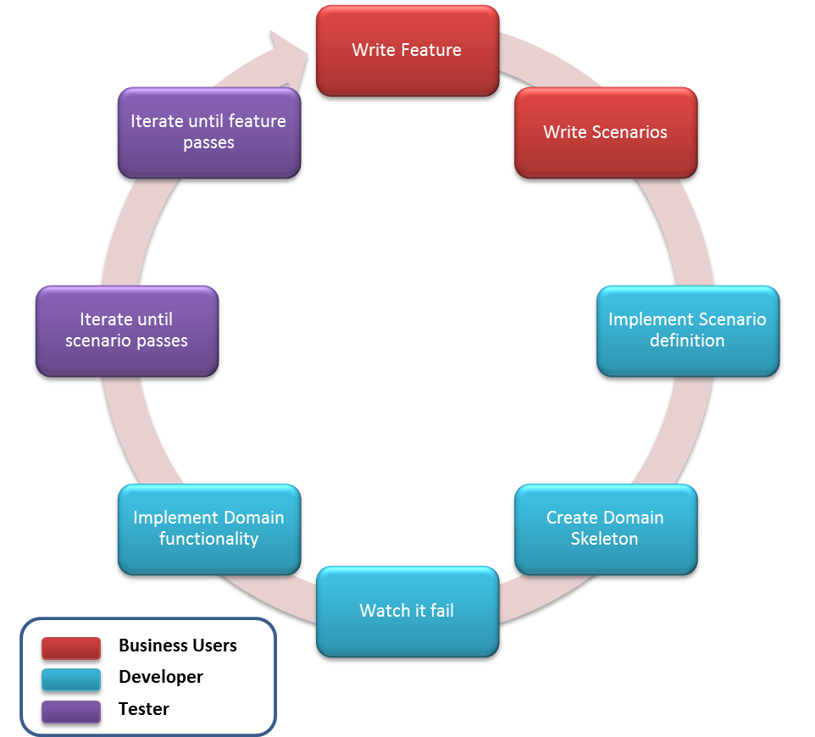
BDD-behavior driven development

Slide 7
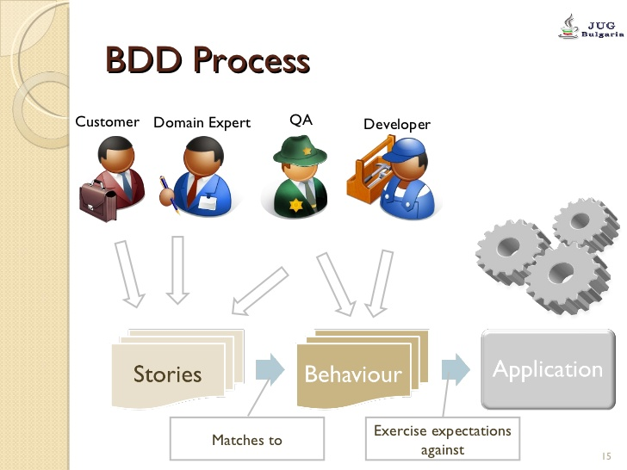
BDD Process

Slide 8
Lets use the “5 Whys” technique to help understand why we use BDD
Q1. Why would we use BDD?
A1. To get a better quality product
Q2. Why?
A2. Because we (often) get it wrong
Q3. Why?
A3. Because there are misunderstandings, ambiguities or errors in what has been specified and/or what we eventually get in the form of the product
Q4. Why?
A4. Because the traditional methods for specifying behaviour are not always effective in capturing
Q5. Why?
A5. Because they fail to use concrete examples and a ubiquitous language

Slide 9
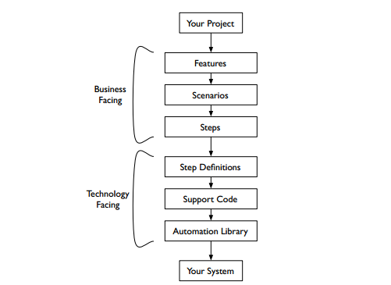
Behat testing stack

Slide 10
What Gherkin for ?
When we build software for stakeholders or client, it is difficult to figure out exactly what they want us to build.
We’ve all worked on projects where, because of a misunderstanding, code that we’d worked hard on for several days or more had to be thrown away.
Better communication between developers and stakeholders is essential to help avoid this kind of wasted time.

Slide 11
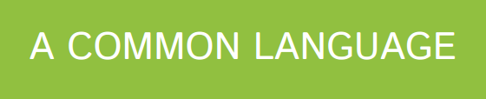
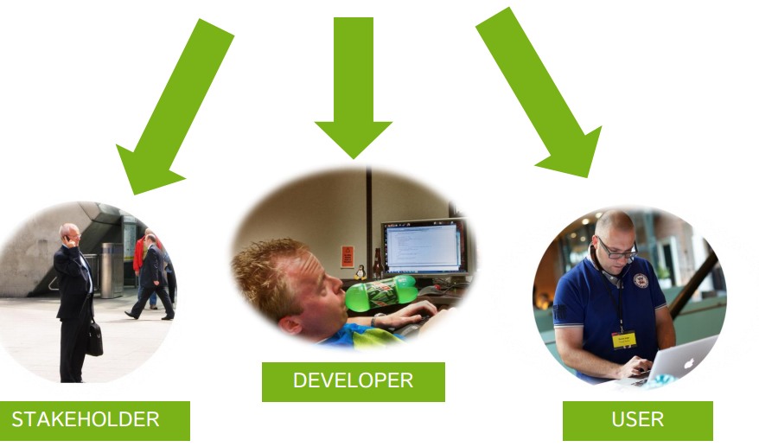
What gherkin for?
Notes:
When we build software for stakeholders, it is difficult to figure out exactly what they want us to build.
We’ve all worked on projects where, because of a misunderstanding, code that we’d worked hard on for several days or more had to be thrown away.
Better communication between developers and stakeholders is essential to help avoid this kind of wasted time.

Slide 12
A Gherkin Source file usually look like
Feature: {custom title}
In order to {benefit/value of the feature}
As a {user/role who will benefit from this feature}
I need to {short feature description}
Scenario: Some determinable business situation
Given some precondition
And some other precondition
When some action by the actor
And some other action And yet another action
Then some testable outcome is achieved
And something else we can check happens too

Slide 13
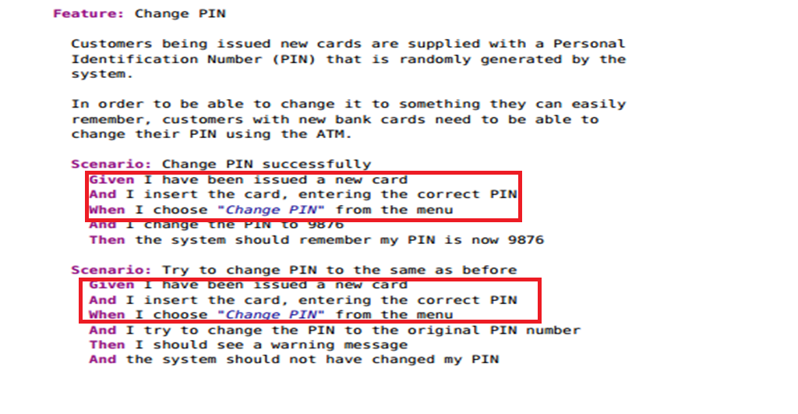
Why to use Background keyword?

Slide 14
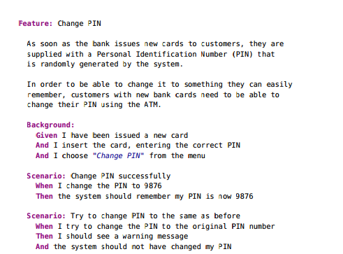
Why to use Background keyword?
Notes:
A background section in a feature file allows you to specify a set of steps that are common to every scenario in the file.
Instead of having to repeat those discuss steps over and over for each scenario, you move them up into a Background element.
There are a couple of advantages to doing this:
• If you ever need to change those steps, you have to change them in only one place.
• The importance of those steps fades into the background so that when you’re reading each individual scenario, you can focus on what is unique and important about that scenario.

Slide 15
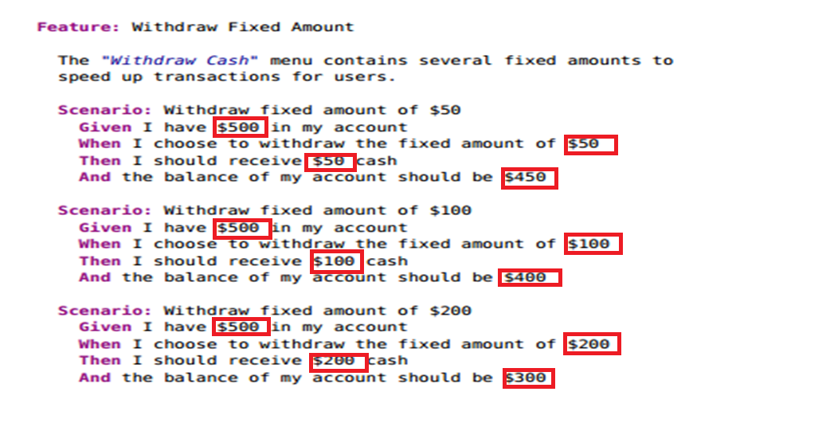
Why to use Scenario outline & examples keyword?

Slide 16
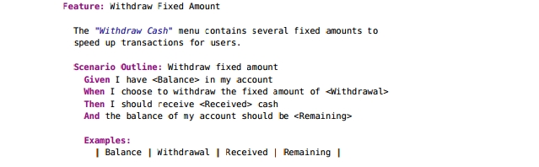

Why to use Scenario outline & examples keyword?
Notes:
Sometimes you have several scenarios that follow exactly the same pattern of steps, just with different input values or expected outcomes.
We can use a scenario outline to specify the steps once and then play multiple sets of values through them.
We indicate placeholders within the scenario outline using angle brackets (<>).
Behind the scenes, Behat converts each row in the Examples table into a scenario before executing it.
You can prove this to yourself by using the --expand option.

Slide 17
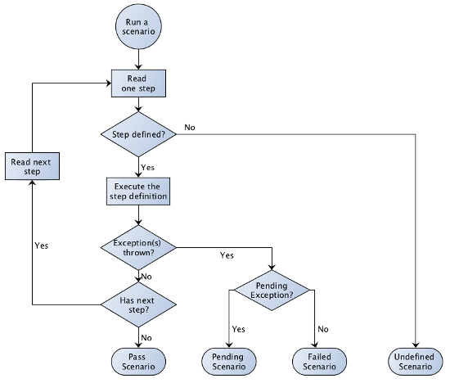
How behat execute the scenario

Slide 18
Thank You

