Slide 1
Jenkins
By
kirubanand

Slide 2
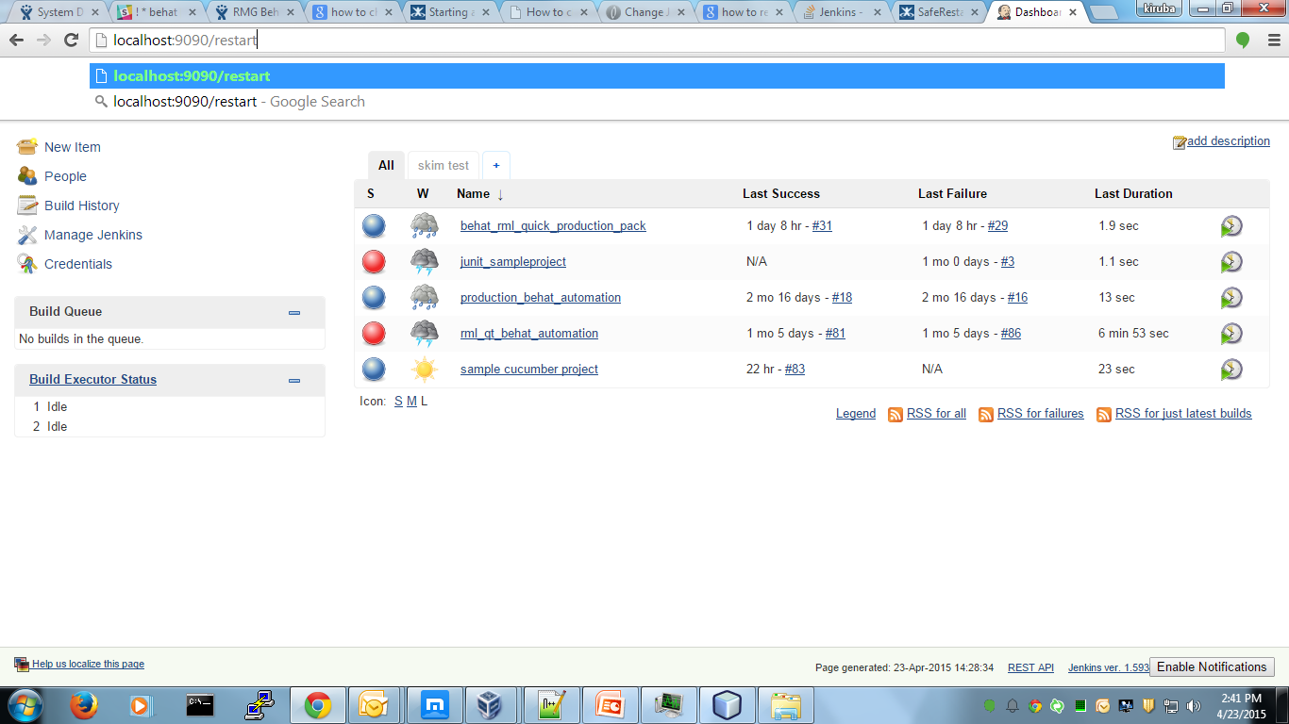
How to restart jenkins
Just type the jenkins url /restart.

Slide 3
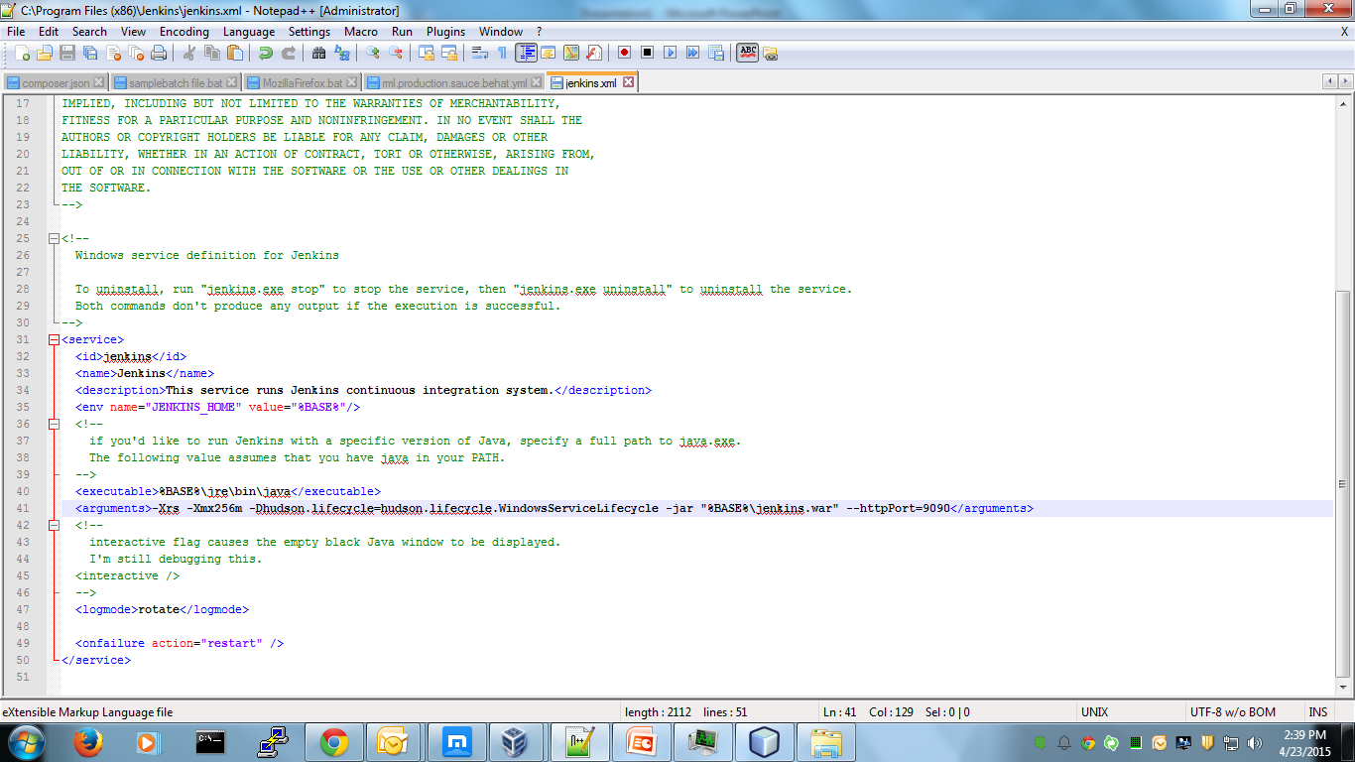
How to change the port in jenkins
Naviagte to C:\Program Files (x86)\Jenkins and find the jenkins.xml file and update ur port no

Slide 4
How to configure jenkins into webserver

Slide 5
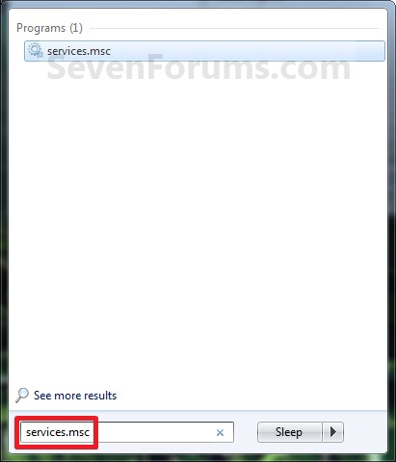
To Start, Stop, and Disable Services in "Services" Window
For reference http://www.sevenforums.com/tutorials/2495-services-start-disable.html

