Slide 1
Basics
By
kirubanand

Slide 2
How to determine if a port is open on a Windows server?
Command in cmd: --netstat –an.

Slide 3
To enable Remote Desktop Connection in windows
Open System by clicking the Start button , right-clicking Computer, and then clicking Properties.
In the left pane, click Remote settings. If you're prompted for an administrator password or confirmation, type the password or provide confirmation.
Under Remote Desktop, select one of the options to allow connections. For more information about these options, see
Click Select Users.
In the Remote Desktop Users dialog box, click Add.
In the Select Users or Groups dialog box, do one or more of the following:
To specify the search location, click Locations.
To specify the types of objects (user names) that you want to search for, click Object Types.
In the Enter the object names to select box, type the user name that you want to search for, and then click Check Names. If the user name isn't found, click Advanced to run an advanced search.
When you find the correct name, click OK.
The name will be displayed in the list of users in the Remote Desktop Users dialog box.
Click OK, and then click OK again.

Slide 4
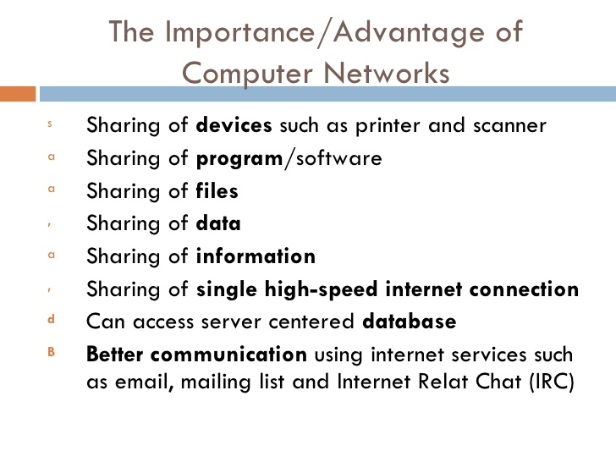

Slide 5
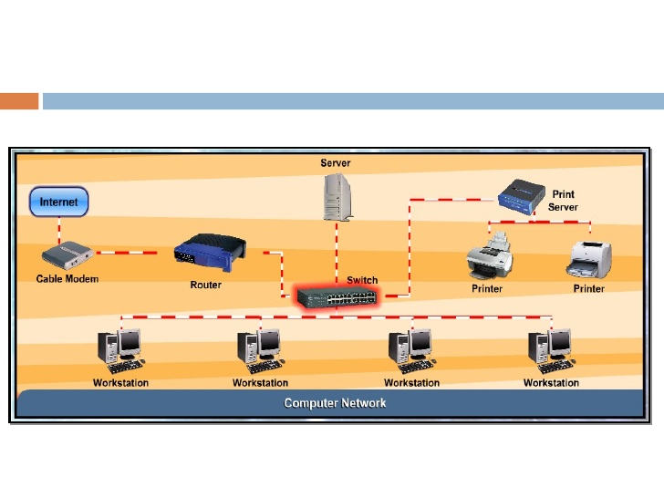
Workflow of computer network

Slide 6
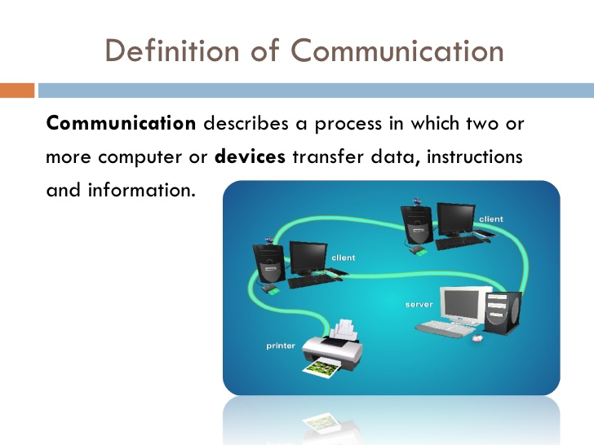

Slide 7
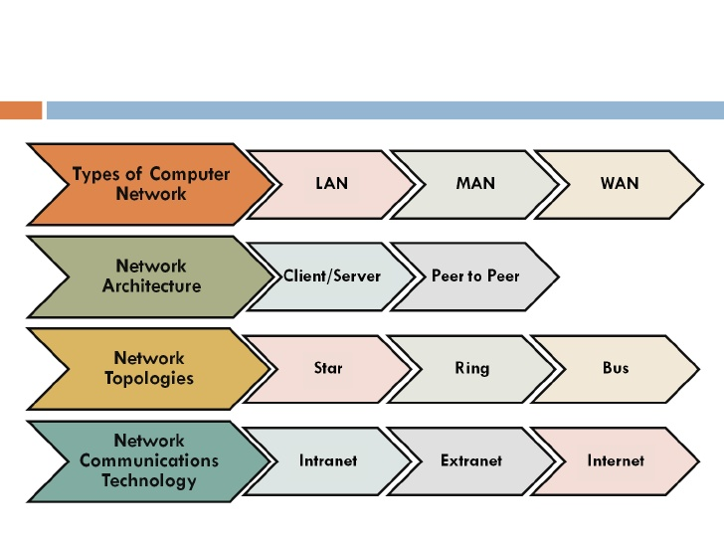
Networking basics

Slide 8
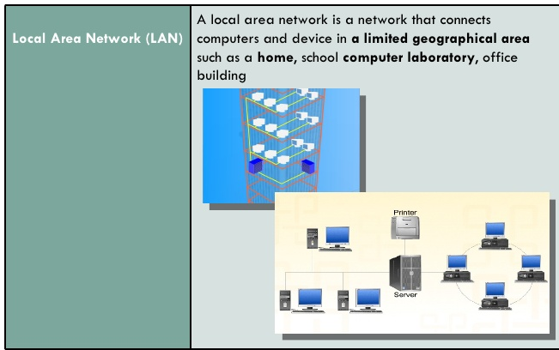
LAN

Slide 9
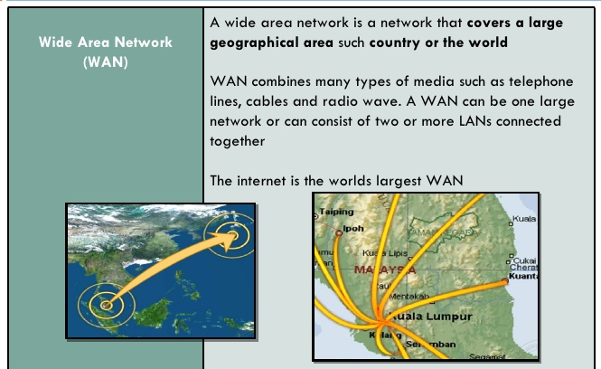
WAN

Slide 10
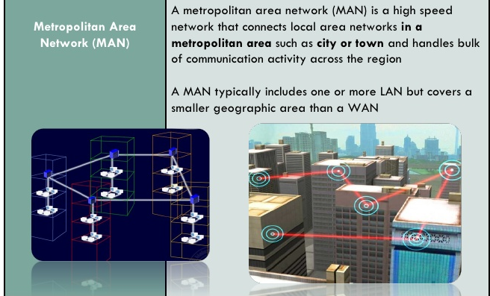
MAN

Slide 11
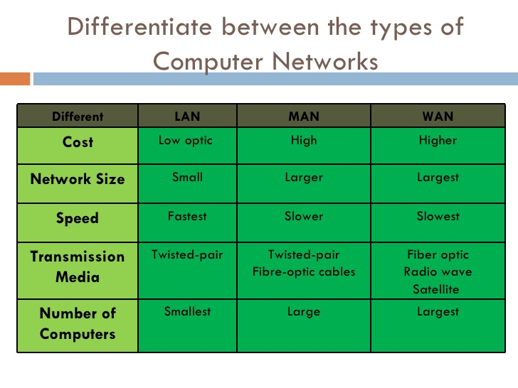

Slide 12
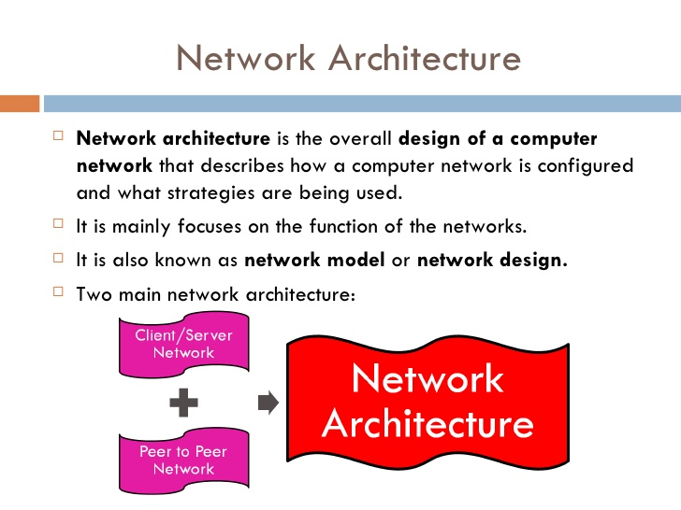

Slide 13
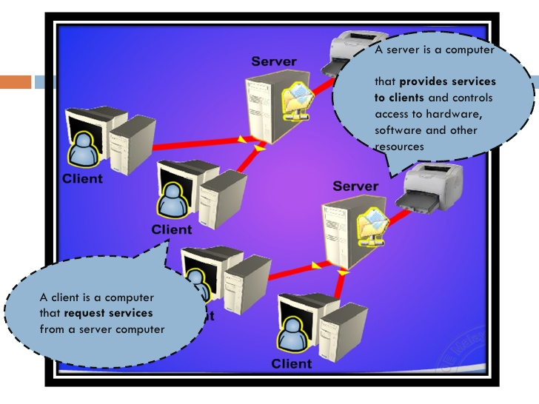

Slide 14
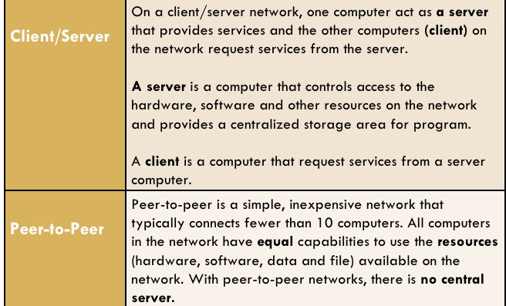

Slide 15
