Slide 1
maven

Slide 2
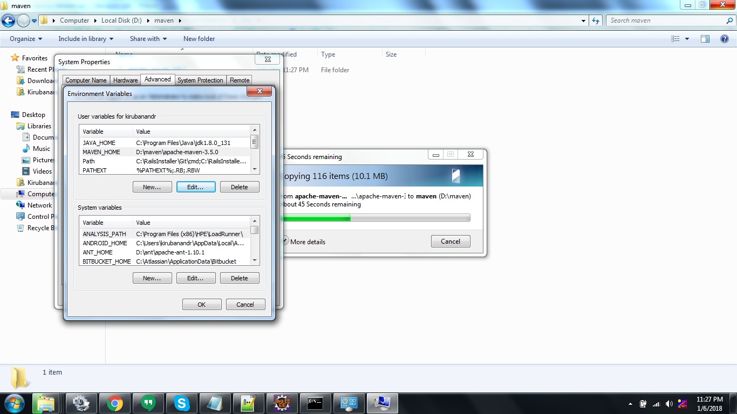

Slide 3
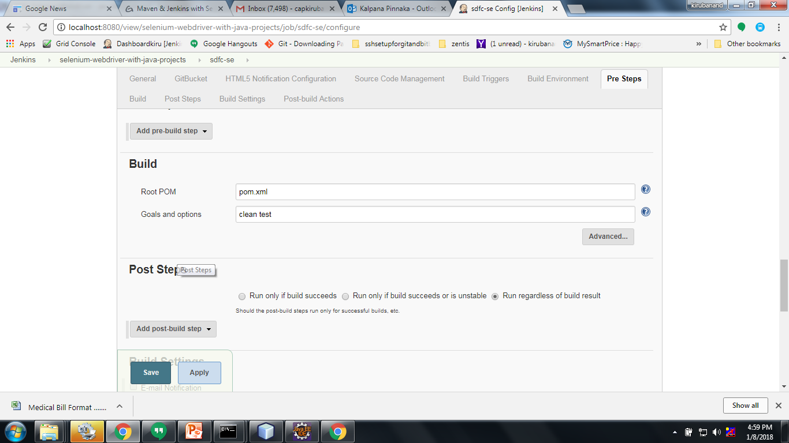
Notes:
mvn eclipse:clean eclipse:eclipse -U
mvn clean install

Slide 4
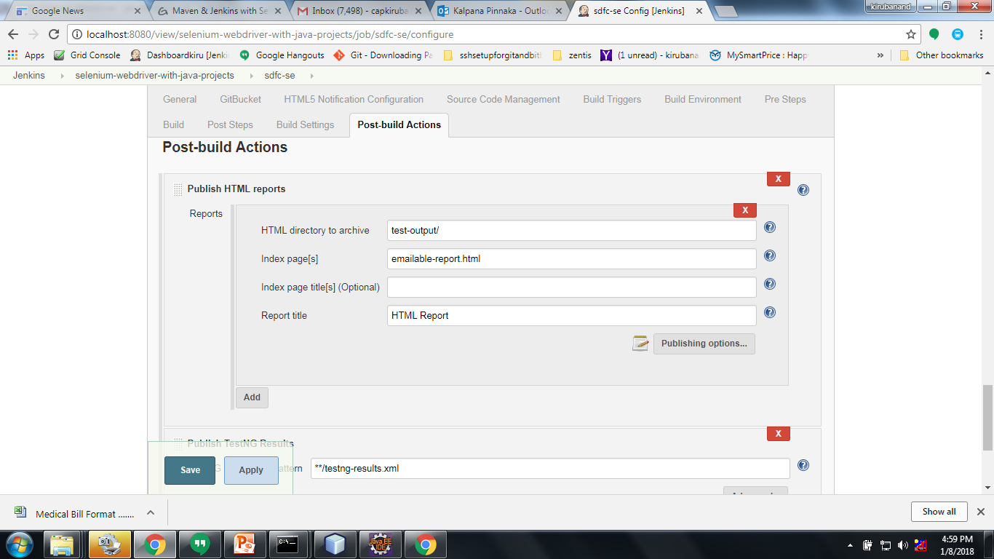
Notes:
<project xmlns="http://maven.apache.org/POM/4.0.0" xmlns:xsi="http://www.w3.org/2001/XMLSchema-instance"
xsi:schemaLocation="http://maven.apache.org/POM/4.0.0 http://maven.apache.org/xsd/maven-4.0.0.xsd">
<modelVersion>4.0.0</modelVersion>
<groupId>com.testing.pe</groupId>
<artifactId>pe-sfdc</artifactId>
<version>0.0.1-SNAPSHOT</version>
<packaging>jar</packaging>
<name>pe-sfdc</name>
<url>http://maven.apache.org</url>
<properties>
<project.build.sourceEncoding>UTF-8</project.build.sourceEncoding>
<poi.version>3.9</poi.version>
<selenium.version>3.4.0</selenium.version>
<jre.level>1.8</jre.level>
<jdk.level>1.8</jdk.level>
</properties>
<build>
<plugins>
<!-- Compiler plug-in -->
<plugin>
<groupId>org.apache.maven.plugins</groupId>
<artifactId>maven-compiler-plugin</artifactId>
<version>3.6.1</version>
<configuration>
<source>${jdk.level}</source>
<target>${jdk.level}</target>
</configuration>
</plugin>
<!-- Below plug-in is used to execute tests -->
<plugin>
<groupId>org.apache.maven.plugins</groupId>
<artifactId>maven-surefire-plugin</artifactId>
<version>2.18.1</version>
<configuration>
<suiteXmlFiles>
<!-- TestNG suite XML files -->
<suiteXmlFile>testng.xml</suiteXmlFile>
</suiteXmlFiles>
</configuration>
</plugin>
</plugins>
</build>
<dependencies>
<dependency>
<groupId>org.seleniumhq.selenium</groupId>
<artifactId>selenium-java</artifactId>
<version>${selenium.version}</version>
</dependency>
<dependency>
<groupId>org.apache.poi</groupId>
<artifactId>poi</artifactId>
<version>${poi.version}</version>
</dependency>
<dependency>
<groupId>org.apache.poi</groupId>
<artifactId>poi-scratchpad</artifactId>
<version>${poi.version}</version>
</dependency>
<dependency>
<groupId>org.apache.poi</groupId>
<artifactId>poi-ooxml</artifactId>
<version>${poi.version}</version>
</dependency>
<dependency>
<groupId>log4j</groupId>
<artifactId>log4j</artifactId>
<version>1.2.16</version>
</dependency>
<dependency>
<groupId>xerces</groupId>
<artifactId>xercesImpl</artifactId>
<version>2.10.0</version>
</dependency>
<dependency>
<groupId>commons-io</groupId>
<artifactId>commons-io</artifactId>
<version>2.4</version>
</dependency>
<!-- https://mvnrepository.com/artifact/org.testng/testng -->
<dependency>
<groupId>org.testng</groupId>
<artifactId>testng</artifactId>
<version>6.11</version>
</dependency>
<dependency>
<groupId>org.jsoup</groupId>
<artifactId>jsoup</artifactId>
<version>1.7.3</version>
</dependency>
<!-- <dependency> <groupId>junit</groupId> <artifactId>junit</artifactId>
<version>4.11</version> <scope>test</scope> </dependency> -->
<dependency>
<groupId>net.sf.opencsv</groupId>
<artifactId>opencsv</artifactId>
<version>2.3</version>
</dependency>
<dependency>
<groupId>org.seleniumhq.selenium</groupId>
<artifactId>htmlunit-driver</artifactId>
<version>2.26</version>
</dependency>
<!-- https://mvnrepository.com/artifact/org.uncommons/reportng -->
<dependency>
<groupId>org.uncommons</groupId>
<artifactId>reportng</artifactId>
<version>1.1.4</version>
<scope>test</scope>
</dependency>
<!-- https://mvnrepository.com/artifact/velocity/velocity-dep -->
<dependency>
<groupId>velocity</groupId>
<artifactId>velocity-dep</artifactId>
<version>1.4</version>
</dependency>
<!-- https://mvnrepository.com/artifact/com.google.inject/guice -->
<dependency>
<groupId>com.google.inject</groupId>
<artifactId>guice</artifactId>
<version>3.0</version>
</dependency>
</dependencies>
</project>

Slide 5
