Slide 1
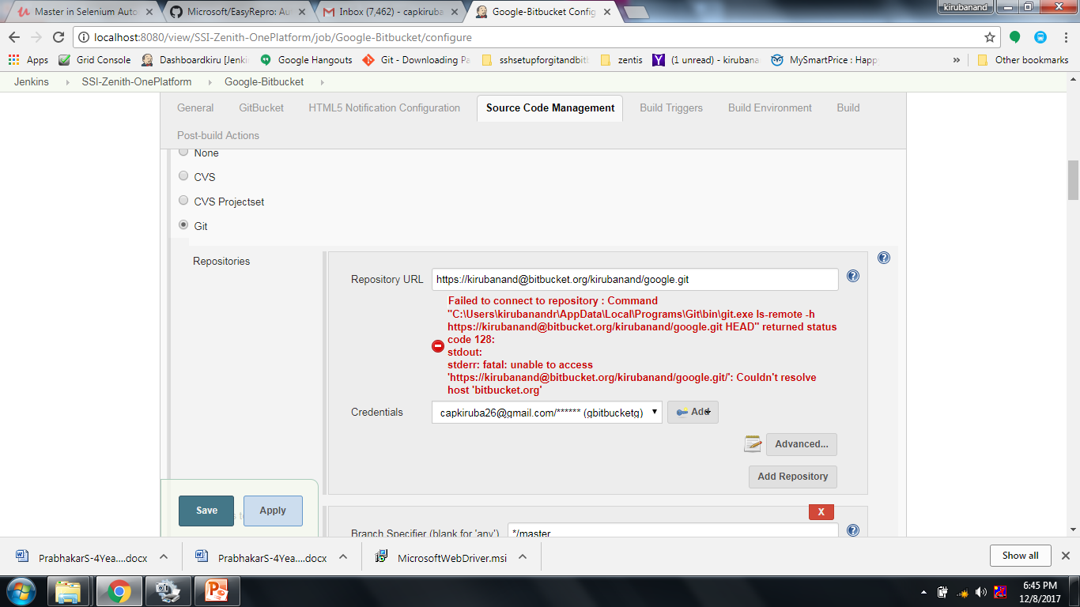
Jenkins
By
Kirubanand ramasamy

Slide 2
Then(/^I check the picklist value of "([^"]*)" field$/) do |arg1|
begin
sleep 5
arg = getAccountsDetails 'account_details'
if page.has_select?("acc24")
puts "#{arg1} picklist field is present and a picklist field"
within all('.pbSubsection')[0] do
actualvalue =find(:xpath, "//*[contains(@name, 'acc24')]").all('option').collect(&:text)
puts "actual values = #{actualvalue}"
expectedvalue =Array.new
expectedvalue = arg["account_currency"].split(',')
puts "expectedvalues = #{expectedvalue}"
if actualvalue.sort == expectedvalue.sort
puts "expected values are visible in new record picklist"
else
writeFailure "expected values are not visible in new record picklist"
end
end
else
writeFailure "#{arg1} picklist is not present"
end
end
end
Notes:
Then(/^I check the picklist value of "([^"]*)" field$/) do |arg1|
begin
sleep 5
arg = getAccountsDetails 'account_details'
if page.has_select?("acc24")
puts "#{arg1} picklist field is present and a picklist field"
within all('.pbSubsection')[0] do
actualvalue =find(:xpath, "//*[contains(@name, 'acc24')]").all('option').collect(&:text)
puts "actual values = #{actualvalue}"
expectedvalue =Array.new
expectedvalue = arg["account_currency"].split(',')
puts "expectedvalues = #{expectedvalue}"
if actualvalue.sort == expectedvalue.sort
puts "expected values are visible in new record picklist"
else
writeFailure "expected values are not visible in new record picklist"
end
end
else
writeFailure "#{arg1} picklist is not present"
end
end
end

Slide 3
Why string is mutable and unmuteable

Slide 4
<html><head>
<meta http-equiv="Content-Type" content="text/html; charset=utf-8">
<title>Response CPQ Automation Report</title>
<style type="text/css">
a {color: #4A72AF;}
body, #header h1, #header h2, p {margin: 0; padding: 0;}
#main {border: 1px solid #cfcece;}
img {display: block;}
#top-message p, #bottom-message p {color: #3f4042; font-size: 12px; font-family: Arial, Helvetica, sans-serif; }
#header h1 {color: #ffffff !important; font-family: "Lucida Grande", "Lucida Sans", "Lucida Sans Unicode", sans-serif; font-size: 24px; margin-bottom: 0!important; padding-bottom: 0; }
#header h2 {color: #ffffff !important; font-family: Arial, Helvetica, sans-serif; font-size: 24px; margin-bottom: 0 !important; padding-bottom: 0; }
#header p {color: #ffffff !important; font-family: "Lucida Grande", "Lucida Sans", "Lucida Sans Unicode", sans-serif; font-size: 12px; }
h1, h2, h3, h4, h5, h6 {margin: 0 0 0.8em 0;}
h3 {font-size: 28px; color: #444444 !important; font-family: Arial, Helvetica, sans-serif; }
h4 {font-size: 22px; color: #4A72AF !important; font-family: Arial, Helvetica, sans-serif; }
h5 {font-size: 18px; color: #444444 !important; font-family: Arial, Helvetica, sans-serif; }
p {font-size: 12px; color: #444444 !important; font-family: "Lucida Grande", "Lucida Sans", "Lucida Sans Unicode", sans-serif; line-height: 1.5;}
</style>
</head>
<body>
<table width="100%" cellpadding="0" cellspacing="0" bgcolor="e4e4e4"><tbody><tr><td>
<table id="top-message" cellpadding="20" cellspacing="0" width="600" align="center">
<tbody><tr>
<td align="center">
</td>
</tr>
</tbody></table>
<table id="main" width="600" align="center" cellpadding="0" cellspacing="15" bgcolor="ffffff">
<tbody><tr>
<td>
<table id="header" cellpadding="10" cellspacing="0" align="center" bgcolor="8fb3e9">
<tbody><tr>
<td width="570" bgcolor="FF0000"><h1>Response CPQ</h1></td>
</tr>
<tr>
<td width="570" align="right" bgcolor="FF0000"><p>Build number: $BUILD_NUMBER | Build date: $BUILD_TIMESTAMP</p></td>
</tr>
</tbody></table>
</td>
</tr>
<tr>
<td></td>
</tr>
<tr>
<td>
<table id="content-2" cellpadding="0" cellspacing="0" align="center">
<tbody><tr>
<td width="570"><p>The cucumber test ran successfully Please click below link to view results </p></td>
</tr>
</tbody></table><br />
<table id="content-1" cellpadding="0" cellspacing="0" align="left">
<tbody><tr>
<td>
<h5>Total tests: $TEST_COUNTS</h5>
<h5><font color=green>Passed: ${TEST_COUNTS,var="pass"}</font></h5>
<h5><font color=red >Failed: ${TEST_COUNTS,var="fail"}</font></h5>
<h5><font color=blue >Skipped: ${TEST_COUNTS,var="skip"}</font></h5>
</td>
</tr>
</tbody></table>
</td>
</tr>
<tr>
<td>
</tbody></table>
<table id="bottom-message" cellpadding="20" cellspacing="0" width="600" align="center">
<tbody><tr>
<td align="center">
<p>Links to the build:</p>
<p><a href="$BUILD_URL/cucumber-html-reports/overview-features.html">Overview-Features-Results</a> | <a href="$BUILD_URL/cucumber-html-reports/overview-tags.html">Overview-Tags-Report</a>| <a href="$BUILD_URL/cucumber-html-reports/overview-trends.html">Overview-Trends-Report</a>| <a href="$BUILD_URL/cucumber-html-reports/overview-failures.html">Failures</a>
</td>
</tr>
</tbody></table>
</td></tr></tbody></table>
</body></html>
Notes:
<html><head>
<meta http-equiv="Content-Type" content="text/html; charset=utf-8">
<title>Response CPQ Automation Report</title>
<style type="text/css">
a {color: #4A72AF;}
body, #header h1, #header h2, p {margin: 0; padding: 0;}
#main {border: 1px solid #cfcece;}
img {display: block;}
#top-message p, #bottom-message p {color: #3f4042; font-size: 12px; font-family: Arial, Helvetica, sans-serif; }
#header h1 {color: #ffffff !important; font-family: "Lucida Grande", "Lucida Sans", "Lucida Sans Unicode", sans-serif; font-size: 24px; margin-bottom: 0!important; padding-bottom: 0; }
#header h2 {color: #ffffff !important; font-family: Arial, Helvetica, sans-serif; font-size: 24px; margin-bottom: 0 !important; padding-bottom: 0; }
#header p {color: #ffffff !important; font-family: "Lucida Grande", "Lucida Sans", "Lucida Sans Unicode", sans-serif; font-size: 12px; }
h1, h2, h3, h4, h5, h6 {margin: 0 0 0.8em 0;}
h3 {font-size: 28px; color: #444444 !important; font-family: Arial, Helvetica, sans-serif; }
h4 {font-size: 22px; color: #4A72AF !important; font-family: Arial, Helvetica, sans-serif; }
h5 {font-size: 18px; color: #444444 !important; font-family: Arial, Helvetica, sans-serif; }
p {font-size: 12px; color: #444444 !important; font-family: "Lucida Grande", "Lucida Sans", "Lucida Sans Unicode", sans-serif; line-height: 1.5;}
</style>
</head>
<body>
<table width="100%" cellpadding="0" cellspacing="0" bgcolor="e4e4e4"><tbody><tr><td>
<table id="top-message" cellpadding="20" cellspacing="0" width="600" align="center">
<tbody><tr>
<td align="center">
</td>
</tr>
</tbody></table>
<table id="main" width="600" align="center" cellpadding="0" cellspacing="15" bgcolor="ffffff">
<tbody><tr>
<td>
<table id="header" cellpadding="10" cellspacing="0" align="center" bgcolor="8fb3e9">
<tbody><tr>
<td width="570" bgcolor="FF0000"><h1>Response CPQ</h1></td>
</tr>
<tr>
<td width="570" align="right" bgcolor="FF0000"><p>Build number: $BUILD_NUMBER | Build date: $BUILD_TIMESTAMP</p></td>
</tr>
</tbody></table>
</td>
</tr>
<tr>
<td></td>
</tr>
<tr>
<td>
<table id="content-2" cellpadding="0" cellspacing="0" align="center">
<tbody><tr>
<td width="570"><p>The cucumber test ran successfully Please click below link to view results </p></td>
</tr>
</tbody></table><br />
<table id="content-1" cellpadding="0" cellspacing="0" align="left">
<tbody><tr>
<td>
<h5>Total tests: $TEST_COUNTS</h5>
<h5><font color=green>Passed: ${TEST_COUNTS,var="pass"}</font></h5>
<h5><font color=red >Failed: ${TEST_COUNTS,var="fail"}</font></h5>
<h5><font color=blue >Skipped: ${TEST_COUNTS,var="skip"}</font></h5>
</td>
</tr>
</tbody></table>
</td>
</tr>
<tr>
<td>
</tbody></table>
<table id="bottom-message" cellpadding="20" cellspacing="0" width="600" align="center">
<tbody><tr>
<td align="center">
<p>Links to the build:</p>
<p><a href="$BUILD_URL/cucumber-html-reports/overview-features.html">Overview-Features-Results</a> | <a href="$BUILD_URL/cucumber-html-reports/overview-tags.html">Overview-Tags-Report</a>| <a href="$BUILD_URL/cucumber-html-reports/overview-trends.html">Overview-Trends-Report</a>| <a href="$BUILD_URL/cucumber-html-reports/overview-failures.html">Failures</a>
</td>
</tr>
</tbody></table>
</td></tr></tbody></table>
</body></html>

Slide 5
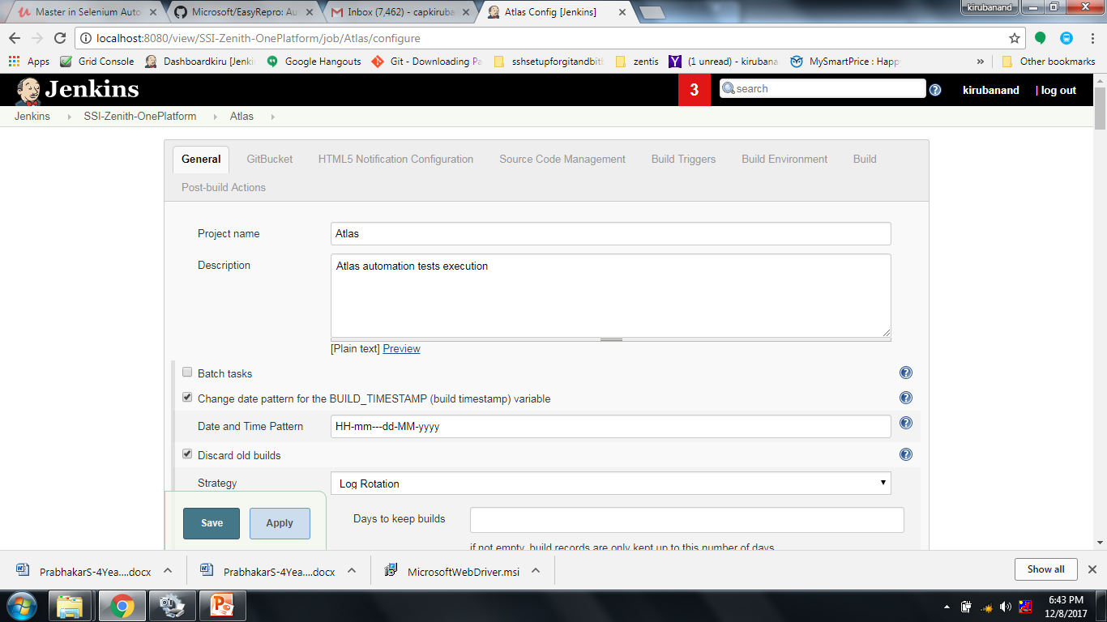
Notes:
<html><head>
<meta http-equiv="Content-Type" content="text/html; charset=utf-8">
<title>Response CPQ Automation Report</title>
<style type="text/css">
a {color: #4A72AF;}
body, #header h1, #header h2, p {margin: 0; padding: 0;}
#main {border: 1px solid #cfcece;}
img {display: block;}
#top-message p, #bottom-message p {color: #3f4042; font-size: 12px; font-family: Arial, Helvetica, sans-serif; }
#header h1 {color: #ffffff !important; font-family: "Lucida Grande", "Lucida Sans", "Lucida Sans Unicode", sans-serif; font-size: 24px; margin-bottom: 0!important; padding-bottom: 0; }
#header h2 {color: #ffffff !important; font-family: Arial, Helvetica, sans-serif; font-size: 24px; margin-bottom: 0 !important; padding-bottom: 0; }
#header p {color: #ffffff !important; font-family: "Lucida Grande", "Lucida Sans", "Lucida Sans Unicode", sans-serif; font-size: 12px; }
h1, h2, h3, h4, h5, h6 {margin: 0 0 0.8em 0;}
h3 {font-size: 28px; color: #444444 !important; font-family: Arial, Helvetica, sans-serif; }
h4 {font-size: 22px; color: #4A72AF !important; font-family: Arial, Helvetica, sans-serif; }
h5 {font-size: 18px; color: #444444 !important; font-family: Arial, Helvetica, sans-serif; }
p {font-size: 12px; color: #444444 !important; font-family: "Lucida Grande", "Lucida Sans", "Lucida Sans Unicode", sans-serif; line-height: 1.5;}
</style>
</head>
<body>
<table width="100%" cellpadding="0" cellspacing="0" bgcolor="e4e4e4"><tbody><tr><td>
<table id="top-message" cellpadding="20" cellspacing="0" width="600" align="center">
<tbody><tr>
<td align="center">
</td>
</tr>
</tbody></table>
<table id="main" width="600" align="center" cellpadding="0" cellspacing="15" bgcolor="ffffff">
<tbody><tr>
<td>
<table id="header" cellpadding="10" cellspacing="0" align="center" bgcolor="8fb3e9">
<tbody><tr>
<td width="570" bgcolor="FF0000"><h1>Response CPQ</h1></td>
</tr>
<tr>
<td width="570" align="right" bgcolor="FF0000"><p>Build number: $BUILD_NUMBER | Build date: $BUILD_TIMESTAMP</p></td>
</tr>
</tbody></table>
</td>
</tr>
<tr>
<td></td>
</tr>
<tr>
<td>
<table id="content-2" cellpadding="0" cellspacing="0" align="center">
<tbody><tr>
<td width="570"><p>The cucumber test ran successfully Please click below link to view results </p></td>
</tr>
</tbody></table><br />
<table id="content-1" cellpadding="0" cellspacing="0" align="left">
<tbody><tr>
<td>
<h5>Total tests: $TEST_COUNTS</h5>
<h5><font color=green>Passed: ${TEST_COUNTS,var="pass"}</font></h5>
<h5><font color=red >Failed: ${TEST_COUNTS,var="fail"}</font></h5>
<h5><font color=blue >Skipped: ${TEST_COUNTS,var="skip"}</font></h5>
</td>
</tr>
</tbody></table>
</td>
</tr>
<tr>
<td>
</tbody></table>
<table id="bottom-message" cellpadding="20" cellspacing="0" width="600" align="center">
<tbody><tr>
<td align="center">
<p>Links to the build:</p>
<p><a href="$BUILD_URL/cucumber-html-reports/overview-features.html">Overview-Features-Results</a> | <a href="$BUILD_URL/cucumber-html-reports/overview-tags.html">Overview-Tags-Report</a>| <a href="$BUILD_URL/cucumber-html-reports/overview-trends.html">Overview-Trends-Report</a>| <a href="$BUILD_URL/cucumber-html-reports/overview-failures.html">Failures</a>
</td>
</tr>
</tbody></table>
</td></tr></tbody></table>
</body></html>

Slide 6
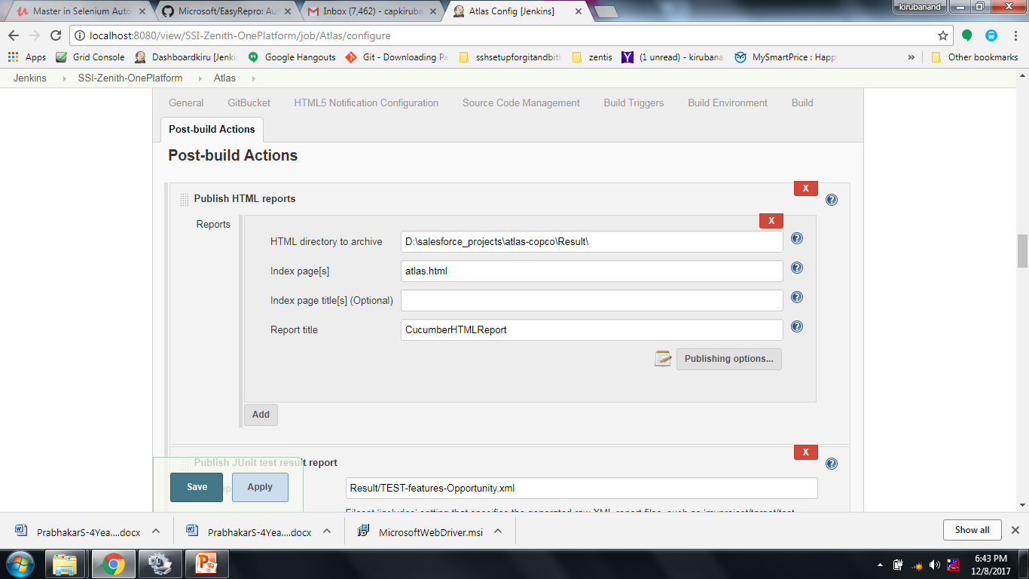

Slide 7
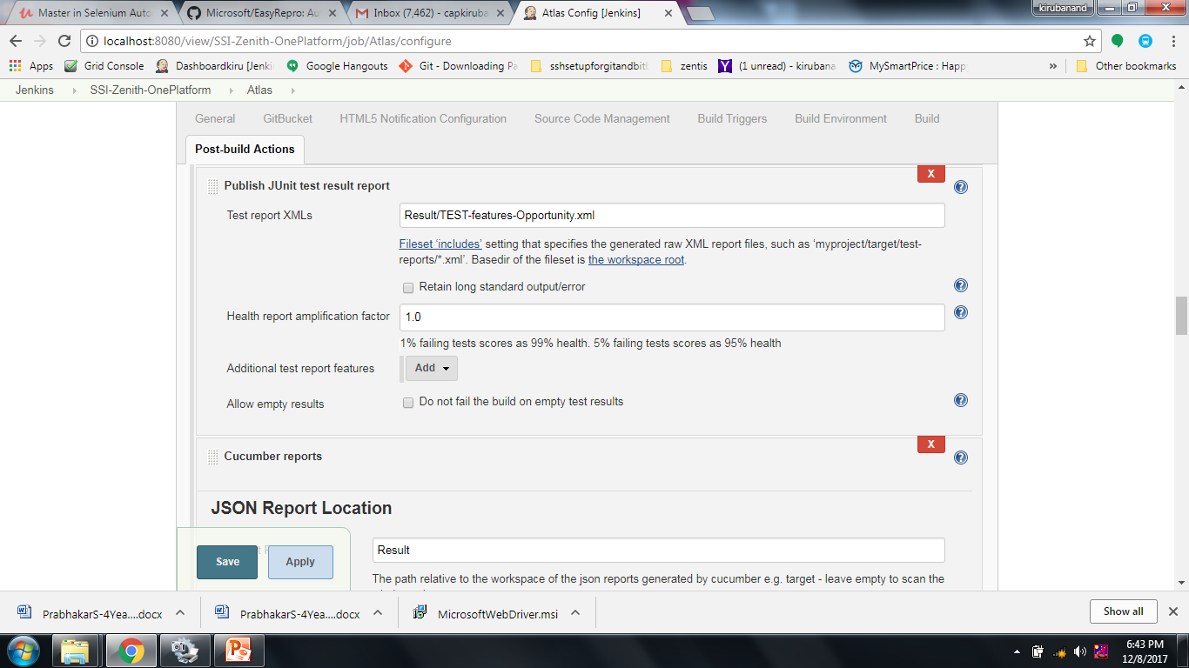

Slide 8
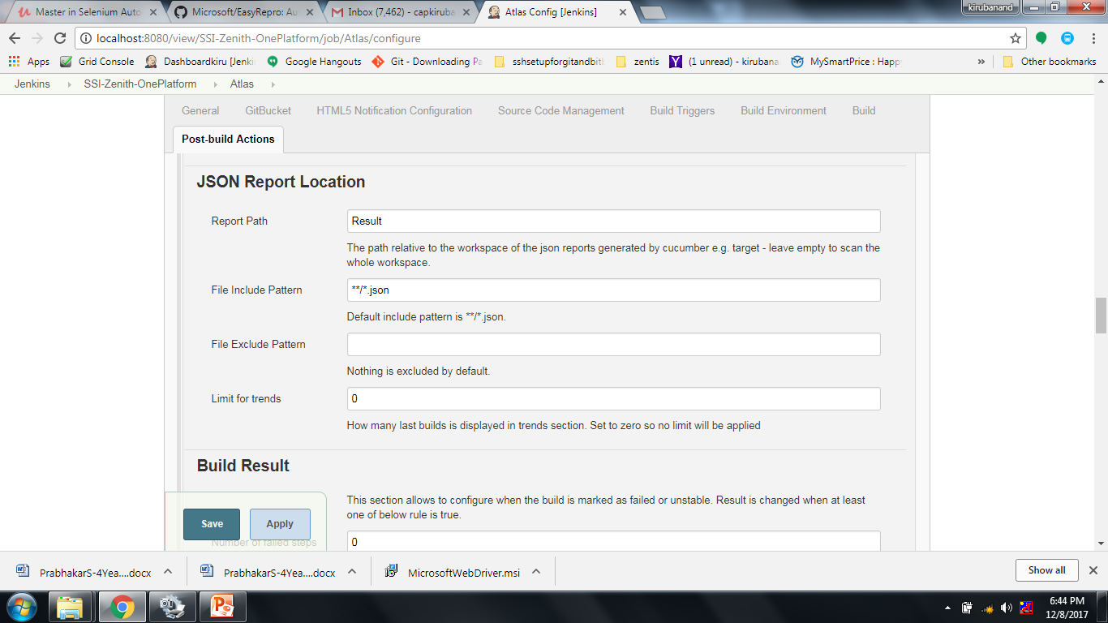

Slide 9
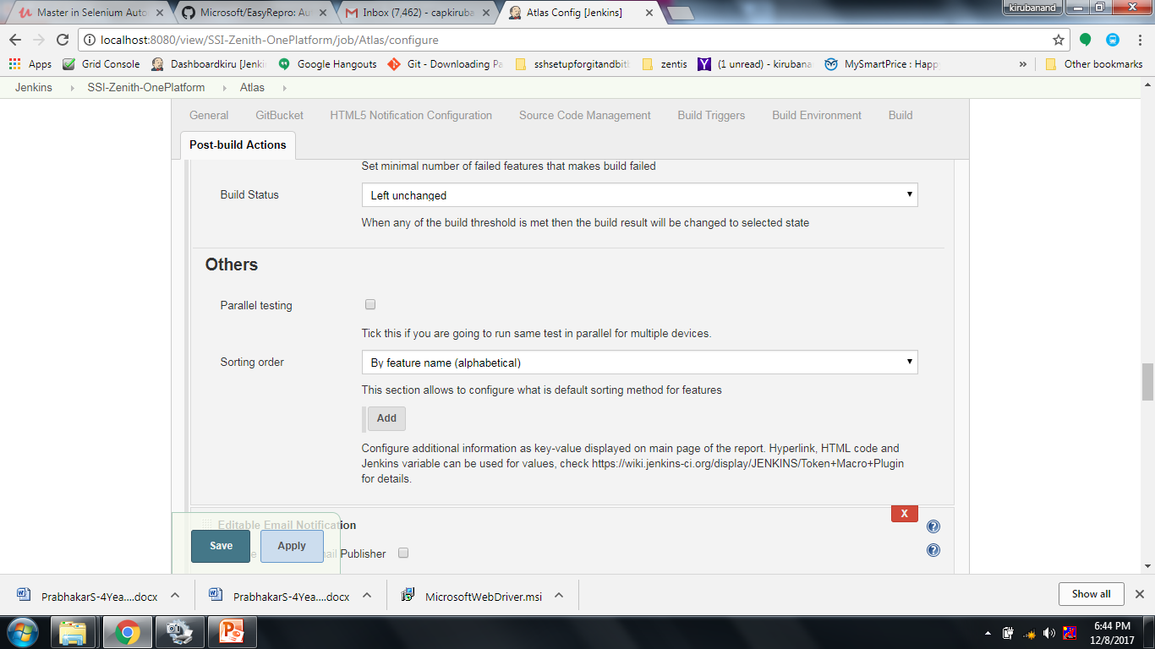

Slide 10
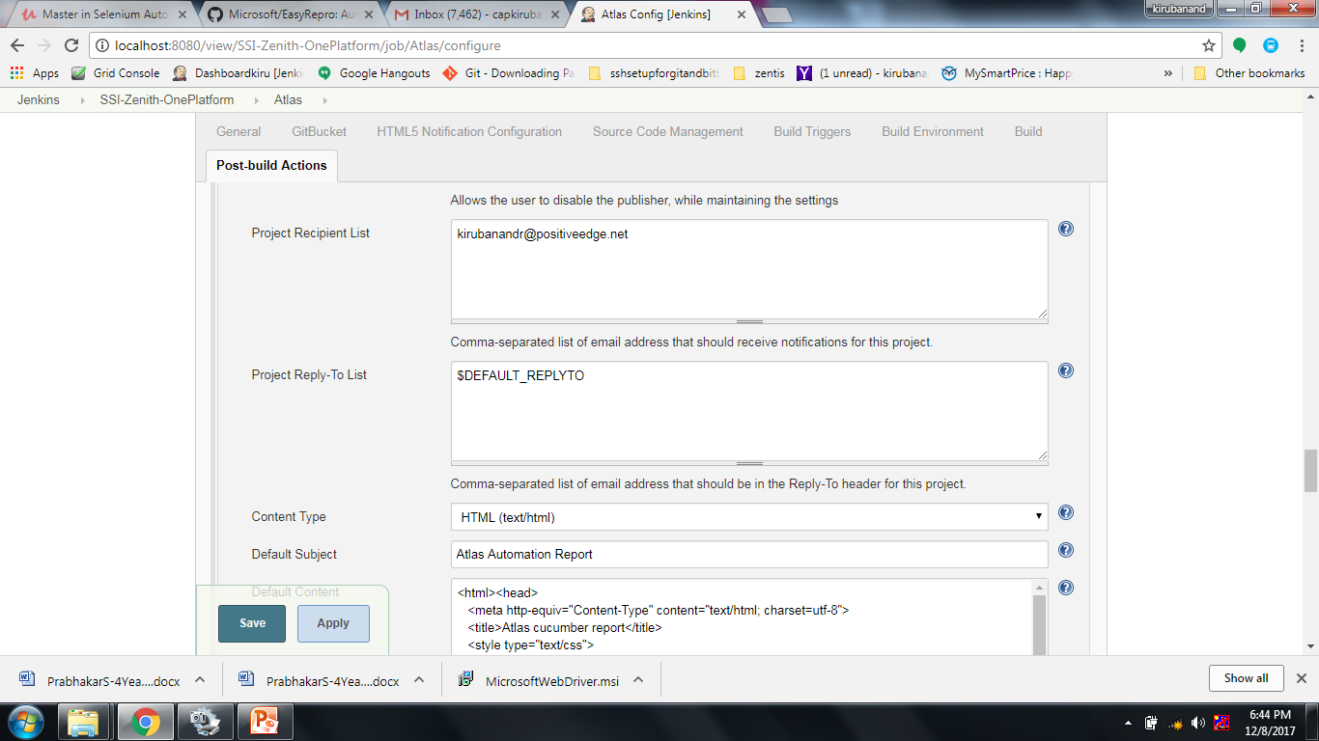

Slide 11
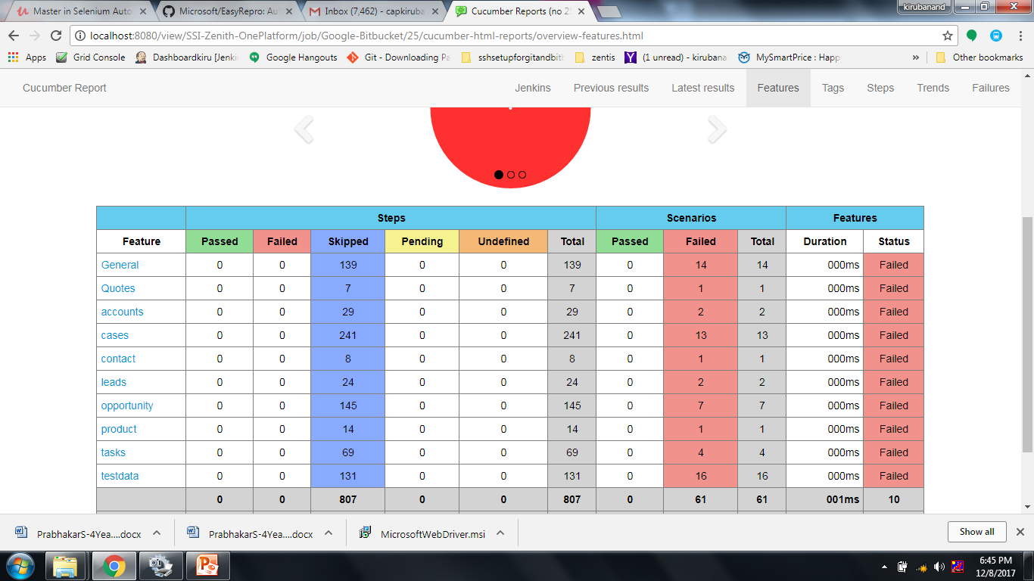

Slide 12
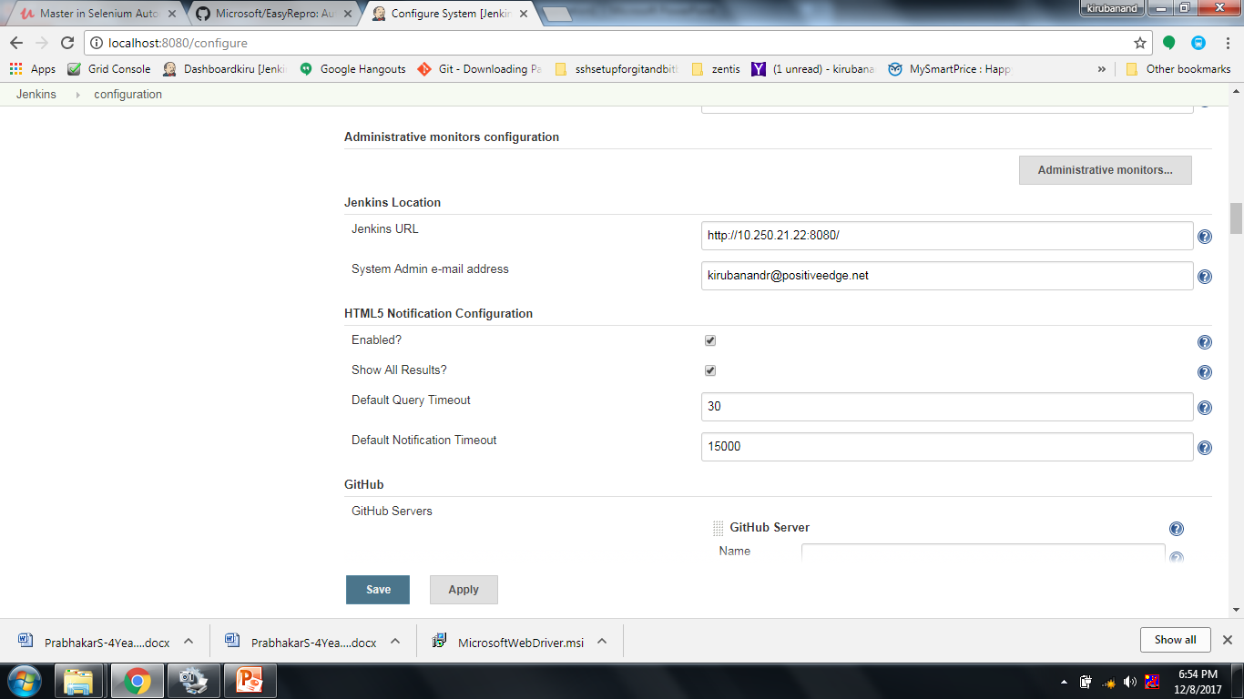

Slide 13
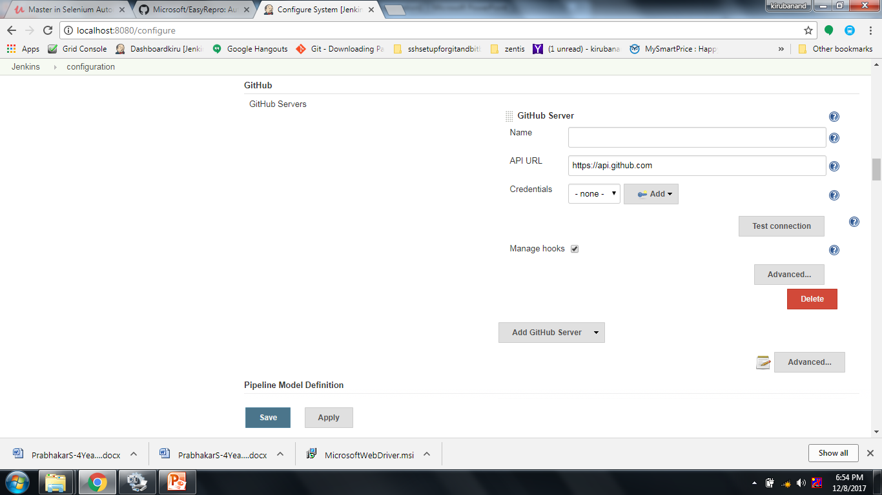

Slide 14
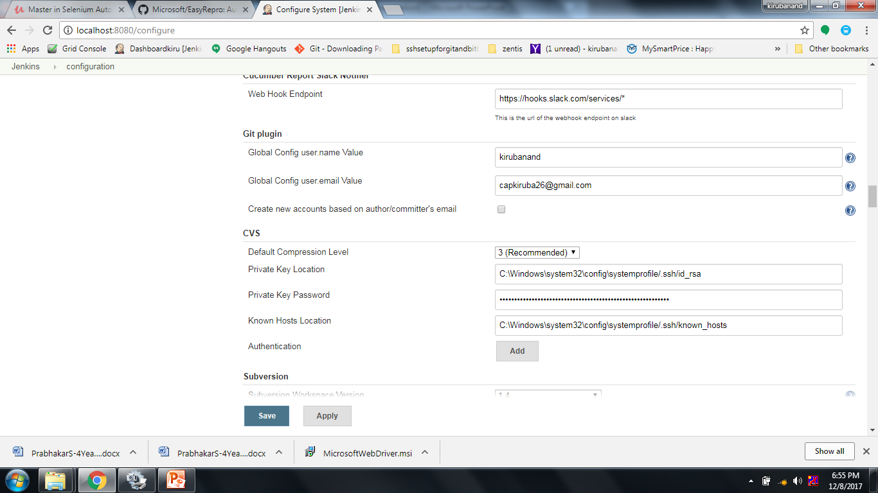

Slide 15
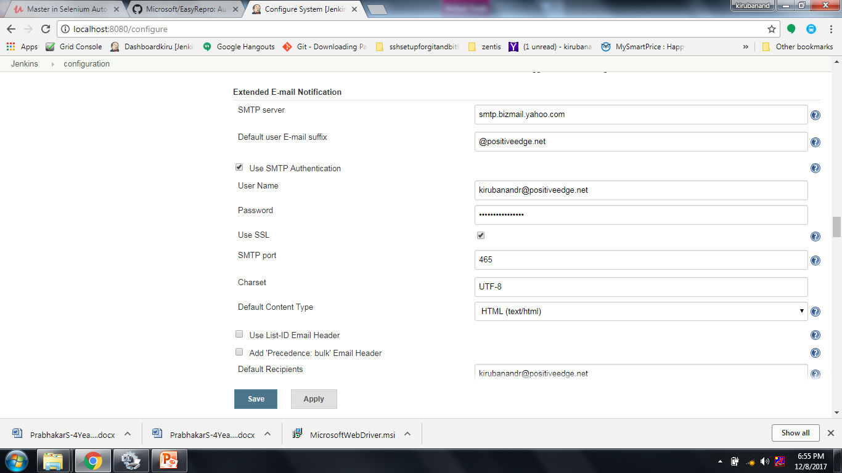

Slide 16
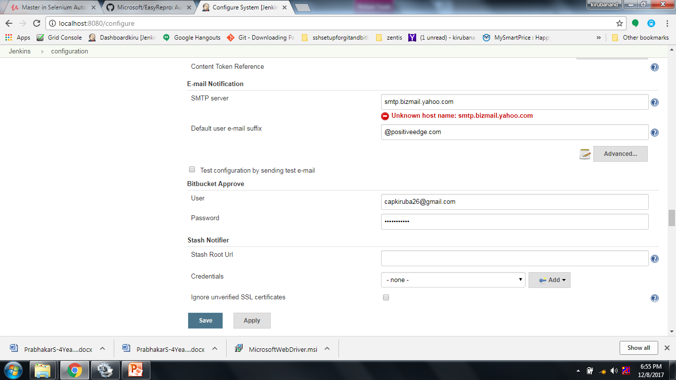

Slide 17
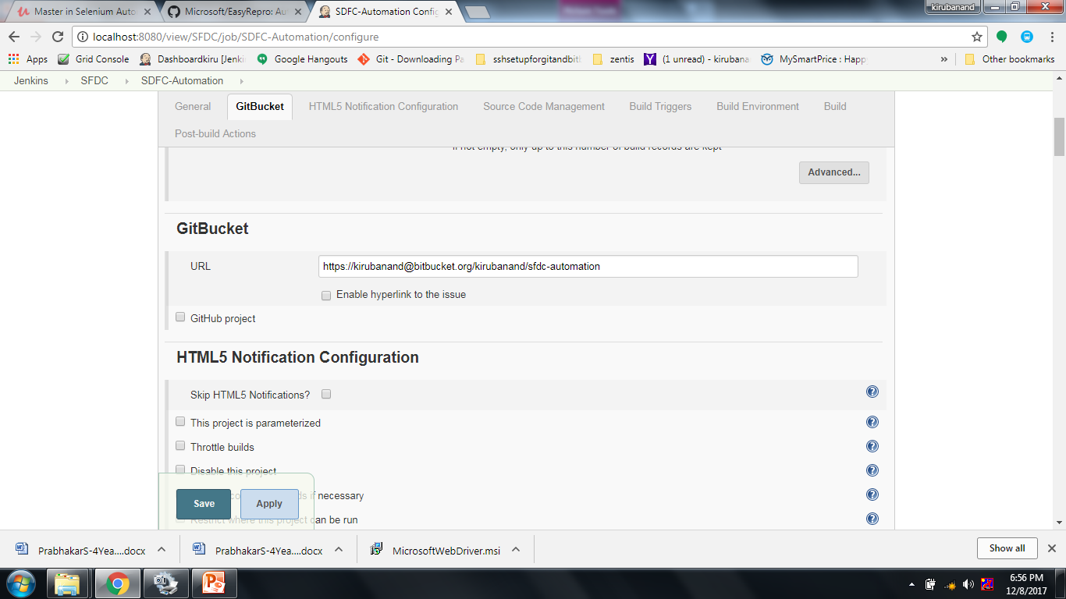

Slide 18
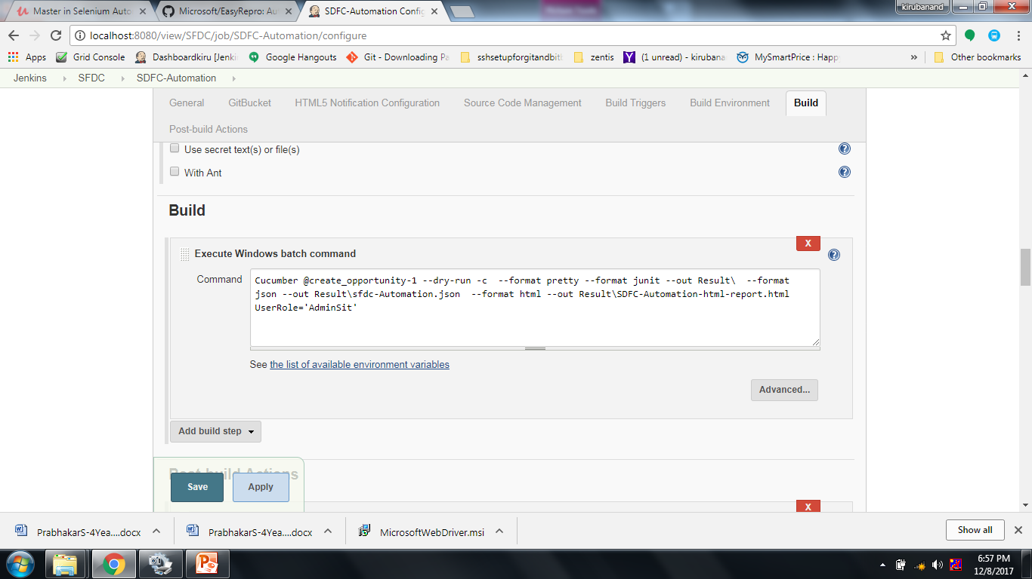

Slide 19
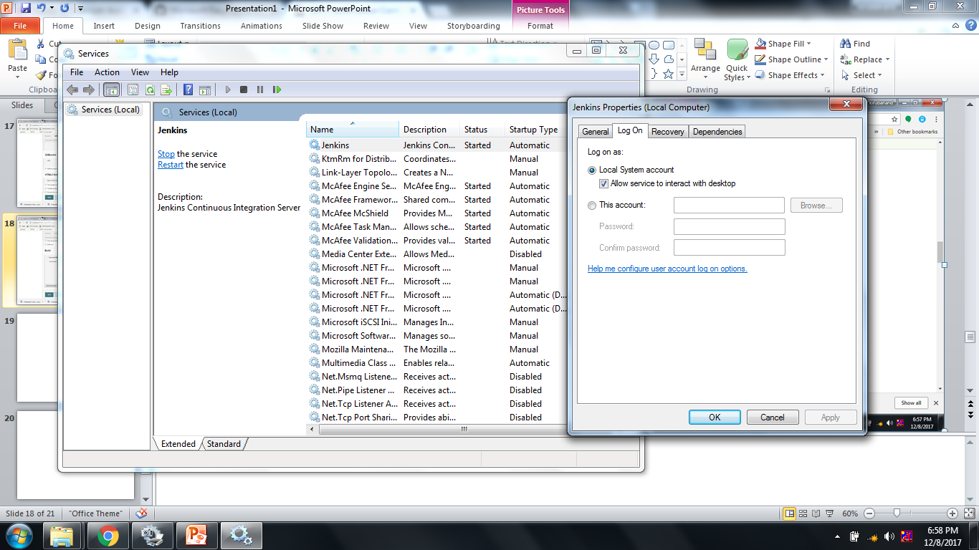

Slide 20
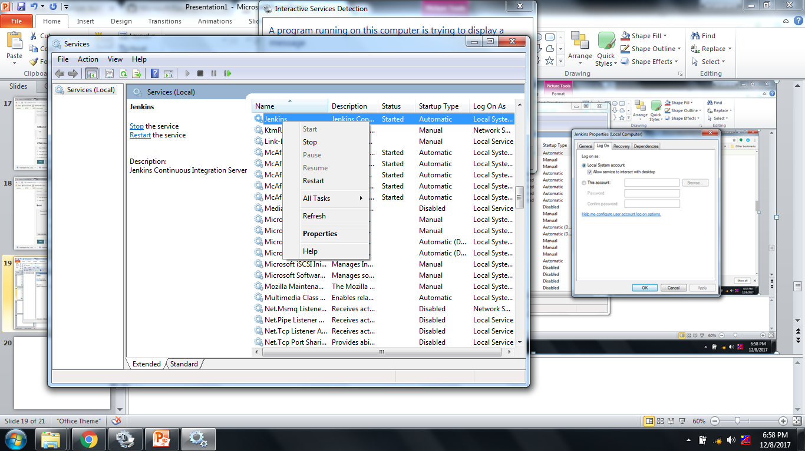

Slide 21
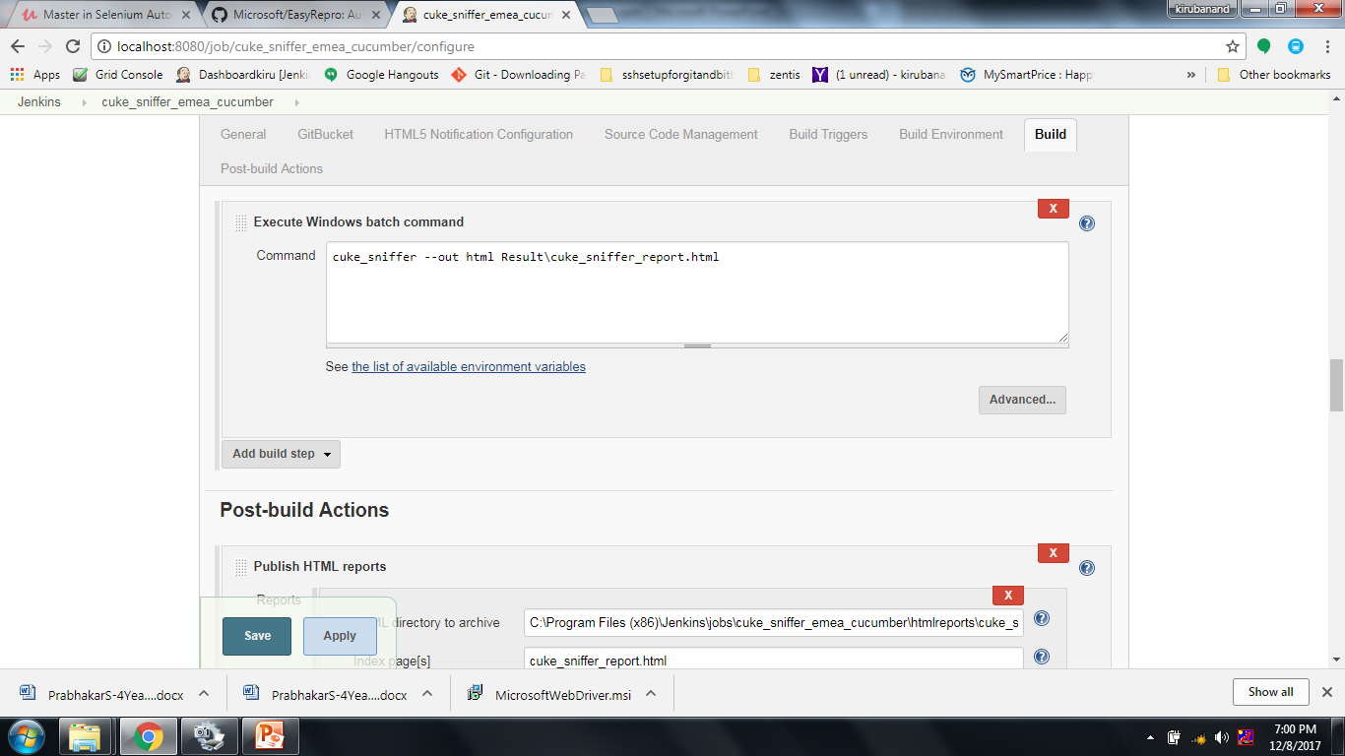

Slide 22
