Slide 1
.Net Framework - MVC

Slide 2
MVC ARCHITECTURE

Slide 3
MVC Architecture
1.Model = Defines Structure of the Data & Business Logic
2.View = Defines presentation
3.Controller = Execution Flow & Programming Logic
Controller can call Model and View also.
View can call Model.
Model can’t call View/Controller

Slide 4
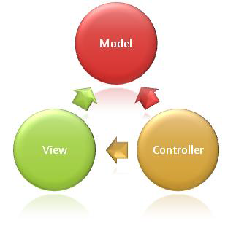

Slide 5
Model Controller and View
Model: It is a class, which defines structure of the data , to be maintained. It can also contain business logic.
Controller: It is a class, which defines application logic and also receives the request from browser and also returns response to the browser.
View: It is a web page, which defines UI.

Slide 6
URL Syntax in MVC
Syntax : {Controller / Action }
Example: Home/Index
It calls Index action in Home controller.
Then that action method call the view.
The view executes and provides the response to the browser.
Note: Index is the default action method in MVC.

Slide 7
Domain:www.bajaj.com Demo.Bajaj
www.bajaj.com/Bikes/Index
www.bajaj.com/Bikes/show/Pulsar
www.bajaj.com/Bikes/show/Discover
www.bajaj.com/Bikes/show/Ninja
www.bajaj.com/Bikes/NewArrivals
www.bajaj.com/Corporate/Index
www.bajaj.com/Corporate/Chairman
www.bajaj.com/Corporate/Awards
www.bajaj.com/Investers/Index
www.bajaj.com/Investers/Services/ServiceCenters
www.bajaj.com/Investers/AnnualReport/2012
www.bajaj.com/Careers/Index
www.bajaj.com/Careers/WhyBajaj
www.bajaj.com/BookNow/Index
Reference:
http://www.bajajauto.com/

Slide 8
Url.Action()
It returns the URL associated to given action and controller.
Syntax:
<a href="@Url.Action("YourActionName", "YourControllerName")">Click here</a>
Example:
<a href="@Url.Action("Index", "Home")">Click here</a>

Slide 9
Execution Flow in MVC
URL : Home/Index
Browser
Controllers Action
Method
Rendered View
View

Slide 10
URL ROUTING

Slide 11
Objective
URL Routing
What is URL Routing
Route Maps
Parameters
Constraints in Parameters

Slide 12
URL Routing
URL Routing is a process of creating meaningful URL’s
A meaningful URL consists of some words, to reach to the actual context of page, instead of representing the folder structure of page.
Ex: /racing/showreviews/needforspeed

Slide 13
URL Routing
URL Routing includes with creating ONE OR MORE URL Routes,
URL Route contains a syntax (pattern) of URL.
Default URL pattern: {controller}/{action}/{id}
It is defined in RouteConfig.cs file in VS 2017(MVC5).
It is defined in global.asax file in VS 2010(MVC3)
An application can have ‘n’ no. of routes.

Slide 14
Ex:
/{controller}/{action}/{id}
/reports/{reportname}/{year}
/reports/monthly/{reportname}/{year}
The words specified in curly braces are called as parameters/arguments.

Slide 15
Demo
www.bajaj.com/Bikes/Index
www.bajaj.com/Bikes/show/Pulsar
www.bajaj.com/Bikes/show/Discover
www.bajaj.com/Bikes/show/Ninja
www.bajaj.com/Bikes/NewArrivals
www.bajaj.com/Corporate/Index
www.bajaj.com/Corporate/Chairman
www.bajaj.com/Corporate/Awards
www.bajaj.com/Investers/Index
www.bajaj.com/Investers/Services/ServiceCenters
www.bajaj.com/Investers/AnnualReport/2012
www.bajaj.com/Careers/Index
www.bajaj.com/Careers/WhyBajaj
www.bajaj.com/BookNow/Index
Reference:
http://www.bajajauto.com/

Slide 16
Syntax of creating a URL Route
public static void RegisterRoutes(RouteCollection routes)
{
routes.MapRoute(
“YourRouteNameHere”,
“YourURLPatternHere”,
YourParameterDefaultsHere,
YourParameterConstraintsHereOptionally
);
}

Slide 17
URL for Execution
URL syntax in MVC:
Syn: /ControllerName/ActionName
Ex: /Controller1/Action1
Ex: /Sample/Page1

Slide 18
URL Route
A URL Route contains:
1.An unique route name.
2.URL pattern
3.Default values
4.URL constraints (optinal)

Slide 19

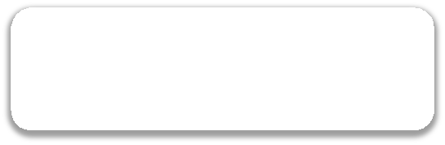
Response
Request
View Rendered
IIS
View Engine
ASP.NET
(aspnet_isapi.dll)
Model
Action Method
Routing Core
Route Handler
Controller

Slide 20
MVC Folder Structure

Slide 21
Objectives
MVC Application Folder Structure
Controllers
Action Methods
Execution Flow
URL Syntax
View Bag
Views
Models
View Engines
Razor View Engine
MVC 5 Project Templates

Slide 22
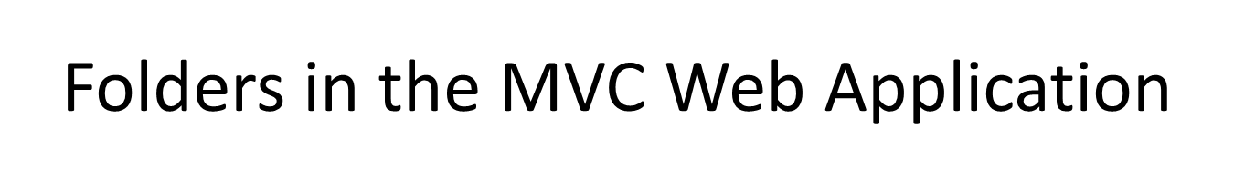
SNO | Folder Name | Description
1 | App_Data | Contains local SQL Server database files (.mdf) if any.
2 | App_Start | Contains necessary files to initialize the environment like some startup executable files RouteConfig.cs, BundleConfig.cs, These will be executed when the first request is sent to the web application
3 | Content | Contains static content like images ,.css files and JQuery UI themes etc.
4 | Controllers | All the controller classes must be present in "Controllers" folder.
5 | Fonts | Contains the custom fonts.
6 | Models | All the model classes must be present in "Models" folder.
7 | Scripts | Contains the .js & jquery files
8 | Views | All the views (.cshtml or .vbhtml or .aspx) must be present in "Views" folder.

Slide 23
APP_START
SNO | NAME | DESCRIPTION
1 | RouteConfig.cs | Used to configure URL routing
2 | BundleConfig.cs | Used to configure bundles and Minification
3 | FilterConfig.cs | Used to configure global action filters
4 | Startup.Auth.cs | Used to configure 'DotNet Open Auth'
5 | WebApiConfig.cs | Used to configure web api URL routing

Slide 24
Files in the MVC Web Application
S.NO | File | Description
1 | Global.asax | It contains application level events & session level events. Ex: Application_Start, Application_End, Session_Start, Session_End
2 | Packages.config | It contains the list of all currently installed nuget packages in our application
3 | web.config | It is the 'web site configuration file', which contains all the configuration settings that related to current working web application. Ex: connection strings, app settings, custom errors, authentication & authorization etc.

Slide 25
Creating an ASP.NET MVC Application

Slide 26
Steps for development asp.net MVC Web Site
Open Visual Studio 2017
File - New - Project.
Language = Visual C#
Project Template = ASP.NET MVC 5 Web Application
Name = {any project name}
Location = {any folder name, where you want to store the project }
Click on OK.
Select "Basic".
View Engine = Razor
Click on OK

Slide 27
MODELS

Slide 28
Model
It is a class
Defines the structure of the data to be maintained
Can contain business logic.

Slide 29
Example
public class CustomerModel
{
public int CustomerID { get; set; }
public string CustomerName { get; set; }
public string Email { get; set; }
}

Slide 30
Steps for creating a model
In the solution Explorer
Select Models Folder under the project
Right click on "Models" folder.
Select "Add" - "Class".
Name = UserModel
Note: There is no any particular suffix and particular base class for the models.
Click on "Add".
- It creates a "Models\UserModel.cs" file.

Slide 31
Syntax of a model
namespace
ProjectName.Models
{
public class classname
{
//some properties & methods here
}
}

Slide 32
CONTROLLER

Slide 33
Controller
It is a class, present under Controller folder
It is a collection of action methods
Action Methods contains application logic.
The Request sent from the browser will be received by an action Method in the controller class.
Ex: The URL a/b calls "b" action method in "a" controller.

Slide 34
Open Solution Explorer
- Right click on "Controllers" folder.
- Select "Add" - "Controller".
- Name = HomeController
- Template = Empty MVC Controller
Note: The suffix "Controller" is must.
- Click on "Add".

Slide 35
Syntax of a Controller
namespace YourProjectName.Controllers
{
public class YourControllerNameController : Controller
{
//action methods here
}
}

Slide 36
Syntax of Action Method
namespace ProjectName.Controllers
{
public class ControllerNameController : Controller
{
public ActionResult ActionMethodName()
{
//some code here
return View();
//calls the view with same name
}
}
}

Slide 37
Rules for Controller
It must be a public class and should have suffix “Controller”.
Ex: “HomeController”
It should be a sub class of “System.Web.Mvc.Controller”
Each Action Method should have corresponding View with same name under “Views/Controller” folder.
Each Action Method should return view with the same name.

Slide 38
Passing data to view
The controller creates & passes an instance of model to the view.
using ViewBag.
Passing Model instance to return View()
Passing wrapper class instance to View
Strongly typed view

Slide 39
Passing Model to View through View Bag
Example 1
public class Customer
{
public int CustomerID { get; set; }
public string CustomerName { get; set; }
public string Email { get; set; }
}

Slide 40
using ProjectName.Models;
public class HelloWorldController : Controller
{
public ActionResult Page9()
{
//create an object for Customer class
Customer c = new Customer()
{
CustomerID = 101,
CustomerName = "some customer name",
Email = "some email" };
ViewBag.CurrentCustomer = c;
return View();
}
}

Slide 41
Displaying Model data through ViewBag
<h2>Page9</h2>
@ViewBag.CurrentCustomer.CustomerID <br />
@ViewBag.CurrentCustomer.CustomerName <br />
@ViewBag.CurrentCustomer.Email <br />

Slide 42
Passing Model to View through View Bag
// GET: /HelloWorld/Page10
public ActionResult Page10()
{
//create an object for Customer class
Customer c = new Customer() { CustomerID = 101, CustomerName = "some customer name", Email = "some email" };
return View(c);
}

Slide 43
@model MvcTraining1.Models.Customer
@{
ViewBag.Title = "Page10";
Layout = "~/Views/Shared/_LayoutPage1.cshtml";
}
<h2>Page10</h2>
@Model.CustomerID<br />
@Model.CustomerName<br />
@Model.Email<br />
<hr />
@using (Html.BeginForm("UpdateCustomer", "HelloWorld"))
{
@Html.EditorFor(item => item.CustomerID)
<br />
@Html.EditorFor(item => item.CustomerName)
<br />
@Html.EditorFor(item => item.Email)
<input type="submit" />
}

Slide 44
Wrapper Class
Wrapper Class is a model class; present under 'Models' folder.
class EmployeeModel
{
}
class CustomerModel
{
}
class WrapperClass
{
EmployeeModel emp { get; set; }
CustomerModel cs { get; set; }
}

Slide 45
controller:
public ActionResult Index()
{
EmployeeModel emp1 = new EmployeeModel() { ....};
CustomerModel cs1 = new CustomerModel() { ... };
WrapperClass wc = new WrapperClass();
wc.emp = emp1;
wc.cs = cs1;
return View(wc);
}

Slide 46
Automatic Model Binding:
When a form is submitted for the server, if the model property names and form element names are match, then you can receive an object of the model class.
Then system generates an object of the model class and assigns the form element values into the respective model properties.

Slide 47
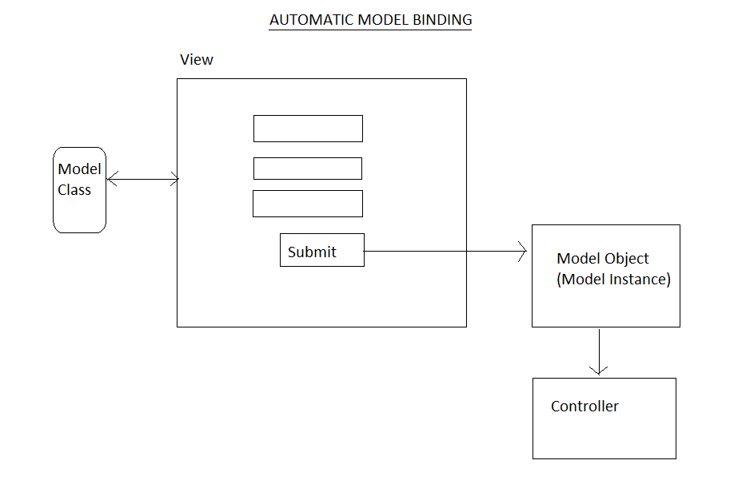

Slide 48
View bag VS Tempdata VS ViewData

Slide 49
ViewData
ViewData is used to pass data from controller to view
It is derived from ViewDataDictionary class
public ViewDataDictionary ViewData { get; set; }
It is available for the current request only
Requires typecasting for complex data type and checks for null values to avoid error
If redirection occurs, then its value becomes null

Slide 50
ViewBag
ViewBag is also used to pass data from the controller to the respective view
ViewBag is a dynamic property that takes advantage of the new dynamic features in C# 4.0
public Object ViewBag { get; }
It is also available for the current request only
If redirection occurs, then its value becomes null
Doesn’t require typecasting for complex data type

Slide 51
Where to use ViewData and ViewBag
Both the ViewData and ViewBag objects work well in the following scenarios:
Incorporating dropdown lists of lookup data into an entity
Components like a shopping cart
Widgets like a user profile widget
Small amounts of aggregate data
- See more at: http://rachelappel.com/when-to-use-viewbag-viewdata-or-tempdata-in-asp.net-mvc-3-applications#sthash.pNaYdzvb.dpuf

Slide 52
TempData
TempData is derived from TempDataDictionary class
public TempDataDictionary TempData { get; set; }
TempData is used to pass data from the current request to the next request
It keeps the information for the time of an HTTP Request. This means only from one page to another. It helps to maintain the data when we move from one controller to another controller or from one action to another action
It requires typecasting for complex data type and checks for null values to avoid error. Generally, it is used to store only one time messages like the error messages and validation messages

Slide 53
Where to use tempdata
While the TempData object works well in one basic scenario:
Passing data between the current and next HTTP requests
- See more at: http://rachelappel.com/when-to-use-viewbag-viewdata-or-tempdata-in-asp.net-mvc-3-applications#sthash.pNaYdzvb.dpuf

Slide 54
Session
Session is an object that is derived from HttpSessionState class.
public HttpSessionState Session { get; }
Session is a property of HttpContext class.
Session is also used to pass data within the ASP.NET MVC application and Unlike TempData, it never expires.
Session is valid for all requests, not for a single redirect.
It’s also required typecasting for getting data and check for null values to avoid error.

Slide 55
ViewData Example
//Controller Code
public ActionResult Index()
{
List<string> Student = new List<string>();
Student.Add("Jignesh");
Student.Add("Tejas");
Student.Add("Rakesh");
ViewData["Student"] = Student;
return View();
}
//Page code
<ul>
<% foreach (var student in ViewData["Student"] as List<string>)
{ %>
<li><%: student%></li>
<% } %>
</ul>

Slide 56
ViewBag Example
//Controller Code
public ActionResult Index()
{
List<string> Student = new List<string>();
Student.Add("Jignesh");
Student.Add("Tejas");
Student.Add("Rakesh");
ViewBag.Student = Student;
return View();
}
//page code
<ul>
<% foreach (var student in ViewBag.Student)
{ %>
<li><%: student%></li>
<% } %>
</ul>

Slide 57
TempData Example
//Controller Code
public ActionResult Index()
{
List<string> Student = new List<string>();
Student.Add("Jignesh");
Student.Add("Tejas");
Student.Add("Rakesh");
TempData["Student"] = Student;
return View();
}
//page code
<ul>
<% foreach (var student in TempData["Student"] as List<string>)
{ %>
<li><%: student%></li>
<% } %>
</ul>

Slide 58
ViewData vs ViewBag vs TempData
ViewData | ViewBag | TempData
It is Key-Value Dictionary collection | It is a type object | It is Key-Value Dictionary collection
ViewData is a dictionary object and it is property of ControllerBase class | ViewBag is Dynamic property of ControllerBase class. | TempData is a dictionary object and it is property of controllerBase class.
ViewData is Faster than ViewBag | ViewBag is slower than ViewData | NA
ViewData is introduced in MVC 1.0 and available in MVC 1.0 and above | ViewBag is introduced in MVC 3.0 and available in MVC 3.0 and above | TempData is also introduced in MVC1.0 and available in MVC 1.0 and above.
ViewData is also work with .net framework 3.5 and above | ViewBag is only work with .net framework 4.0 and above | TempData is also work with .net framework 3.5 and above

Slide 59
ViewData vs ViewBag vs TempData
View Data | ViewBag | TempData
Type Conversion code is required while enumerating | In depth, ViewBag is used dynamic, so there is no need to type conversion while enumerating. | Type Conversion code is required while enumerating
It value become null if redirection is occurred. | Same as ViewData | TempData is used to pass data between two consecutive requests.
It lies only during the current request. | Same as ViewData | TempData is only work during the current and subsequent request

Slide 60
Conclusion We have three options ViewData, ViewBag and TempData for passing data from controller to view and in next request. ViewData and ViewBag are almost similar and it helps us to transfer the data from controller to view whereas TempData is also work during the current and subsequent request.

Slide 61
VIEW MODEL

Slide 62
Note: The WrapperClass can also be called as 'View Model'.
class EmployeeModel
{
}
class CustomerModel
{
}
class WrapperClass
{
EmployeeModel emp { get; set; }
CustomerModel cs { get; set; }
}

Slide 63
public ActionResult Index()
{
EmployeeModel emp1 = new EmployeeModel() { ....};
CustomerModel cs1 = new CustomerModel() { ... };
WrapperClass wc = new WrapperClass();
wc.emp = emp1;
wc.cs = cs1;
return View(wc);
}
WrapperClass is a model class; present under 'Models' folder.

Slide 64
VIEW

Slide 65
View
It is a web page, which contains presentation logic / design logic (html, css, javascript / jquery, c#.net).
Note: No server-side event handlers in MVC views.

Slide 66
View
View is a page in MVC.
File extension is “.cshtml” and ”.vbhtml” if you have selected VB.NET.
It contains presentation logic in C#.
Usually there should be one view for each action method in the associated folder.
The shared folder contains the views, that belong to all controllers

Slide 67
View Engine
To develop the view, we need to use any one of the View Engine.
View Engine provides rules for defining a view.
It explains how can you write server side presentation logic view.
ASP.NET MVC comes with two View Engines:
Razor View Engine(introduced in MVC3)
ASPX View Engine(available from MVC1)

Slide 68
ASPX View Engine - Syntaxes
The following aspx syntaxes can be used in any .aspx file in MVC.
1) Code block
2) Printing the value of a variable
3) ASPX Comments
4) ASPX Loops

Slide 69
1) Code block:
<%
//some c# code here
%>
2) Printing the value of a variable:
<%:variablename%>

Slide 70
3) ASPX Comments:
no specific comments (use html comments / c# comments)

Slide 71
4) ASPX Loops:
<%
for(int i=1; i<=10 ;i++)
{
//some code here
}
%>
(or)
<%
foreach(var temp in MyCollection)
{
//some code here
}
%>

Slide 72
Razor View Engine
Used to create Views easily.
Benefits : easiness
It is a view engine , developed and recommended by Microsoft.
The View extension from “.cshtml” / “.vbhtml”

Slide 73
Just comparison of ASPX View Engine and Razor View Engine
Syntax in ASPX view Engine
<%
foreach ( var i in collection)
{
%>
<div> Employee Number:
<%: i.EmpNo %> </div>
…….
<%
}
%>
@foreach( var i in collection )
{
<div>Employee Number:
@i.EmpNo
</div>
....
}

Slide 74
Understanding Razor View engine
a)Code Blocks
b)Printing Variables
c)Loops
d)Expressions
e)Comments
f)Static Text

Slide 75
a)Code Block
syntax
@{
Your code here
}
Example
@{
//some c# code
int a=10, b=20;
int c= a+b;
}

Slide 76
Printing Variables Properties MVC
Syntax
@YourVariable
Example
@c

Slide 77
c)Loops
Example
@for(int i=1;i<=10;i++)
{
@i<br/>
}

Slide 78
d)Expressions
Syntax
@( expression )
Example
@( a*b )
@( a+b+c)
@( n+10 )

Slide 79
e) Comments
Syntax
@*Your comments here*@
Example
@*hi, this is comment *@

Slide 80
f) Static Text
Syntax
@{
@: Your Static text here
}
Example
@{
@:This is static text
}

Slide 81
Special Features of MVC Views
No code-behind (you must use Inline coding technique just like ASP 3.0)
No page life cycle / page events. The MVC View executes top-to-bottom.
No "Server controls"... -That means, no <asp:Button>, <asp:GridView> etc.
No "Post back".
No Server side events (like button1_Click)
No "View State".
But we can use Session State, Application State and Caching also.

Slide 82
MVC 5 Web Application Project Templates
Sl. No | Project Template | Description
1 | Empty (new) | Creates essential folders only. •No sample pages will be created automatically. •No jQuery UI themes and default master page will be added, by default.
2 | Basic | •Creates essential folders only. •No sample pages will be created automatically. •jQuery UI themes and default master page will be added automatically.
3 | Internet Application | •Creates essential folders automatically. •Sample pages will be created automatically. •Enables "Forms based security" in web.config
4 | Intranet Application | Creates essential folders automatically. •Sample pages will be created automatically. •Enables "Windows based security" in web.config
5 | Mobile(new) | •Create "mobile web pages" will be created by integrating "jQuery Mobile".

Slide 83
Creating View
Right Click on required action Method (For example: Index method in Home Controller)
Select Add View option from the
shortcut menu
Name = Index
Note = Action method name and
view name must be same.
View Engine = Razor
Uncheck all check boxes
Click on “ADD”
It creates file called “Index.cshtml”
under “Views/Home” folder.
Type HTML code press F5.

Slide 84
Types of Views
MVC supports 3 types of views.
Strongly typed view
Layout View
Partial view

Slide 85
Types of Views
Sl.No | Type of View | Description
1 | Normal View | It is a general purpose view.
2 | Layout View | It is a master page. It is used to contain a layout design for the web application.
3 | Content View | It is a normal view, which is developed based on Layout View. Similar to Content Pages in ASP.NET Web Forms
4 | Partial View | It is a user control. It is used to display some information commonly among many normal views.

Slide 86
Types of views
Layout Views:
- same as 'Master pages' in ASP.NET
- used to design the 'page template' and apply the same for all web pages present within the web site.
Partial Views:
- same as 'Web User Control' in ASP.NET
- used to repeat the same UI in many web pages, wherever required.
Strongly-typed Views:
- A view, that is associated to a 'ViewModel' class is called as 'Strongly-typed views'.
- Advantage:
1) The strongly-typed view can RECEIVE an object for 'ViewModel' class from the controller 2) The strongly-typed view can SUBMIT (send) an object for 'ViewModel' class to the controller.

Slide 87
Layout Views
It is just like "Master Pages" in ASP.NET Web Forms.
Used to contain the site template.
The pages which are created based on the layout view are called as "Content view".
Ex: LayoutView1.cshtml

Slide 88
Defining a Layout View
<!DOCTYPE html>
<html>
<head>
<title>Untitled</title>
</head>
<body>
<div>
@RenderBody()
</div>
</body>
</html>
Note:
@RenderBody( ) method renders
the page-specific content, which is running currently running.

Slide 89
Defining a Content View
@{
Layout = "your layout view file path here";
}
This markup will be rendered in RenderBody()
The "Layout" property specifies layout page path.

Slide 90
Steps for Layout Views
1) Create a Layout View:
Right click on the "Views\Shared" folder and say "Add" – "New Item".
Select “MVC” - "MVC 5 Layout Page".
Name = _LayoutPage1.cshtml
Click on "Add".

Slide 91
Steps for Layout Views(contd)
2) Create a Content View (Based on an existing Layout View):
Right click on your action method and say "Add View".
Name = same as your action method
View Engine = Razor
Check the check box "Use a layout or master page". Click on "..." button and choose "Views\Shared\LayoutView1.cshtml".
Click on "Add".

Slide 92
_ViewStart.cshtml
It is used to specify a default layout view for all the views.
The views can also override the layout view later.
Views\_ViewStart.cshtml
@{
Layout=“Views/Shared/_LayoutView1.cshtml”;
}

Slide 93
Methods in Layout Views
In a layout view, the following methods can be used.
1. @RenderBody( )
It calls the content of content view.
This method is must.
2. @RenderSection("YourSectionName")
It calls a section, that is defined in the content view.
This is optional.

Slide 94
Sections in Layout Views
Section in Layout View: It is similar to ContentPlaceHolder in Master Page.
These are used to show page-specific content at-a-certain place at layout view.
Its implementation includes with two steps:
1. Define the section in content view.
2. Invoke / call it in the Layout view.
Rule: If you use a section in Layout view, you must define section in all the corresponding content views.

Slide 95
Steps for Working with Sections
1) Define Section in Content View (Ex: Index.cshtml):
@section Section1
{
this content will be rendered in RenderSection.
}
2) Call / Invoke the Section in the Layout View (Ex: LayoutView1.cshtml):
@RenderSection("Section1")

Slide 96
Demo

Slide 97
Partial View
It is a view, which contains ‘reusable UI’.
These are just like “User controls” in asp.net web forms.
Can be called any no of times in any view present with in the project i.e Used to display the same markup in multiple views.
File Extension: .cshtml
Mostly, we place partial views in "Shared" folder.

Slide 98
Adding a Partial Views
Right click on your action method and say "Add View".
Select the option "Create as a partial view".
Click on "Add".

Slide 100
Partial views are usually place in Shared folder.
In which folder partial views should be present
If you place partial views in "Views\ControllerName" folder, those can be acessible in other views present with in the same folder.
b) If you place partial views in "Views\Shared" folder, thsoe can be accessible in ANY OTHER VIEW within the entire project. This is RECOMMENDED.

Slide 101
Rules for Partial views:
1) Partial views SHOULD NOT have 'Layout view' (master page)
2) Partial views SHOULD NOT have tags like <html>, <head> <body> etc.
3) Partial views can't be run directly on the browser.
4) Partial views can receive additional data from the controller using 'ViewBag'.
5) Partial views CAN BE strongly-typed views.

Slide 102
Steps for creating a partial view:
> Go to "Solution Explorer".
> Right click on "Views\Shared" folder and click on "Add" - "View".
> View Name = { any view name }
> View Engine = Razor
> Optional: "Create as a strongly typed view".
> Check the check box "Create as a partial view".
> Click on "Add".

Slide 103
Syntax of calling a partial view:
@{
Html.RenderPartial("PartialViewName");
}
Note: Make sure, whether the partial view is exist or not, in the "Views" folder.

Slide 104
1) Create the Partial View:
Views\Shared\PartialView1.cshtml
Your markup here
2) Call the partial view form a view:
@{
Html.RenderPartial(“PartialView1”)
}

Slide 105
Introducing Strongly Typed View
It is a view, which is “bind” (or associated) with the model class.
It can receive a model object or collection from controller.
The model class name must be defined at the top of the view.
@model YourModelClassNameHere
Recommended: Make most of the dynamic pages (like registration,login,search) etc, as strongly typed views.

Slide 106
STRONGLY TYPED VIEW

Slide 107
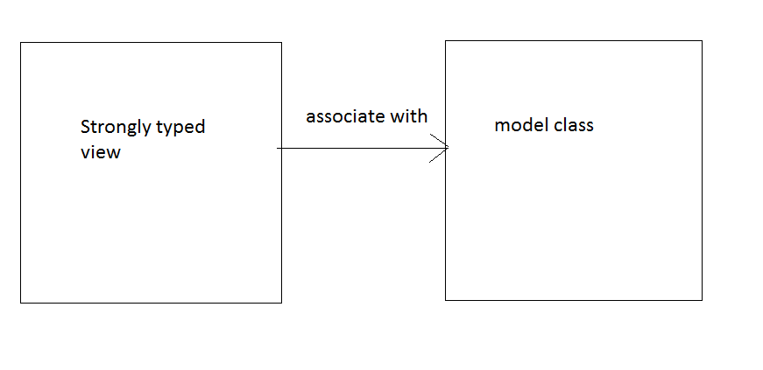

Slide 108
The “Model”property
Every strongly typed view can use a built-in property called “Model”.
It contains the data that is sent from the controller.
Step1: Send data to the view:
return view(obj1);
Step2: Access the data in the view:
Model

Slide 109
Advantage of strongly typed view:
1) As the view known what type of model object is being received, the visual studio provides intelli-sence while accessing model properties.
2) You can use "strongly typed html helpers" in the "strongly typed views" only.

Slide 110
The name of model class should be specified at the top of the view using the following syntax:
@model ModelClassName

Slide 111
The 'Model' property in the view
The 'Model' property of the view holds the early bound object which is received from the controller.
To get the properties of the specified model class, use 'Model' property in the view.
'Model' is the built-in property that is available in the view, which contains the model data that is sent from the controller to the view.

Slide 112
Steps for Development of Strongly-Typed Views:
Step 1) Controller: Return the view & also pass the instance of model class in the controller:
public ActionResult SomeActionMethod()
{
return View(ModelInstanceHere);
}
Observation: This model instance will be sent to the the target view (which has same name as action method) and also it will be stored in the "Model" property of the view.

Slide 113
Step 2) View: Specify the model class (at the top of the view)
@model ModelClassNameHere
Step 3) View: Get the properties of model class
Model.property1
Model.property2
Model.property3
..................

Slide 114
Note: In MVC, Microsoft recommends to define all the dynamic views that deal with databases, as strongly-typed views only.

Slide 115
HTML HELPERS

Slide 116
HTML HELPER
These are the pre-defined methods in MVC, which are used to generate forms & controls easily.
Can be used to create html forms and html elements,
These are used to create html forms easily.
It can be used only in the Strongly Types Views.
Each HTML helper will produce a html tag directly at runtime.
HTML helpers receive a lambda expression as argument, which represents a property of the associated model.
@Html.TextBoxFor() → <input type=“text”/>
Each HTML Helper method just produces a HTML tag at run time.
Benefit: Auotmatic binding

Slide 117
Html.BeginForm
Html.BeginForm() : It is a pre-defined HTMl Helper, which is used to create a client side form at runtime.
@using(Html.BeginForm(“Action1”,”Controller”,FormMethod.Post)
{
Your form elements here
}
Output:
<form action=“Controller1/Action1” method=“post”>
--yout form elements will be rendered here
</form>

Slide 118
Important HTML Helpers
1. @Html.BeginForm()
2.@Html.LabelFor()
3.@Html.TextBoxFor()
4.@Html.TextAreaFor()
5.@Html.DropDownListFor()
6.@Html.ListBoxFor()
7.@Html.HiddenFor()
8.@Html.CheckBoxFor()
9.@Html.RadioButtonFor()

Slide 119
Syntax
@Html.TextBoxFor(model => model.Property1)

Slide 120
Html.BeginForm()
It is used to generate a <form> tag. - It specifies starting and ending point of the form. - A form is a logical collection of controls.
Syntax: @using (Html.BeginForm()) { //your form elements here }
Output: <form action="controllername/actionname" method="post"> </form>
Note: By default, it takes current working controller name and current working action name automatically; We can also specify different controller & different action too.

Slide 121
Html.LabelFor()
It generates a label for associated field.
- Syntax: @Html.LabelFor(model => model.PropertyHere)
- Example: @Html.LabelFor(model => model.CustomerID) <label for="CustomerID">CustomerID</label>

Slide 122
Html.EditorFor()
It generates a textbox for associated field.
- Syntax: @Html.EditorFor(model => model.PropertyHere)
- Example: @Html.EditorFor(model => model.CustomerID) <input type="text" name="CustomerID" id="CustomerID" />

Slide 123
Html.ValidationMessageFor()
It displays validation message associated to the text box.
- Syntax: @Html.ValidationMessageFor(model => model.PropertyHere) –
Example: @Html.ValidationMessageFor(model => model.CustomerID) Note: To apply validation rules, use data annotations in the model class.

Slide 124
Html.RadioButtonFor()
It generates a radio button for associated field.
- Syntax: @Html.RadioButtonFor(model => model.PropertyHere)
- Example: @Html.RadioButtonFor(model => model.Gender, "Male") @Html.RadioButtonFor(model => model.Gender, "Female") <input type="radio" name="Gender" id="Gender" value="Male" /> <input type="radio" name="Gender" id="Gender" value="Male" />

Slide 125
Html.DropDownListFor()
It is used to create a drop down list for the associated field.
- Syntax: @Html.DropDownListFor(model => model.PropertyHere, ListOfSelectListItemHere) –
Example: @Html.DropDownListFor(model => model.State, new List<SelectListItem> { new SelectListItem() { Text = "Andhra Pradesh", Value = "AP", Selected = true }, new SelectListItem() { Text = "Tamilnadu", Value = "TN" }, new SelectListItem() { Text = "Karnataka", Value = "KN" }, new SelectListItem() { Text = "Maha Rashtra", Value = "MH" }, }) <select name="State" id="State"> <option value="AP">Andhra Pradesh</option> <option value="TN">Tamilnadu</option> <option value="KN">Karnataka</option> <option value="KN">Maha Rashtra</option> </select>

Slide 126
Html.CheckBoxFor()
It is used to create a check box for the associated field.
- Syntax: @Html.CheckBoxFor(model => model.PropertyHere)
- Example: @Html.CheckBoxFor(model => model.ReceiveNewsLetters) <input type="checkbox" name="ReceiveNewsLetters" id="ReceiveNewsLetters" value="true" />

Slide 127
Html.ListBoxFor()
It is used to create a list box for the associated field.
Syntax: @Html.ListBoxFor(model => model.PropertyHere, ListOfSelectListItemHere)
- Example: @Html.ListBoxFor(model => model.State, new List<SelectListItem> { new SelectListItem() { Text = "Andhra Pradesh", Value = "AP", Selected = true }, new SelectListItem() { Text = "Tamilnadu", Value = "TN" }, new SelectListItem() { Text = "Karnataka", Value = "KN" }, new SelectListItem() { Text = "Maha Rashtra", Value = "MH" }, }) <select name="State" id="State" multiple="multiple"> <option value="AP">Andhra Pradesh</option> <option value="TN">Tamilnadu</option> <option value="KN">Karnataka</option> <option value="KN">Maha Rashtra</option> </select>

Slide 128
Html.ActionLink()
It is used to create a hyperlink for specified action.
- Syntax: @Html.ActionLink("Link Text Here", "Action Name", "Controller Name")
- Example: @Html.ActionLink("Create New", "Create") - Observation: The controller name is optional. It take the current working controller automatically.

Slide 129
Html.DisplayNameFor() ********************** - It is used to display 'field heading' for associated field. - Syntax: @Html.DisplayNameFor(model => model.PropertyNameHere) - Example: @Html.DisplayNameFor(model => model.CustomerName)

Slide 130
Html.DisplayFor()
It is used to display the actual value of the associated field.
- Syntax: @Html.DisplayFor(modelItem => item.PropertyNameHere) –
Example: @Html.DisplayFor(modelItem => item.CustomerName)

Slide 131
Scaffold template

Slide 132
What is Scaffold Template?
These are the 'view templates',
which are the pre-defined templates for the views.
Based on the scaffolding template, we can create views for a particular purpose.
When we create a view based on the scaffolding template, it generates essential code automatically & of course, we can customize it later.
Adv: It saves the time of writing the code manually (like everything from the scratch level).

Slide 133
What is Strongly Typed View?
A view, which is associated with a specific model class.
It is the 'binding' between a view and a model class.
To work with scaffolding, it is MUST to make the view as a strongly typed view.
Adv: During development itself, we and system knows what type of data comes from the controller;
so we will have the benefits like Intelli-sence in Visual Studio.

Slide 134
MVC offers the following types of scaffold templates:
1) Create (Used to create an insertion page)
2) Edit (Used to create an editing page)
3) Delete (Used to create an deleting page)
4) List (Used to create an grid page)
5) Details (Used to create an details page)

Slide 135
Steps for creating the controller and all the views automatically based on the scaffolding templates:
1) Configure the model classes, DbContext & connection string properly.
2) Right click on the "Controllers" folder & select "Add" - "Controller".
3) Select "MVC 5 Controller with views, using Entity Framework". Click on "Add".
4) Specify following details:
Controller Name = DepartmentsController
Model class = Department
DbContext class = MvcWebApplication1DbContext
5) Check the following check boxes: Generate views Reference script assemblies Use a layout page
6) Click on "Add"
7) Specify scaffold template.
Scaffold template = Create / Delete / Details / Edit / List / Empty
7) Click on "Add"

Slide 136
Where Scaffold Templates exist
Scaffold templates location in VS 2010:
C:\Program Files\Microsoft Visual Studio 10.0\Common7\IDE\ItemTemplates\CSharp\Web\MVC 3\CodeTemplates\AddView\CSHTML
Saffold templates location in VS 2012:
C:\Program Files (x86)\Microsoft Visual Studio 11.0\Common7\IDE\ItemTemplates\CSharp\Web\MVC 4\CodeTemplates\AddView\CSHTML

Slide 137
Scaffold Templates in MVC
These are used to create CRUD operations easily, for any table.
It will generate a view based on an existing template.
It is a "view template".
MVC supports the following scaffold templates.
1. List
2. Details
3. Create
4. Delete
5. Edit

Slide 138
Scaffold Templates in MVC
MVC 4 supports 5 Scaffold Templates:
1. List:
• Used to show the table data.
2. Details:
• Used to show the selected record.
3. Create:
• It is used to show an "insertion form".
4. Delete:
• It is used to show a "deletion form".
5. Edit
• It is used to show an "updation form".

Slide 139
ACTION FILTERS

Slide 140
Action Filters
Also known as “Action attributes”.
These can be applied to an action method as an attribute.
Ex: [HttpPost] , [OutputCache] etc.
Defines nature of action.
An action can have multiple action filters also.

Slide 141
Action filters
Example
[ActionFilterHere]
public ActionResult Action1()
{
//some code here
return View();
}

Slide 142
MVC action filters:
1) [HttpPost]
2) [HttpGet]
3) [ValidateAntiForgeryToken]
4) [OutputCache]
5) [HandleError]
6) [NonAction]
7) [ActionName]
8) [Authorize]
Note: You can apply more than one action filter for one action method.

Slide 143
Action Filters
Sl.No | Action Filter | Description
1. | [HttpPost] | Enables the action to receive only Http-Post request. (by submitting a form).
2. | [HttpGet] | Enables the action to receiveonly Http-Get request (by typing a URL on the browser address bar).
3. | [OutputCache] | Enablesthe output cache for the specified action.
4. | [HandleError] | Enablesthe action to have a custom exception page.

Slide 144
Sl.No | Action Filter | Description
5. | [NonAction] | Definesa normal method in the controller class; which is not an action. The non-action method can't receive any browser requests.
6. | [Authorise] | Used to implement forms based security for the specific action.
7. | [ValidateAntiForgeryToken] | Used to validate the anti-forgery token that is submitted thru html form. It access the requests came from same domain (same web site).
8. | [ActionName] | It is used to specify action name( to maintain actual method name and action name different)

Slide 145
1.[HttpPost]
It is used to receive ONLY POST request, for a specific action method.
Usually when the user clicks on "Submit" button, browser sends POST request.

Slide 146
2) [HttpGet]:
It is used to receive ONLY GET request, for a specific action method.
It is default.
Usually when the user types some url on the browser (or) click on a hyperlink, browser sends GET request.

Slide 147
3) [OutputCache]:
It is used to enable output caching for a specific action method.
When it is enabled, the action method and corresponding view will be executed ONLY ONCE for a specific period of time.
Syntax:
[OutputCache(Duration=SomeSeconds)]
Ex: [OutputCache(Duration=120)]

Slide 148
4) [HandleError]
It is used to enable custom error page for a specific action method.
When it is enabled, asp.net shows a custom error page, instead of a system-defined one.
You must enable "CustomErrors" in web.config, to use this.
Steps to enable custom Error
a) Enable Custom Errors in web.config:
<customErrors mode="On" />
b) Create a custom error page called "Views\Shared\Error.cshtml".
c) Enable [HandleError] attribute for the required action method:
[HandleError]
public ActionResult SomeAction()
{
}

Slide 149
5) [NonAction]:
By default, all methods present within the controller class are treated as 'action methods'.
It is used to make a method in the controller class, as a normal method, which is NOT an action method, to which browser can't send request.

Slide 150
6) [Authorise]:
It is used to enable forms authentication for the requied action method.

Slide 151
7) [ValidateAntiForgeryToken]:
It is used to accept requests from same domain only.
It enables security, by avoiding cross-site hijacking.
To work with this, in the corresponding form (in the view), you must use this:
@Html.AntiForgeryToken()

Slide 152
8) [ActionName]:
It is used to specify action name
It is used to maintain actual method name and action name different

Slide 153
Global Action Filters
App_Start\FilterConfig.cs
filters.Add(new HandleErrorAttribute());

