Slide 1
AI
InterviewAI
Your AI Interview Prep Coach
COMP7505 — User Interface Design and Development
Track A: Smart Adaptive Interfaces | Group: Cre8

Slide 2
Problem
Solution
Design
Track A
Evaluation
Demo
Roadmap
Roadmap for Today
Problem & Users
1
Who we serve and why it matters
🎯 Our Goal
Solution Overview
Convince you that InterviewAI solves a real pain point with evidence-based design — not feature stacking.
2
What InterviewAI does differently
Interaction Design
3
How users interact with the system
Evaluation Criteria:
Smart Adaptive Interface
① User pain-point match
4
Track A requirements in action
② Prototype quality & design rationale
Evaluation & Iteration
③ Evaluation iteration evidence
5
Evidence-driven design improvement
④ Solution feasibility
Live Demo
⑤ UX-based differentiation
6
Prototype walkthrough
Roadmap & Closing
7
Where we're headed next
2/14

Slide 3
Problem
Solution
Design
Track A
Evaluation
Demo
Roadmap
The Interview Prep Gap
Fresh tech graduates face a broken preparation loop
👤 User Persona
Core Pain Points
Name
Age
From pre-project questionnaire & interviews (n=5)
Alex Lee
22
❓
"Is this AI feedback even reliable?"
Occupation
HKU MSC CS Student
Key Goals
Land a frontend/SWE role within 2 months; prepare structured, contextual answers tailored to each JD
🎯
"Feedback is too generic — doesn't use my resume or JD"
Pain Points
AI feedback feels unreliable and generic; no guidance while drafting; can't tell if answer is good before submitting
🔄
"I don't know if my answer is good until I submit"
User Quotes
"Is this AI feedback even reliable?" / "Feedback is too generic — doesn't use my resume or JD"
😰
"Practice doesn't feel like a real interview"
3/14

Slide 4
Problem
Solution
Design
Track A
Evaluation
Demo
Roadmap
InterviewAI — Not a Grader, a Coach
Two core tasks that close the preparation loop
Task A: Practice
Task B: Review
1. Paste Job Description + Upload Resume
1. Upload a mock interview recording
2. AI generates tailored interview questions
2. AI extracts Q&A pairs automatically
3. Answer with real-time coaching feedback
3. Review & edit extracted content
4. Receive structured, actionable evaluation
4. Get structured feedback summary
💡 Key Differentiator
AI shifts from a post-hoc scoring tool → an in-process coach. Users get real-time STAR coverage checks, live coaching tips, and quick-improvement inserts while drafting — not after submitting.
4/14

Slide 5
Problem
Solution
Design
Track A
Evaluation
Demo
Roadmap
Human–AI Collaborative Model
Three principles guiding every design decision
🔍
🎛️
🛡️
Transparency
User Control
Graceful Degradation
Every AI output includes reasoning explanation and confidence indicator. Users judge relevance, not blindly trust.
Users can flag inaccuracies, override scores, undo actions, and discard evaluations. AI suggests — user decides.
When AI fails, the system offers clear fallback paths: text input for voice failure, generic question bank for generation errors.
5/14

Slide 6
Problem
Solution
Design
Track A
Evaluation
Demo
Roadmap
Information Architecture & Core Workflows
5 Core Modules
Practice Workflow
Dashboard
Entry point & session overview
Job Context → Resume Upload → AI Questions → Answer (Text/Voice) → AI Feedback → Next / Save
Exceptions: invalid file, network error, AI error, voice failure → retry / fallback
Practice
JD → Resume → Questions → Answer → Feedback
Review
Upload → Extract → Edit → Summary
Review Workflow
History
Past sessions, comparison & reflection
Audio Upload → Q&A Extraction → Edit & Verify → Feedback Summary → Export
Settings
Preferences & account management
Exceptions: invalid upload, extraction failure, low audio quality → retry / text input
6/14

Slide 7
Problem
Solution
Design
Track A
Evaluation
Demo
Roadmap
Building a Trustworthy Smart Interface
How we ensure users stay in control when AI assists their preparation
📏 ① Capability Boundaries
🎛️ ② User Control Mechanism
What the system can and cannot do
Users have final authority over all AI outputs
✅ Can: Evaluate answer structure, STAR usage, clarity
🚩 Flag Inaccurate — report wrong feedback
✅ Can: Generate role-relevant questions from JD
✏️ Override Scores — manually adjust dimensions
❌ Cannot: Judge industry-specific technical depth
↩️ Undo — revert any action
❌ Cannot: Replace real interviewer judgment
🗑️ Discard — reject entire evaluation
⚠️ Limited: Voice accuracy depends on audio quality
🛡️ ③ System Failure Handling (3 types)
📢 ④ Limitation Communication
Pre-designed fallback for AI errors & malfunctions
Proactively conveying system boundaries to users
Voice Recognition Failed → switch to text input
Confidence indicators (High 🟢 / Low 🟡) on every AI output
AI Generation Error → use generic question bank
AI limitation banner on all evaluation views
Audio Extraction Failure → manual Q&A entry
Audio quality warning on voice extraction
Clear error messages with recovery paths
Capability Boundaries section in Design Spec
7/14

Slide 8
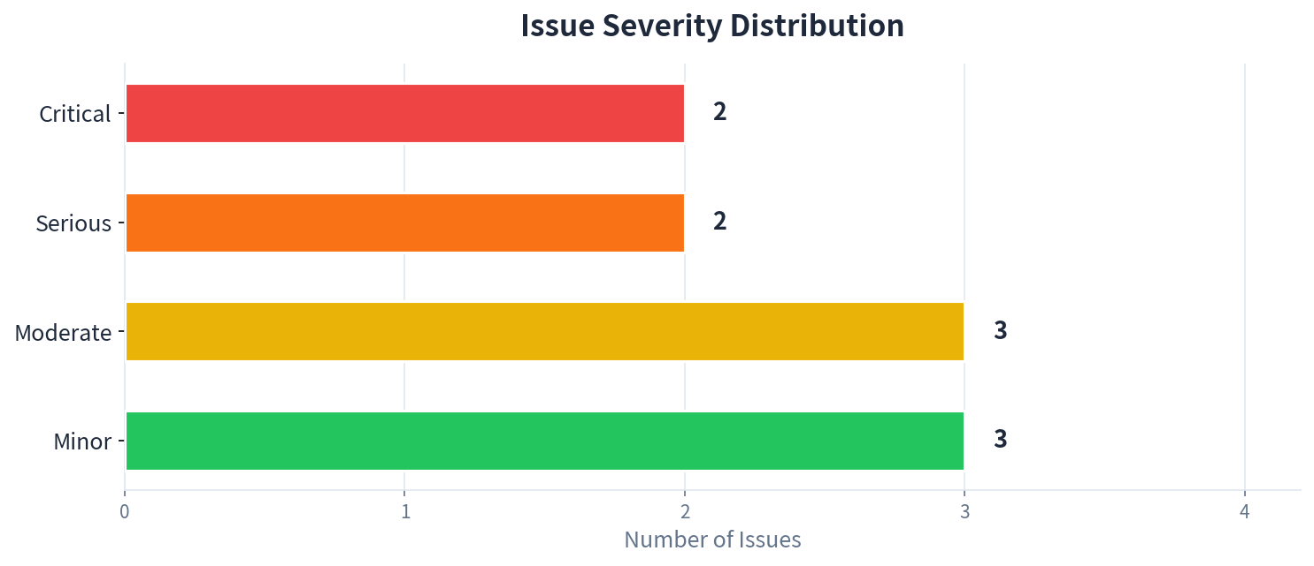
Problem
Solution
Design
Track A
Evaluation
Demo
Roadmap
Design Evaluation — 3 Mixed Methods
Heuristic Evaluation + Cognitive Walkthrough + Think-Aloud Testing
📋
🧠
🗣️
Heuristic Evaluation
Cognitive Walkthrough
Think-Aloud Protocol
3 evaluators • Nielsen's 10 heuristics • 6 dimensions rated 1–5
First-time users • 2 core tasks • 4 questions per step
3 participants • 25 min sessions • verbal commentary
Avg score: 3.0/5
3 breakdowns found
"Feels like guessing"
Problems Found: 2 Critical • 2 Serious • 3 Moderate • 3 Minor
All problems traceable to specific heuristic violations and user quotes.
Evaluation Focus:
User trust • Interaction transparency • Cognitive load • Error recovery • User control protection
8/14

Slide 9
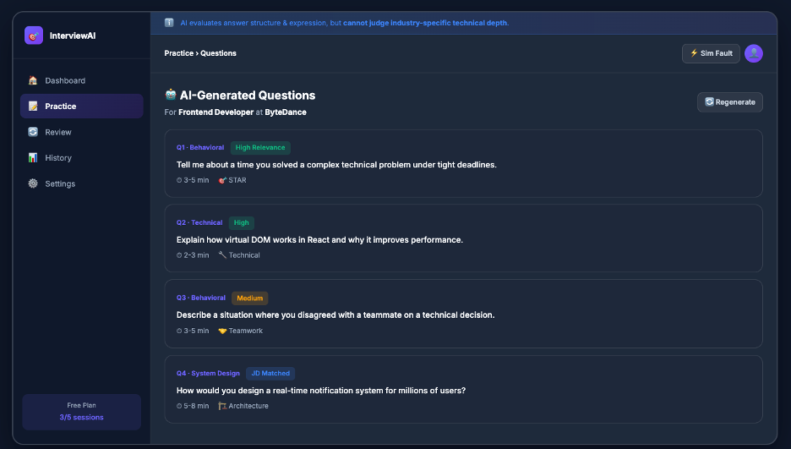
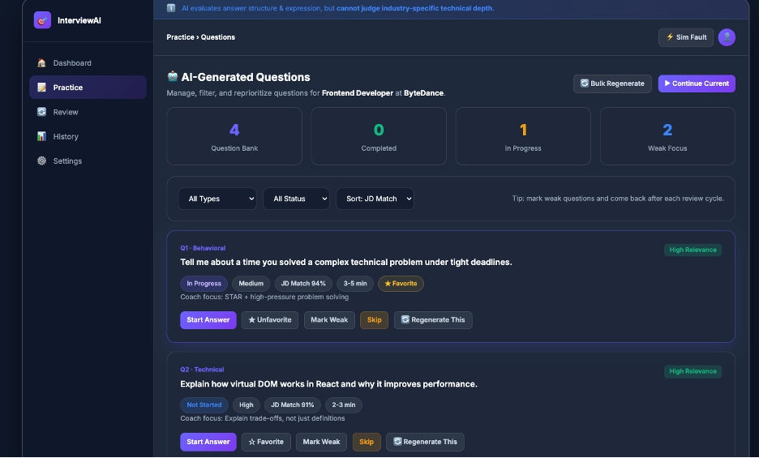
Problem
Solution
Design
Track A
Evaluation
Demo
Roadmap
Iteration 1: Question Management
Trigger: M-03 (filter overload) + S-02 (cognitive overload)
BEFORE
AFTER
What Changed
✅ Added filter bar (type / status / sort) — defaults to collapsed to reduce initial cognitive load
✅ Added question status tracking: Not Started / In Progress / Completed / Skipped
✅ Added Favorite & Mark Weak buttons for focused practice
✅ Added progress counters (Total / Completed / In Progress / Weak Focus)
✅ Added Skip & Regenerate controls per question
9/14

Slide 10
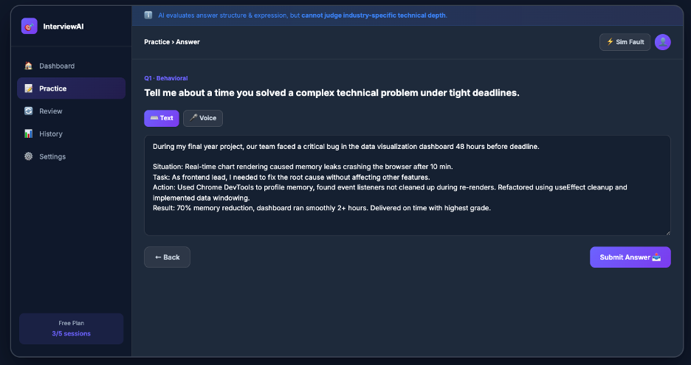
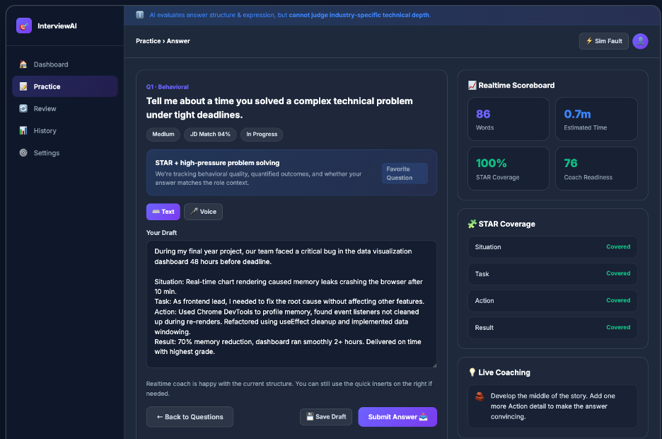
Problem
Solution
Design
Track A
Evaluation
Demo
Roadmap
Iteration 2: Real-Time Coaching ⭐
Trigger: S-02 (no guidance while drafting) + user quote: "Feels like guessing"
BEFORE
AFTER
What Changed — Core Iteration
✅ Added Realtime Scoreboard (Words / Est. Time / STAR Coverage / Coach Readiness)
✅ Added STAR Coverage panel — live detection of Situation / Task / Action / Result
✅ Added Live Coaching tips — specific, actionable suggestions while drafting
✅ Added Quick Improvement Inserts — one-click to add quantified result, team context, role relevance
✅ Coaching panel is collapsible — users who find it distracting can dismiss it
10/14

Slide 11
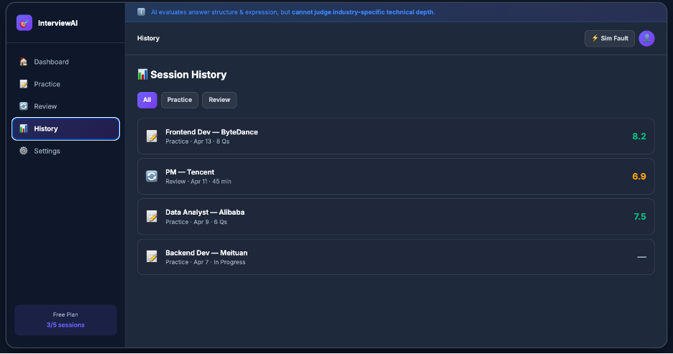
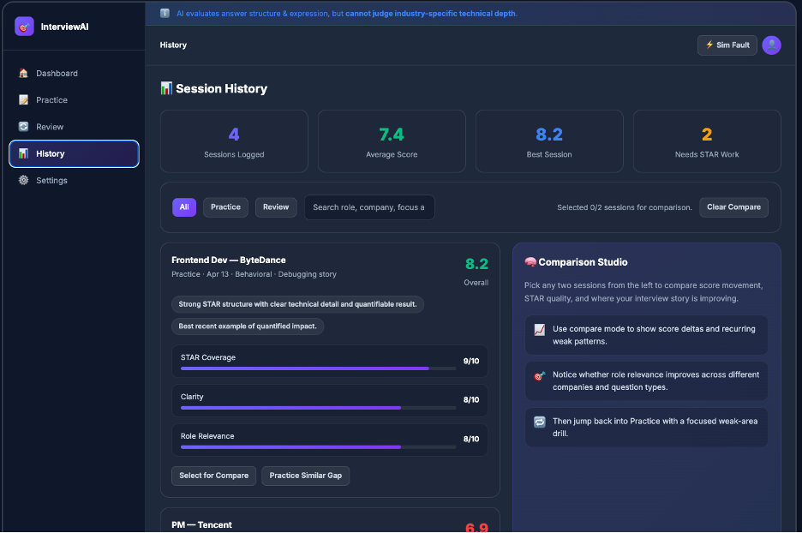
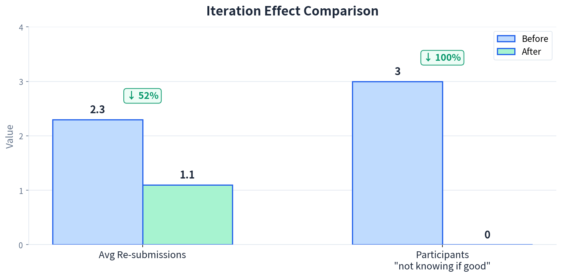
Problem
Solution
Design
Track A
Evaluation
Demo
Roadmap
Iteration 3: History Comparison Studio
Trigger: General Usability — closing the learn → reflect → improve loop
AFTER
BEFORE
What Changed
✅ Added Comparison Studio — select 2 sessions to compare side by side
✅ Added score delta visualization across dimensions
📊 Overall Impact
✅ Added "Practice Similar Gap" button — from reflection back to targeted practice
✅ Added session filtering (Practice / Review) and search
11/14

Slide 12
Problem
Solution
Design
Track A
Evaluation
Demo
Roadmap
🎬 LIVE DEMO
1
2
3
4
5
Dashboard
Practice + Coaching
Question Mgmt
Sim Fault ⚠️
History Compare
Session overview & quick start
Answer page with live STAR feedback
Filter, favorite, mark weak
Voice fail → text fallback
Comparison Studio + gap practice
10s
25s
10s
10s
10s
12/14

Slide 13
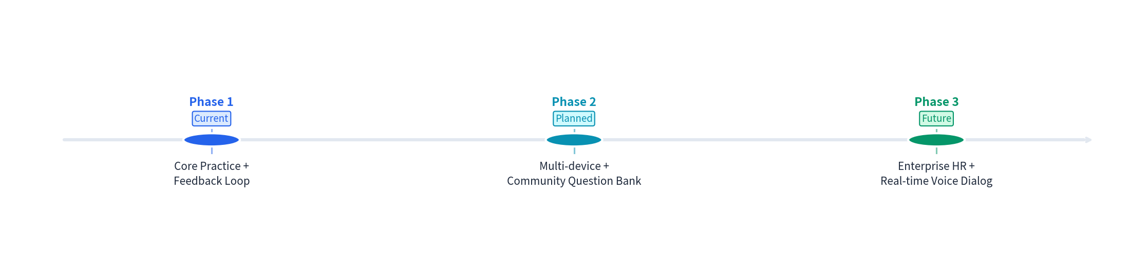
Problem
Solution
Design
Track A
Evaluation
Demo
Roadmap
Product Roadmap & Design Principles
3 Reusable Design Principles
1
AI output must include reasoning + confidence — let users judge, not blindly trust.
2
Users always have final control — AI suggestions can be overridden, undone, or discarded.
3
System failures must provide clear degradation paths — no dead ends, ever.
13/14

Slide 14
AI
Thank You
Questions & Answers
InterviewAI — Your AI Interview Prep Coach
COMP7505 • Track A: Smart Adaptive Interfaces • Group: Cre8
14/14

