Slide 1
An IBM Data Science Capstone Project Classification Of Venues Around Istanbul Metro Stations
Submitted by: Karla Marie I. De Jesus

Slide 2
Istanbul metro
Has 84 stations and 6 inter- connected lines. (3 more lines under construction)
Strategically located around the city.
Serves up to 200,000 passengers per day per line.

Slide 3
Objective of the study:
To help entrepreneurs identify the ideal location for a new business based on the types of venues and venue counts surrounding each metro station in Istanbul.

Slide 4
Main sources of data:
Foursquare
Wikipedia
www.metro.istanbul

Slide 5
Methodology:
Gather relevant data from sources.
Plot Istanbul Metro on the map for visualization.
From Foursquare, gather Top10 venues categories and venue counts around each station.
Normalize data with Standardized Scaler from sklearn.
Group data using K-means clustering.
Plot and analyze different groups on Istanbul map.

Slide 6


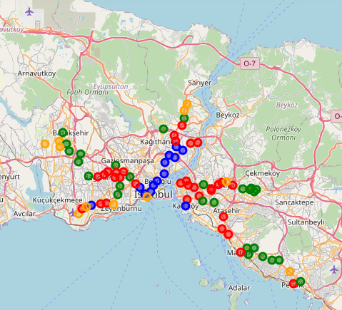
Results: A plot of 4 clusters
Blue - Areas with high venues count
Green - Areas with quite some venues
Red- Areas with not so much venues
Orange - Areas with very little number of venues

Slide 7
conclusion
Highest numbers of venues are indicated by Blue markers on the map, indicating more foot traffic and a better choice for entrepreneurs when choosing a viable location for their new business.
Very accessible to people from all over the city because of its close distance from the Metro stations.

Slide 8
Thank you very much!

