Slide 1
MtAD
Kathy

Slide 2
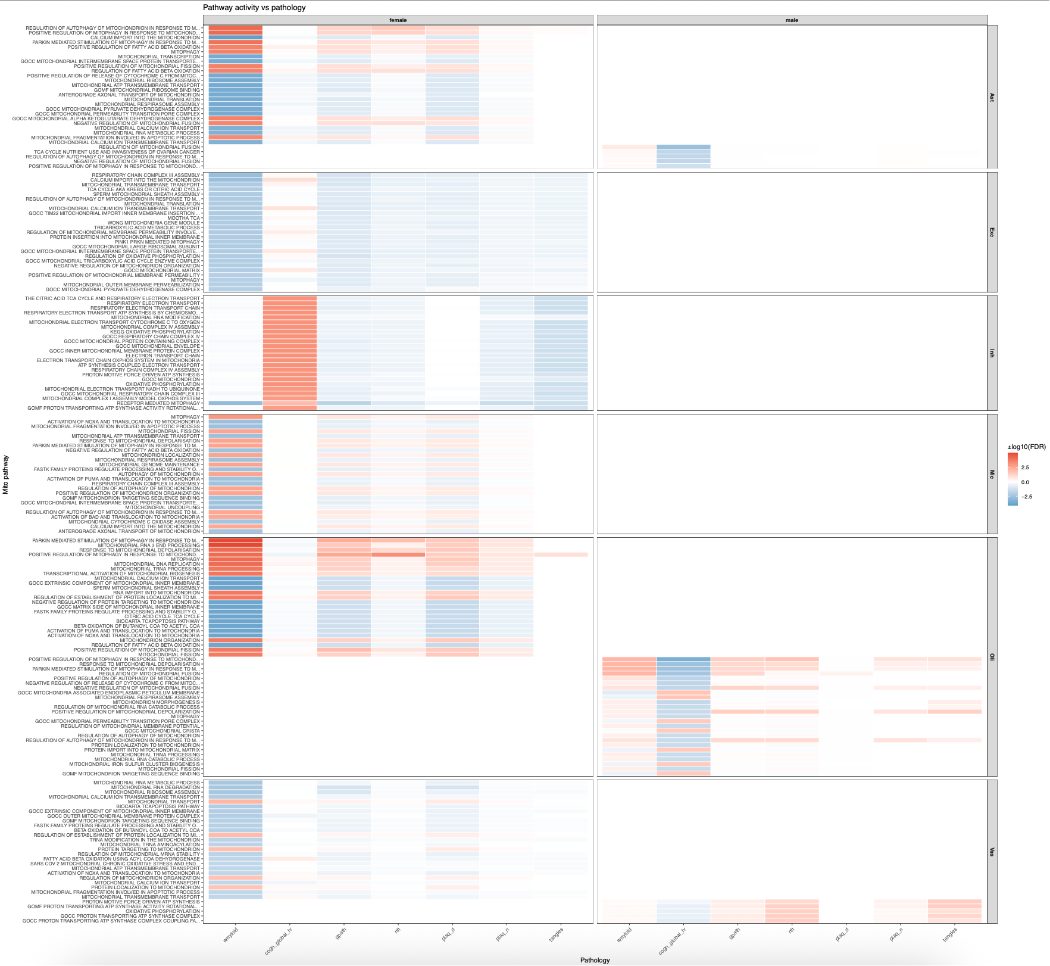
Mitochondrial pathways vs AD pathologies (all cells)
Heatmap of pathway-pathology associations, colored by signed -log10(FDR)
Rows: mito pathways
Columns: pathology metrics

Slide 3
Key takeaways
Inh:
  Robust OXPHOS/respiratory chain and translation signals across multiple pathologies
Oli:
  Lipid catabolism/ β-oxidation pathways light up for amyloid/plaque measures; several RNA-processing/translation sets move with gPath
Ast:
  autophagy/mitophagy terms show consistent associations (moderate strangth).
Mic:
  sparser, but mitophagy/ROS handling pops for gPath/NFT

Slide 4
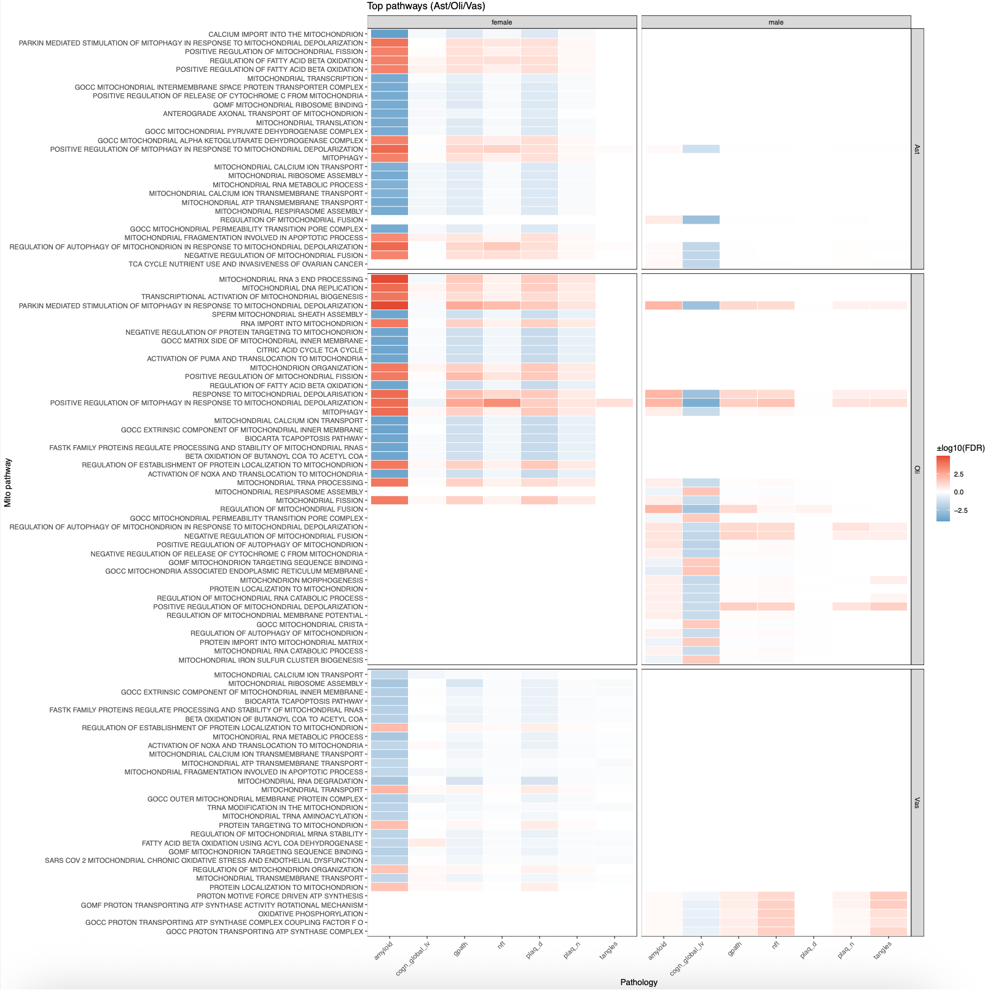
Sex-stratified pathway heatmap
Same heatmap layout, stratified by sex (female vs male facets)

Slide 5
Key takeaways
Vas (female):
  Strong OXPHOS/translation/mitophagy signals across amyloid, NFT, gPath.
Oli (male):
  β-oxidation and mitophagy terms are more prominent than in females.
Ast:
  modest sex differences—autophagy/mitophagy slightly stronger in females.
  Points to sex-specific mitochondrial remodeling with AD burden,
  especially in neuronal and myelinating lineages

Slide 6
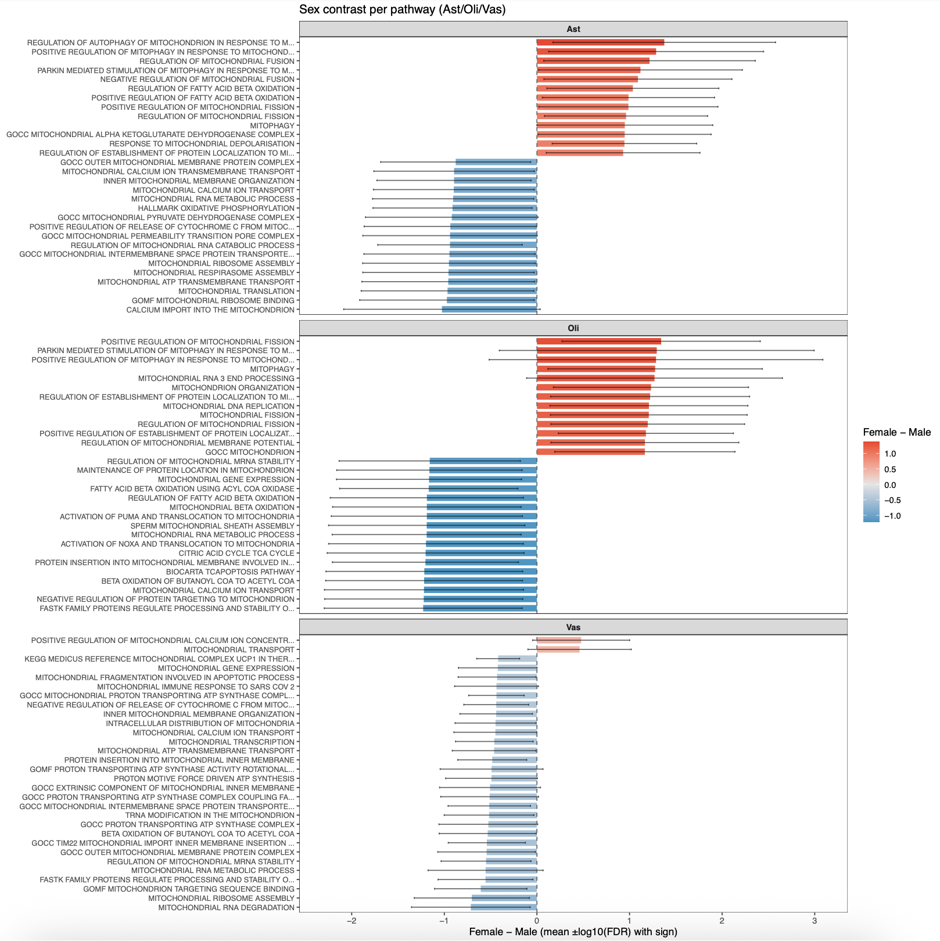
Female vs Male enrichment (per pathay)
For each pathway and cell type, mean signed –log10 (FDR) in F vs M and F-M difference (bar/contrast panel)

Slide 7
Key takeaways
Ast
  Large positive F-M contrasts for respiratory chain and mito-translation terms.
Oli
  Negative F-M contrasts for β-oxidation/mitophagy (male-biased).
  neurons (F) >> neurons (M)
  Oli flips direction

Slide 8
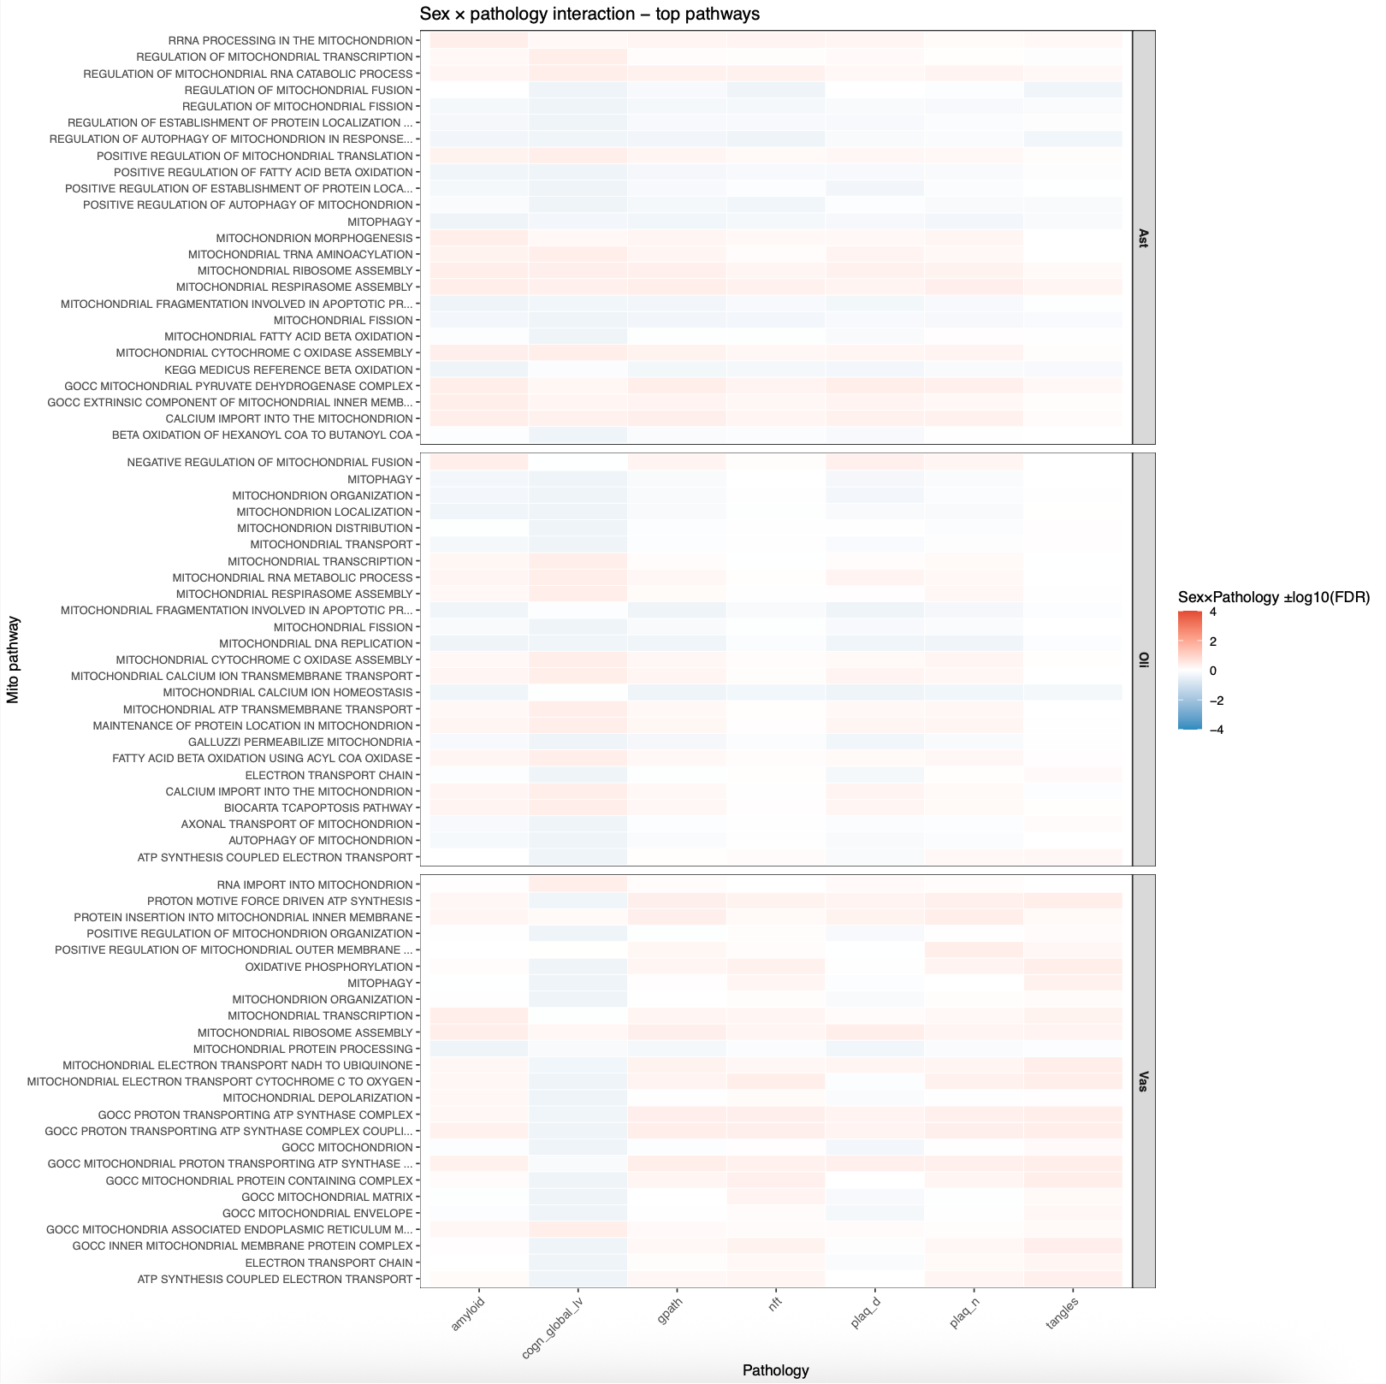
Sex × Pathology interactions — top pathways
Female slopes are steeper for neuronal OXPHOS/translation
male slopes steeper for Oli β-oxidation and mitophagy.

Slide 9
Key takeaways
Ast
  Interaction favors females for electron transport/translation sets.
Oli
  Interaction favors males for β-oxidation and mitophagy terms
Vas
  Fewer but coherent signals (ATP synthase/PMF terms show male-leaning interaction).

Slide 10
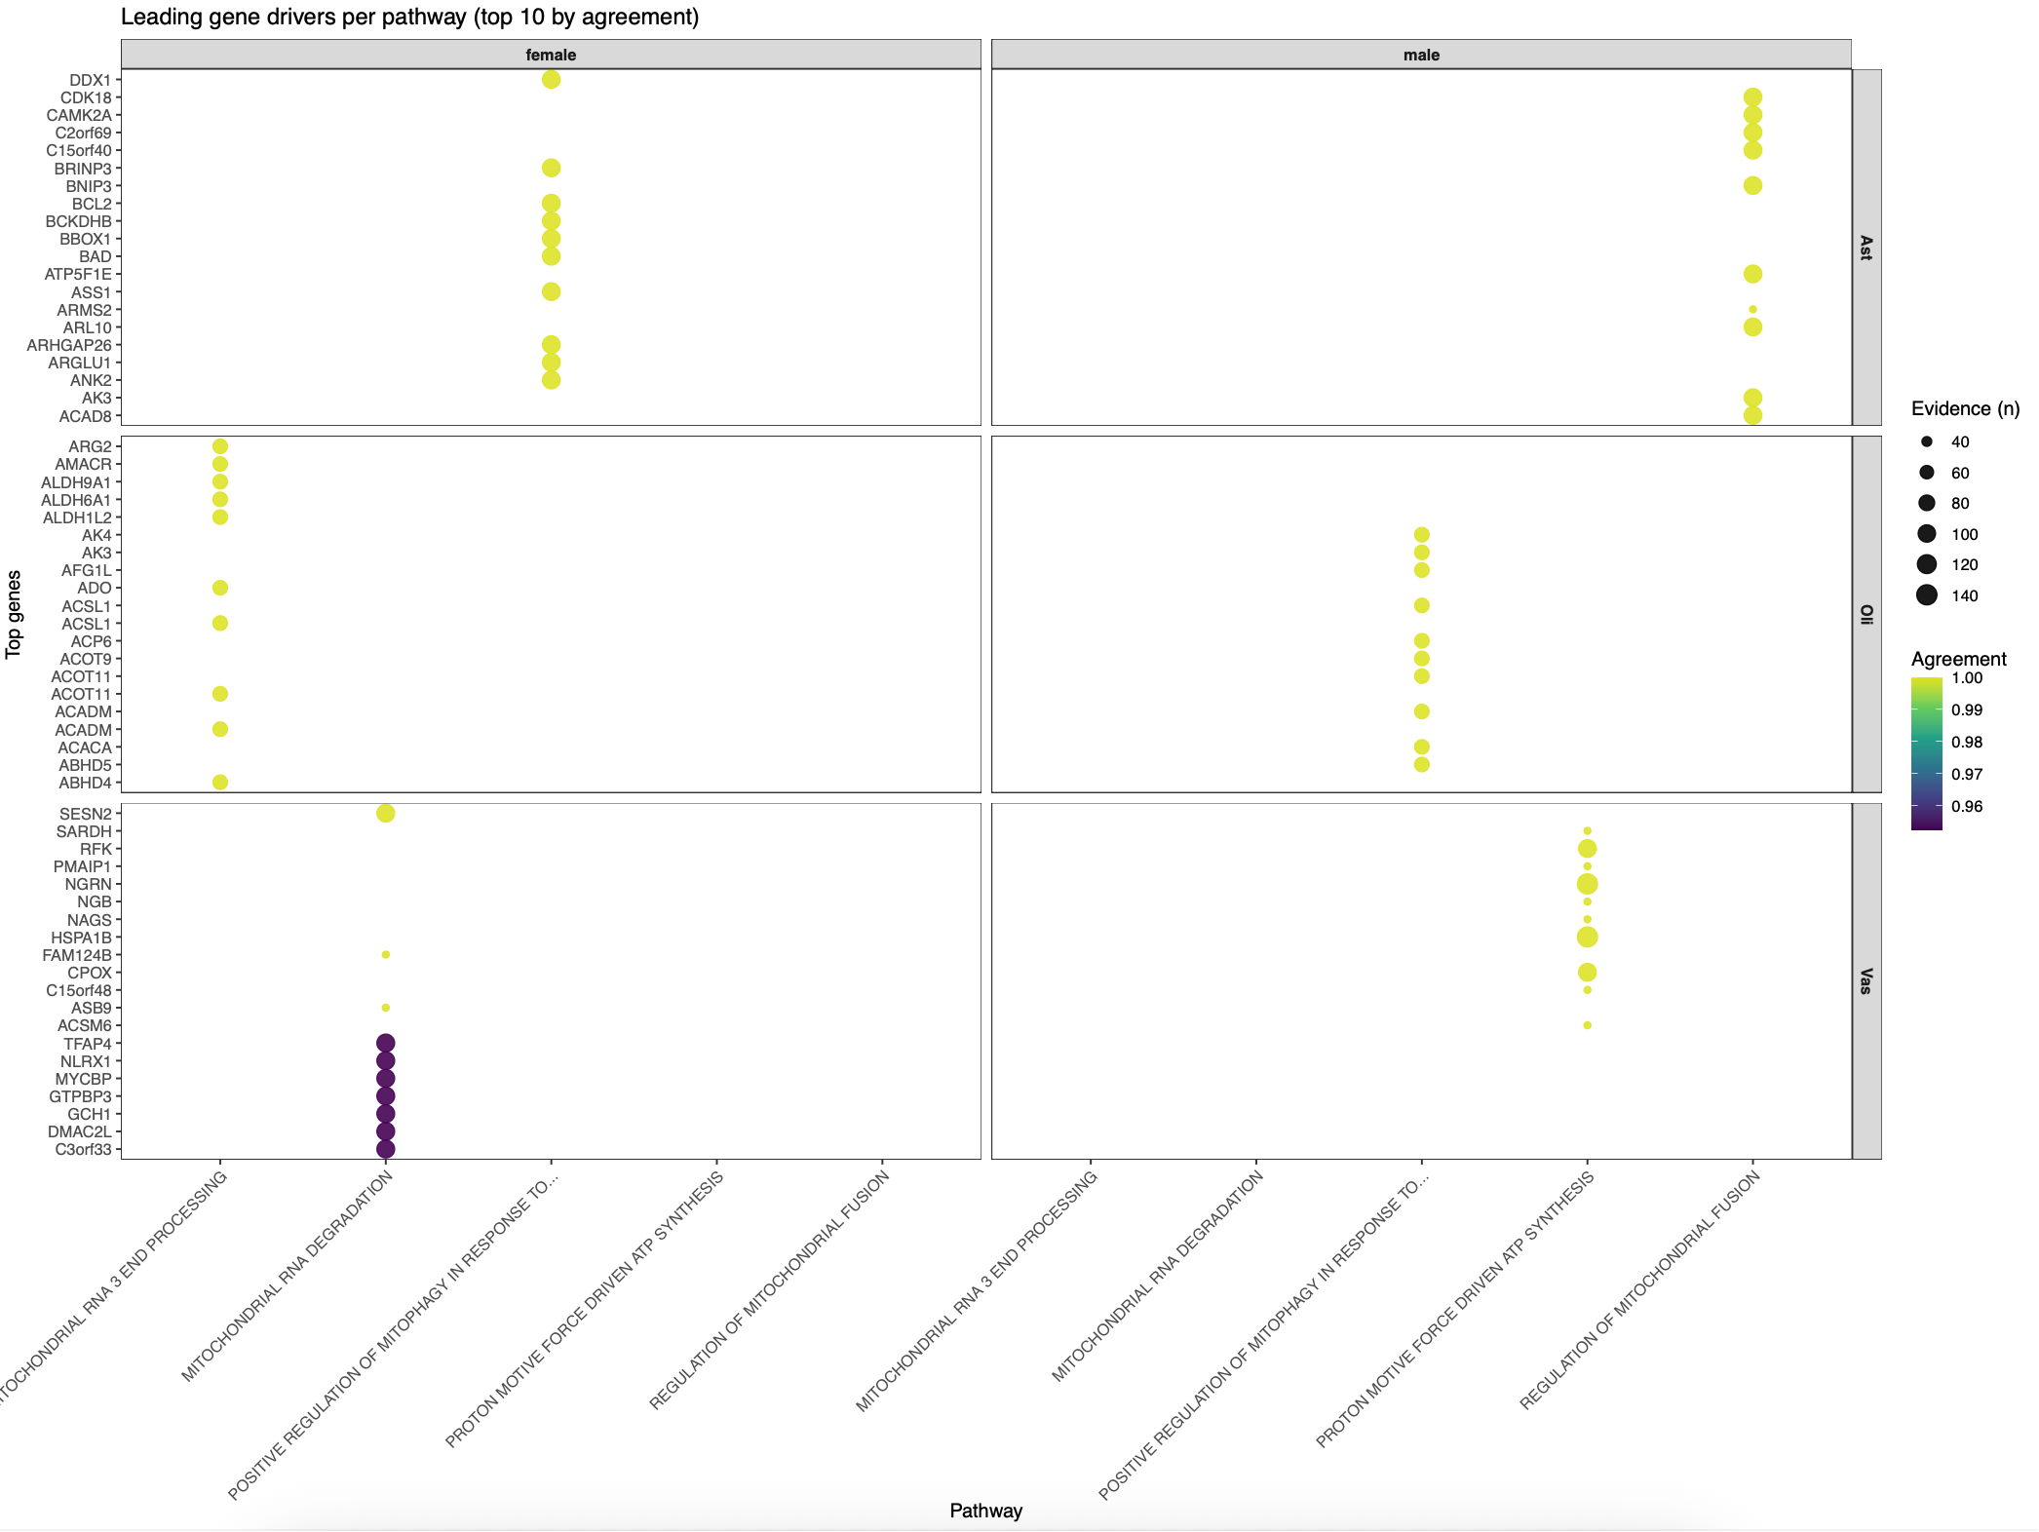
Leading genes behind pathway hits
Top genes with the highest agreement (fraction of pathologies for which the gene aligned in sign with pathway) and evidence counts (n)

Slide 11
Key takeaways
Ast
  Autophagy/mitophagy regulators (BCL2/BNIP3/BAD, MAPK-related) show high agreement.
Oli
  ACADM/ACSL1/ACOT family, AMACR, ALDHs (canonical fatty-acid β-oxidation/cholesterol side-chain enzymes) lead “positive regulation of mitophagy/FAO” pathways.
Vas
  Mitochondrial RNA processing/degradation genes (GTPBP3, HSPA, SESN2) drive signals.

