Slide 1
Mt-AD
Kathy

Slide 2
Overview
- How many mt-genes associated with each pathology × cell type?
What is the direction of change (up vs down)?
What are the recurrent mt-genes across pathologies?
Formal test of sex differences in the number of significant genes

Slide 3
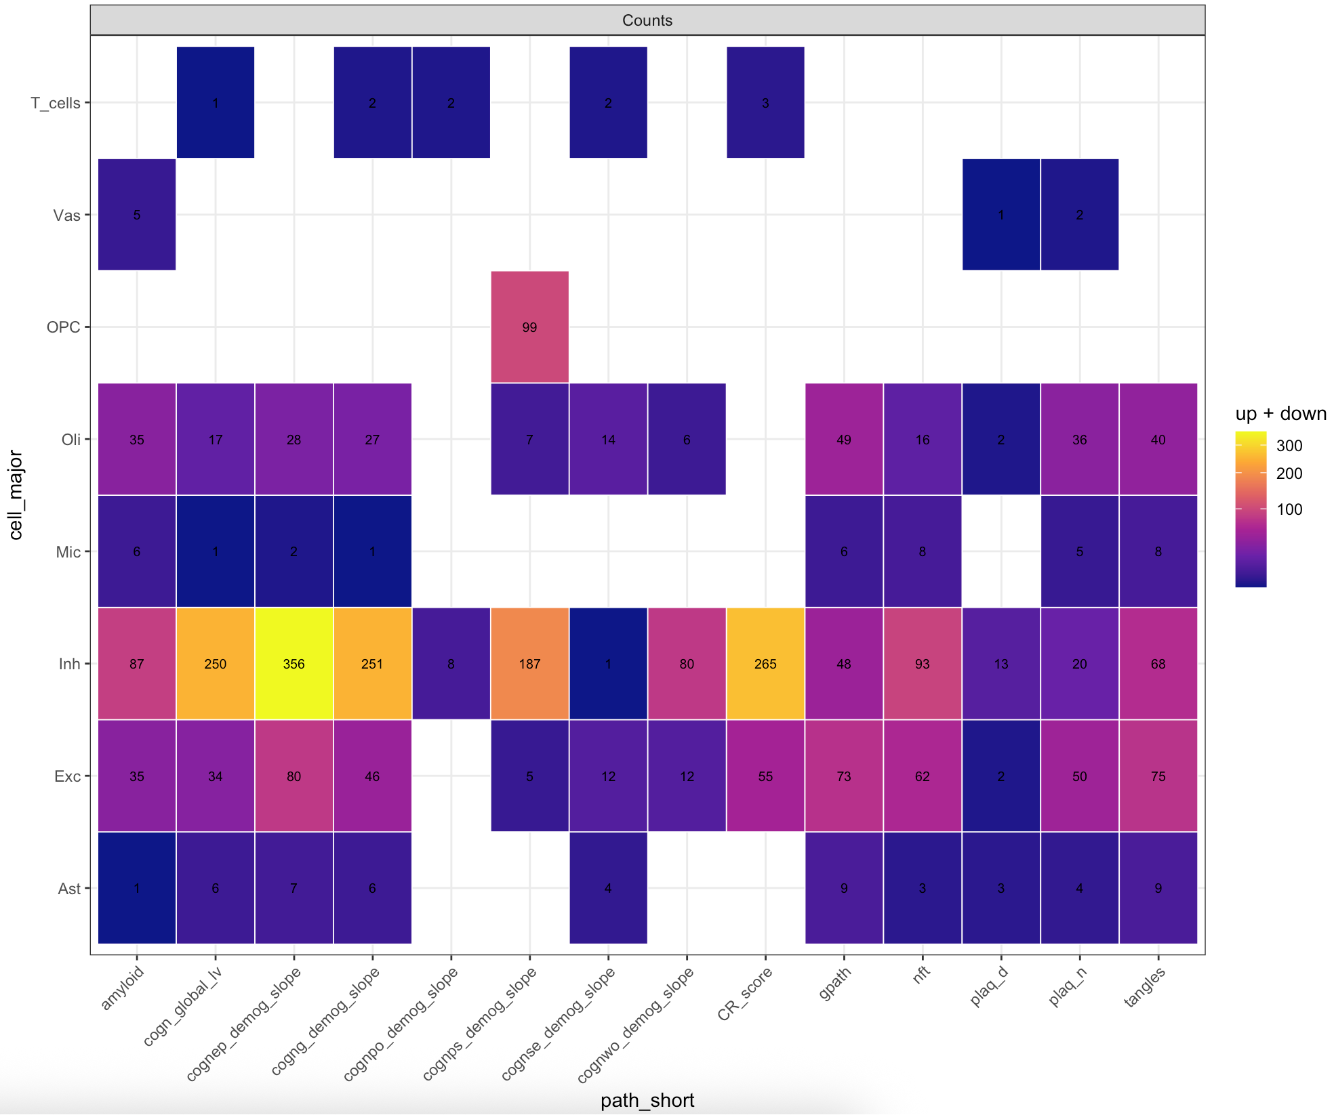
Key takeaways
Inhibitory neurons dominate
Excitatory neurons & Oli show substantial signal
OPC signal is focal, while Mic, Vas, T cells are sparse
Caveats
- Counts may ignore effect size direction and gene overlap.
- Differences in tests per cell type can inflate counts

Slide 4
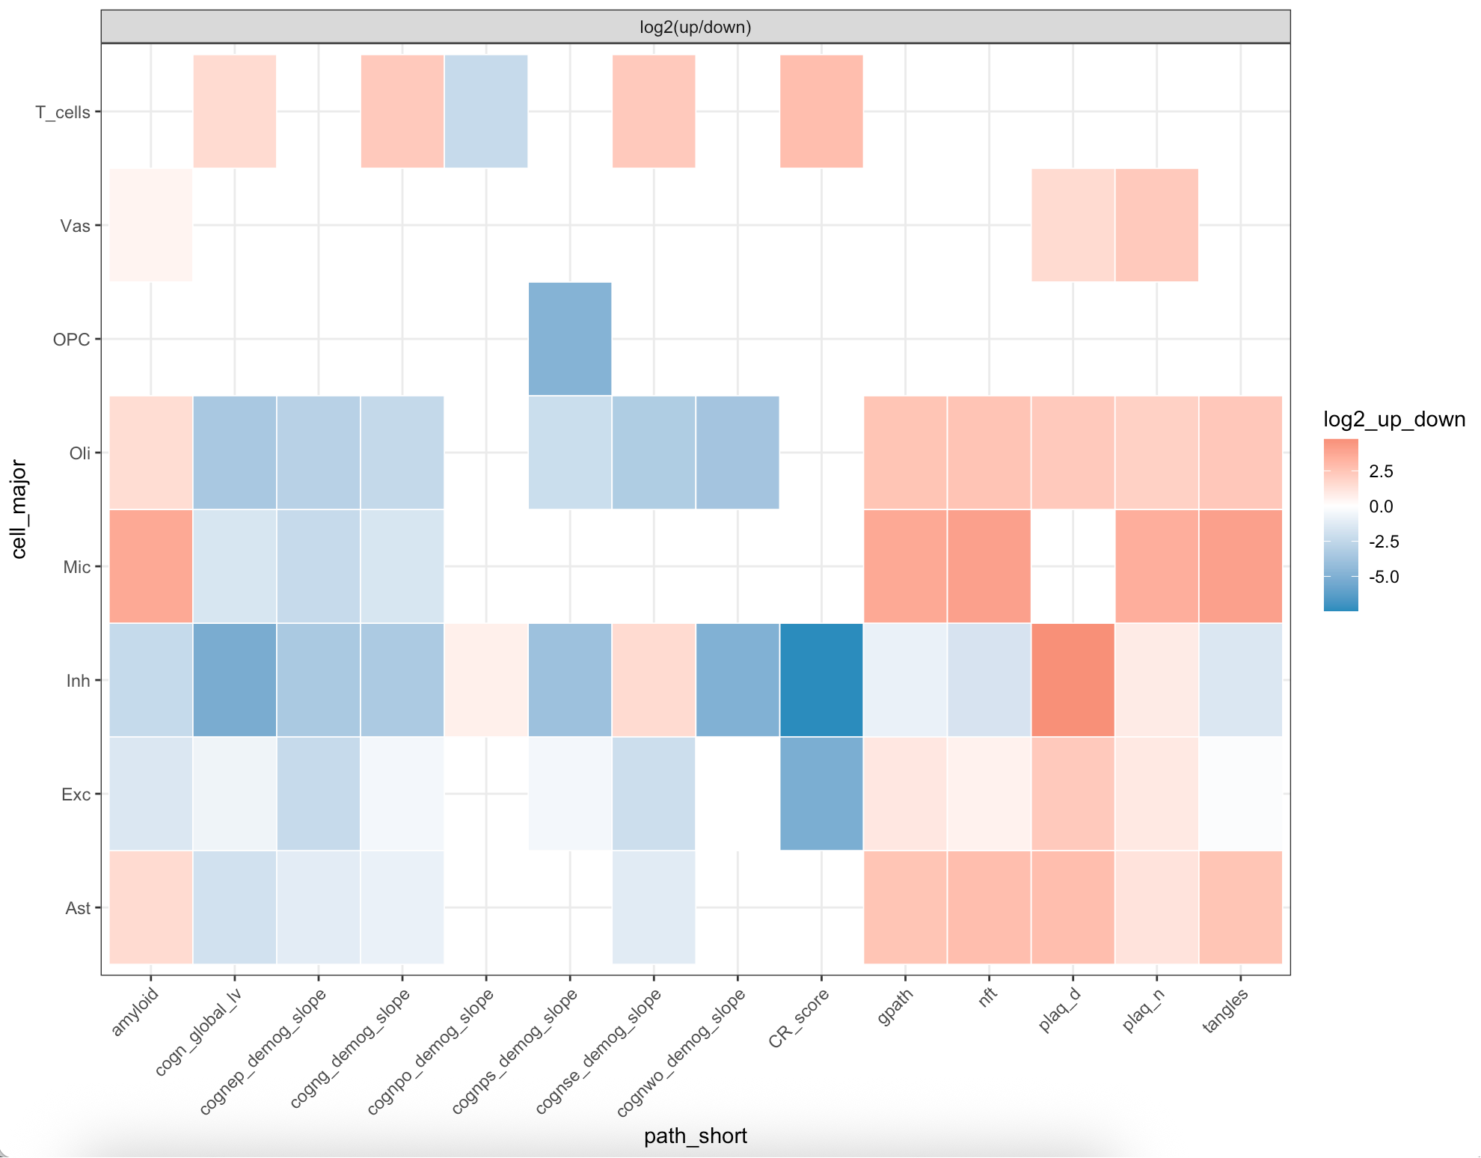
Key takeaways
Cognitive-slope traits skew negative in Inh
Classical histopathology (gpath/mt/plaques/tangles) skews positive in Exc & Oli
Mic shows mixed/weak direction
Vas tends mildly positive

Slide 5
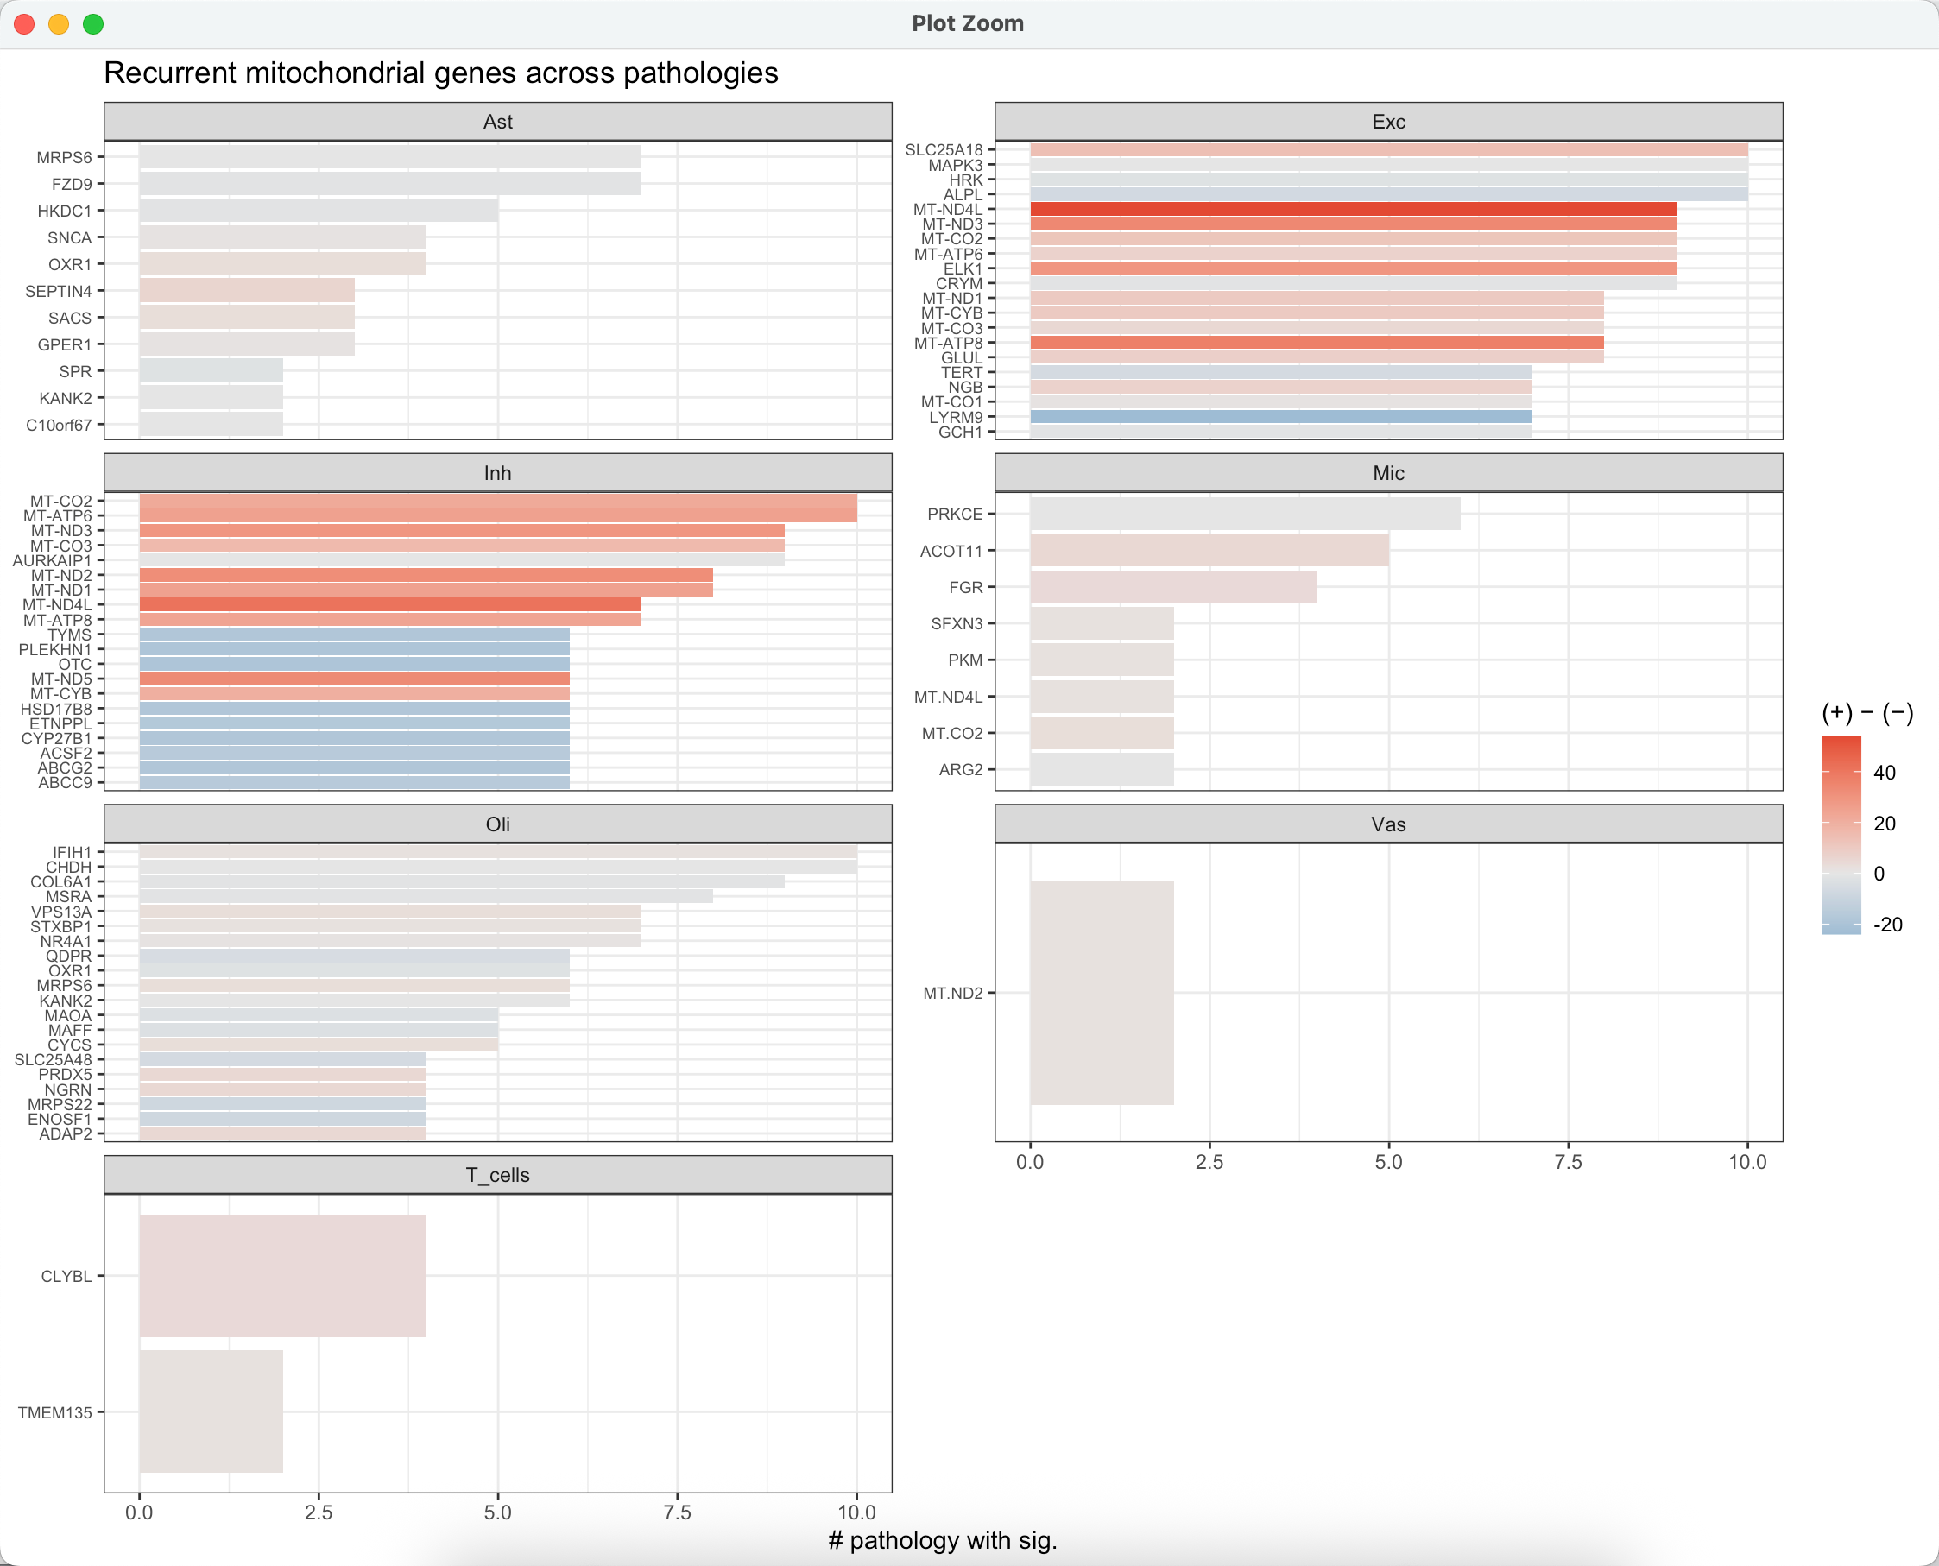
For each cell type,
Bar = # of pathologies where a gene is significant
Color = (# positive -# negative) across those hits

Slide 6
Key takeaways
Exc: recurrent hits are mt-encoded OXPHOS genes with consistently positive direction → respiratory chain programs repeatedly associate with pathology in excitatory neurons.
Inh: both mt-encoded and nuclear mt-regulatory genes recur. Mix of directions but many positive associations.
Oli: recurrent lipid/FAO/translation/respiration genes (nuclear) → oligodendroglial mt-lipid coupling may be important.
Mic/Vas/T_cells: few recurrent drivers (Mic modest glycolytic/respiratory; Vas sparse)

Slide 7
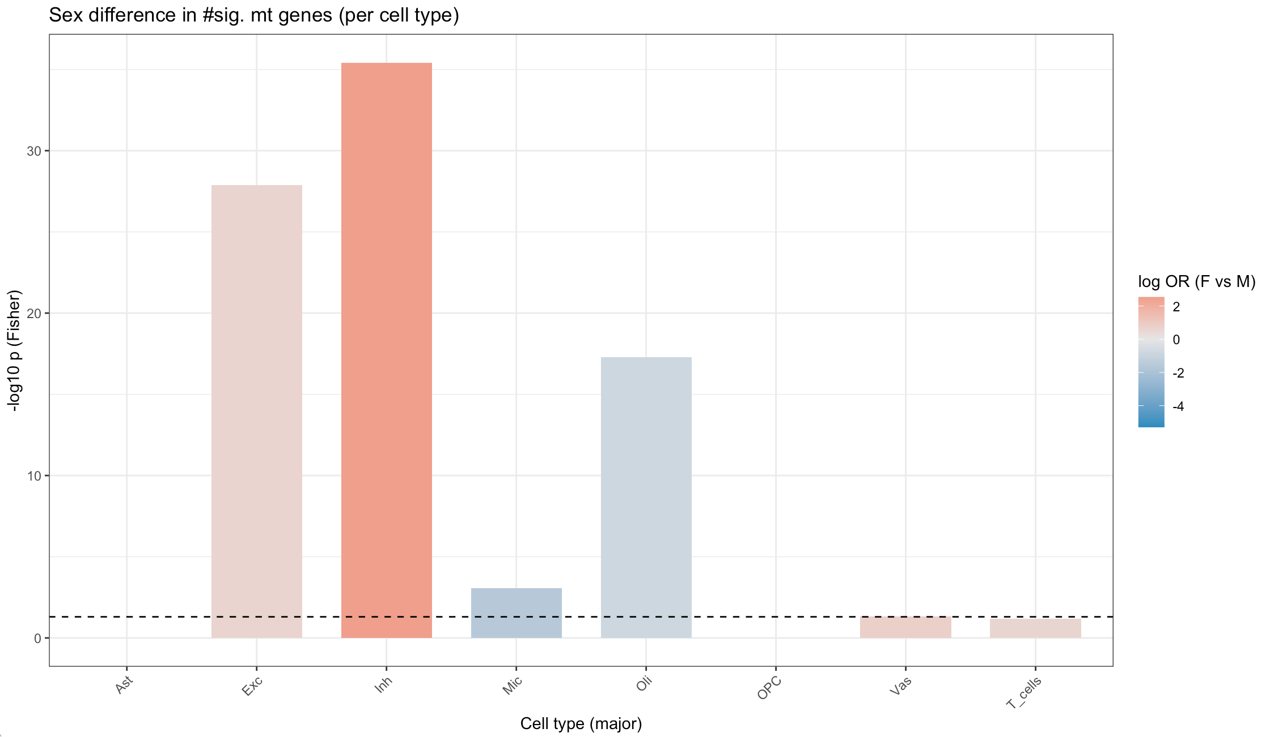
For each cell type,
2×2 Fisher test on gene significant in F vs M.
Fill = log odds ratio (F v M)
Red favors female
Blue favors male

Slide 8
Key takeaways
Inh and Exc strongly female-enriched
  Very small p, large positive log-OR
Oli shows male-enriched signal
  Blue, significant
Mic weakly male-leaning
Vas/T_cells ~ null
Suggests sex-specific vulnerability
  Female bias in neuronal mt-associations
  Male bias in oligodendroglia

