Slide 1
Mt-AD
Oct.1 2025
Kathy

Slide 2
Overview
Data:
snRNA-seq ROSMAP
Association of mt-gene effects with neuropathology & cognition outcomes
Scope today:
all-pathway overview
Per-pathology heatmaps
Sex stratification
Recurrent genes
Pathway-level contrasts
Mt-pathway score workflow
* All are exploratory

Slide 3
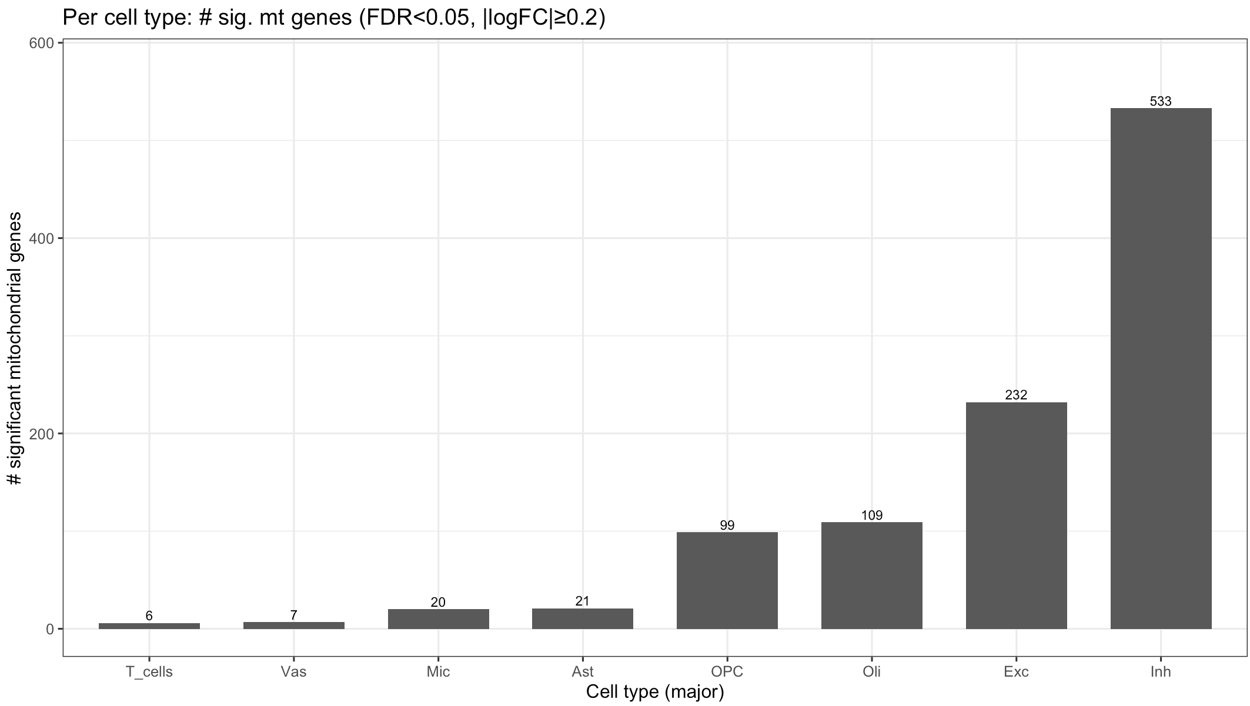
All pathways

Slide 4
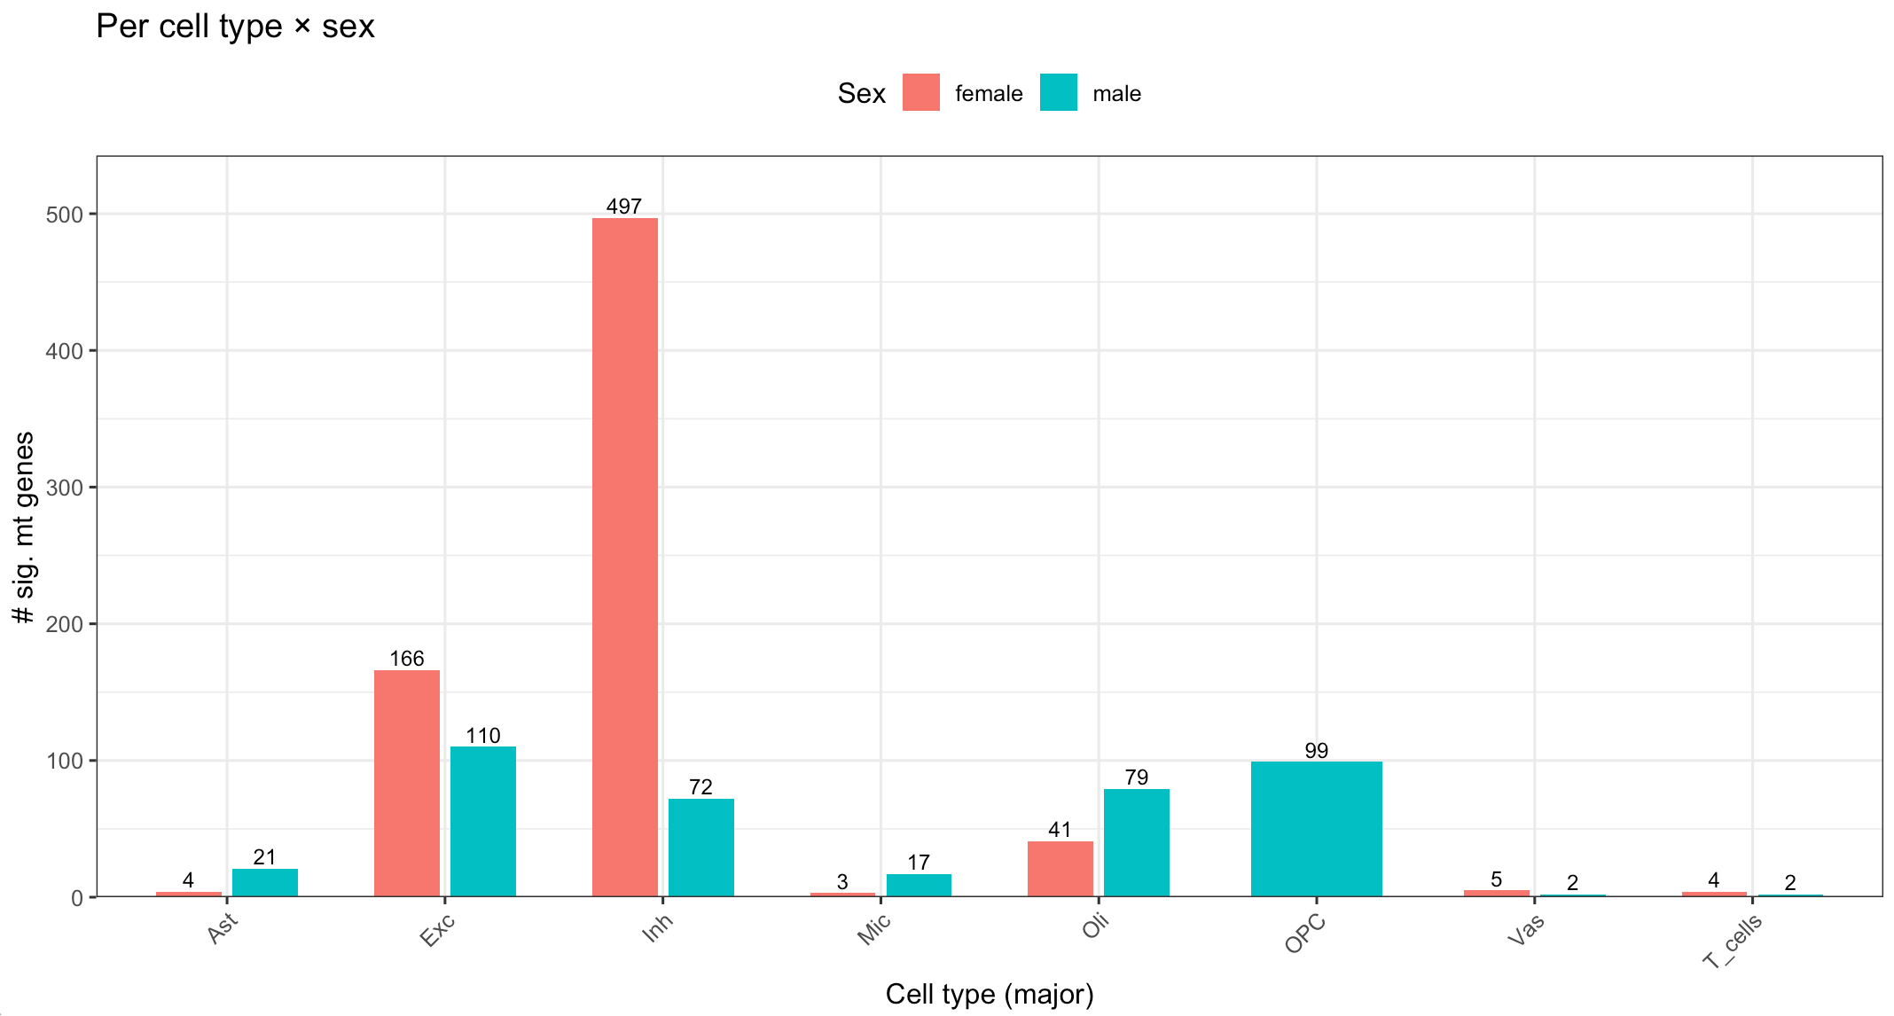
All pathways

Slide 5
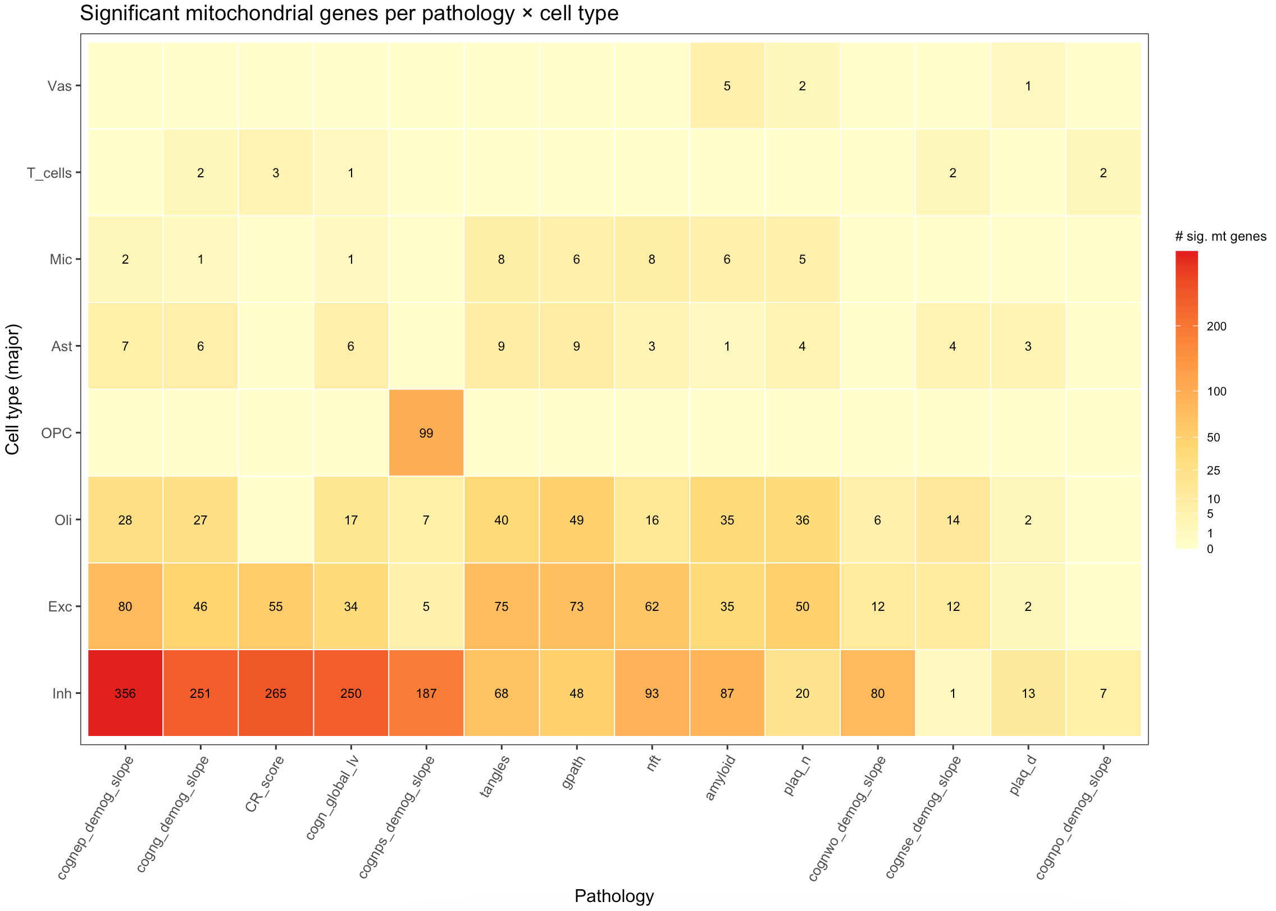

Slide 6
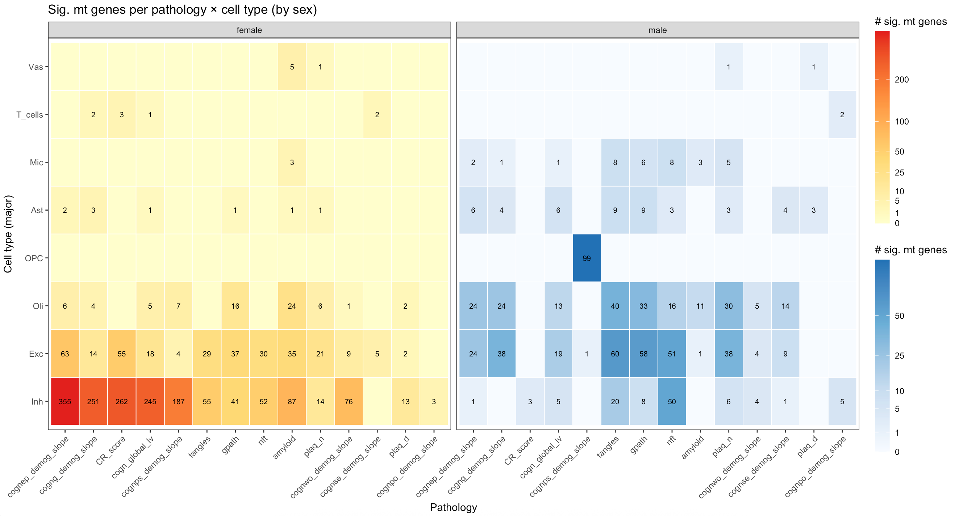

Slide 7
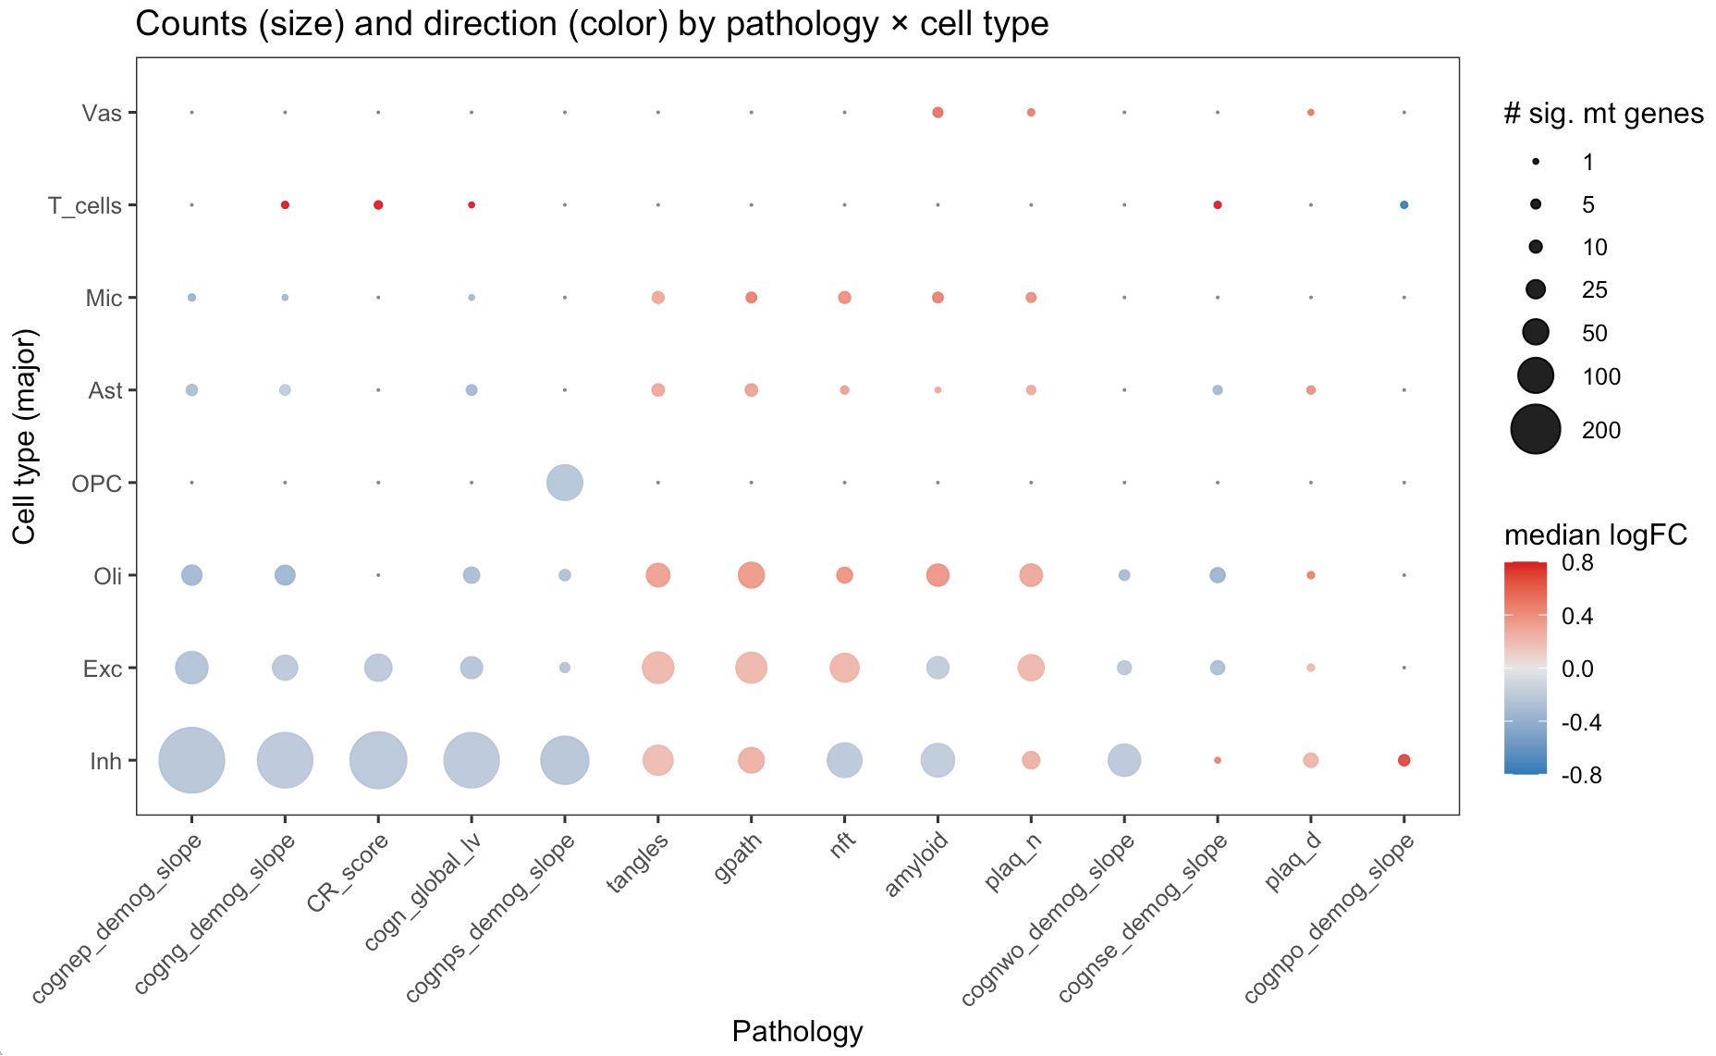
All pathways

Slide 8
Pathway Specific

Slide 9
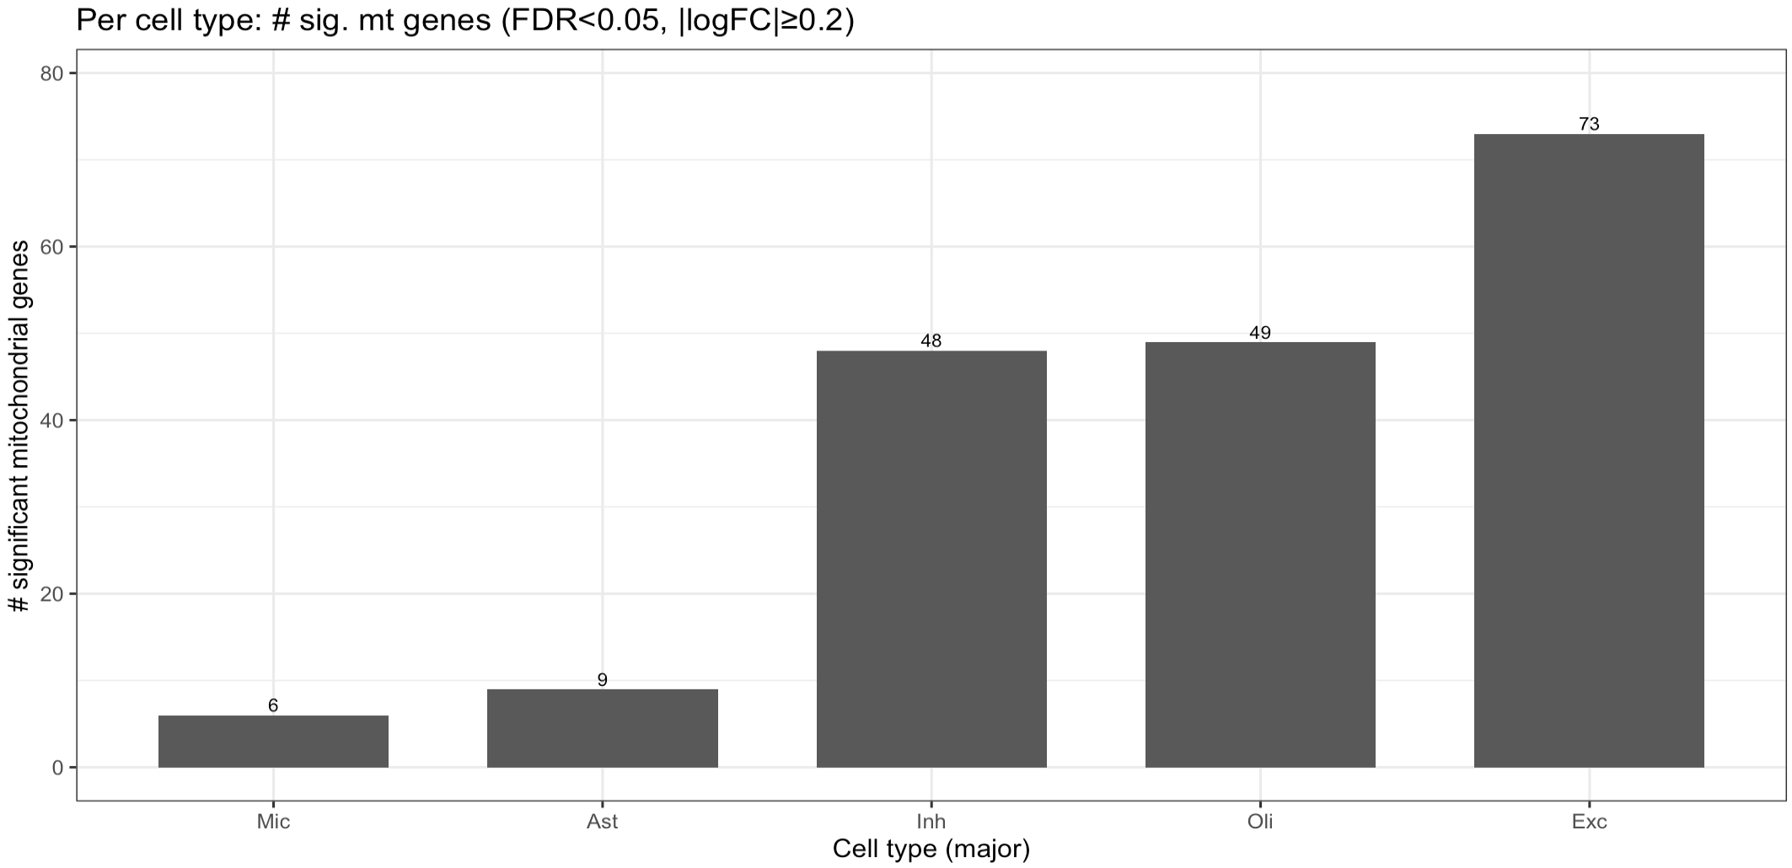
gpath

Slide 10
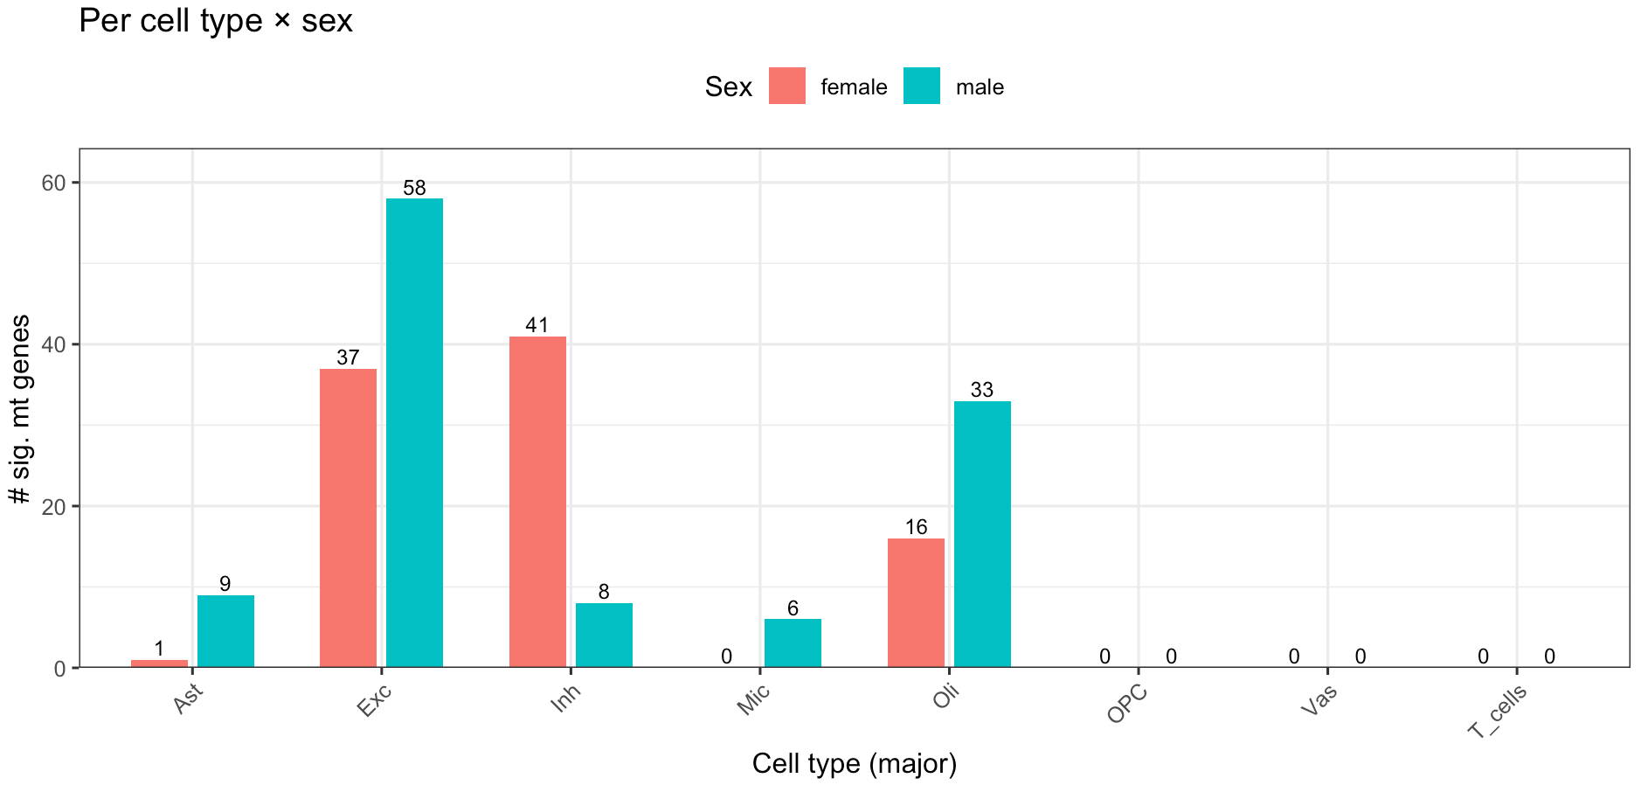
gpath

Slide 11
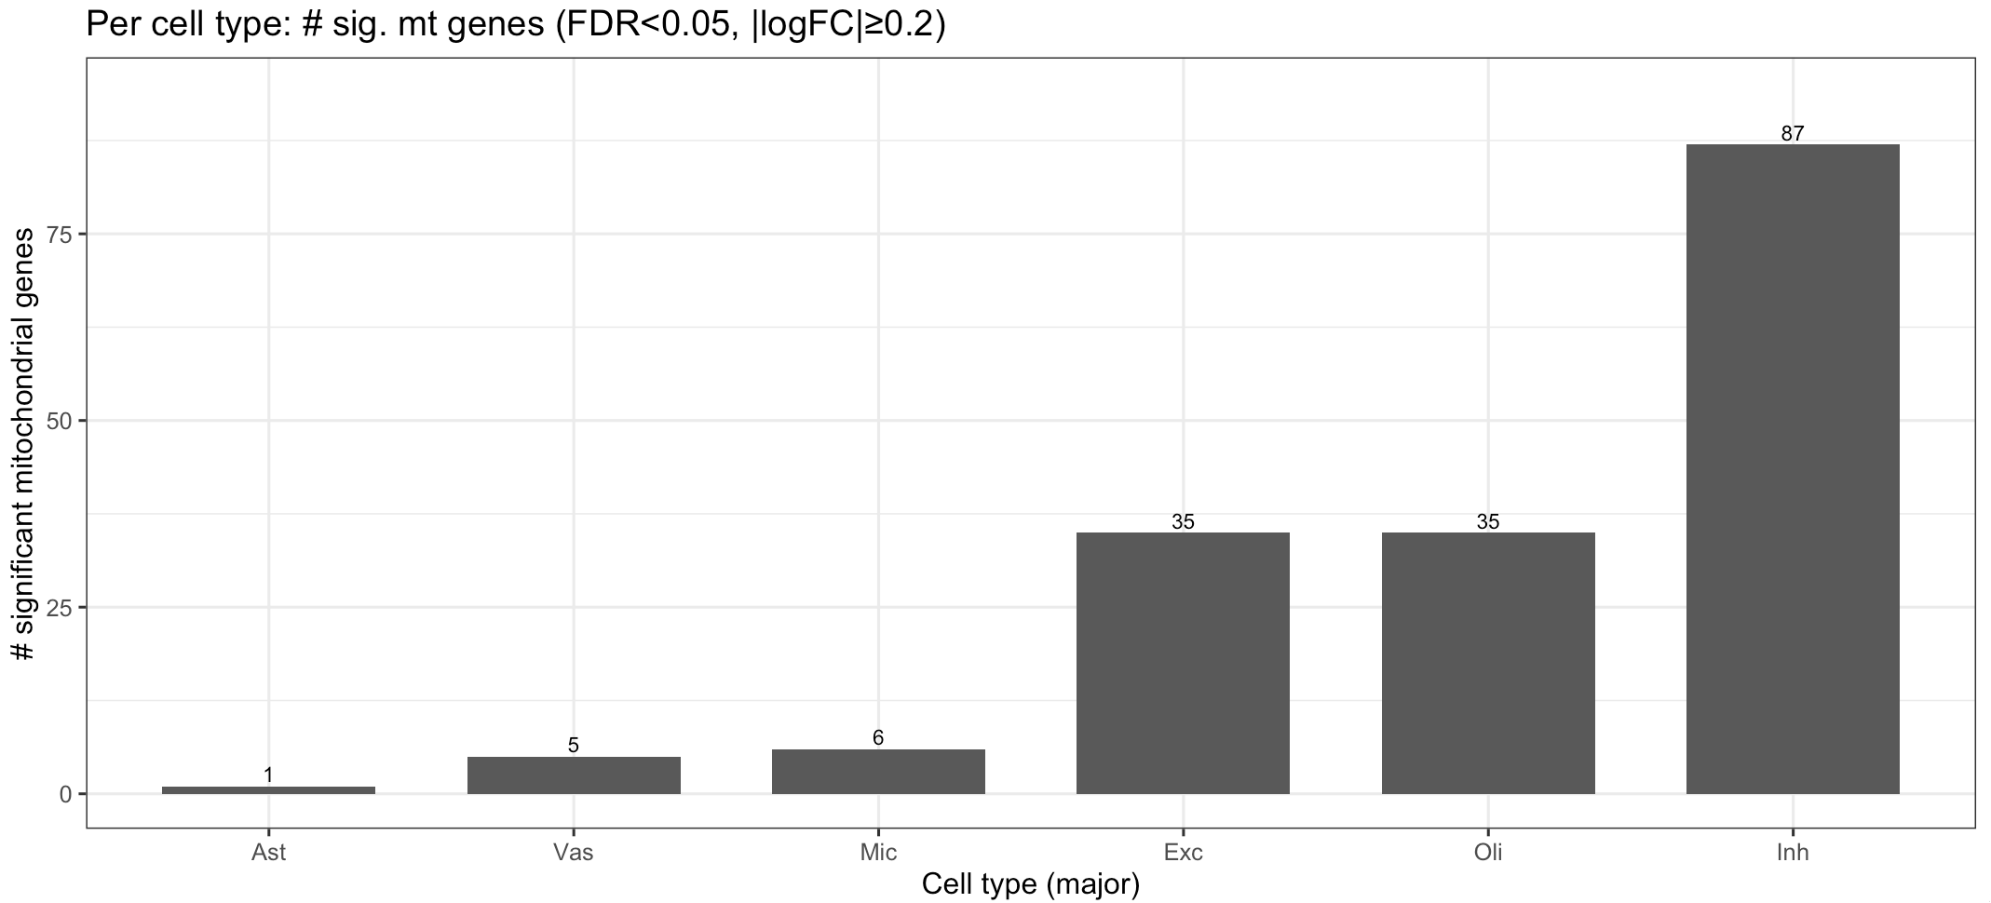
Amyloid

Slide 12
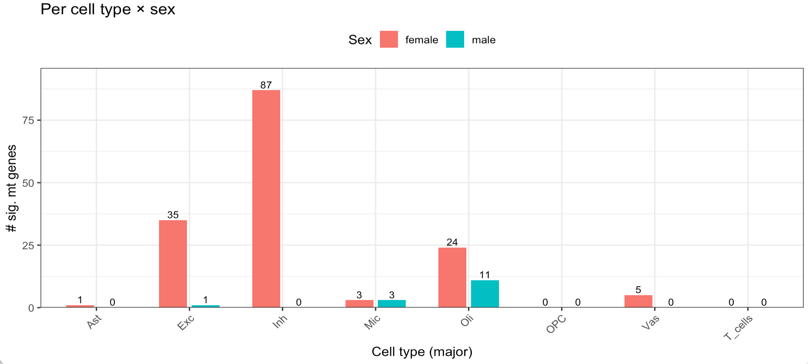
Amyloid

Slide 13
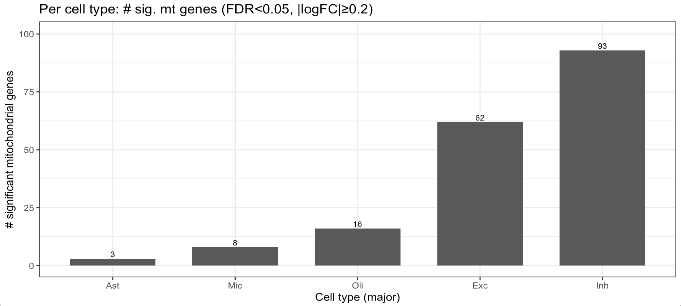
nft

Slide 14
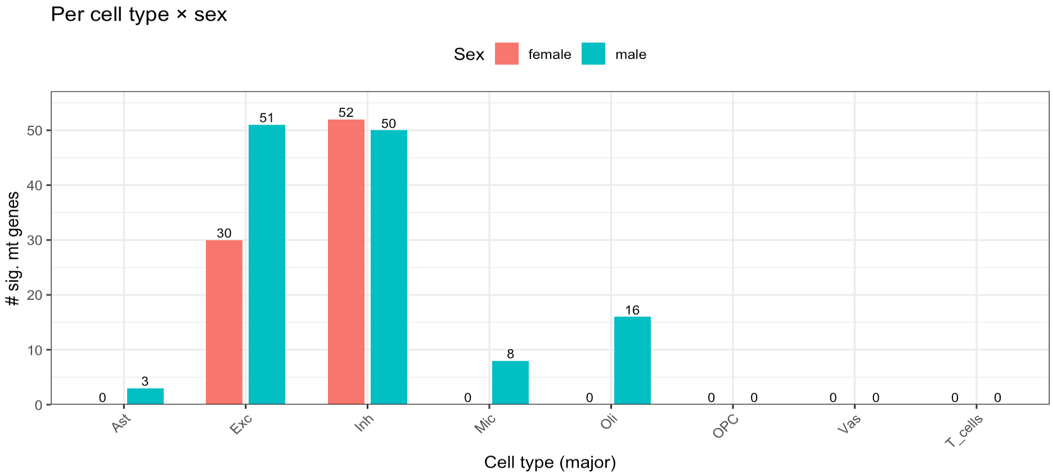
nft

Slide 15
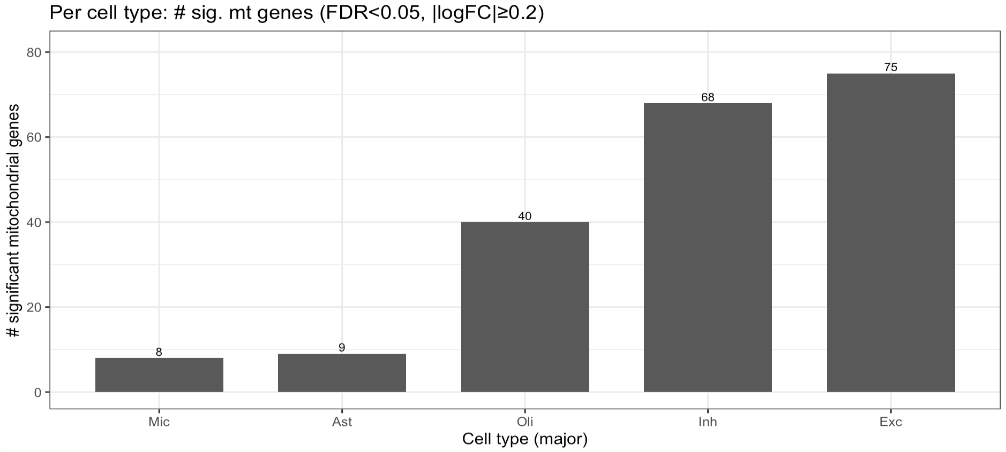
tangles

Slide 16
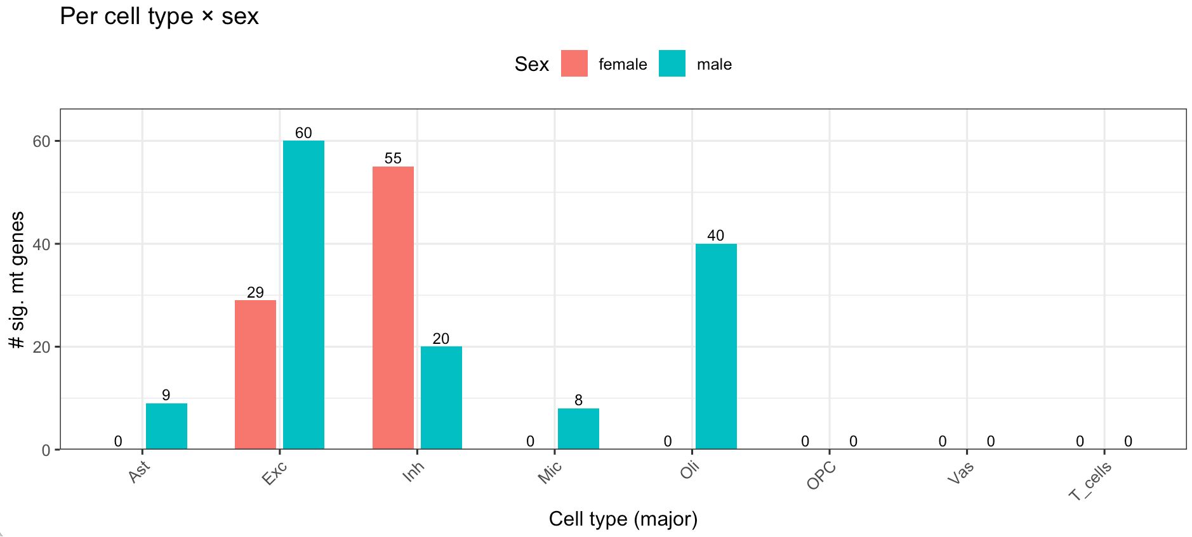
tangles

Slide 17
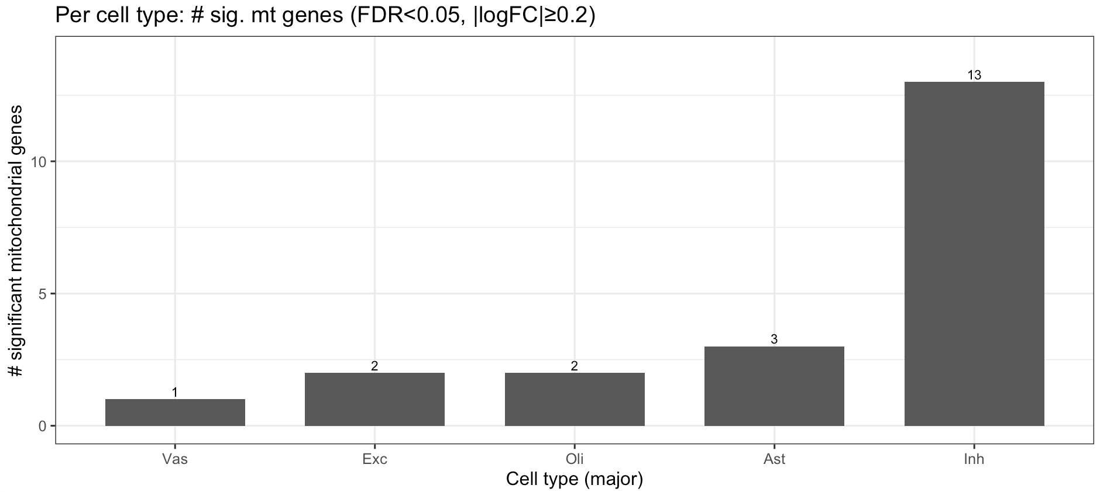
plaq_d

Slide 18
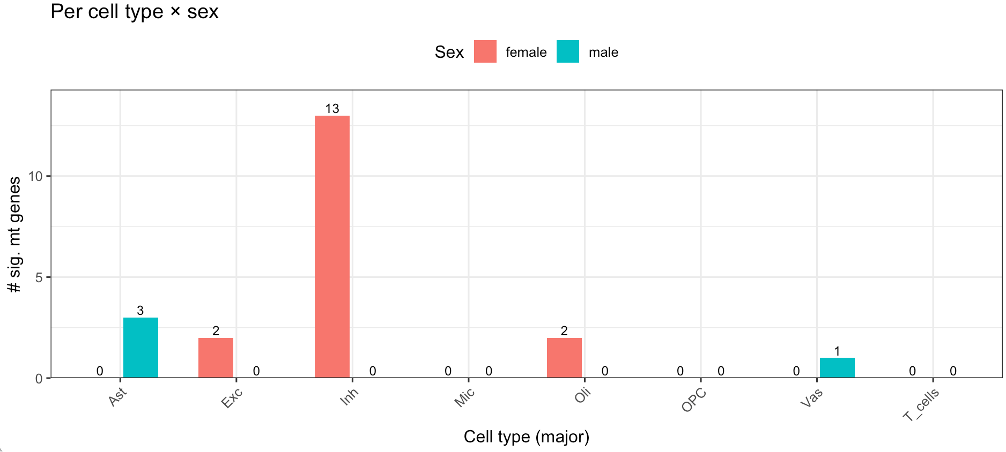
plaq_d

Slide 19
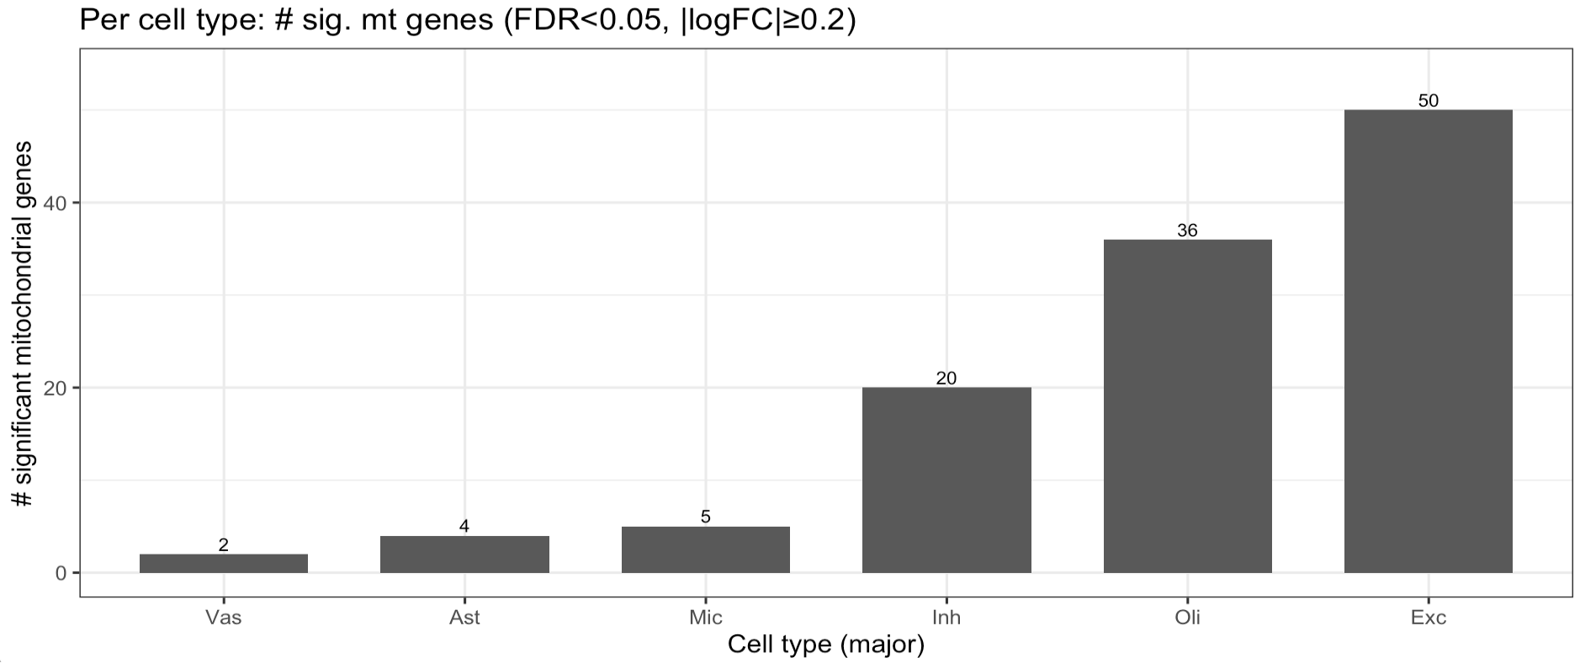
plaq_n

Slide 20
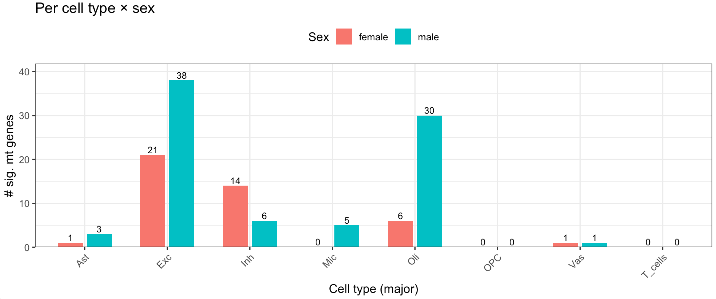
plaq_n

Slide 21
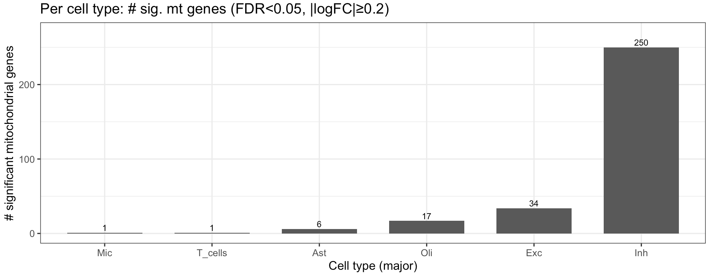
cogn_global_lv

Slide 22
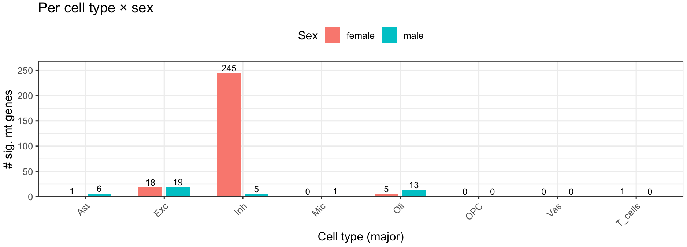
cogn_global_lv

Slide 23
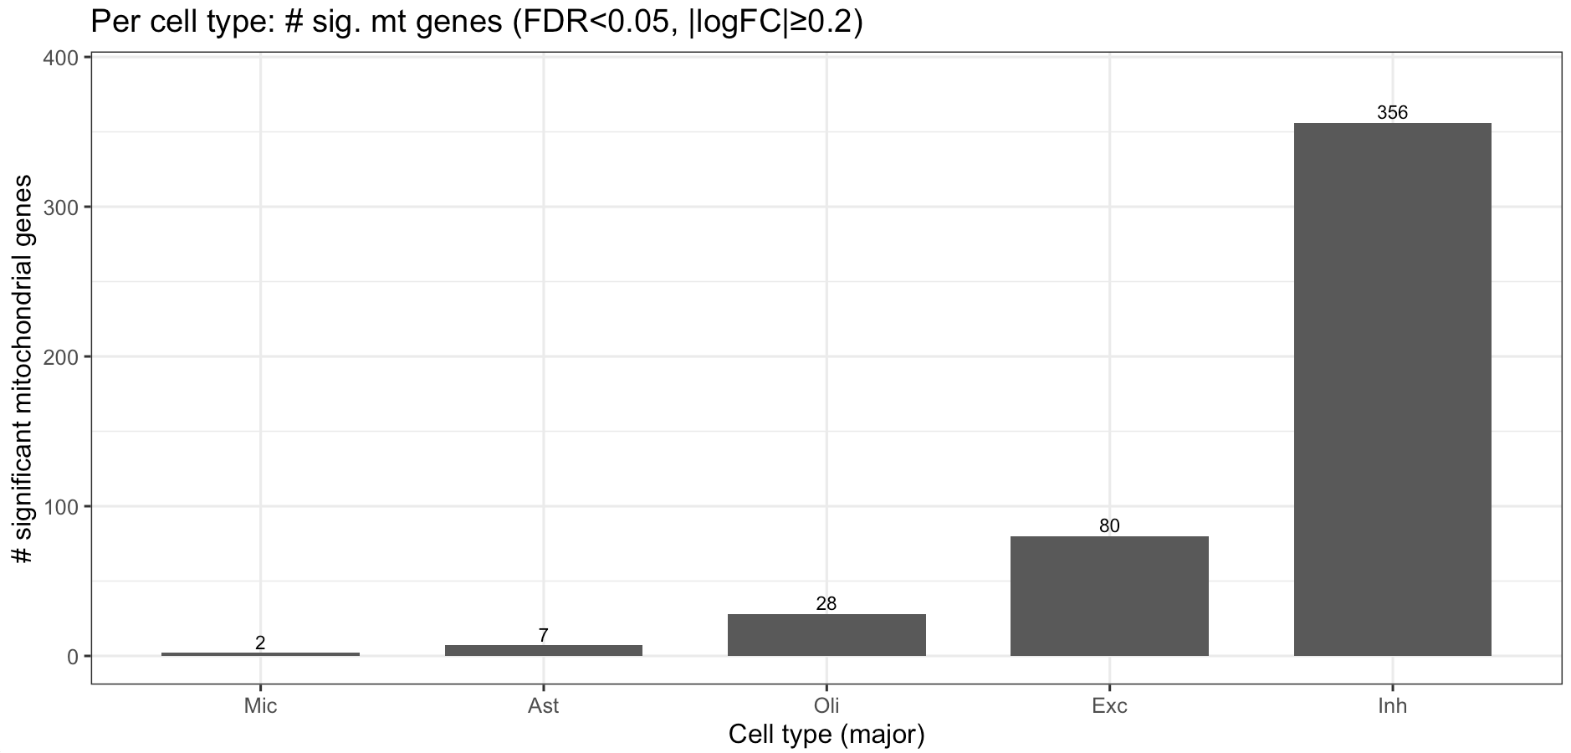
cognep_demog_slope

Slide 24
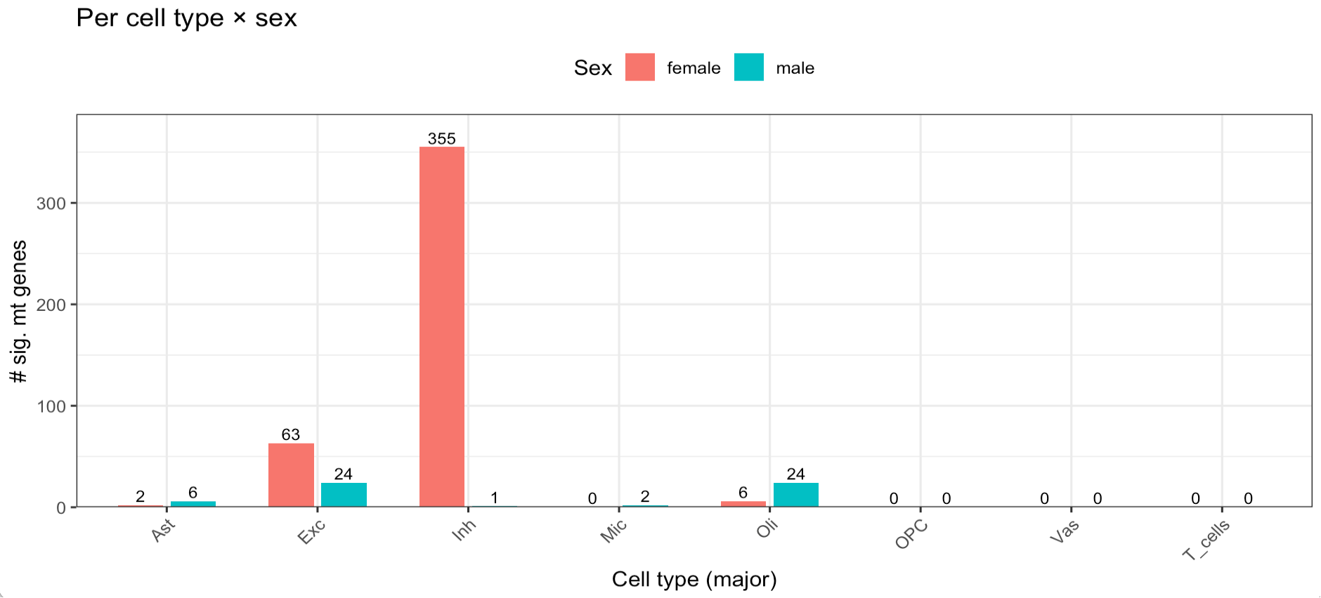
cognep_demog_slope

Slide 25
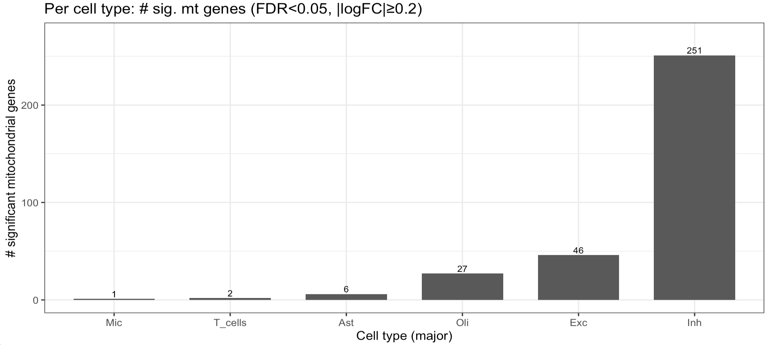
cogng_demog_slope

Slide 26
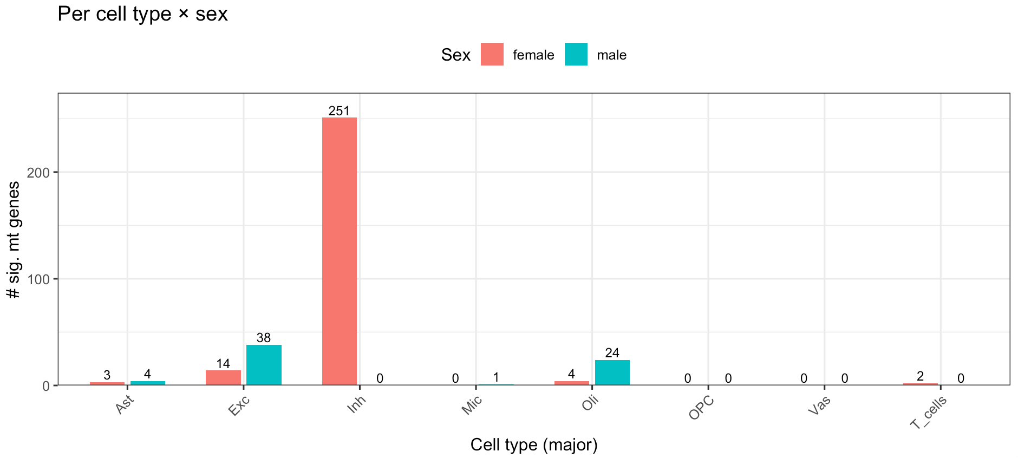
cogng_demog_slope

Slide 27
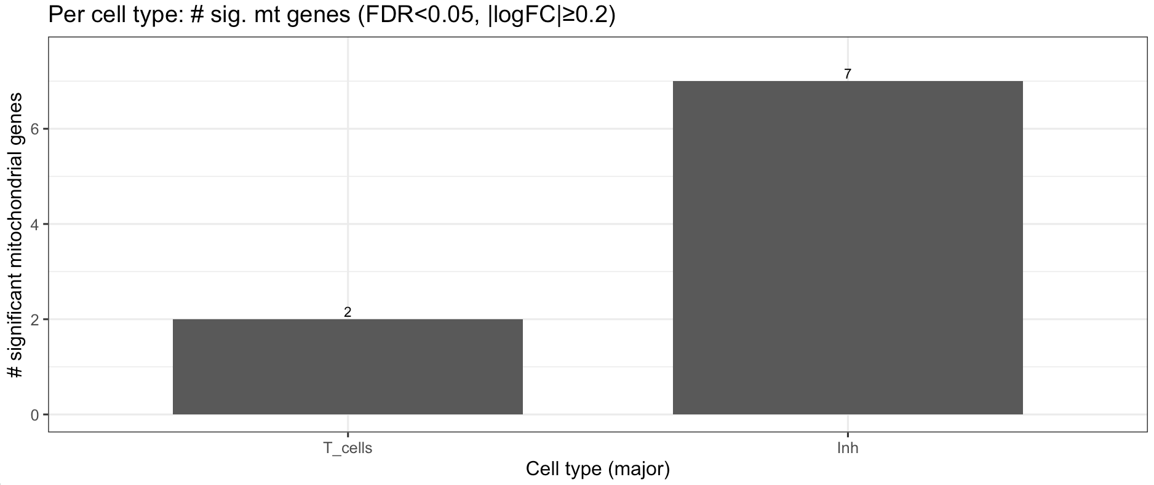
cognpo_demog_slope

Slide 28
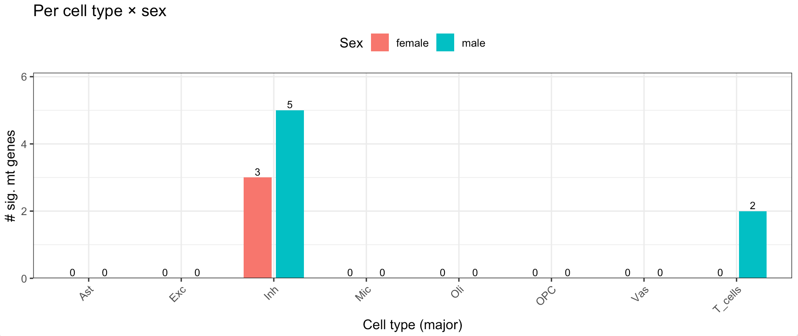
cognpo_demog_slope

Slide 29
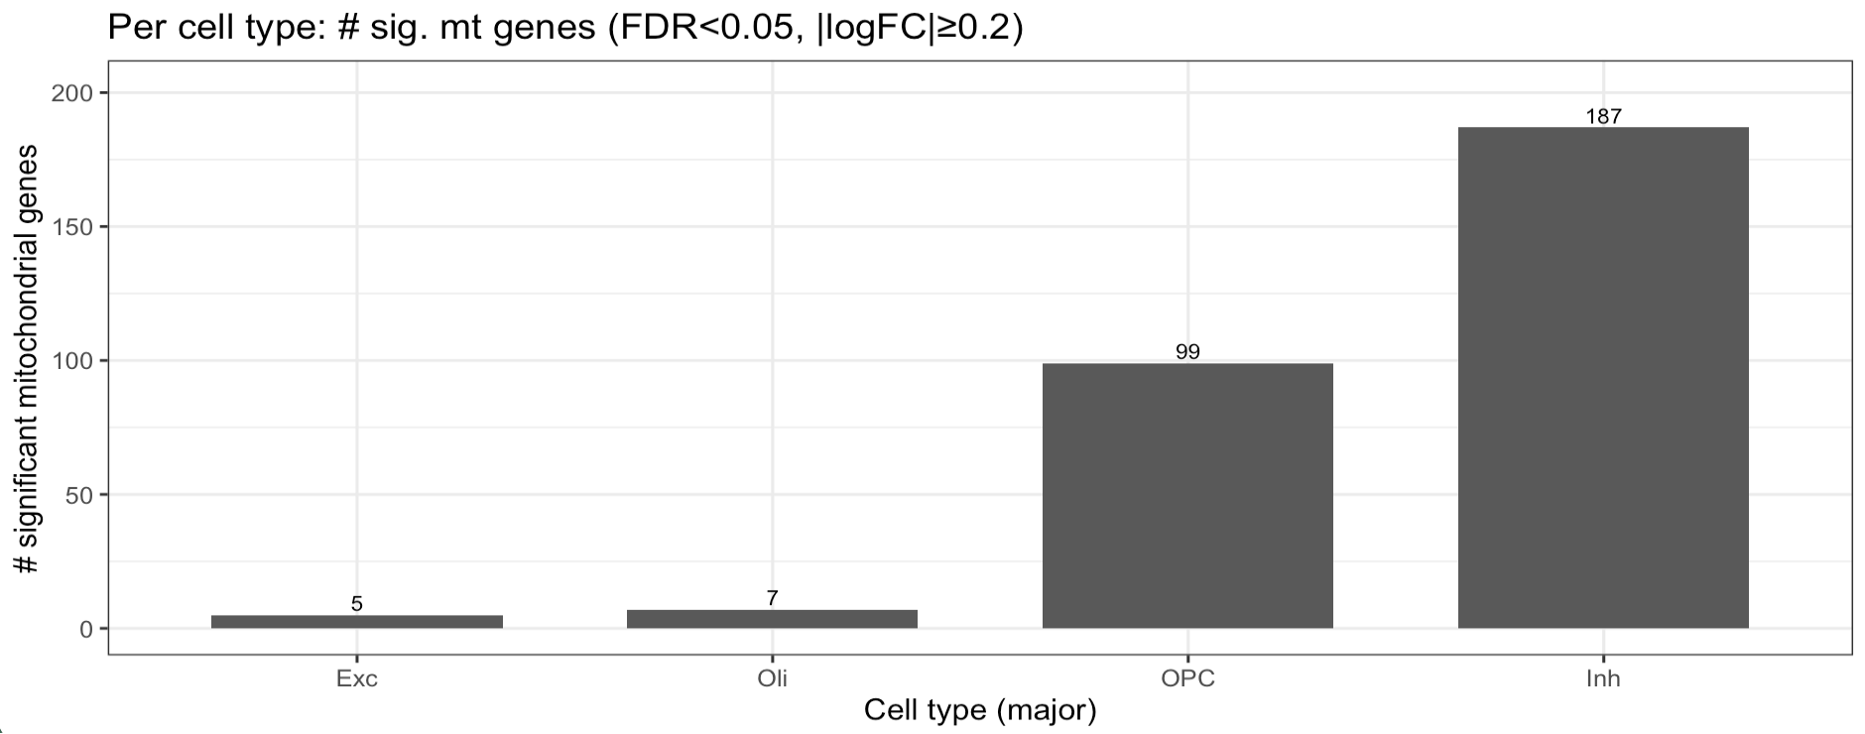
cognps_demog_slope

Slide 30
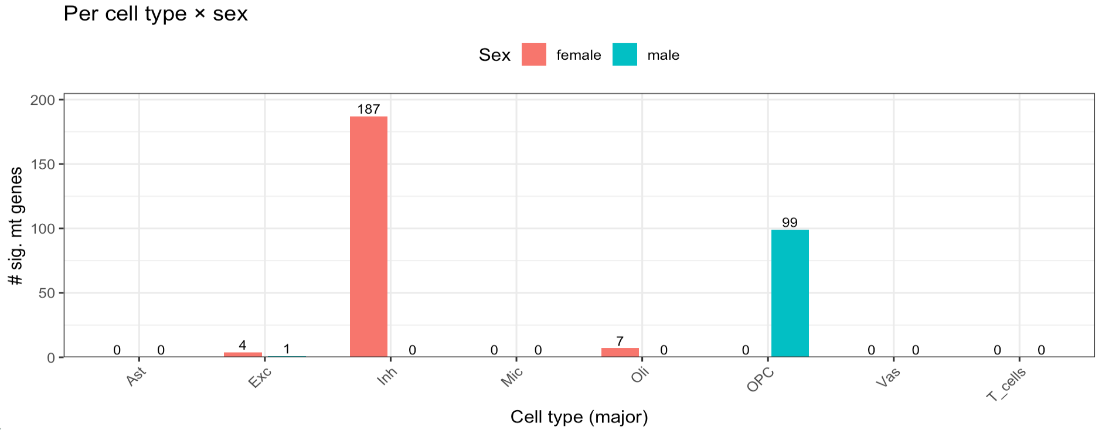
cognps_demog_slope

Slide 31
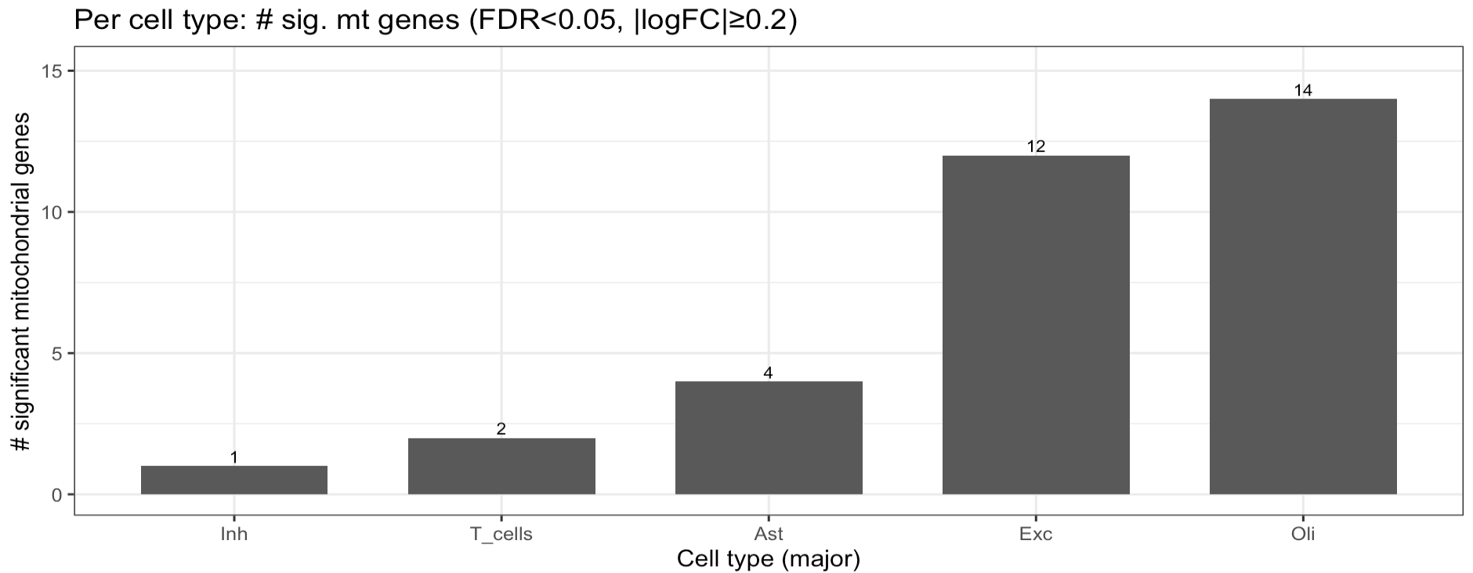
cognse_demog_slope

Slide 32
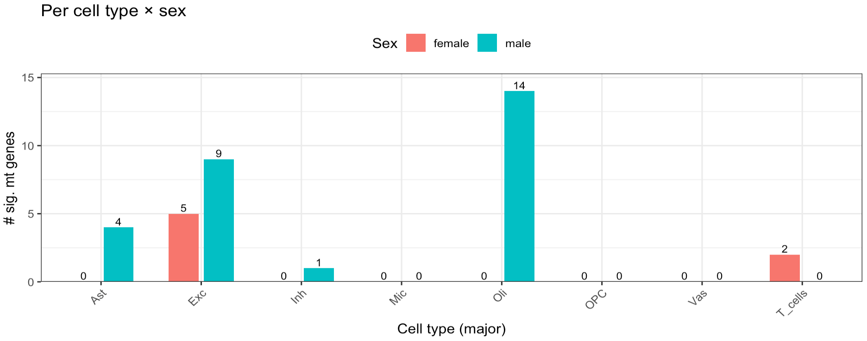
cognse_demog_slope

Slide 33
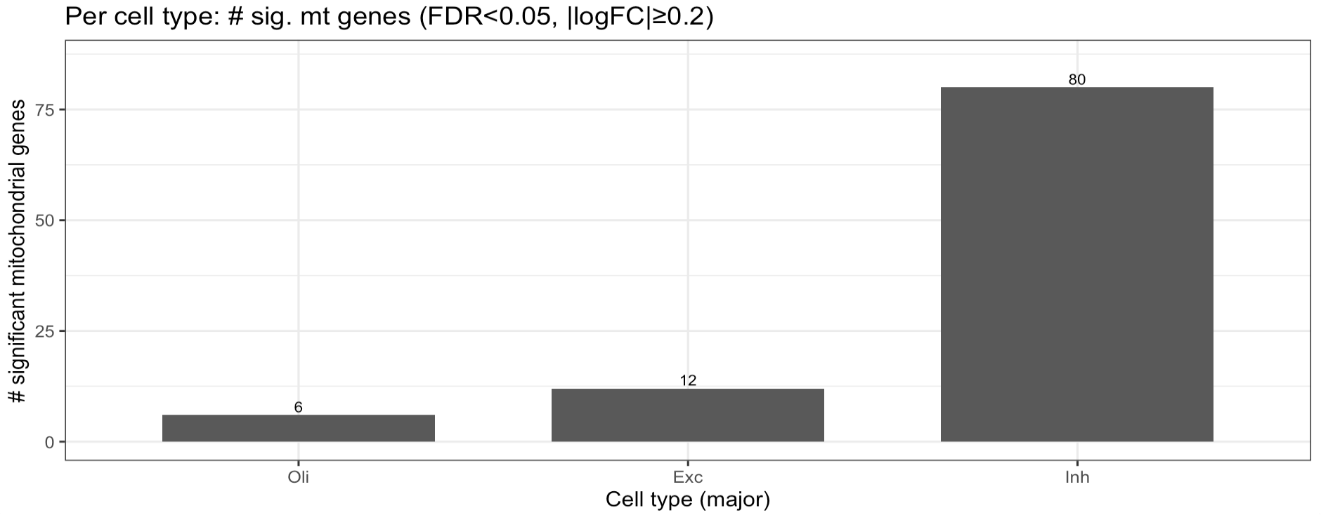
cognwo_demog_slope

Slide 34
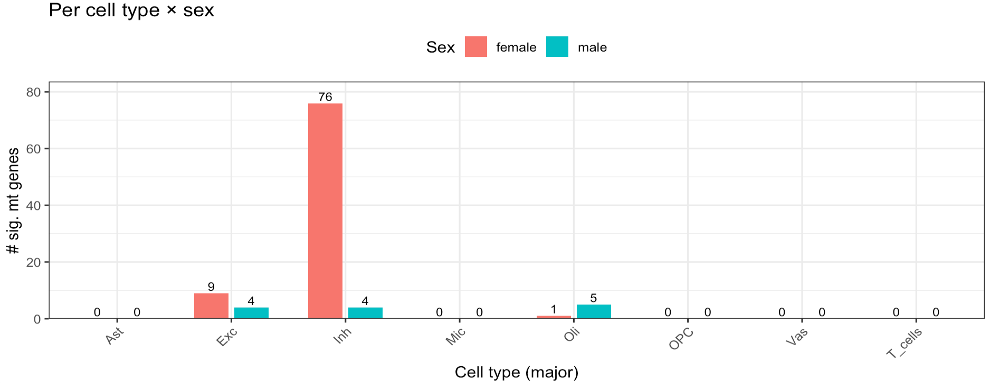
cognwo_demog_slope

Slide 35
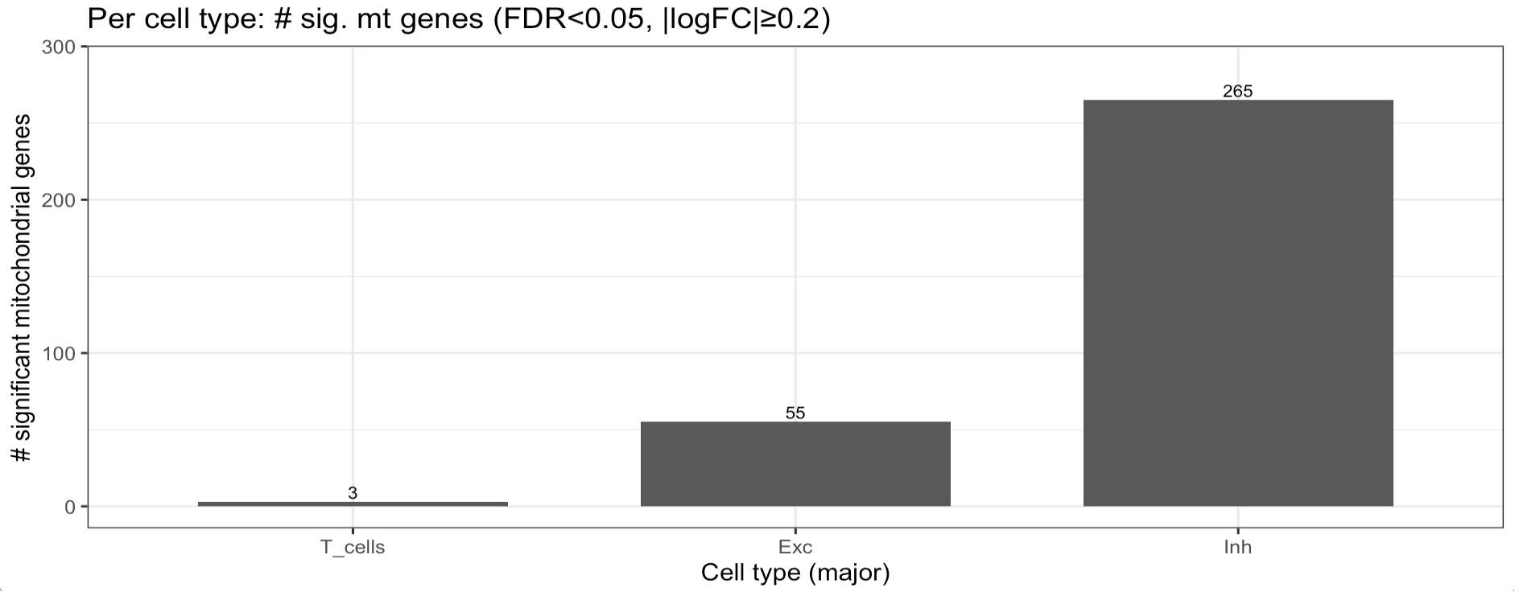
CR_score

Slide 36
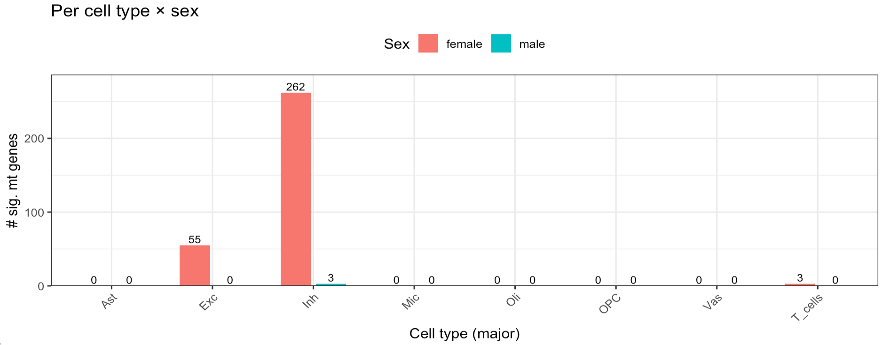
CR_score

Slide 37
Heatmap for gpath, sig. mt genes

