Slide 1
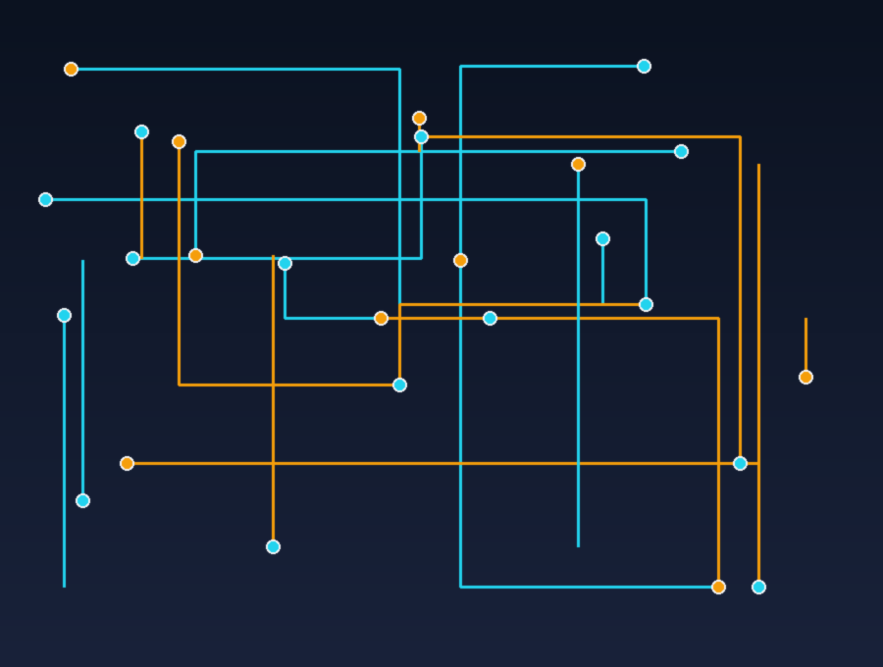
DATA &
COMPUTERS
How machines turn data into knowledge
English Presentation
Presented by: Khaled
Class: English • 2026
“Data is the new oil of the digital world.”

Slide 2
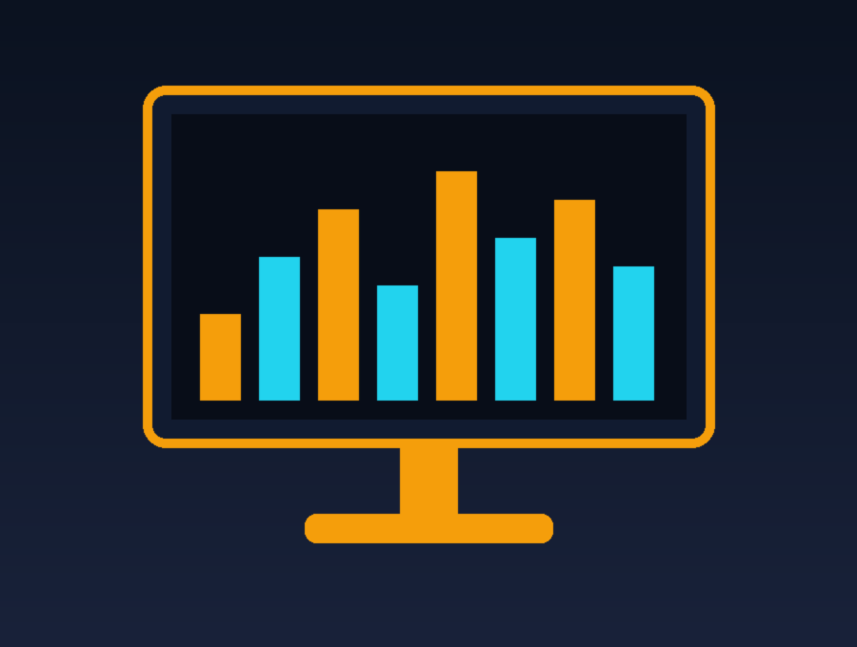
PART 01 — THE MACHINE
What is a Computer?
▸ A computer is an electronic machine that receives, stores, and processes data.
▸ It follows instructions called programs, written by software developers.
▸ Computers work with amazing speed — billions of operations every second.
▸ They never get tired and repeat tasks with perfect accuracy.
▸ Today computers are everywhere: phones, cars, hospitals, and even watches.
02

Slide 3
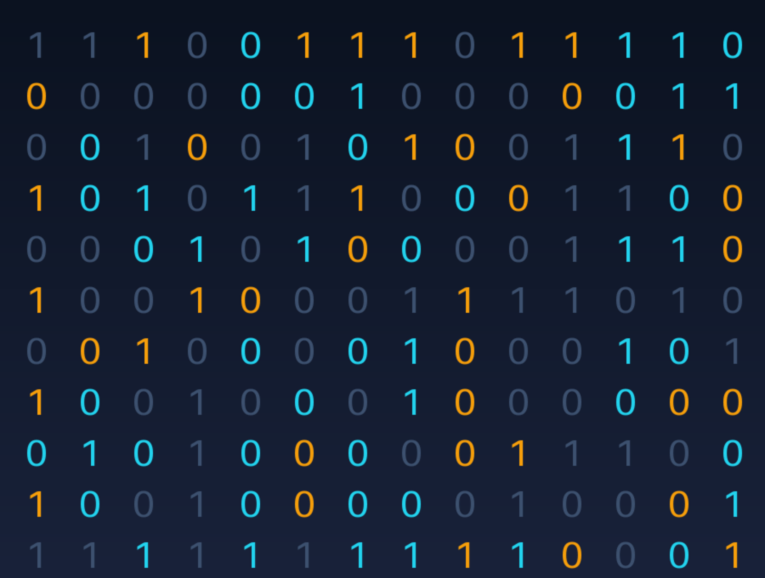
PART 02 — THE FUEL
What is Data?
▸ Data means raw facts and figures — numbers, words, images, and sounds.
▸ Alone, raw data has no clear meaning; it is like puzzle pieces on a table.
▸ Computers store all data as binary digits: only zeros and ones (0 and 1).
▸ Every photo, song, and message on your phone is really millions of bits.
▸ Humans create around 400 million terabytes of new data every single day!
03

Slide 4
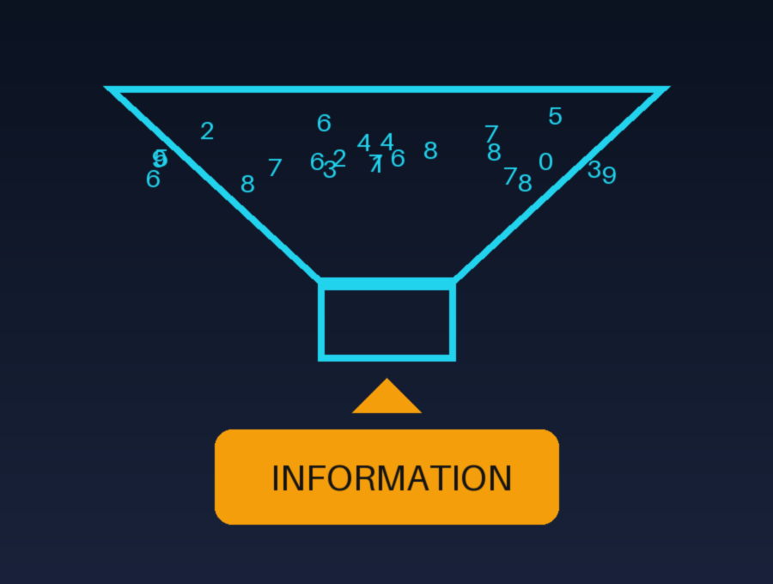
PART 03 — THE MEANING
Data vs. Information
▸ Data is the raw input; information is data with meaning and context.
▸ Example: “85, 90, 77” is data — “your average grade is 84” is information.
▸ Computers transform data into information by sorting, counting, and comparing.
▸ Good information helps people make smart decisions in school and business.
▸ This transformation is the real magic and purpose of every computer system.
04

Slide 5
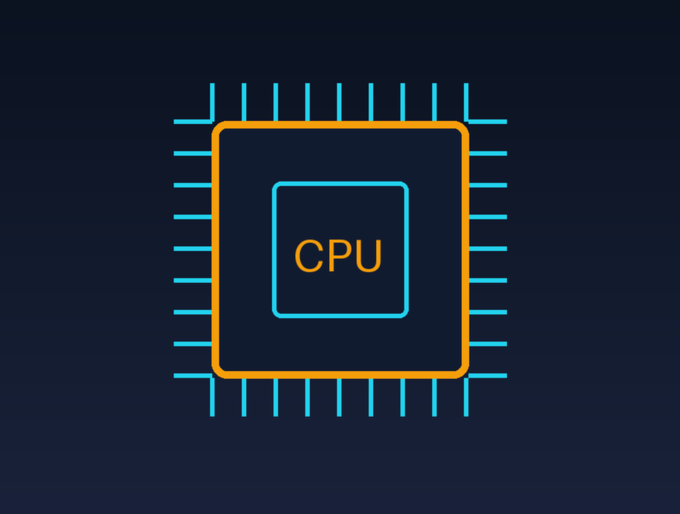
PART 04 — THE BRAIN
How Computers Process Data
▸ Step 1 — INPUT: keyboard, mouse, camera, or sensors send data inside.
▸ Step 2 — PROCESSING: the CPU, the “brain”, calculates and makes decisions.
▸ Step 3 — MEMORY: RAM holds the data the computer is working on right now.
▸ Step 4 — OUTPUT: results appear on the screen, speakers, or printer.
▸ This cycle repeats billions of times per second — faster than a blink!
05

Slide 6
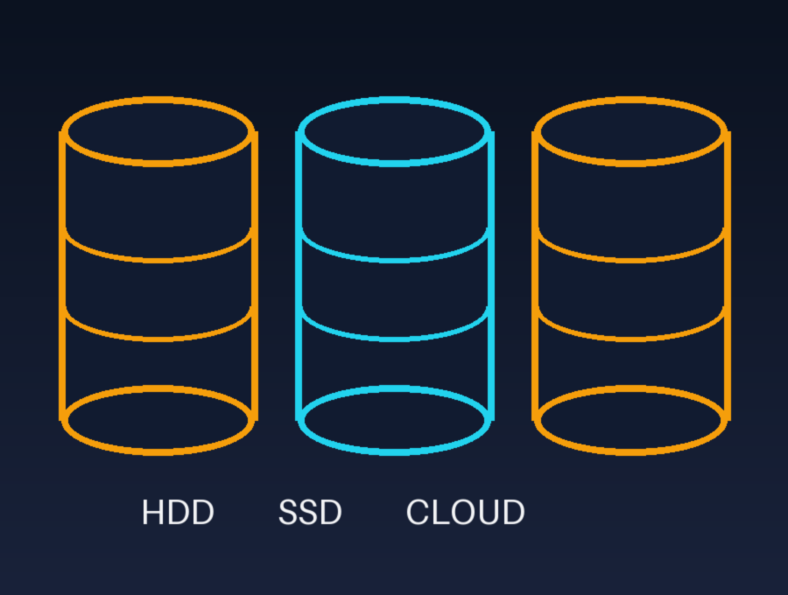
PART 05 — THE MEMORY
Where Data Lives: Storage
▸ Hard drives (HDD) store data on spinning magnetic disks — big and cheap.
▸ Solid-state drives (SSD) have no moving parts, so they are much faster.
▸ USB flash drives let us carry gigabytes of data in our pockets.
▸ Cloud storage saves our files on the internet — safe even if we lose the phone.
▸ One terabyte can hold about 250,000 photos or 500 hours of video.
06

Slide 7
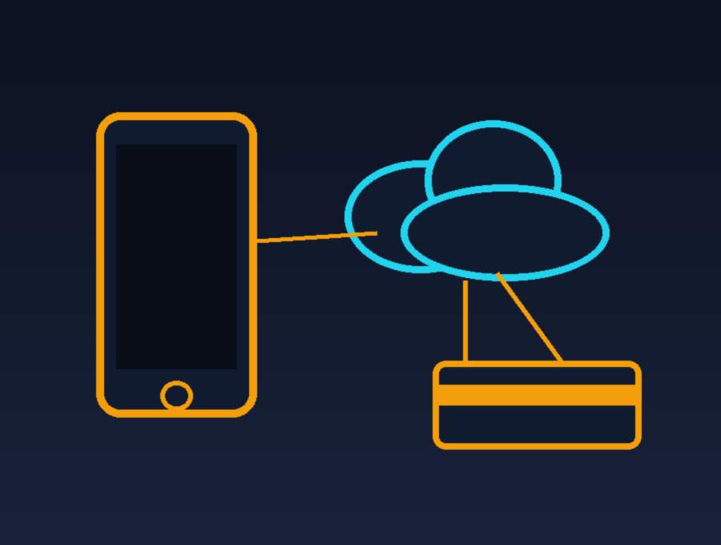
PART 06 — THE IMPACT
Data in Our Daily Life
▸ Social media apps study our data to show posts and videos we like.
▸ Maps use live traffic data from millions of phones to find the fastest road.
▸ Banks protect our money using encrypted data and smart security systems.
▸ Doctors use patient data to discover diseases earlier and save lives.
▸ That is why protecting personal data — privacy — is so important today.
07

Slide 8
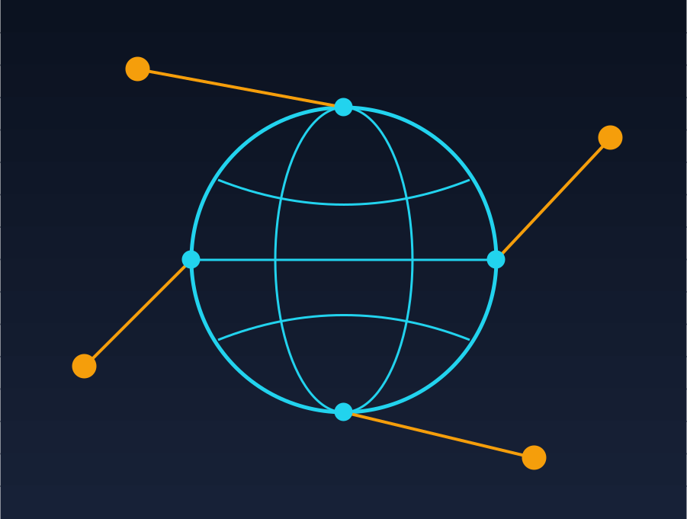
PART 07 — THE NETWORK
The Internet: Data on the Move
▸ The internet connects billions of computers into one giant network.
▸ Data travels as small packets through cables, Wi-Fi, and satellites.
▸ Every device has an IP address — like a home address for data.
▸ A message can cross the whole world in less than one second.
▸ Undersea cables carry almost 99% of all international data.
08

Slide 9
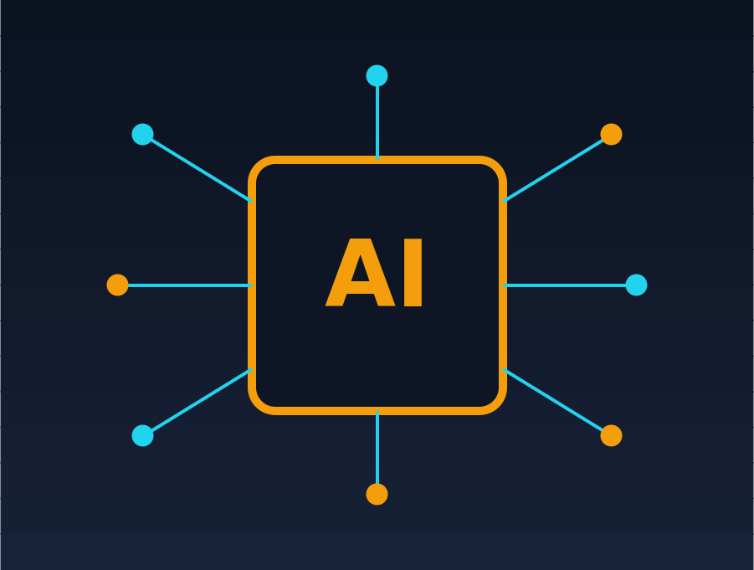
PART 08 — THE FUTURE
Big Data & Artificial Intelligence
▸ Every day the world creates more than 400 million terabytes of new data.
▸ “Big data” means collections too large for one normal computer to handle.
▸ Artificial intelligence learns patterns by studying millions of examples.
▸ AI already recommends videos, translates languages, and drives cars.
▸ The more good data AI receives, the smarter and more useful it becomes.
09

Slide 10

PART 09 — THE END
Conclusion
▸ Computers are powerful machines, but data is what gives them purpose.
▸ Raw data becomes valuable information through processing.
▸ Storage technology lets humanity keep and share all its knowledge.
▸ Data already shapes our daily lives — from maps to medicine.
▸ The future belongs to those who understand and protect their data. Thank you!
10

