Slide 1
INTELLIGENCE ANALYTICS CHALLENGE 3.0
MMP TEAM
Haojie Zhang
Junyan Xu
Yiyuan Guo
Yangranzi Xiong

Slide 2
CONTENTS
A
Summary
B
Variable Analysis
C
Variable Analysis
Predictive Analysis

Slide 3
2012 TIME SPENDING PATTERN
Working
Time
Family Time
1
2
3
4
Leisure
Activities
Necessary Activities

Slide 4
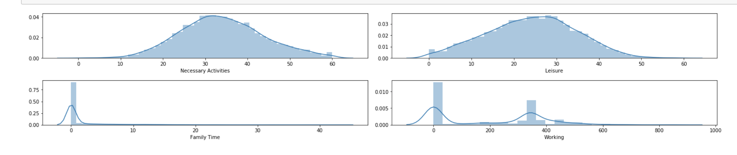
2012 TIME SPENDING PATTERN
People spend most of their time on necessary activities and leisure activities
Working
2
4
Leisure
Activities
Necessary Activities

Slide 5
2012 TIME SPENDING PATTERN
Working = 254.0687579095523 + -0.36Age + 0.06Weekly Earnings + 27.82ELnew_Bachelor & Associate + 12.99ELnew_Doctoral Degree + 31.07ELnew_High School & Some College + 37.37ELnew_Master & Prof + -262.97Employment Status_Not in labor force + -241.15Employment Status_Unemployed + 21.01Gender_Male + -0.56Cnew_1 + -10.87Cnew_2 + -3.93Cnew_3 + -13.93Cnew_4
Family Time = -0.8237562147634512 + -0.02Age + 2.10ELnew_Bachelor & Associate + 3.54ELnew_Doctoral Degree + 1.54ELnew_High School & Some College + 2.31ELnew_Master & Prof + 0.64Employment Status_Not in labor force + -0.08Employment Status_Unemployed + -0.37Gender_Male + 2.72Cnew_1 + 4.04Cnew_2 + 4.12Cnew_3 + 4.88Cnew_4
Leisure = 22.910276812297283 + 0.08Age + -3.22ELnew_Bachelor & Associate + -5.87ELnew_Doctoral Degree + -1.92ELnew_High School & Some College + -3.63ELnew_Master & Prof + 3.03Employment Status_Not in labor force + 2.64Employment Status_Unemployed + 2.08Gender_Male + -2.63Cnew_1 + -4.31Cnew_2 + -5.73Cnew_3 + -5.82Cnew_4
Necessary Activities = 38.092503758389014 + -0.05Age + 0.46ELnew_Bachelor & Associate + 0.87ELnew_Doctoral Degree + -0.47ELnew_High School & Some College + 1.03ELnew_Master & Prof + -3.85Employment Status_Not in labor force + -3.57Employment Status_Unemployed + -1.73Gender_Male + 0.03Cnew_1 + 0.34Cnew_2 + 1.55Cnew_3 + 0.95Cnew_4

Slide 6
2012 TIME SPENDING PATTERN-SEGMENTATION
Relationship | Age | Working Status | Education Level
Working Time | - | Unem: - | +
 |  | NILF: -
Family Time | - | Unem: - | +
 |  | NILF: -
Leisure Activities | + | Unem: + | -
 |  | NILF: +
 | - | Unem: - | +
Necessary Activities |  | NILF: -

Slide 7
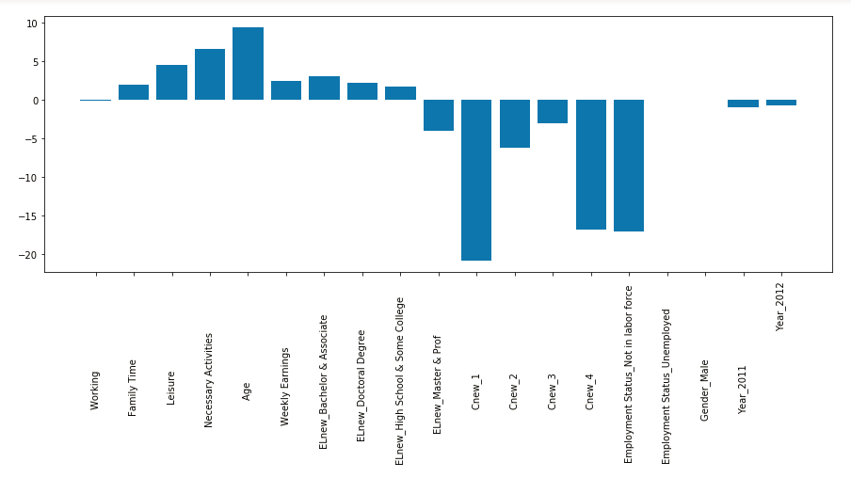
BABY CARE

Slide 8
LEISURE TIME
The higher weekly earning is the less leisure time
Among all age generations, age is negatively related to leisure time
Weekly Earning
AGE

Slide 9
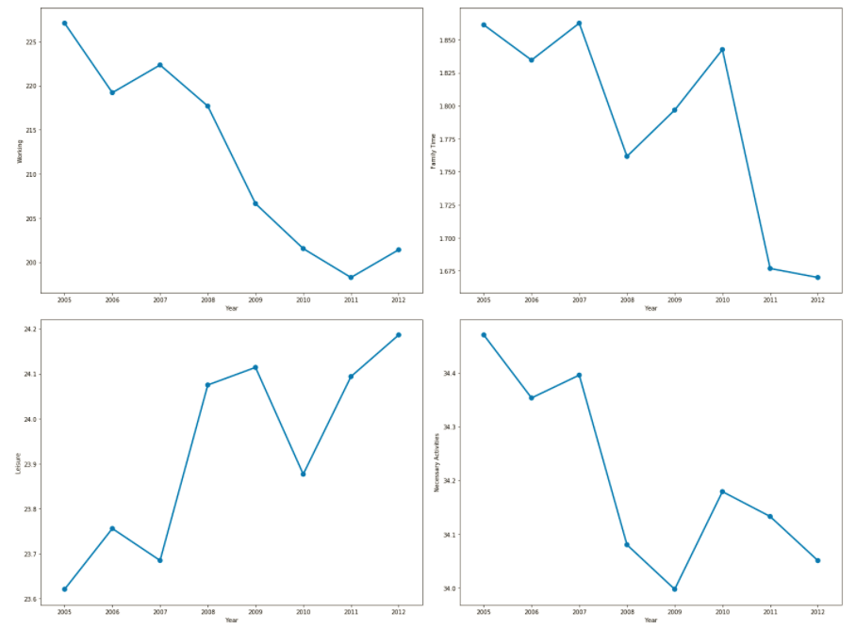
Great Recession（2008-2009）
Working
Family Time
Leisure
Necessary
Activities

Slide 10
Common Primary Activities
Sleeping
Socializing & Relaxing
Television
Eating & Drinking
Grooming
1
2
3
4
5
Among all age generations, above 5 activities are common primary activities for each person

Slide 11
Primary Activity(Age)
Age Range | Primary Activity
0-19 | Shopping; Housework; Volunteering
20-29 | Working; Caring for Children; Housework
30-39 | Working; Caring for Children; Housework
40-49 | Working; Housework; Food & Drink Prep
50-59 | Working; Housework; Food & Drink Prep
60-69 | Working; Housework; Food & Drink Prep
70-79 | Housework; Food & Drink Prep; Shopping
80+ | Housework; Food & Drink Prep; Shopping

Slide 12
Employment Status
We run the regression and list Top three significant variable.
Compared the result, we found the weekly hours worked is the most significant variable which affecting the employment as well
 | Unemployed | Employed | Not in labor force
Weekly Earnings | 11.514417 | -9.396505 | -3.343975
Weekly Hours Worked | 11.644857 | -9.806494 | -2.975192
Total | -3.000108 | 2.508926 | 1.084585

Slide 13
Predict Employment Status
Employment Status | Number
Employed | 20866
Unemployed | 1091
Not in labor force | 11313

Slide 14
Thanks for Listening

