Slide 1
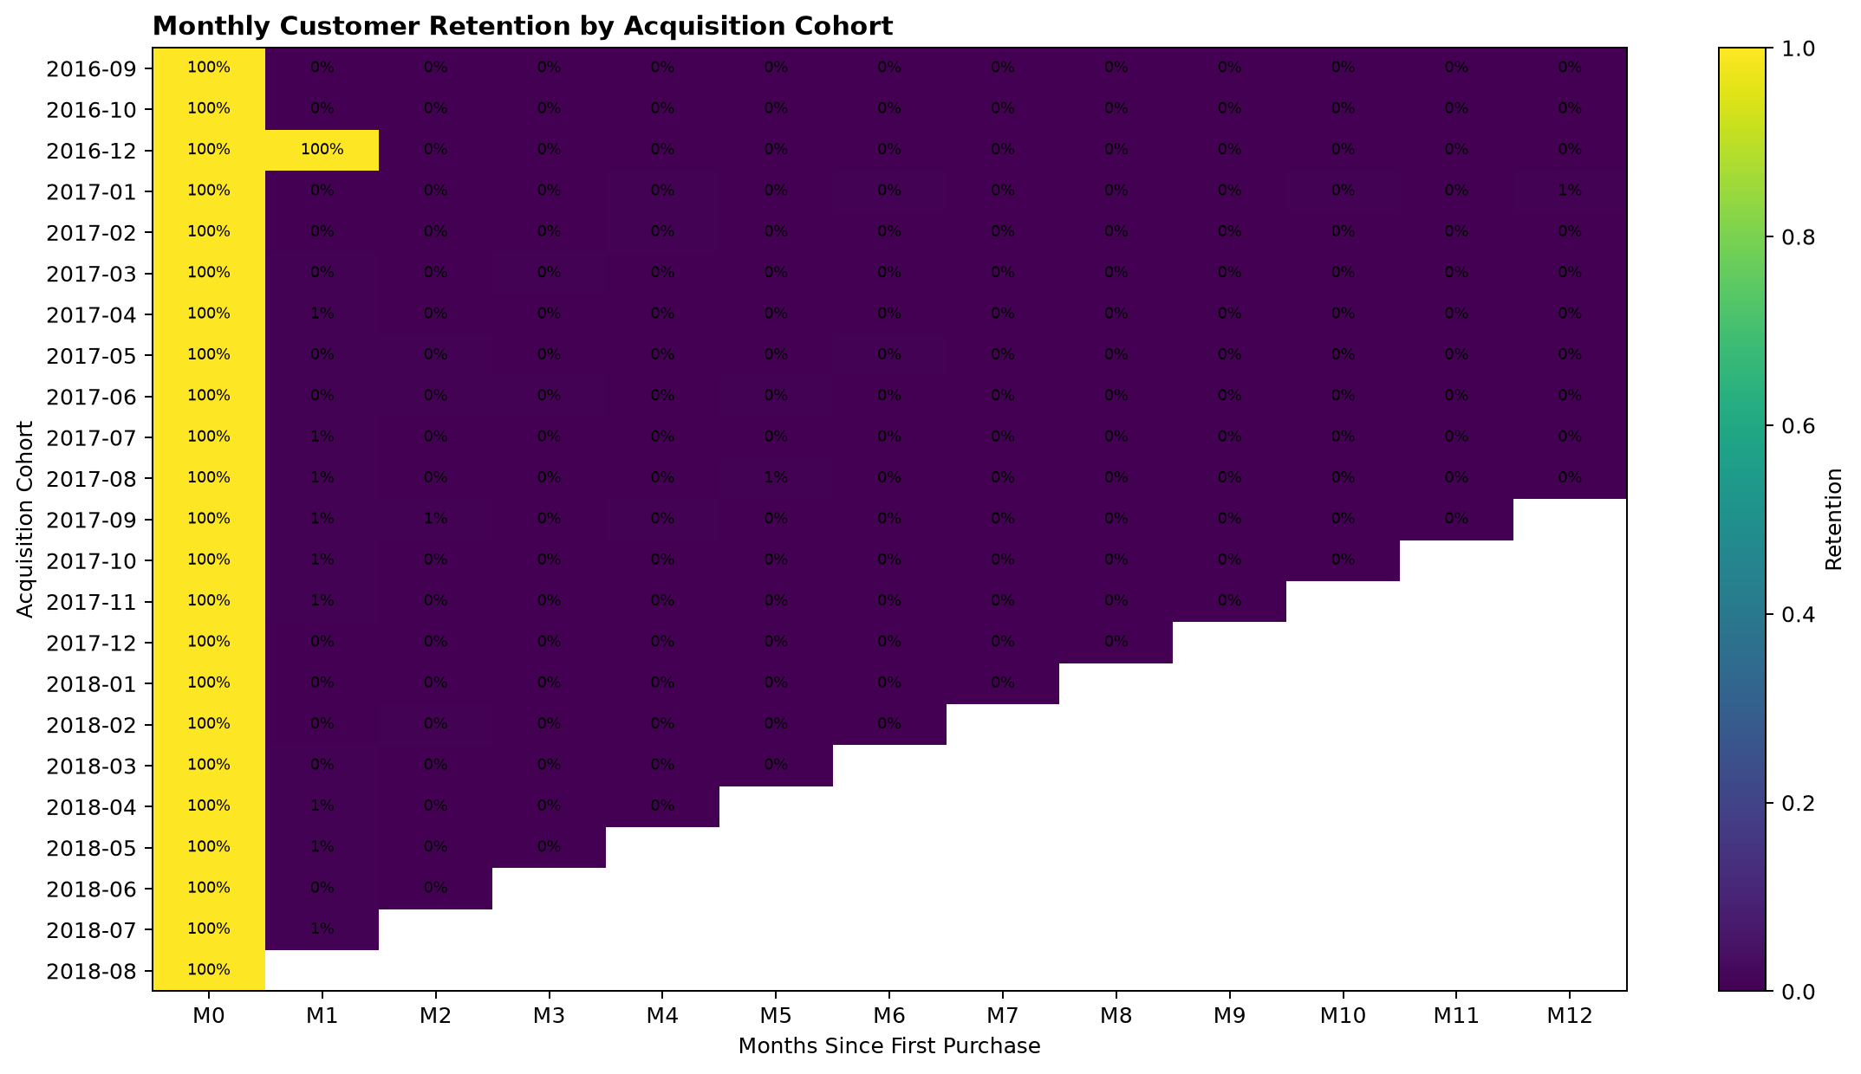
E-Commerce Customer Retention & Revenue Analysis
Customer growth, repeat purchasing, segmentation and customer experience
13.2M
3.0%
Merchandise revenue
Repeat purchase rate
5.0%
6.7%
M1 retention
Late-delivery rate
Portfolio focus
End-to-end customer analytics: data quality, revenue diagnostics, cohort retention, RFM segmentation and operational impact.
Olist Brazilian E-Commerce public dataset | Portfolio case
1

Slide 2
Executive Summary
The dataset shows strong acquisition, but weak repeat buying and measurable operational impact on reviews.
97.1%
2.9%
3.0%
4.29 → 2.27
Revenue from first purchases
Returning-purchase revenue
Repeat customers
Review score when late
• Revenue is acquisition-heavy: first purchases generate 97.1% of merchandise revenue, while returning purchases contribute only 2.9%.
• Repeat buying is low: 3.0% of customers made more than one delivered purchase, and censored-adjusted M1 retention is 5.0%.
• The highest-revenue month was November 2017 with 987,765 in merchandise revenue.
• Average review score falls from 4.29 for on-time/early deliveries to 2.27 for late deliveries.
Primary business issue
Customer acquisition generates almost all revenue, but very few customers return. Retention should become a recurring management KPI.
Management implication
Growth should be separated into active-customer volume, purchase frequency and average order value rather than assessed from total revenue alone.
Olist Brazilian E-Commerce public dataset | Portfolio case
2

Slide 3
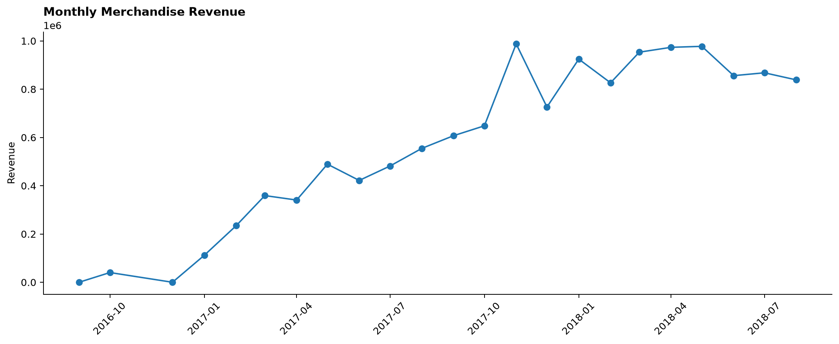
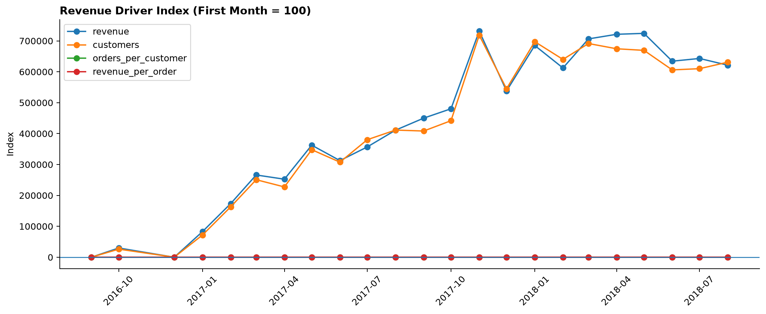
Revenue Growth Is Primarily Acquisition-Led
The strongest revenue month was driven by customer volume while purchase frequency remained structurally low.
Peak month
November 2017 reached 988k in merchandise revenue.
Interpretation
Revenue expansion should be separated into active-customer growth, order frequency and average order value. This prevents acquisition-led growth from being mistaken for stronger retention.
Management KPI
Track returning-customer revenue share alongside total revenue each month.
Olist Brazilian E-Commerce public dataset | Portfolio case
3

Slide 4
Cohort Retention Drops Immediately After First Purchase
Incomplete cohort months are censored rather than treated as zero retention.
5.0%
Censored-adjusted M1 retention
3.0%
Repeat purchase rate
What this means
Very few acquired customers convert into a second purchase. This is a retention and activation issue, not only an acquisition issue.
Action
Build first-to-second-purchase campaigns by category, purchase timing and customer value.
Olist Brazilian E-Commerce public dataset | Portfolio case
4

Slide 5
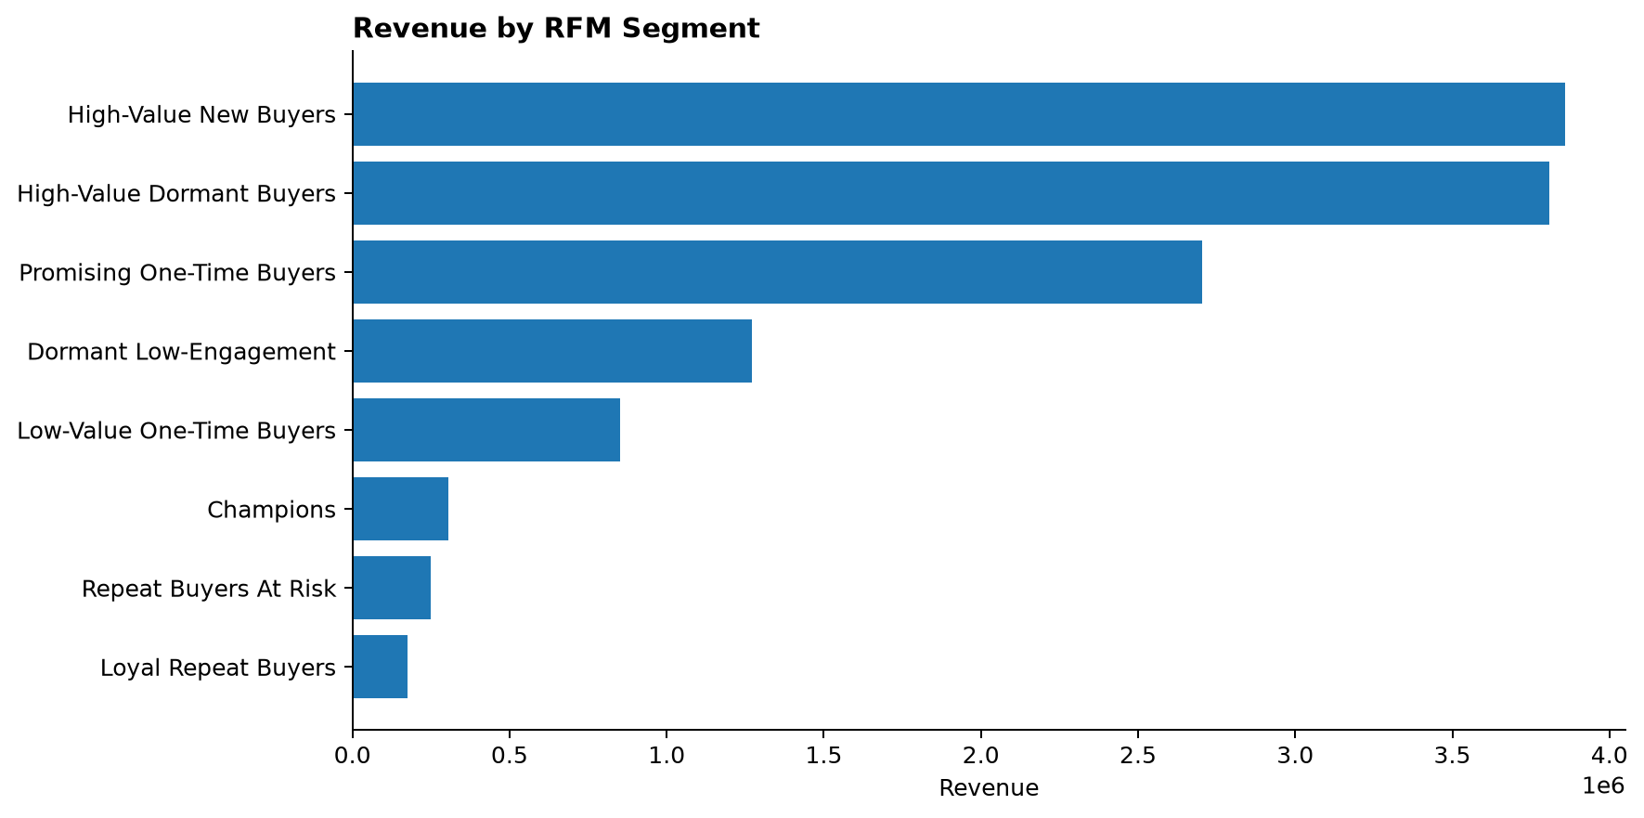
Customer Segmentation Separates Value from Frequency
Frequency scoring uses actual repeat behavior so one-time buyers are not automatically treated as mid-frequency customers.
High-Value New Buyers
Top revenue segment
29.2%
Share of customer revenue
Segmentation logic
One order = low frequency; two orders = mid frequency; three or more orders = high frequency.
Use case
Prioritize high-value new buyers and repeat buyers at risk before broad low-value reactivation.
Olist Brazilian E-Commerce public dataset | Portfolio case
5

Slide 6
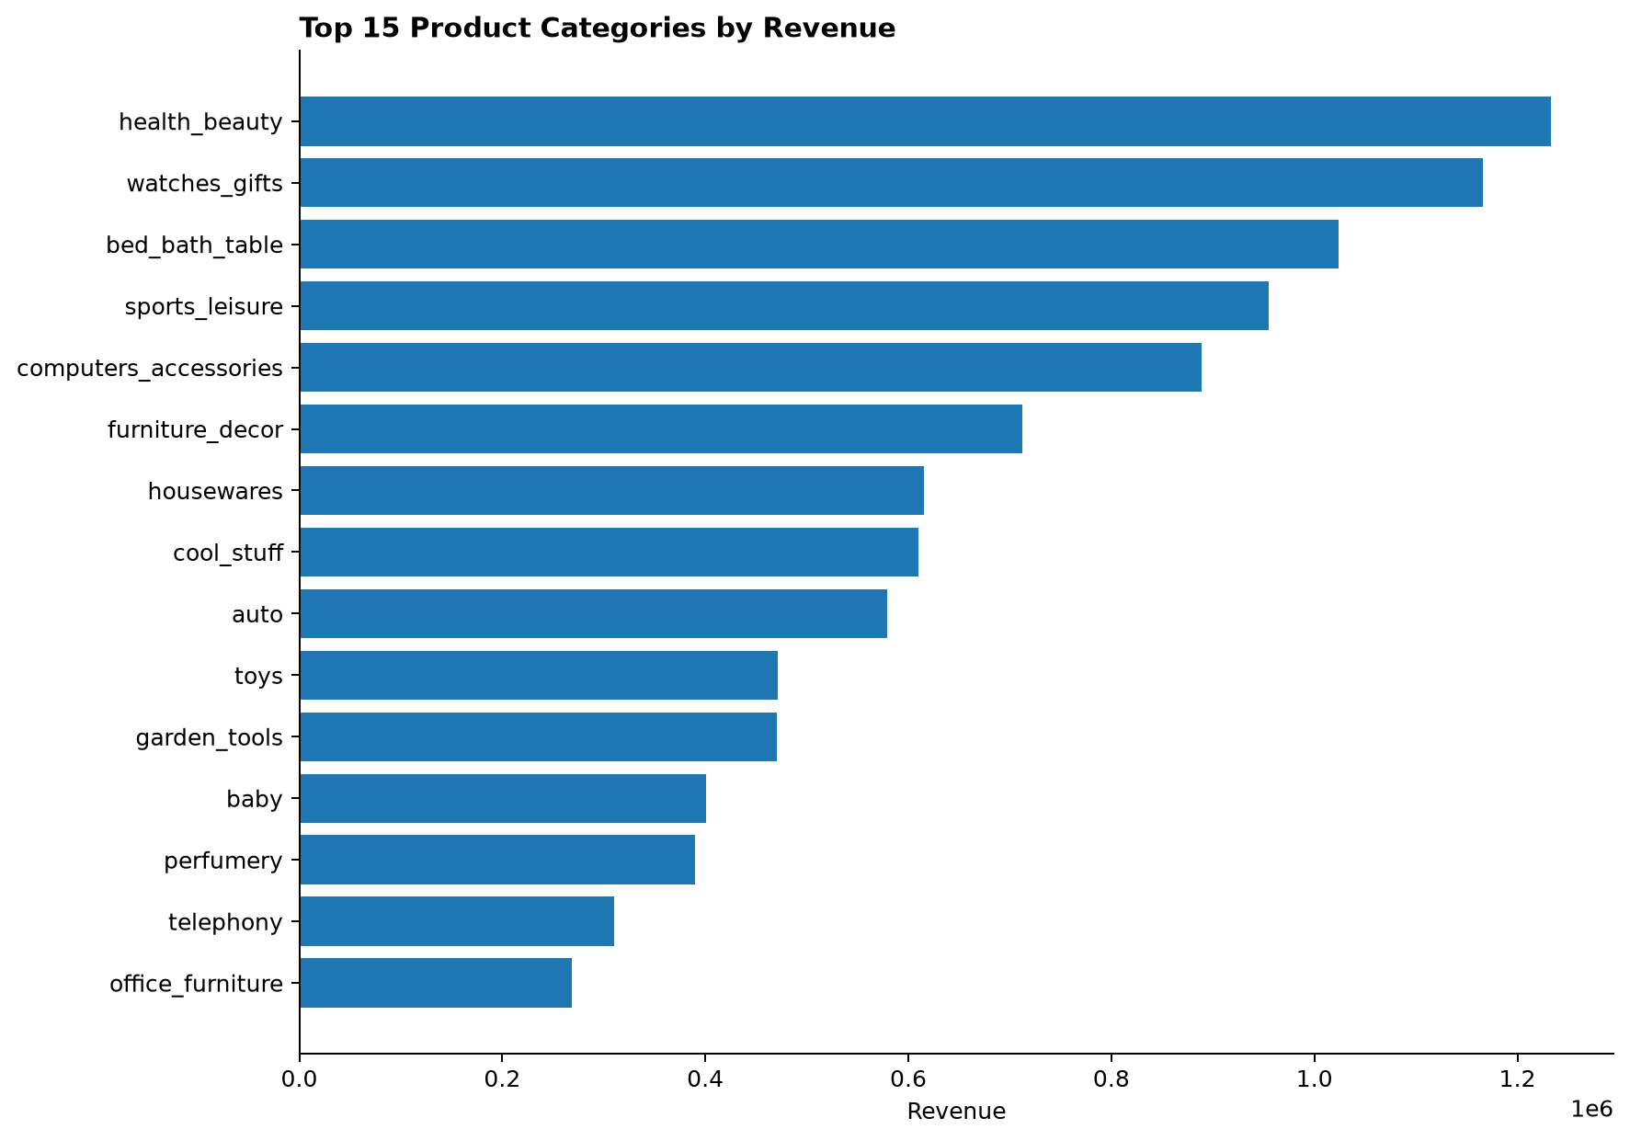
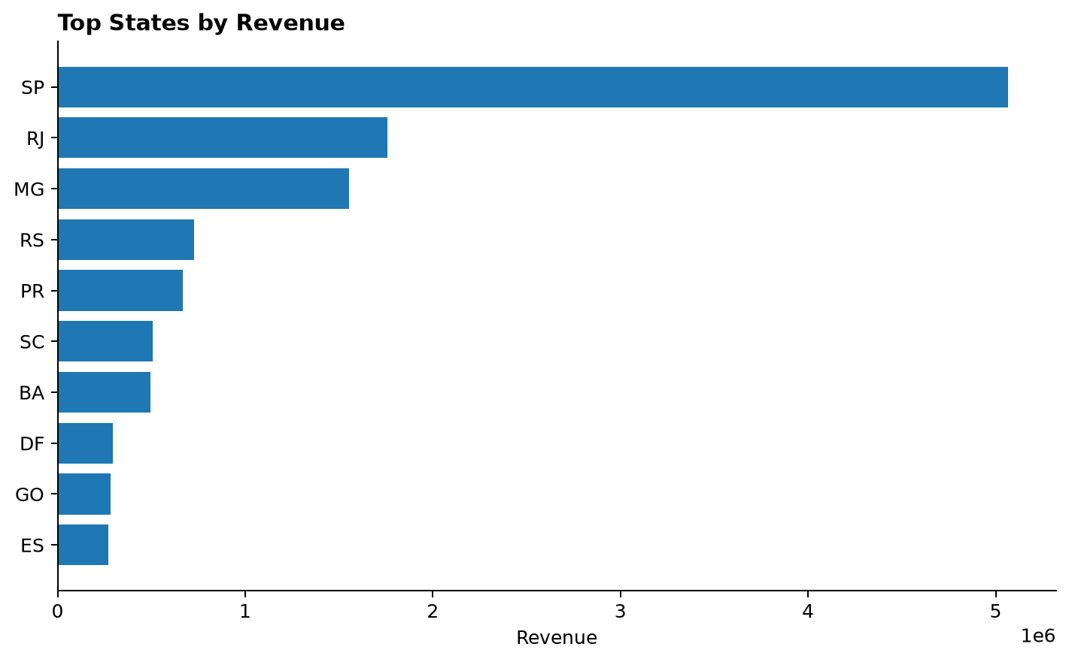
Category and Region Performance Identify Where to Prioritize
Revenue concentration and delivery performance vary materially by product category and geography.
Largest category
Largest state
health_beauty leads revenue with 1.2M.
SP leads revenue with 5.1M; late-delivery rate is 4.5%.
Olist Brazilian E-Commerce public dataset | Portfolio case
6

Slide 7
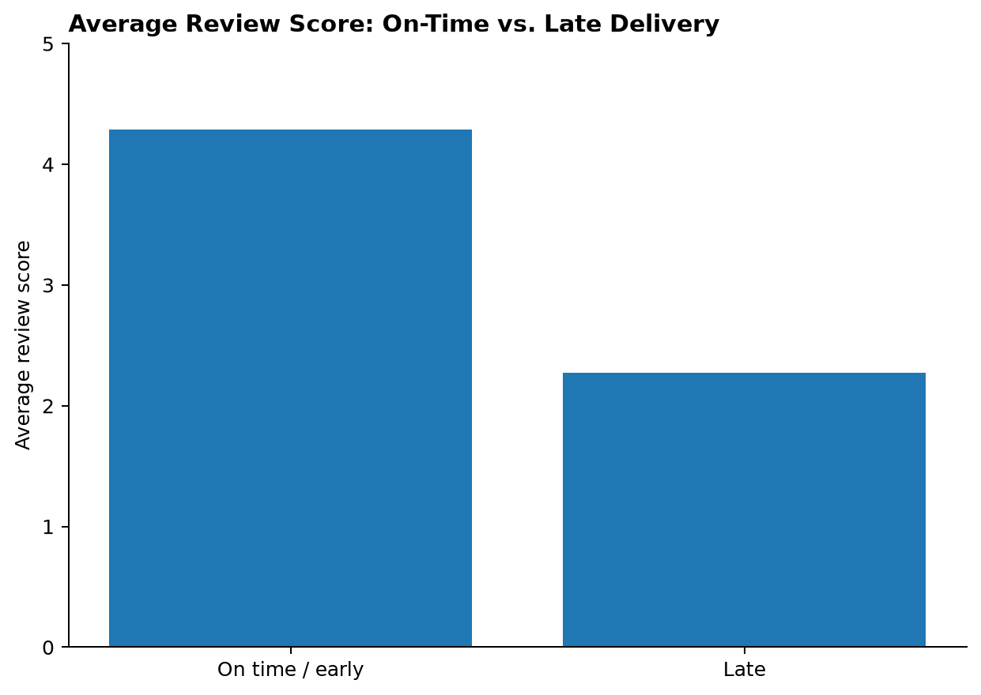
Late Delivery Is a Measurable Customer-Experience Risk
Operational delays correlate with a material drop in customer review scores.
4.29
2.27
On-time / early review score
Late-delivery review score
6.7%
Late-delivery rate
• Late orders should trigger proactive service recovery before the review is submitted.
• Regions with high revenue and high delay rates deserve separate operational review.
• Delivery reliability should be tracked as a retention lever, not only as a logistics metric.
Olist Brazilian E-Commerce public dataset | Portfolio case
7

Slide 8
Recommended Management Actions
The next step is a repeatable retention reporting process rather than another one-off analysis.
01
Prioritize first-to-second-purchase conversion after the initial order instead of relying only on continued acquisition.
Suggested recurring dashboard
Monthly revenue, active customers, repeat purchase rate, M1/M2 retention, returning-customer revenue share, RFM segment revenue and delivery/review impact.
02
Track M1/M2 cohort retention, repeat purchase rate and returning-customer revenue share as recurring management KPIs.
03
Target high-value new buyers and repeat buyers at risk before running broad reactivation campaigns.
Portfolio deliverables
Jupyter notebook, Excel management workbook, reusable analysis pipeline and client-ready presentation.
04
Investigate categories and regions with high acquisition volume but weak repeat purchasing.
05
Treat late delivery as a retention risk and trigger proactive service recovery for delayed orders.
Business value
Transaction data is translated into decisions about acquisition quality, retention priorities and operational risk.
Olist Brazilian E-Commerce public dataset | Portfolio case
8

