Slide 1
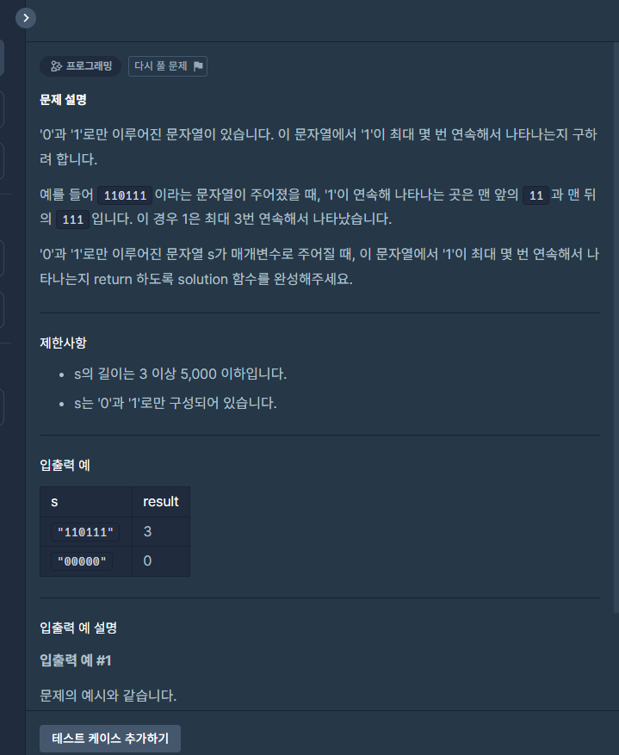
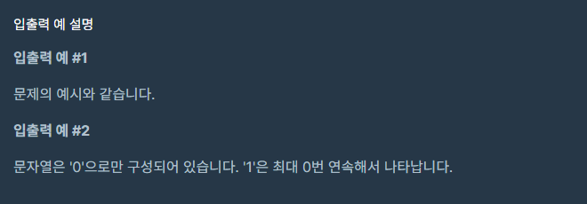
[로직] 문제1
코드 풀이
import java.util.ArrayList;
import java.util.Collections;
class Solution {
public int solution(String s) {
int answer = -1;
String[] arData = s.split("0");
ArrayList<Integer> lengths = new ArrayList<>();
if(arData.length == 0){
answer = 0;
}else{
for(String data : arData){
lengths.add(data.length());
}
Collections.sort(lengths);
answer = lengths.get(lengths.size() - 1);
}
return answer;
}
}

Slide 2
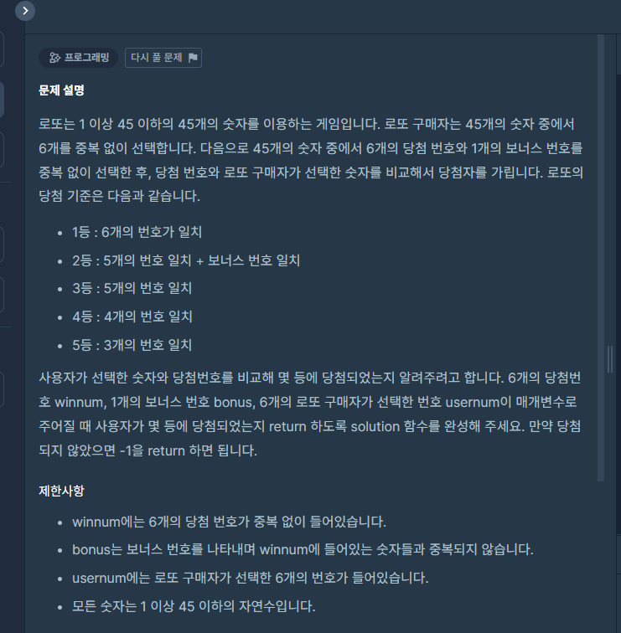
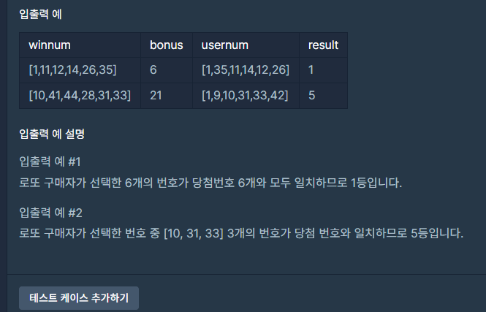
[로직] 문제2
코드 풀이
import java.util.HashSet;
import java.util.ArrayList;
class Solution {
public int solution(int[] winnum, int bonus, int[] usernum) {
int answer = 0;
int index = 0;
HashSet<Integer> winnumSet = new HashSet<>();
ArrayList<Integer> usernumList = new ArrayList<>();
for(int i=0; i<winnum.length; i++){
winnumSet.add(winnum[i]);
}
for(int i=0; i<usernum.length; i++, index++){
usernumList.add(usernum[i]);
if(winnumSet.contains(usernumList.get(index))){
usernumList.remove(index);
index--;
}
}
switch(usernumList.size()){
case 0:
answer = 1;
break;
case 1:
if(usernumList.get(0) == bonus){
answer = 2;
break;
}
answer = 3;
break;
case 2:
answer = 4;
break;
case 3:
answer = 5;
break;
default:
answer = -1;
break;
}
return answer;
}
}

Slide 3
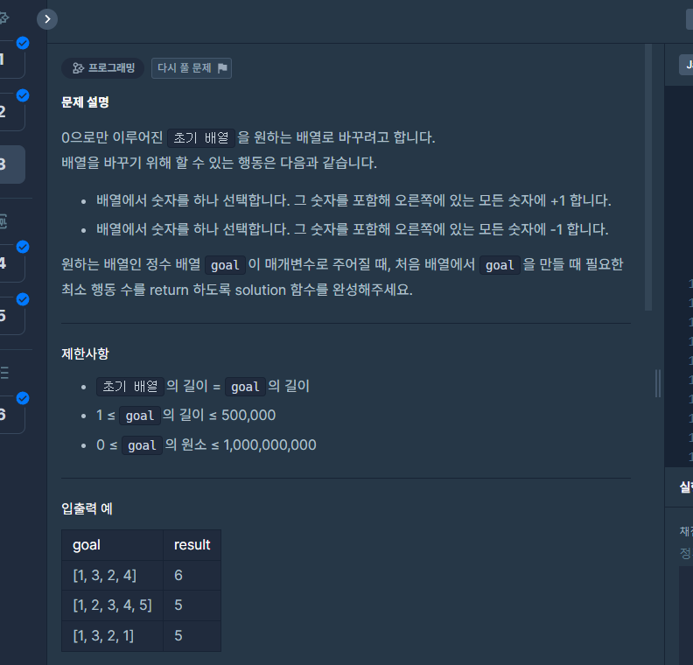
[로직] 문제3
코드 풀이

Slide 4
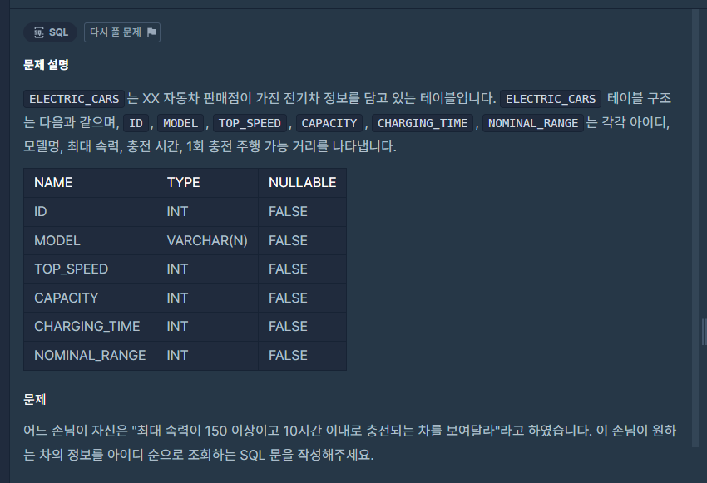
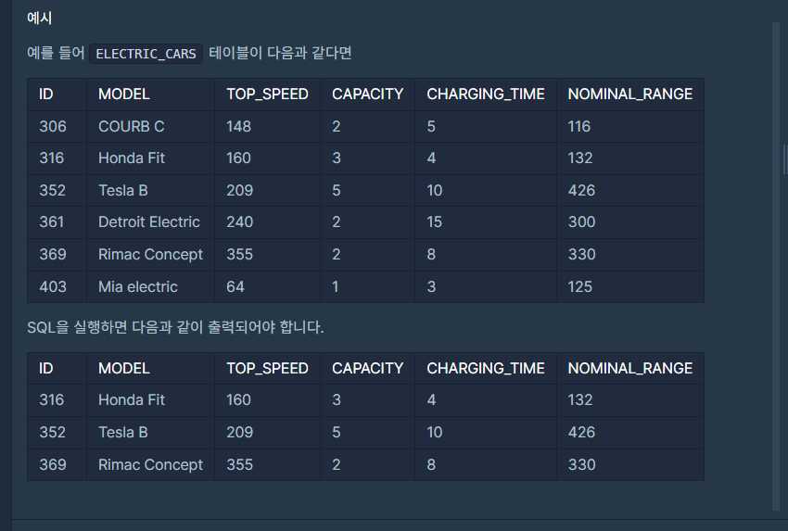
[SQL] 문제4
SQL 풀이
SELECT ID, MODEL, TOP_SPEED, CAPACITY, CHARGING_TIME, NOMINAL_RANGE
FROM ELECTRIC_CARS
WHERE TOP_SPEED >= 150 AND CHARGING_TIME <= 10
ORDER BY 1;

Slide 5
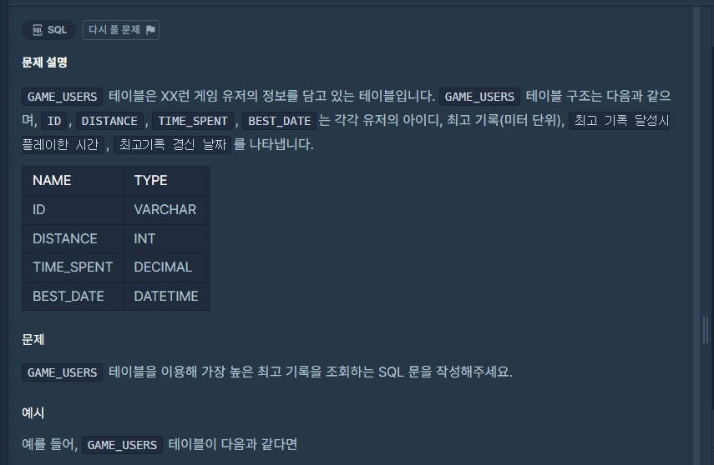
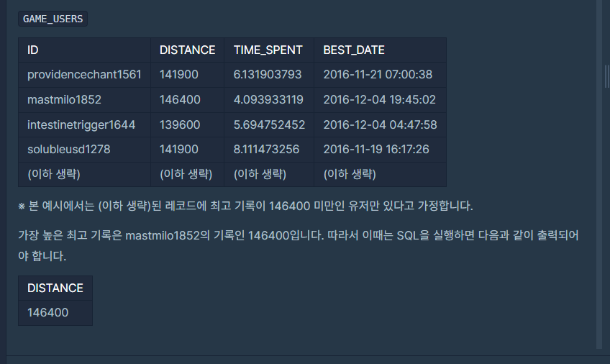
[SQL] 문제5
SQL 풀이
SELECT MAX(DISTANCE) DISTANCE FROM GAME_USERS;

Slide 6
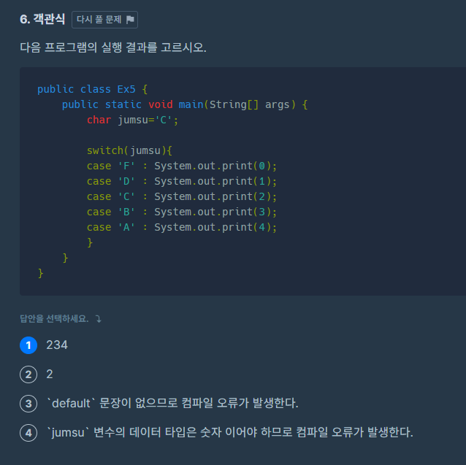
[객관식] 문제6

