Slide 1
Airline Satisfaction Analysis
Killariben Limbachiya

Slide 2
Business Problem
Factors Contributing to Customer Satisfaction:
Comfort: Passengers who find the seating and cabin environment comfortable are more likely to be satisfied.
Cleanliness: A clean cabin, bathrooms, and general flight environment significantly influence satisfaction.
Service Quality: Friendly and attentive staff, along with smooth boarding and in-flight service, contribute to positive experiences.
On-Time Performance: Flights that depart and arrive on time tend to have higher satisfaction rates.
Food Quality: Good quality meals and refreshments can enhance customer satisfaction.
Travel Class: Passengers in business or first class often report higher satisfaction levels due to more amenities and comfort.
Factors Contributing to Customer Dissatisfaction:
Delays: Significant delays in flight arrival or departure can lead to frustration and dissatisfaction.
Seat Comfort: Small or uncomfortable seats, especially in economy class, often lead to negative feedback.
Baggage Issues: Lost or delayed baggage can cause major dissatisfaction.
Poor Customer Service: Rude or unhelpful staff may result in complaints and dissatisfaction.
Flight Distance: Long flights may lead to discomfort, especially if the service or seat quality isn't up to expectations.

Slide 3
Data dictionary
Name | Mean | Mode | Median | Dispersion | Min | Max | Missing
ID | 64940.5 | 1 | 64940.5 | 0.58 | 1 | 129880 | 0 (0%)
Age | 39.43 | 39 | 40 | 0.38 | 7 | 85 | 0 (0%)
Flight Distance | 1190.32 | 337 | 844 | 0.84 | 31 | 4983 | 0 (0%)
Departure Delay | 14.71 | 0 | 0 | 2.59 | 0 | 1592 | 0 (0%)
Arrival Delay | 15.09 | 0 | 0 | 2.55 | 0 | 1584 | 0 (0%)
Departure and Arrival Time Convenience | 3.06 | 4 | 3 | 0.5 | 0 | 5 | 0 (0%)
Ease of Online Booking | 2.76 | 3 | 3 | 0.51 | 0 | 5 | 0 (0%)
Check-in Service | 3.31 | 4 | 3 | 0.38 | 0 | 5 | 0 (0%)
Online Boarding | 3.25 | 4 | 3 | 0.42 | 0 | 5 | 0 (0%)
Gate Location | 2.98 | 3 | 3 | 0.43 | 0 | 5 | 0 (0%)
On-board Service | 3.38 | 4 | 4 | 0.38 | 0 | 5 | 0 (0%)
Seat Comfort | 3.44 | 4 | 4 | 0.38 | 0 | 5 | 0 (0%)
Leg Room Service | 3.35 | 4 | 4 | 0.39 | 0 | 5 | 0 (0%)
Cleanliness | 3.29 | 4 | 3 | 0.4 | 0 | 5 | 0 (0%)
Food and Drink | 3.2 | 4 | 3 | 0.41 | 0 | 5 | 0 (0%)
In-flight Service | 3.64 | 4 | 4 | 0.32 | 0 | 5 | 0 (0%)
In-flight Wifi Service | 2.73 | 2 | 3 | 0.49 | 0 | 5 | 0 (0%)
In-flight Entertainment | 3.36 | 4 | 4 | 0.4 | 0 | 5 | 0 (0%)
Baggage Handling | 3.63 | 4 | 4 | 0.32 | 1 | 5 | 0 (0%)
Gender | Female |  |  |  |  |  | 0 (0%)
Customer Type | Returning |  |  |  |  |  | 0 (0%)
Type of Travel | Business |  |  |  |  |  | 0 (0%)
Class | Business |  |  |  |  |  | 0 (0%)
Satisfaction | Neutral or Dissatisfied |  |  |  |  |  | 0 (0%)
Features | Type
ID | Numerical
Age | Numerical
Flight Distance | Numerical
Departure Delay | Numerical
Arrival Delay | Numerical
Departure and Arrival Time Convenience | Numerical
Ease of Online Booking | Numerical
Check-in Service | Numerical
Online Boarding | Numerical
Gate Location | Numerical
On-board Service | Numerical
Seat Comfort | Numerical
Leg Room Service | Numerical
Cleanliness | Numerical
Food and Drink | Numerical
In-flight Service | Numerical
In-flight Wifi Service | Numerical
In-flight Entertainment | Numerical
Baggage Handling | Numerical
Gender | Categorical
Customer Type | Categorical
Type of Travel | Categorical
Class | Categorical
Satisfaction | Categorical

Slide 4
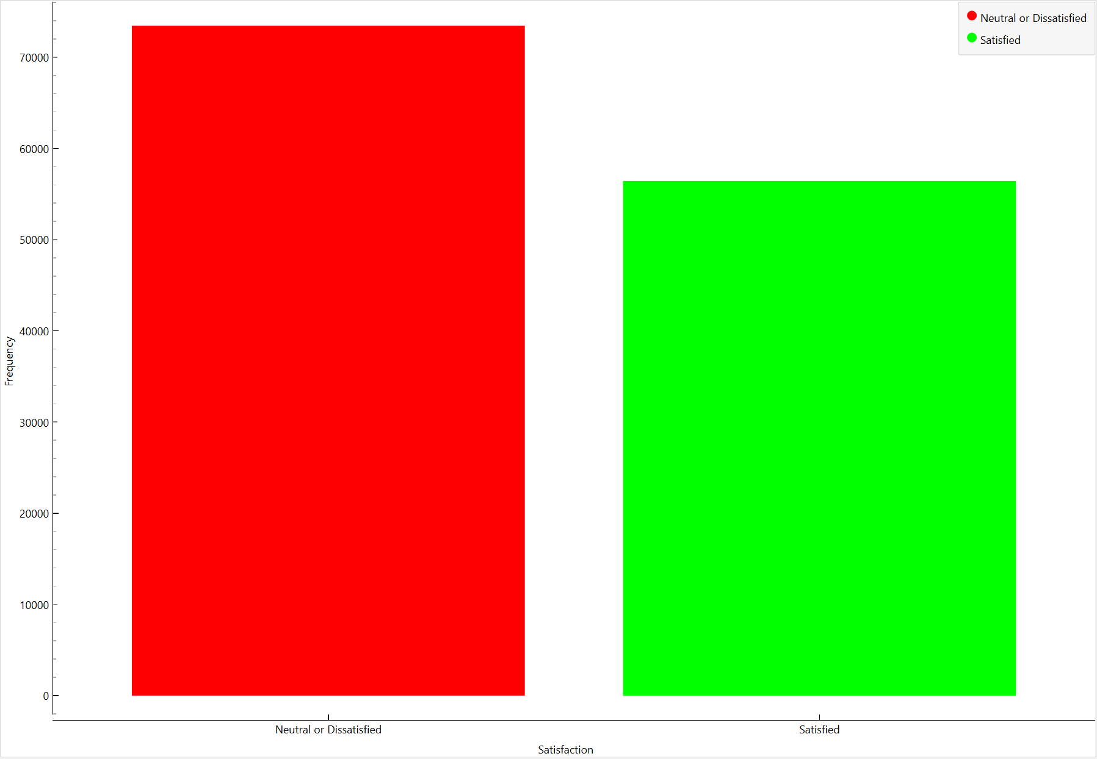
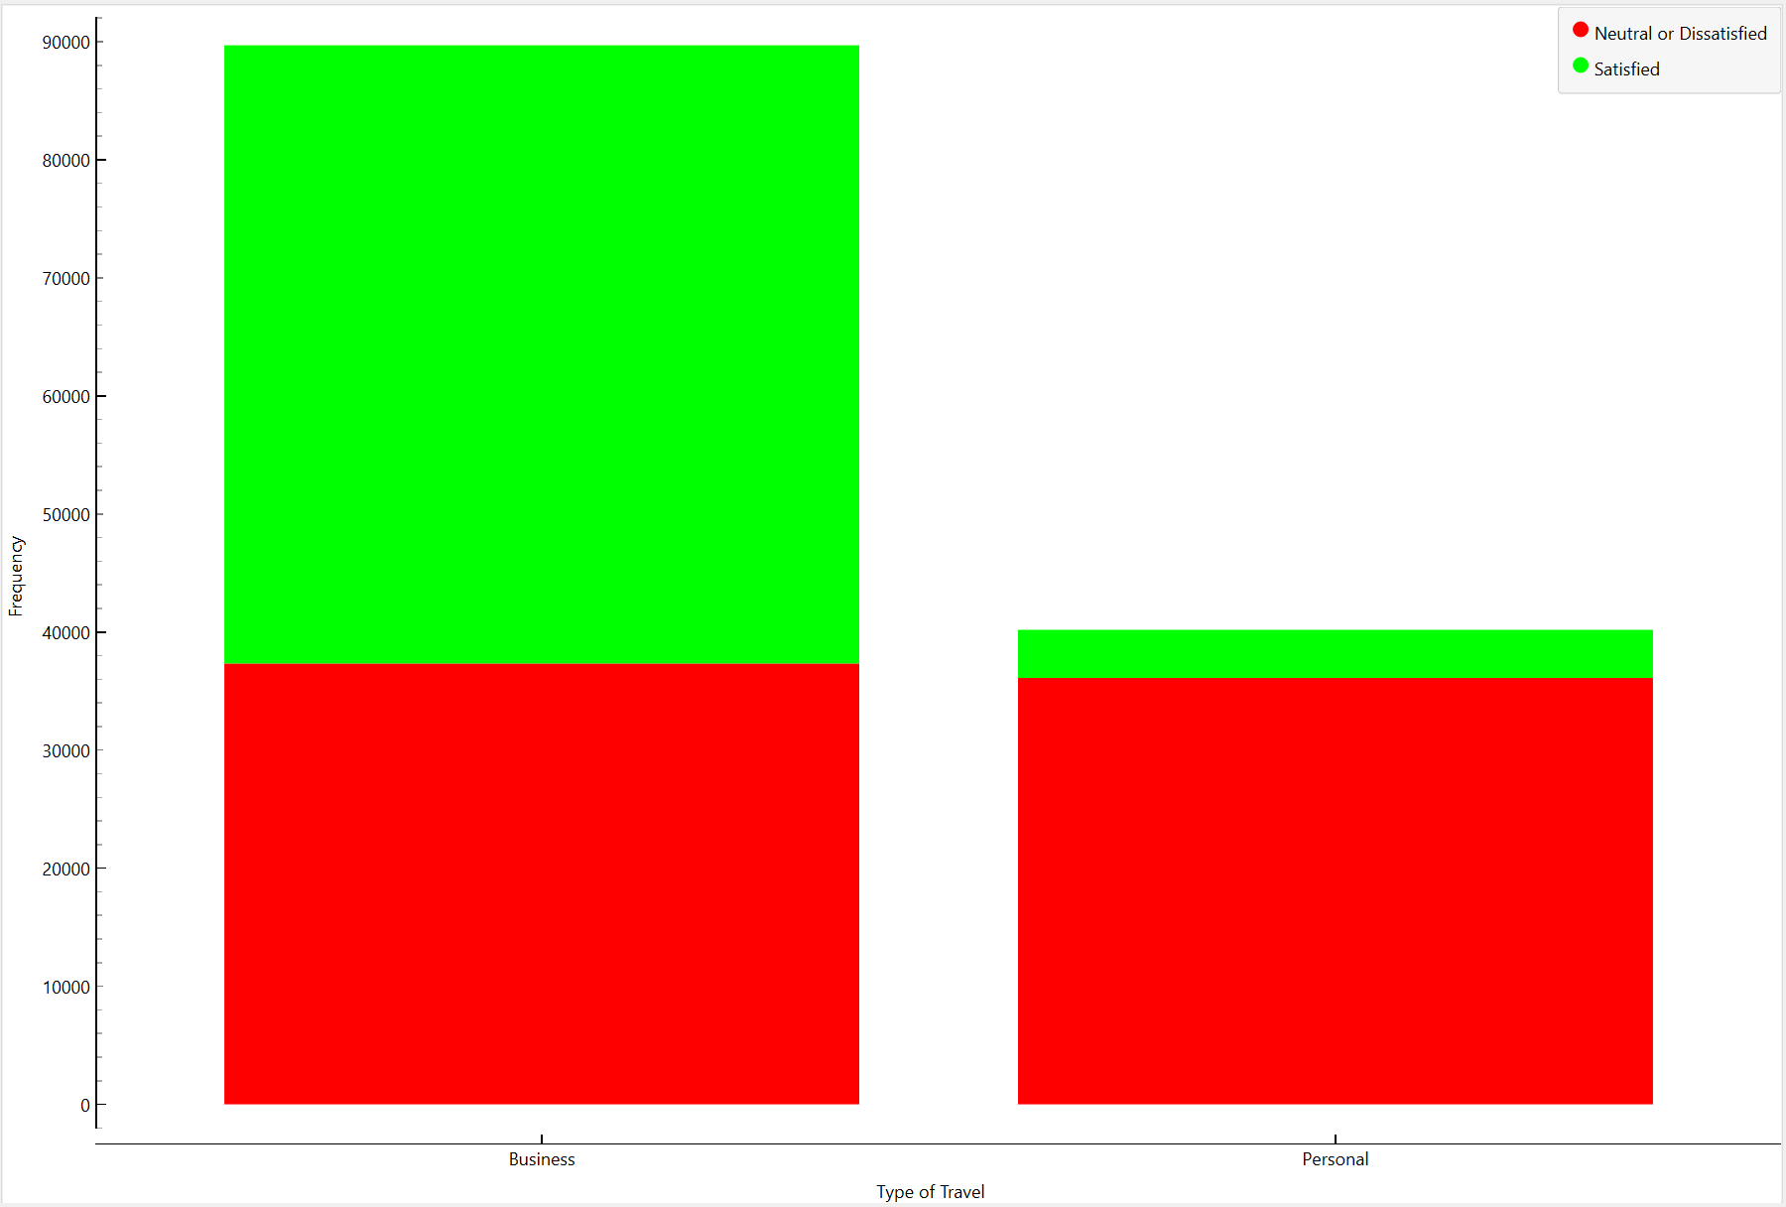
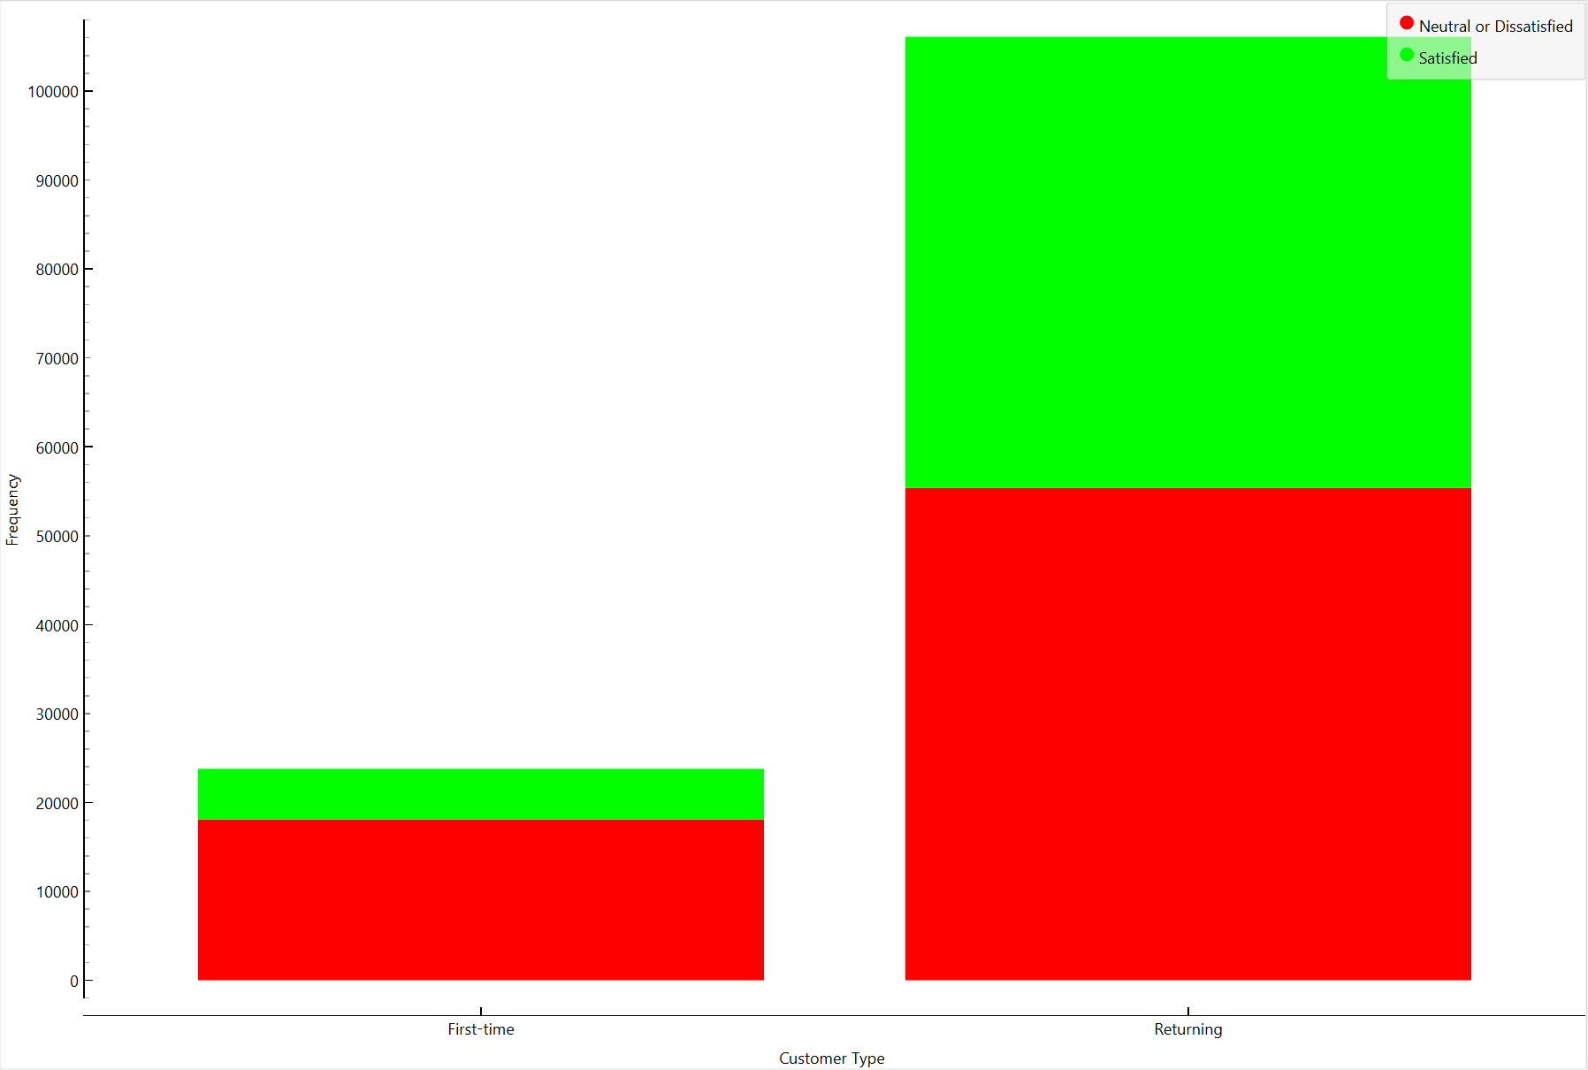
3. Which percentage of airline passengers are satisfied? Does it vary by customer type? What about the kind of travel?
Percentage of airline passengers are satisfied:
43.45 % of customers are satisfied with the airline.
56.55 % of customers are neutral or dissatisfied with the airline.
The number of satisfied customers is lower compared to neutral or dissatisfied customers.
This shows that less than half of the passengers had a positive experience.
Satisfaction by Travel Type:
58.37 % of business travelers are satisfied.
10.13 % of personal travelers are satisfied.
Business travelers are more satisfied compared to personal travelers.
This may be because business travelers use higher-class services (business/first class) with better seating, food, and priority service.
Satisfaction by Customer Type:
47.81 % of returning customers are satisfied.
23.97 % of first-time customers are satisfied.
Returning customers have a higher satisfaction rate compared to first-time passengers.
This means frequent travelers trust the airline more, possibly due to better loyalty benefits or service experience over time.

Slide 5
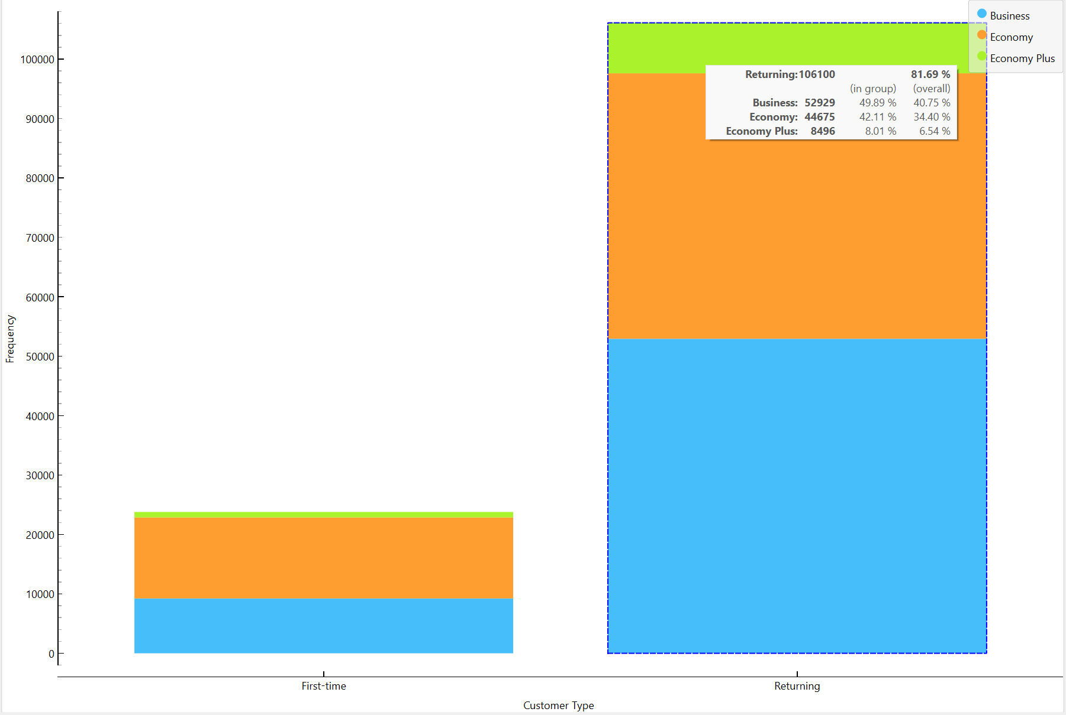
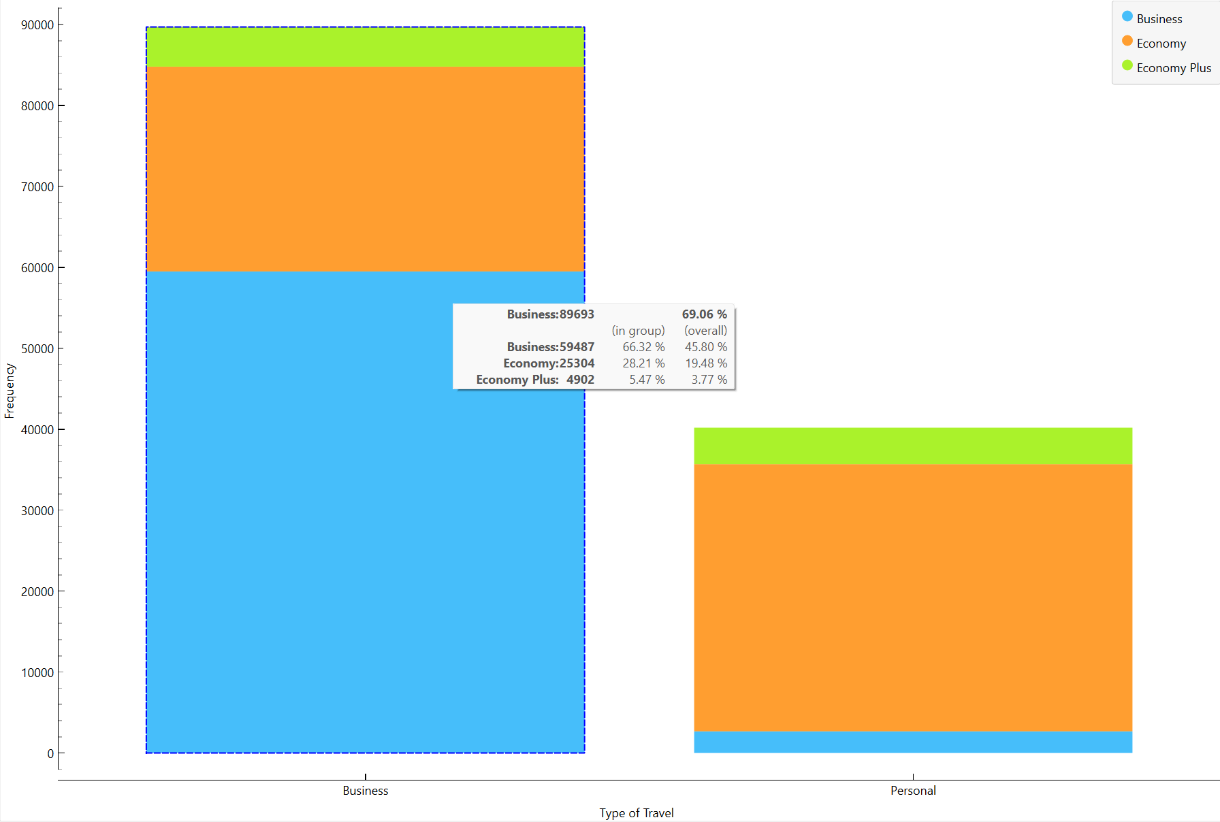
4. What is the customer profile for a repeating airline passenger?
Customer profile for a repeating airline passenger:
Older people (41+ years) are more likely to be repeat customers.
Slightly more females (50.74%) than males are returning passengers.
Most returning passengers prefer Business Class (49.89%) over Economy (42.11%) and Economy Plus (8.01%).
Returning passengers prefer Business Class for comfort.
Business travelers are more loyal to an airline than personal travelers.
Satisfaction is better among returning customers, but there is still room for improvement.

Slide 6
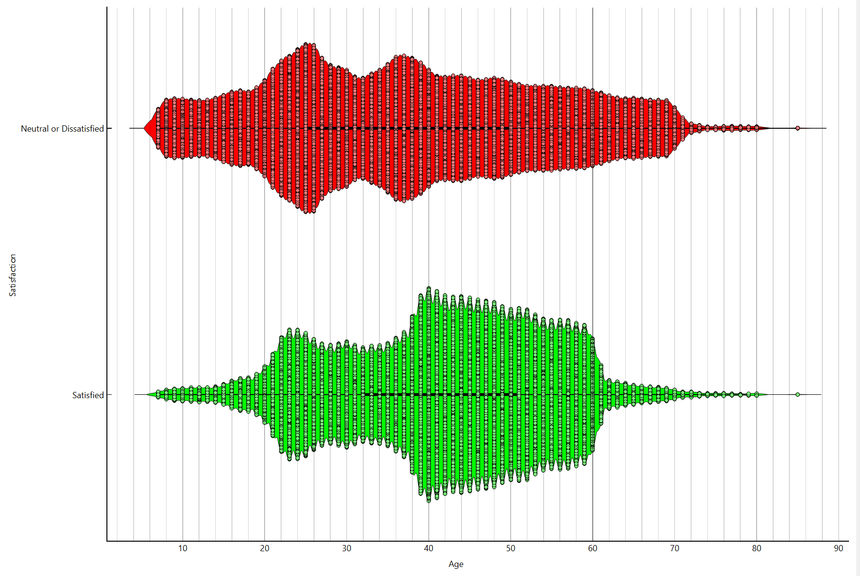
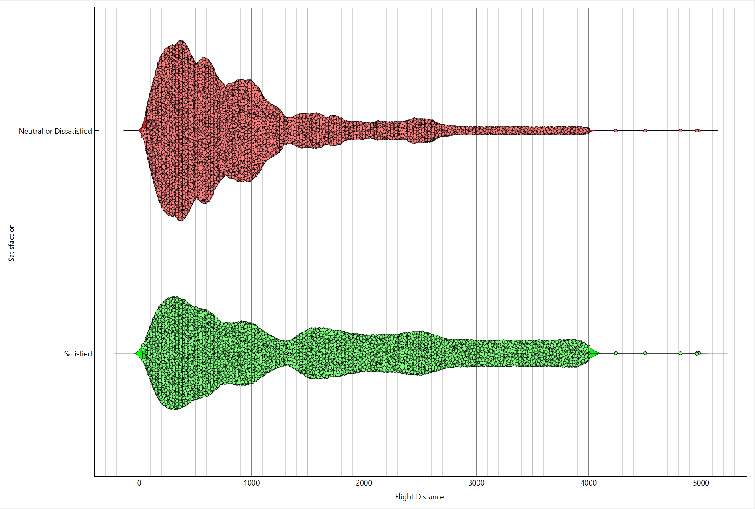
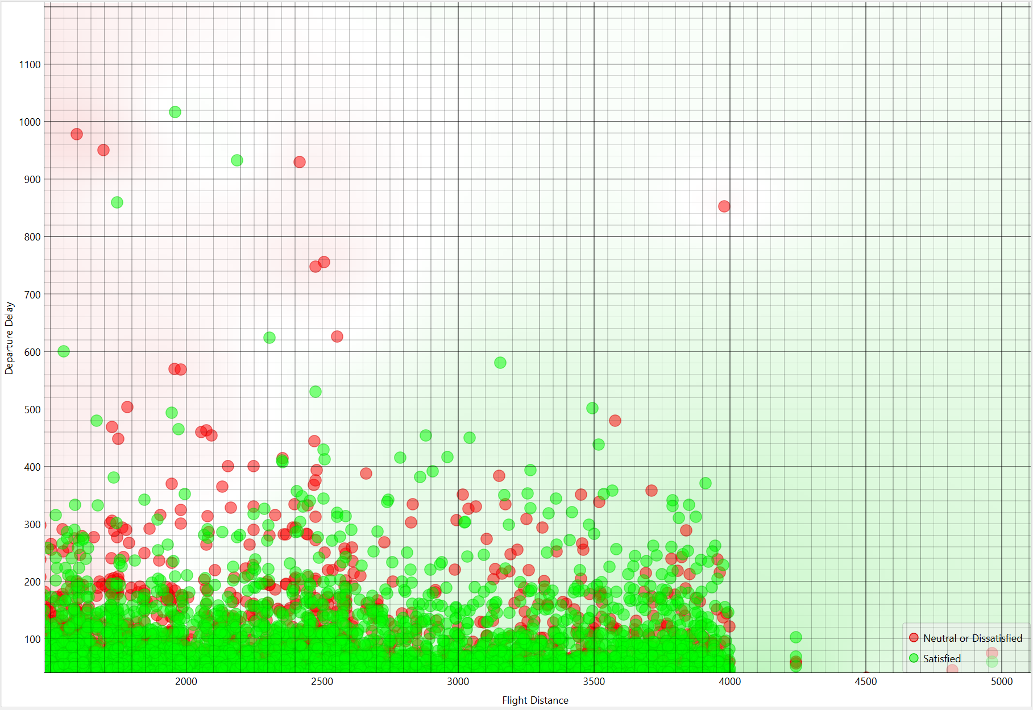

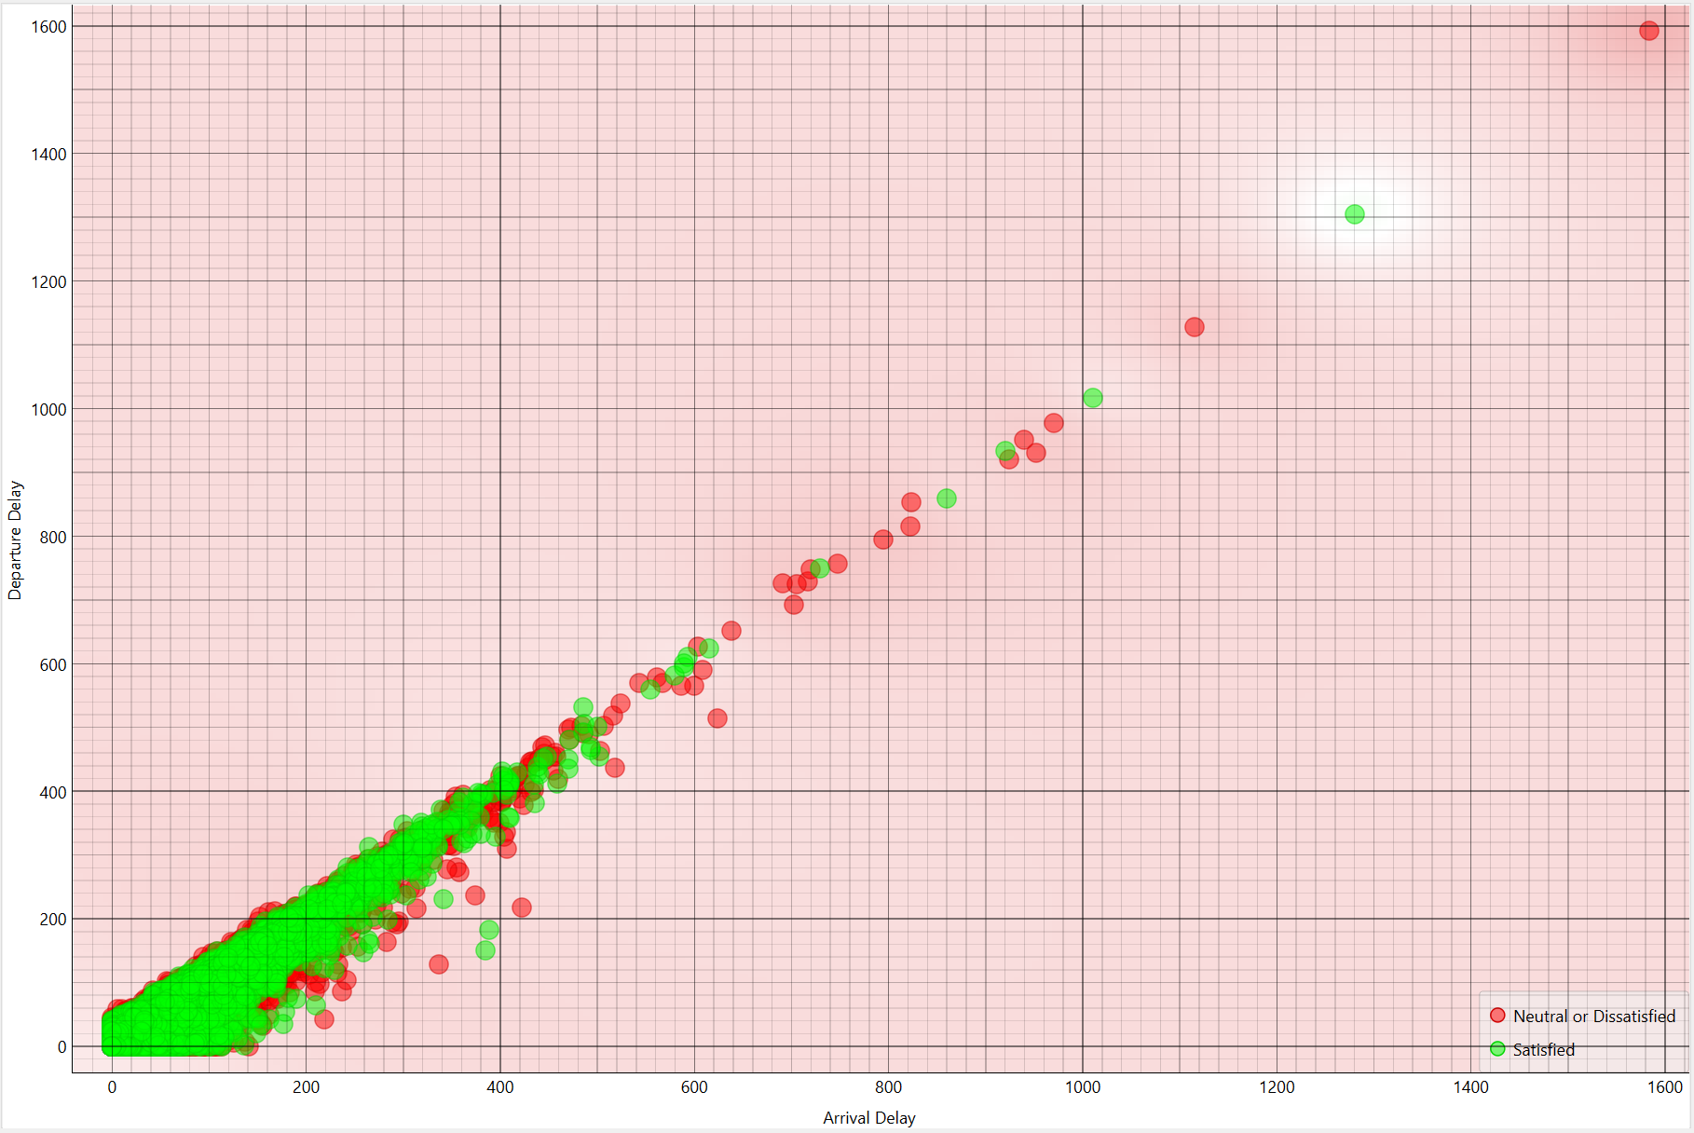
5. Does flight distance affect customer preferences or flight patterns?
Observations on Flight Distance and Customer Preferences:-
Passengers on longer flights (above 2000 km) have a higher satisfaction rate.
This may be because long flights offer better seating, meals, and in-flight services.
Passengers on short flights (below 1000 km) tend to be less satisfied.
This could be due to limited services, delays, or less comfortable seating.
Business travelers have an average flight distance of 1368 km, which is longer than personal travelers (792 km).
This suggests that business travelers prefer airlines that provide long-distance travel services.
Flights with longer delays (arrival or departure) have more dissatisfied passengers.
Many delays happen on longer flights, but they still have higher satisfaction, meaning good service can balance out delay issues.

Slide 7
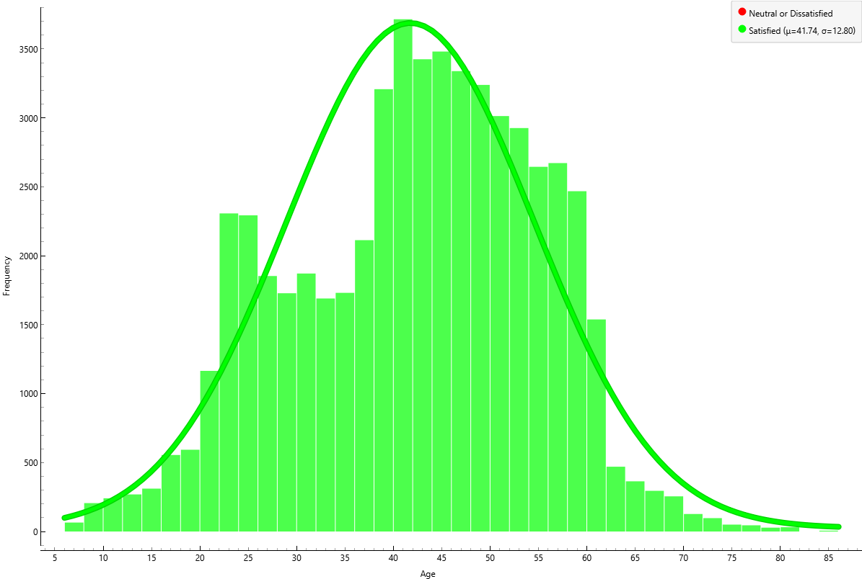
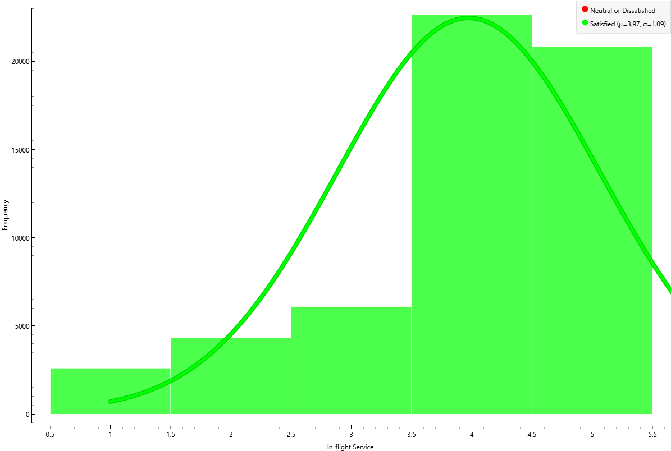
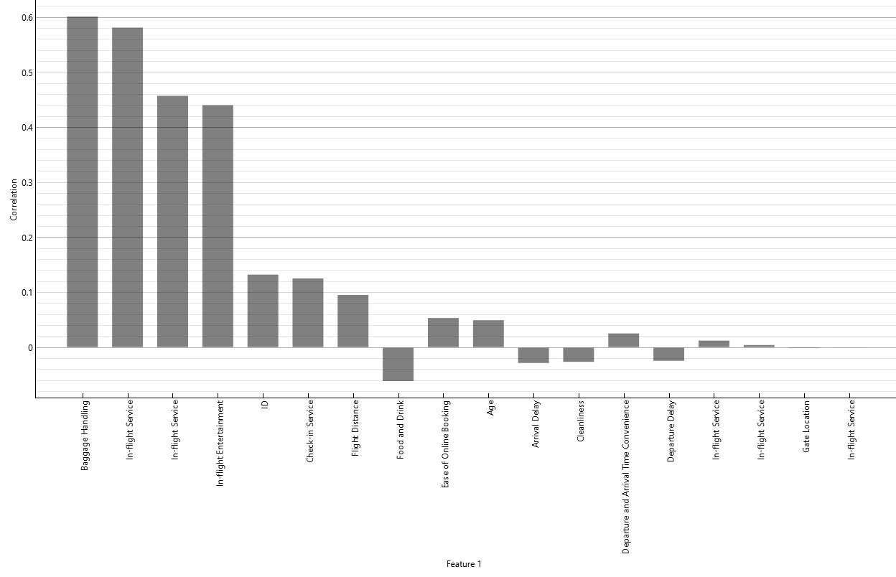
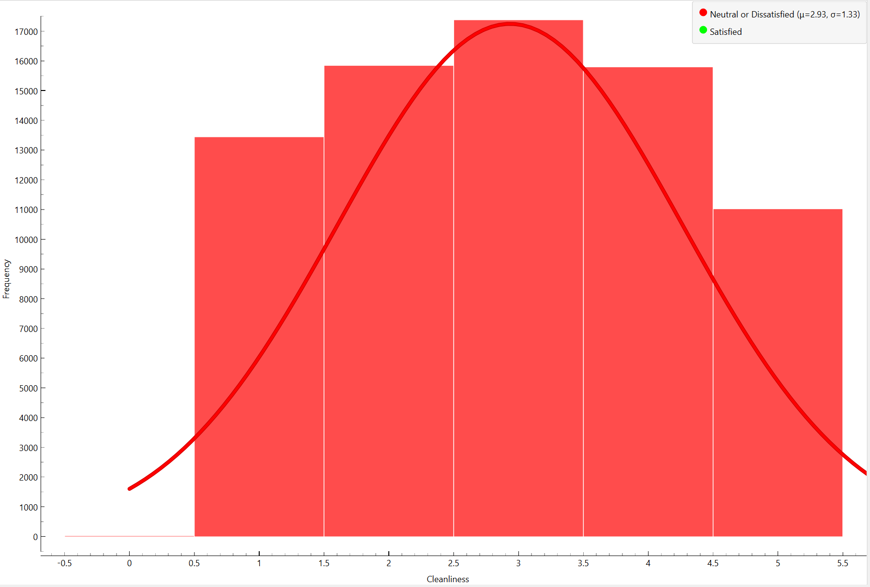
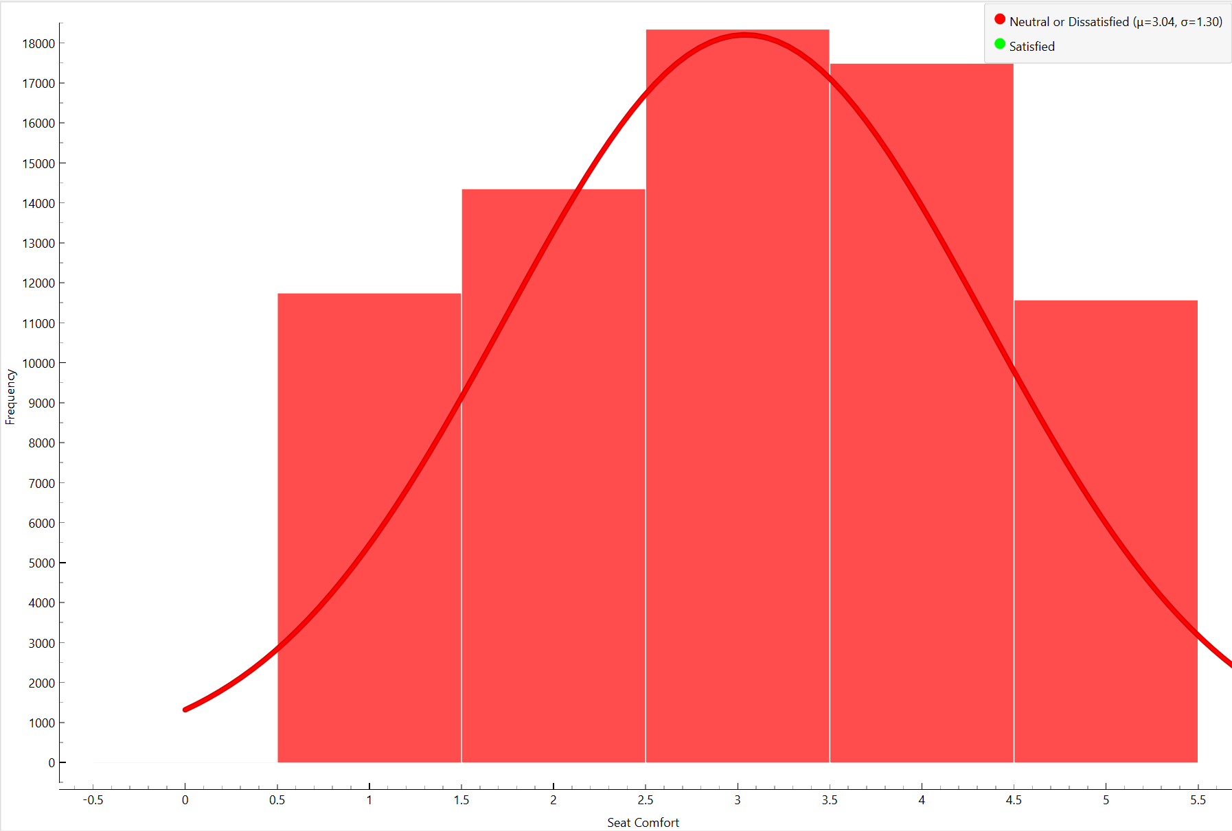
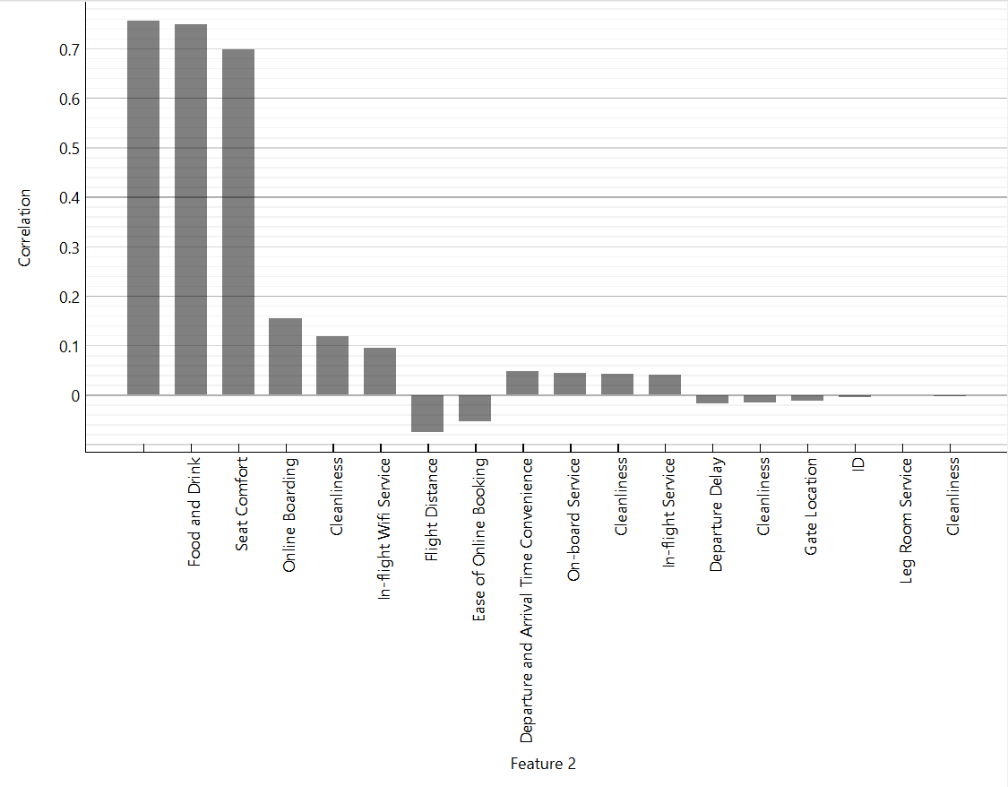
6. Which factors contribute to customer satisfaction the most? What about dissatisfaction?
Key factors contributing to customer satisfaction:
Baggage Handling & In-Flight Service are the most important factors affecting satisfaction.
In-Flight Entertainment also plays a strong role.
Check-in service and food quality have a moderate impact.
Delays (arrival & departure) and cleanliness have a smaller effect.
Most satisfied customers are around 40-45 years old.
Higher ratings for in-flight services (like food, entertainment, and comfort) strongly correlate with satisfaction.
Factors Contributing to Customer Dissatisfaction:
Food and Drink plus Cleanliness are the most important factors affecting customer dissatisfaction.
In-Flight Entertainment and Seat comfort also play a strong role.
Check-in and online onboarding services have a moderate impact.
Many dissatisfied passengers rated seat comfort and cleanliness low (around 3 or below).
Departure and arrival delays contribute to dissatisfaction.

Slide 8
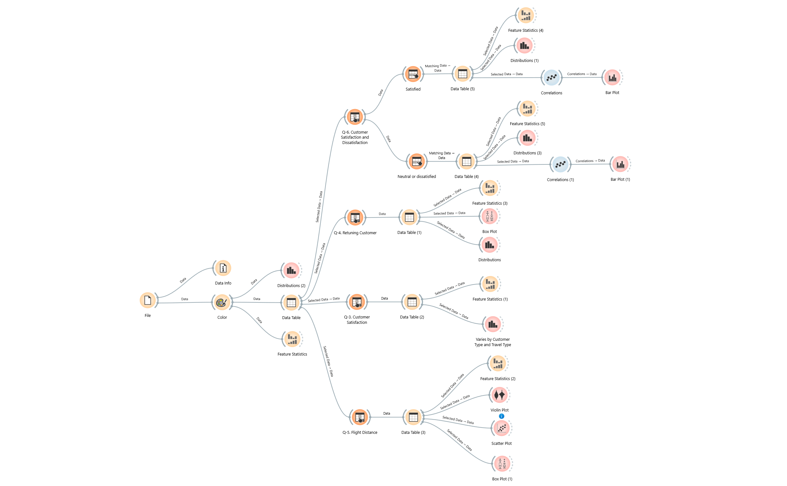
Orange Workflow

Slide 9
Final Observations
More passengers are neutral or dissatisfied compared to satisfied ones.
This shows that airlines need to improve their services to make more passengers happy.
Younger customers are more likely to be first-time customers, whereas customers between 40-45 are mostly returning customers and business travelers due to traveling for work purposes.
Business travelers are more likely to be repeat customers than personal travelers.
Long flights (above 2000 km) have higher satisfaction rates.
Short flights (below 1000 km) have more dissatisfied passengers, likely due to limited services.
Long delays negatively impact customer experience, even for those in premium classes.

