Slide 1
FEATURE SELECTION

Slide 2
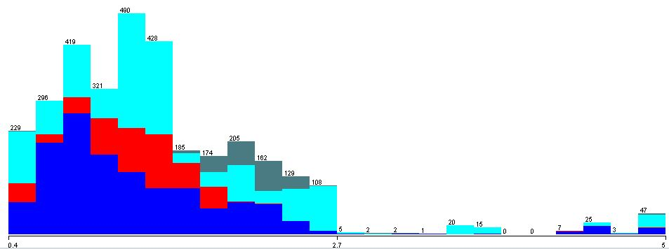
Data
Training set n = 3273

Slide 3
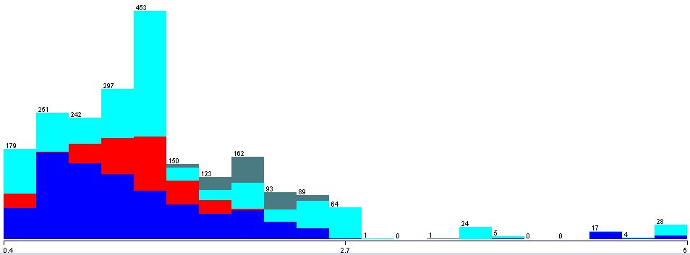
Data
Test set n = 2183

Slide 4
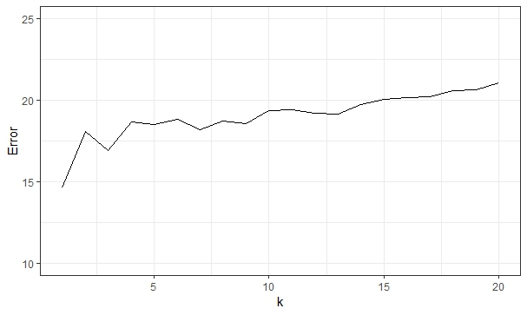
KNN on full training set
Cross validation
K = 1; Incorrectly Classified Instances: 14.6%

Slide 5
KNN on full test set
Correctly Classified Instances 1885 86.3491 %
Incorrectly Classified Instances 298 13.6509 %
Total Number of Instances 2183
a | b | c | d | Classified as
836 | 15 | 12 | 6 | a = Move-Forward
18 | 306 | 1 | 0 | b = Slight-Right-Turn
15 | 3 | 838 | 1 | c = Sharp-Right-Turn
3 | 0 | 6 | 123 | d = Slight-Left-Turn

Slide 6
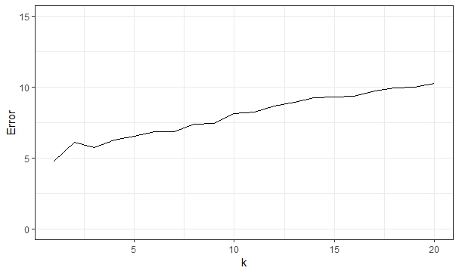
GreedyStepwise Forward/Backward
Forward: US12, US15, US19, US20
Backward: US01, US15, US19, US20

Slide 7
GreedyStepwise Forward/Backward
Correctly Classified Instances 2103 96.3353 %
Incorrectly Classified Instances 80 3.6647 %
Total Number of Instances 2183
a | b | c | d | Classified as
836 | 15 | 12 | 6 | a = Move-Forward
18 | 306 | 1 | 0 | b = Slight-Right-Turn
15 | 3 | 838 | 1 | c = Sharp-Right-Turn
3 | 0 | 6 | 123 | d = Slight-Left-Turn

Slide 8
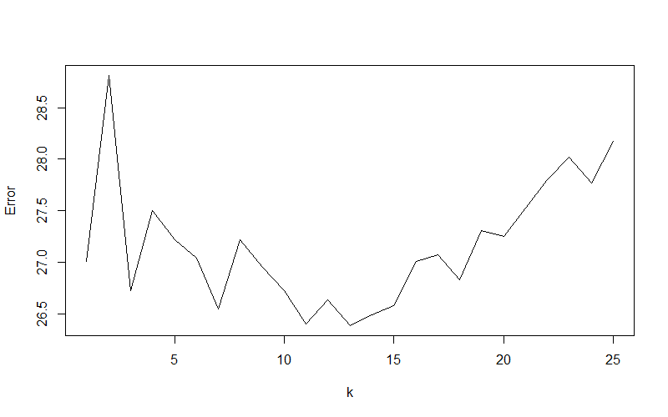
Linear Discriminant Analysis
Reduction to subspace with c-1 = 3 dimensions

Slide 9
Linear Discriminant Analysis
Correctly Classified Instances 1546 70.82 %
Incorrectly Classified Instances 637 29.18 %
Total Number of Instances 2183
a | b | c | d | Classified as
661 | 50 | 137 | 21 | a = Move-Forward
116 | 148 | 58 | 3 | b = Slight-Right-Turn
148 | 41 | 648 | 20 | c = Sharp-Right-Turn
21 | 2 | 20 | 83 | d = Slight-Left-Turn

Slide 10
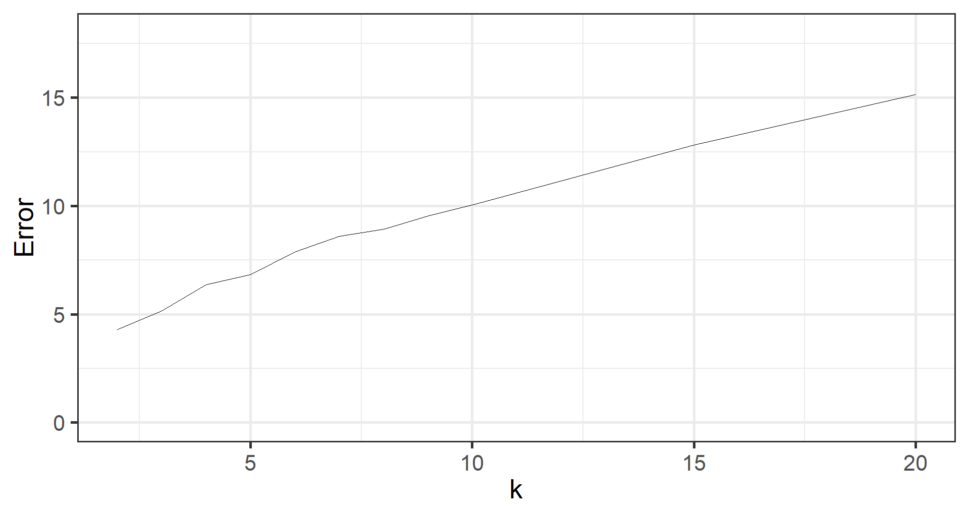
Correlation Feature Selection
Selected attributes: US13, US14, US15, US23, US24

Slide 11
Correlation Feature Selection
Correctly Classified Instances 2074 95.01 %
Incorrectly Classified Instances 109 4.99 %
Total Number of Instances 2183
a | b | c | d | Classified as
825 | 15 | 14 | 15 | a = Move-Forward
23 | 298 | 2 | 2 | b = Slight-Right-Turn
14 | 1 | 840 | 2 | c = Sharp-Right-Turn
15 | 2 | 4 | 111 | d = Slight-Left-Turn

Slide 12
Randomized Feature Selection
Configuration of feature selection
  5 features, Seed: 8
Selected features:
  US01, US05, US06, US11, US17
K = 10

Slide 13
Randomized Feature Selection
Correctly Classified Instances 4394 80.53 %
Incorrectly Classified Instances 1062 19.46 %
Total Number of Instances 5456
a | b | c | d | Classified as
1905 | 101 | 153 | 46 | a = Move-Forward
144 | 614 | 68 | 0 | b = Slight-Right-Turn
371 | 87 | 1623 | 16 | c = Sharp-Right-Turn
47 | 4 | 25 | 253 | d = Slight-Left-Turn

