Slide 1
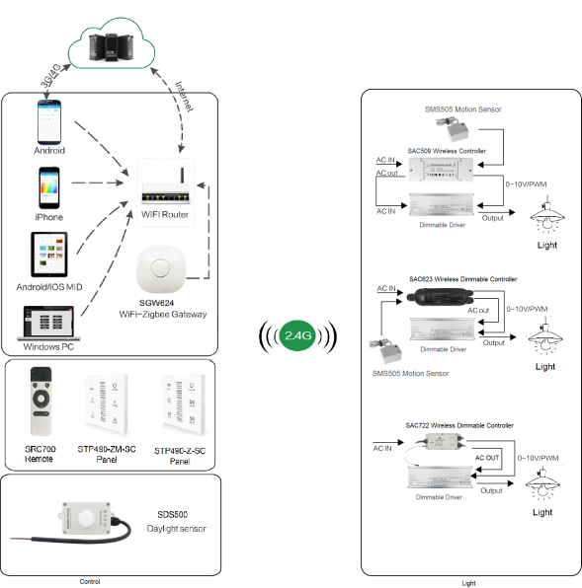
System Diagram

Slide 2
Features
Based on HA1.2 standard protocol
Built-in ZigBee 2.4G wireless transceiver module
Supports large number of 2,500 devices connection.
Able to achieve short & long distance controlling LED lights by
multi solutions
Work with 1-10V or 0-10V dimming drivers, daylight sensor
and motion sensor
Built-in lighting protector, 6KV
Support Over-the-Air upgrade
Power metering

Slide 3
Parameter
Parameters | SAC722-SC-BS-EAR-OTA
Input Power/ Voltage | AC 100-277Vac 50/60Hz 1-10V
0-10V Max Current | 15mA Max
Relay Max Current | 10A Max
PF | > 0.4 (MAX Load)
Frequency | 2.4GHz
Control Distance | 20-30m
Operation Temperature | -40°C to 85°C
Waterproof | IP67
Wire Rod Diameter | D=9mm
SAC722-PM-XX-BEA-OTA
Parameters | SAC722-PM-1C-BEA-OTA | SAC722-PM-2C-BEA-OTA | SAC722-PM-3C-BEA-OTA
Input Power/ Voltage | AC 100-277Vac 50/60Hz 1-10V
0-10V Max Current | 15mA Max
Channel | 1 | 2 | 3
Relay Max Current | 16A | 10A&5A | 10A&5A&5A
Frequency | 2.4GHz
Control Dist. | 100m
Operation Temp. | -40°C to 85°C
Waterproof | IP67
Wire Rod Diameter | D=9mm

Slide 4
Installation
For installation details, please contact us for spec. for your ref.

