Slide 1
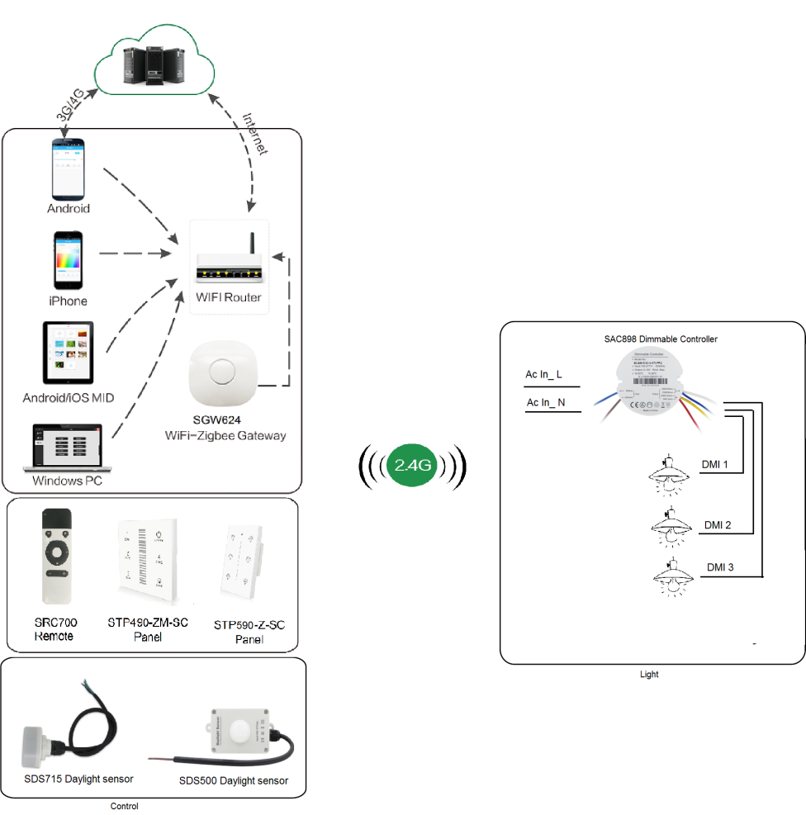
System Diagram

Slide 2
Features
Based on HA1.2 standard protocol
Built-in ZigBee 2.4G wireless transceiver module
Supports large number of 2,500 devices connection.
3 channels 0-10V dimming signal output
Able to achieve short & long distance controlling LED lights
by multi solutions
Work with 0-10V dimming drivers. Work with daylight sensor
and motion sensor
Support Over-the-Air upgrade

Slide 3
Parameter
Parameter | SAC898-3C-IA-OTA | SAC898-3C-EA-OTA
Input Voltage | 100~277Vac 50/60Hz
Output Voltage | Three channels 0-10V | Three channels 0-10V
Input Current | 15mA Max / channel
Frequency | 2.4 GHz
Control Distance | 20-30m
Waterproof | IP20
Operation Temperature | -40℃ ~ +80℃
OTA Upgrade | Yes

Slide 4
Installation
For installation details, please contact us for spec. for your ref.

