Slide 1
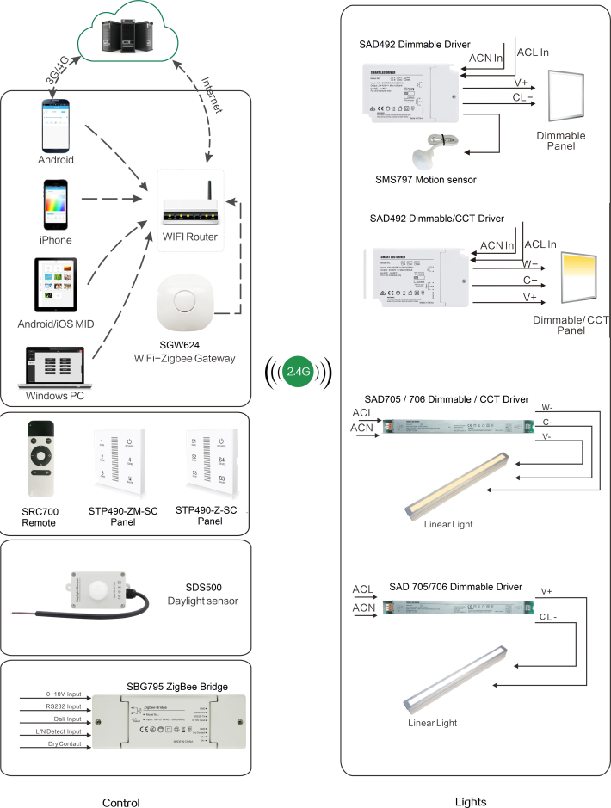
System Diagram

Slide 2
Features
Based on HA1.2 standard protocol
Built-in ZigBee 2.4G wireless transceiver module
Supports large number of 2,500 devices connection
Able to achieve short and long distance controlling LED
lights by multi solutions
Monochromatic, bicolor, built-in antenna, external
antenna are optional.
Work with motion sensor, daylight sensor.
Power metering, real-time detection of voltage,
current and power.
Support Over-the-Air upgrade

Slide 3
Parameter
Parameters | SAD705-SC-PM-1C-IA-OTA | SAD705-CT-PM-2C-IA-OTA | SAD705-Z-SC-PM-1C-EA-OTA | SAD705-CT-PM-2C-EA--OTA
Input Voltage | 200-240Vac 50/60Hz
Output Voltage | 24-42VDC （52VDC MAX at No Load）
Output Current | 2100mA Max±5%
Channel | 1 (SC) | 2 (CT) | 1 (SC) | 2 (CT)
Output Power Max | 80W
PF | > 0.9 (MAX Load)
Efficiency | 85% Max
Frequency | 2.4GHz
Transmission Dist. | 20-30mm
Operation Temp. | -20℃ to 60℃(ta:60℃ ,tc:90℃)
No Land Power | <0.8W (Including Power Metering Chipset)

Slide 4
Installation
For installation details, please contact us for spec. for your ref.

