Slide 1
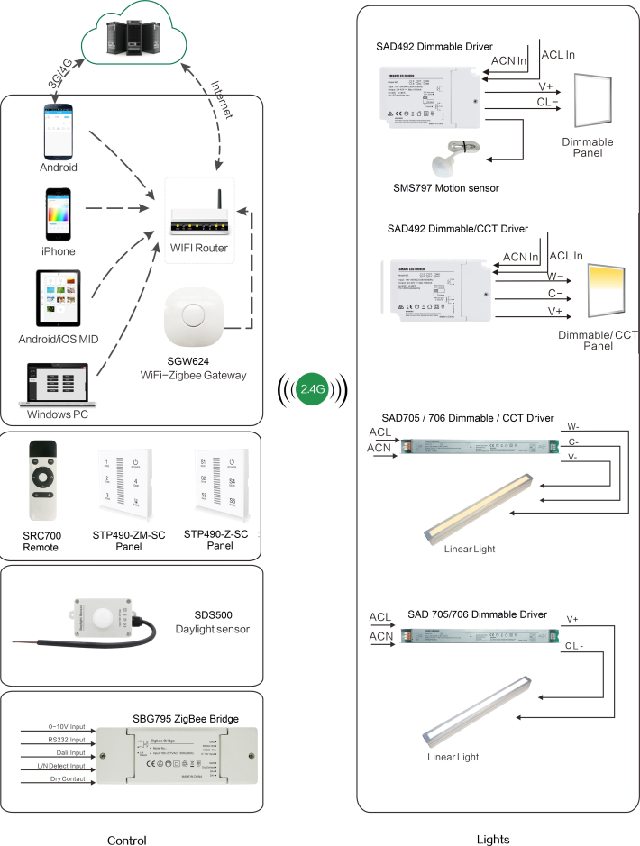
System Diagram

Slide 2
Features
Based on HA1.2 standard protocol
Built-in ZigBee 2.4G wireless transceiver module
Supports large number of 2,500 devices connection
Able to achieve short-distance or long-distance
controlling LED lights by multi solutions
Monochromatic, bicolor is optional.
The max current output can be set by APK.
Work with motion sensor, daylight sensor.
Support Over-the-Air upgrade

Slide 3
Parameter
Parameter | SAD706-CT | SAD706-SC
Input | 200-240VAC | 200-240VAC
Channel | 2 | 1
Output Current | 1050mA MAX±5% | 1050mA MAX±5%
Output Voltage | 24-42VDC (52VDC MAX at No Load) | 24-42VDC (52VDC MAX at No Load)
Max Output Power | 45W | 45W
PF | > 0.9 (MAX Load) | > 0.9 (MAX Load)
Efficiency | 85% Max | 85% Max
Frequency | 2.4GHz | 2.4GHz
Operation temperature | -20°C to 60°C，(ta:60°C,tc:90°C) | -20°C to 60°C(ta:60°C,tc:90°C)

Slide 4
Installation
For installation details, please contact us for spec. for your ref.

